Slide 1

INTERIM VIVA PRESENTATION
AI-Based Threat Detection
and Alert System
for Cloud Security
Independent Project (ACCA6020) | BSc Applied Computing
Muhammad Kamrul Hasan Sohel · Student ID 2316411
Module lecturer: Renuga Jayakumar | Subject supervisor: Md. Sadeque Imam Shaikh
Notes:
Opening (45 seconds): Introduce the project and clarify that this is an interim presentation. The working goal is a lightweight, explainable academic system. Avoid describing the HTML demonstration as a trained AI model.

Slide 2
INTERIM VIVA · ACCA6020
Presentation roadmap
01
Problem, motivation and research question
02
Aim, objectives and literature findings
03
Research method, architecture and plan
04
Prototype demonstration and next steps
AI-Based Threat Detection and Alert System for Cloud Security
02
Notes:
Explain that the presentation follows the university interim viva guidance, including literature, Gantt chart and a current prototype. Allow 12–15 minutes for slides, 3 minutes for demo and remaining time for questions.

Slide 3
INTERIM VIVA · ACCA6020
The problem: why this research matters
SECURITY CHALLENGE
Research focus
Cloud-connected services produce large volumes of network activity.
Can a lightweight workflow classify network records and present meaningful security alerts?
Attacks can resemble normal traffic; manual review is time-consuming.
Rule/signature-based detection can miss unfamiliar patterns.
A small, transparent detection prototype can aid understanding.
Context: ENISA [1]; NIST Cybersecurity Framework [2].
AI-Based Threat Detection and Alert System for Cloud Security
03
Notes:
Explain the difference between recognition of a known signature and learning patterns. Do not claim that machine learning automatically detects all novel threats. The project is relevant to network intrusion detection, with cloud security as the motivating application context.

Slide 4
INTERIM VIVA · ACCA6020
Research question and original contribution
How can a machine-learning-based prototype classify normal and malicious network activity and communicate alerts through a simple web dashboard?
VALUE OF THE PROJECT
End-to-end design rather than a classifier in isolation.
A low-cost, explainable teaching and testing prototype.
Clear discussion of false positives, false negatives and limitations.
AI-Based Threat Detection and Alert System for Cloud Security
04
Notes:
Clarify contribution: not more accurate than commercial platforms by default; contribution is accessibility, transparency and traceable workflow. This is a demonstrator, not a live protective service.

Slide 5
INTERIM VIVA · ACCA6020
Aim and measurable objectives
Aim | Design and evaluate a lightweight threat-detection and alert prototype.
O1
Critically review intrusion-detection methods and datasets
O2
Prepare and inspect labelled network-traffic records
O3
Train and compare a Random Forest with a baseline
O4
Develop the dashboard and evaluate detections/alerts
AI-Based Threat Detection and Alert System for Cloud Security
05
Notes:
These four objectives consolidate the six steps in the submitted proposal. Explain that outcomes will be evidenced by literature notes, dataset preparation, model evaluation, working dashboard and the final report. Random Forest training is a planned task, not yet demonstrated by the standalone HTML page.

Slide 6
INTERIM VIVA · ACCA6020
Literature review: what existing work tells us
ENISA / NIST
Detection and response remain central to cyber-risk management.
[1], [2]
UNSW-NB15 / CICIDS2017
Public labelled datasets support reproducible intrusion-detection experiments.
[3], [4]
Dataset analysis
Imbalance and overlapping classes can make accuracy misleading.
[5]
Model / responsible AI
Performance and explainability must be assessed alongside bias and risk.
[6], [7]
AI-Based Threat Detection and Alert System for Cloud Security
06
Notes:
Discuss evidence critically. Dataset labels enable supervised learning but do not guarantee deployment realism. Highlight the danger of treating a single accuracy score as sufficient. References correspond to your proposal; detailed references are in the slide near the end.

Slide 7
INTERIM VIVA · ACCA6020
Why Random Forest? Comparison of approaches
Method
Strength
Limitation
Signature / rules
Simple, auditable
May miss unfamiliar patterns
Logistic Regression
Fast, interpretable baseline
Linear decision boundary
Random Forest
Handles tabular, nonlinear patterns
Can overfit; must tune and validate
Deep learning
Can model complex patterns
More data and compute; less transparent
Interpretation: traditional ML references [5], [7], [8].
AI-Based Threat Detection and Alert System for Cloud Security
07
Notes:
Explain Random Forest as multiple decision trees voting on a class. For measured comparisons, train a baseline Logistic Regression or Decision Tree under the same test split. Do not invent results or state Random Forest outperforms baselines until tested.

Slide 8
INTERIM VIVA · ACCA6020
Research and development methodology
1
2
3
4
5
→
→
→
→
Review
literature
Acquire &
audit dataset
Pre-process
& split
Train &
test model
Build &
test dashboard
Research design: applied artifact development + controlled, offline classification experiment.
Figure 1. Intended research workflow (author-created from the project proposal).
AI-Based Threat Detection and Alert System for Cloud Security
08
Notes:
Use this slide to explain the reproducible experiment: use public secondary data, assess missingness, class distributions, prevent label leakage, reserve test data, then display outcomes through a dashboard.

Slide 9
INTERIM VIVA · ACCA6020
System architecture: planned full implementation
UNSW-NB15
CSV data
Python + pandas
pre-processing
scikit-learn
Random Forest
Flask web app
classification API
Dashboard +
SQLite history
→
→
→
→
Current demonstrator: a standalone HTML/CSS/JavaScript dashboard using rule-based scoring.
Figure 2. Proposed architecture and current implementation boundary.
AI-Based Threat Detection and Alert System for Cloud Security
09
Notes:
Critical distinction: the full architecture is a development plan, while the offline HTML demonstration currently uses simple rule-based scoring and synthetic records. The site does not run an actual Random Forest, Flask or SQLite back end.

Slide 10
INTERIM VIVA · ACCA6020
Dataset and ethical boundaries
DEMONSTRATION DATA · NOW
BENCHMARK RESEARCH · NEXT
Small synthetic CSV records
Public UNSW-NB15 labelled records
Numeric traffic-style features
Document cleaning and class balance
No identifiable users or live logs
Train/test on separate partitions
Reliable, fast viva demonstration
Report limitations for cloud contexts
Dataset source and scope: UNSW [3].
AI-Based Threat Detection and Alert System for Cloud Security
10
Notes:
Explain provenance clearly. Demo data were synthetic and produced for the sample dashboard. They are not UNSW-NB15. Model performance computed on synthetic data does not support a claim about security effectiveness in real systems. Ethical plan excludes participants and live organisation monitoring.

Slide 11
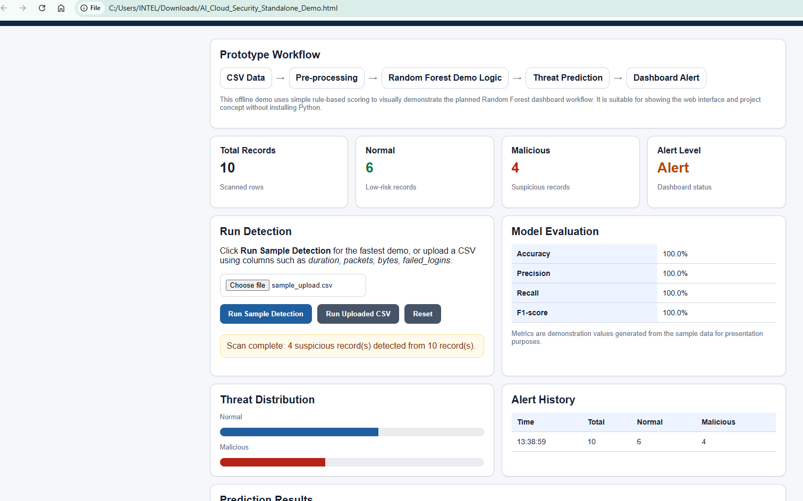
INTERIM VIVA · ACCA6020
Current practical prototype: what can be shown
LIVE DEMO SCRIPT
Open the offline HTML file
Load sample or CSV
Run detection
Explain normal vs suspicious counts
Show alert log & sample metrics
Figure 3. Screenshot of the current offline demo using synthetic sample CSV.
AI-Based Threat Detection and Alert System for Cloud Security
11
Notes:
Demo (~2 minutes). 1) Open AI_Cloud_Security_Standalone_Demo.html in Chrome. 2) Click Run Sample Detection or choose a CSV. 3) Describe numbers and history. 4) Explain that metrics are demonstration values rather than validated performance from UNSW-NB15. If examiners request code, show HTML/JS source and identify the scoring function.

Slide 12
INTERIM VIVA · ACCA6020
How success will be measured
Accuracy
Overall classification correctness
Precision
How many flagged records are actually malicious
Recall
How many malicious records are detected
F1-score
Balance of precision and recall
Confusion matrix
Breakdown of false alerts and missed threats
Evaluation approach draws on [5], [7], [8].
AI-Based Threat Detection and Alert System for Cloud Security
12
Notes:
Most important security trade-off is false negatives (missed malicious cases) versus false positives (unnecessary alerts). Explain train/test separation and why 100% on ten artificial records is not scientifically persuasive. Report class-wise scores after benchmark evaluation.

Slide 13
INTERIM VIVA · ACCA6020
12-week Gantt chart and project milestones
1
2
3
4
5
6
7
8
9
10
11
12
Proposal & ethics
Critical literature review
Dataset acquisition & audit
Pre-processing
Model baseline + Random Forest
Dashboard integration
Validation and interpretation
Report, reflection & rehearsal
Figure 4. Proposed 12-week plan; weeks are indicative and to be confirmed with supervisor.
AI-Based Threat Detection and Alert System for Cloud Security
13
Notes:
This is the proposal schedule, not proof every stage is finished. State current milestone (standalone demo) and next required milestones: benchmark data, trained model, integration, evaluation, report. Be ready to explain risks and contingency time.

Slide 14
INTERIM VIVA · ACCA6020
Risks, limitations and mitigation
Class imbalance
Missed minority attacks
Use per-class recall, F1 and confusion matrices
Data leakage
Inflated performance
Fit transformations on training data only
Synthetic demo
Misleading claims
Label as a rule-based demonstration
Privacy / misuse
Unethical collection or application
Public data only; no real-time blocking
Ethical scope follows the submitted ethics form; responsible AI framing [6].
AI-Based Threat Detection and Alert System for Cloud Security
14
Notes:
Explain the source of each risk and mitigation. Academic transparency matters: do not present simulated 100% scores as experimental Random Forest scores. For ethics, full university approval should be confirmed; a filled form by itself does not prove approval.

Slide 15
INTERIM VIVA · ACCA6020
Progress so far and immediate next steps
COMPLETED / AVAILABLE
TO COMPLETE / VALIDATE
Project proposal and focused research question
Download and audit UNSW-NB15
Literature review and planned evaluation
Train Random Forest with reproducible split
Standalone web dashboard demo
Compare baseline and report real metrics
Synthetic sample CSV and alert workflow
Connect model to Flask; document testing
AI-Based Threat Detection and Alert System for Cloud Security
15
Notes:
Be specific about completed versus proposed work. The HTML demo is demonstrable now. Treat data acquisition, actual machine learning training, baseline comparison and Flask integration as future work until completed.

Slide 16
INTERIM VIVA · ACCA6020
Conclusion and questions
A practical, transparent route from network data to threat alerts
Current proof of concept demonstrates the dashboard. The next academic milestone is validation with a genuinely trained model on benchmark data.
Thank you
AI-Based Threat Detection and Alert System for Cloud Security
16
Notes:
Close: the value is a clearly scoped, ethically safe and testable system design. Do not claim novelty from algorithm choice alone. Invite discussion.

Slide 17
INTERIM VIVA · ACCA6020
References
[1] ENISA, ENISA Threat Landscape 2024, European Union Agency for Cybersecurity, 2024.
[2] NIST, The NIST Cybersecurity Framework (CSF) 2.0, 2024.
[3] UNSW Canberra Cyber, “The UNSW-NB15 Dataset,” dataset resource.
[4] Canadian Institute for Cybersecurity, “CICIDS2017,” University of New Brunswick, 2017.
[5] Z. Zoghi and G. Serpen, “UNSW-NB15 Computer Security Dataset: Analysis through Visualization,” arXiv, 2021.
[6] NIST, Artificial Intelligence Risk Management Framework (AI RMF 1.0), 2023.
[7] A. Géron, Hands-On Machine Learning with Scikit-Learn, Keras, and TensorFlow, 3rd ed., O’Reilly, 2022.
[8] M. Sarhan et al., “NetFlow Datasets for Machine Learning-Based Network Intrusion Detection Systems,” 2020.
AI-Based Threat Detection and Alert System for Cloud Security
17
Notes:
IEEE references are presented in numeric order of first appearance on slides. Read no more than one source aloud. The detailed reference list and any corrected edition details should also be reflected in the written report.

