Slide 1
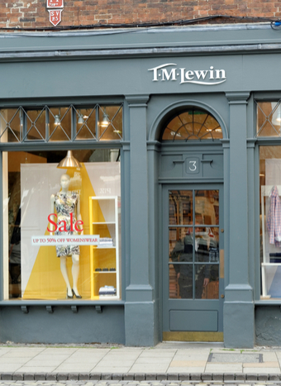
Problem Solving and Decision making
Charlene Johnson
2131892
Problem Solving and Decision making
Dr Chijoke D Uba
BMSW4004

Slide 2
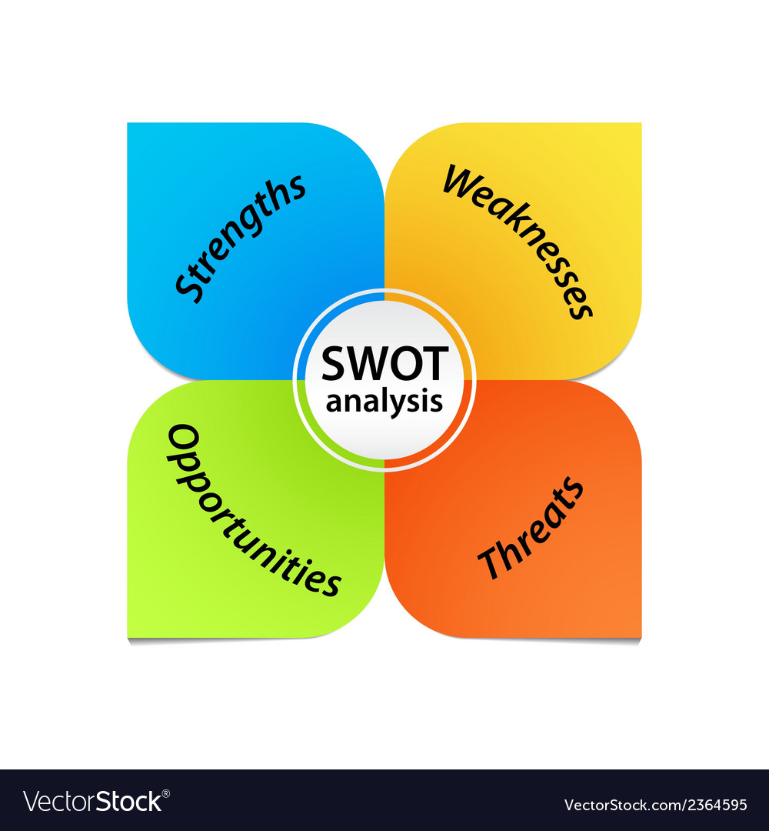
SWOT Analysis
This is called SWOT Analysis, SWOT will analyse the Internal and external factors of TM Lewin business retail stores

Slide 3
SWOT Analysis
The strengths of TM Lewin's businesses is that they were high in demand TM Lewin name was also very well-known and still is today. They were able to provide 600 jobs for employees and has stores in many different places
The weaknesses of TM Lewin's businesses are that he had no online stores at the time or even before the pandemic. The phase casual Friday came into many workplaces and offices during the early 2004 by not expanding into this can be seen as a weakness

Slide 4
SWOT Analysis
The Opportunities TM Lewin could have been an online store sooner and provide casual office wear. The online store could have new technology wear the customer gets a welcome pack with self-measure guild
The Threats are the government policy subsequently had a consequence on Lewin's clothing brand and the pandemic.

Slide 5
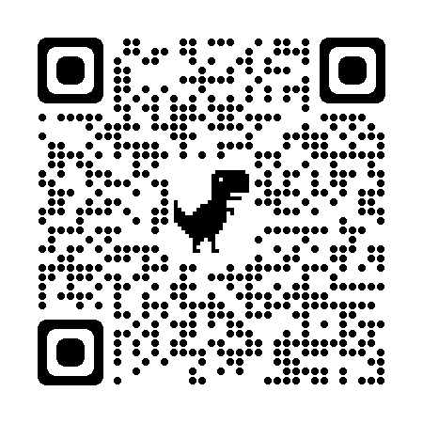
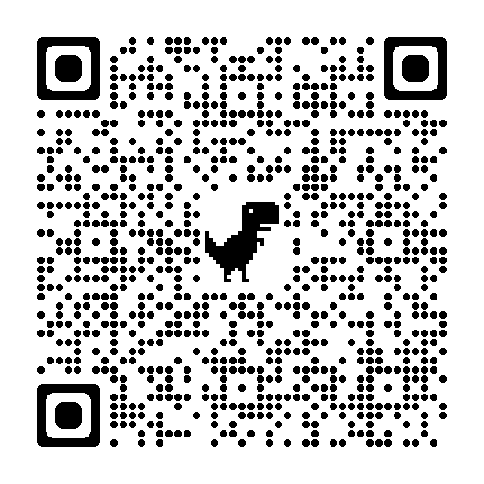

Slide 6
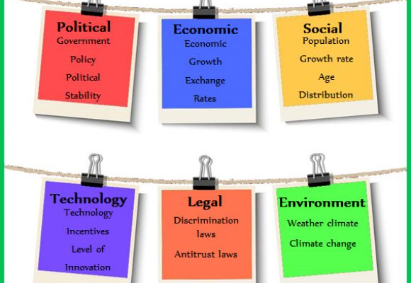
Pestle Analysis
Pestle is used to identify things that can affect your business in a political, economic, social, technical legal and environment it gives an understanding of the risks, the growth, and the decline of an organization or a business.

Slide 7
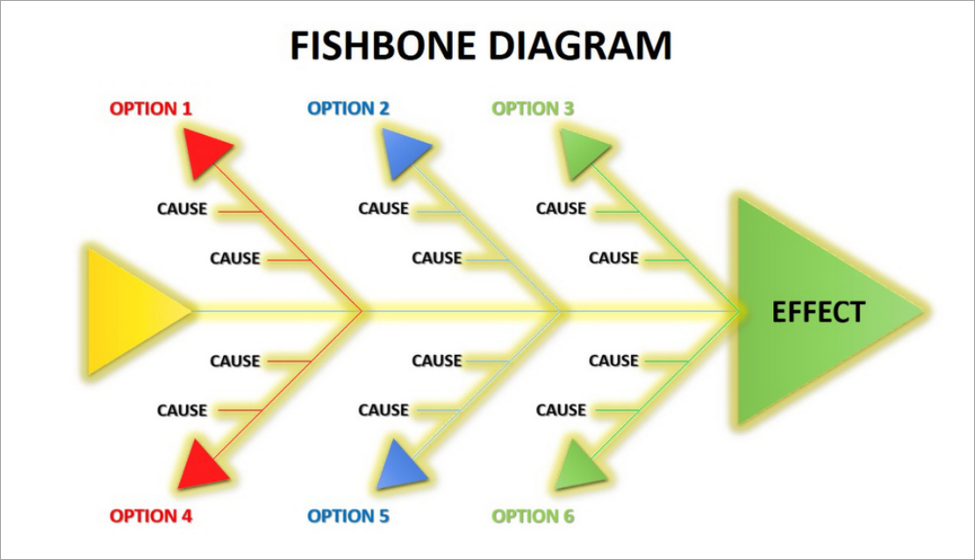
The Ishikawa Diagram
This is the Ishikawa fishbone diagram its purpose is to analysis the possible cause and effect of a business. This diagram will provide an insight into TM Lewin's problems the leading causes and effect of the business. The 122-year-old business has withstood a lot of trials and errs throughout the years

Slide 8
Cause and Effects of TM Lewin's Organisation
The cause
THe Effects
The pandemic made all restriction's come into place the government rules and advices were to be followed.
Before the pandemic in 2019 TM Lewin opened a 3000sq foot store in London on Oxford street which the expenses could have been used to form an online business
TM Lewin had no knowledge of ways to adapt or prepare for unknown trading environments. TM Lewin couldn’t afford the rent for most of his stores, subsequently experiencing closer. The anticipation of job losses and even the cost of doing business with the Uk exchange rate dropping.

Slide 9
TM Lewin Cause and effects
Lockdown, restrictions, fear of covid.
PANDEMIC
Transportation, global lockdown for non essential items.
SUPPLY CHAIN
Job losses, reduction in sales, store closer
INFLATION

