Slide 1
Data Warehousing & Data Mining
ACCA6026
Lecture 3 - Dimensional Modelling
Dr Nik Whitehead

Slide 2
What is dimensional modelling?
DM is a logical design technique that presents data in a standard framework which allows for high-performance access
It uses the standard relational model with some important restrictions
A dimensional model contains
  A fact table with a multi-part key and some measures
  Multiple dimension tables with single part primary keys, each of which corresponds to part of the multipart key of the fact table
Measures are the numerical data that is related to the particular combination of keys that define the record
Dimension tables contain descriptive text and are often the source of selection constraints in SQL queries

Slide 3
Product_key (PK)
SKO
Description
Brand
Category
Package_type
Size
Flavour
Etc...
Time_key (PK)
SQL_date
Day_of_week
Week_number
Month
Etc...
Time_key (FK)
Product_key (FK)
Store_key (FK)
Customer_key (FK)
Clerk_key (FK)
Promotion_key (FK)
Pounds_sold
Units_sold
Pounds_cost
Time dimension
Product dimension
Store_key (PK)
Store_ID
Store_name
Address
District
Floor_type
Etc...
Sales fact table
Customer_key (PK)
Customer_name
Purchase_profile
Credit_profile
Demographic_type
Address
Etc...
Clerk_key (PK)
Clerk_ID
Clerk_name
Clerk_grade
Etc...
Promotion_key (PK)
Promotion_name
Price_type
Ad_type
Display_type
Etc...
Store dimension
Customer dimension
Clerk dimension
Promotion dimension

Slide 4
Large dimensional models
A large data warehouse may have 10-25 of these star-join schemas
Each star-join will have 5-15 dimension tables
Many of these dimension tables will be joined from multiple fact tables
Dimensions which are shared in this manner are said to be conformed
Drilling down (i.e. Requesting more information about a fact) is done by adding more dimensions to a query
Drilling across (i.e. Requesting information about related facts) is done by linking facts via a common dimension

Slide 5
Large star-join data warehouse schema
Dimension 4
Dimension 2
Dimension 3
Fact 4
Dimension 1
Fact 1
Dimension 1
Dimension 2
Dimension 5
Dimension 7
Fact 5
Dimension 5
Dimension 3
Dimension 6
Dimension 6
Fact 2
Dimension 7
Dimension 7
Dimension 9
Dimension 9
Fact 3
Dimension 8

Slide 6
Large star-join data warehouse schema
Fact 4
Dimension 1
Fact 1
Dimension 2
Dimension 3
Dimension 4
Fact 5
Dimension 5
Dimension 6
Dimension 7
Fact 2
Dimension 8
Dimension 9
Fact 3

Slide 7
Advantages of star-join schema
Very easy to add new facts/dimensions without having to redesign the entire database – graceful extensibility
Easy to use aggregates (summary records that are calculated from the table data – these improve performance)
HOWEVER...
It requires that all dimensions must have the same meaning to all fact tables to which they are joined
These conformed dimensions often need to be a ‘distillation’ of data from several sources, e.g. The best and most up-to-date address for a customer

Slide 8
Conformed dimensions
A single dimension table can be used with multiple fact tables
User interfaces and data content are consistent whenever the dimension is used
There is a consistent interpretation of attributes
Designing a good set of conformed dimensions takes up about 80% of the time required to design the overall data architecture for the data warehouse

Slide 9
Conformed fact definitions
The fact tables are created at the same time as the dimension tables
These should all use the same data definitions as defined in the dimension tables
If two fact tables need to calculate something (e.g. revenue, VAT, profit) then they should both use the same equation
If a fact table needs to show figures in multiple units then include multiple units rather than expecting the user to calculate them
Measures are generally numerical, e.g. time, cost
  Measures can be measured, dimensions cannot
Measures should be additive wherever possible

Slide 10
Design process
Designing a data warehouse data architecture has four stages
Define the users
  This defines which data marts will be needed and gives clues to which fact tables will be needed
Define the ‘grain’ – how detailed must the fact tables be to be useful?
  Every transaction? Every invoice? Every day? Every month?
Choose the dimensions
  Examine all of the data available and attach the single-valued ones as dimensions
Choose the facts
  Facts should always be at the grain determined in step 2

Slide 11
Example
Data.gov.uk contains a large number of data files produced by the UK government
Suppose we take the data for all invoices over £500 for the Wales Office for the financial year 2011-2012
ENTITY | EXPENSE_AREA_1 | PAYMENT DATE | PAYMENT NUMBER | SUPPLIER NAME
Wales Office | Commission on Devolution | 30-Mar-12 | 1001016 | PUFFBOX LTD
Wales Office | Wales Office | 30-Mar-12 | 1001016 | PUFFBOX LTD
Wales Office | Wales Office | 30-Mar-12 | 6004 | SWANSEA VALLEY MINERS' APPEAL FUND
Wales Office | Wales Office | 29-Mar-12 | 1001008 | DTZ
INVOICE AMOUNT | NAC DESCRIPTION | SERVICE SUPPLIED
3,120.00 | 223536-IT Services incl Web Hosting | Design and set up of Commission website
8,840.00 | 223536-IT Services incl Web Hosting | Design of Wales Office Intranet
125,478.70 | Charitable donations | Government commitment to contribute to ensuring charity did not lose out in terms of gift aid whilst it sought charitable status
2,165.85 | 222181-Managing Agents Fees | Managing Agents fees for 2010-11

Slide 12
Example
We need to identify
  Potential users
  Grain
  Potential dimensions
  Potential facts
  Metadata
ENTITY | EXPENSE_AREA_1 | PAYMENT DATE | PAYMENT NUMBER | SUPPLIER NAME
Wales Office | Commission on Devolution | 30-Mar-12 | 1001016 | PUFFBOX LTD
Wales Office | Wales Office | 30-Mar-12 | 1001016 | PUFFBOX LTD
Wales Office | Wales Office | 30-Mar-12 | 6004 | SWANSEA VALLEY MINERS' APPEAL FUND
Wales Office | Wales Office | 29-Mar-12 | 1001008 | DTZ
INVOICE AMOUNT | NAC DESCRIPTION | SERVICE SUPPLIED
3,120.00 | 223536-IT Services incl Web Hosting | Design and set up of Commission website
8,840.00 | 223536-IT Services incl Web Hosting | Design of Wales Office Intranet
125,478.70 | Charitable donations | Government commitment to contribute to ensuring charity did not lose out in terms of gift aid whilst it sought charitable status
2,165.85 | 222181-Managing Agents Fees | Managing Agents fees for 2010-11

Slide 13
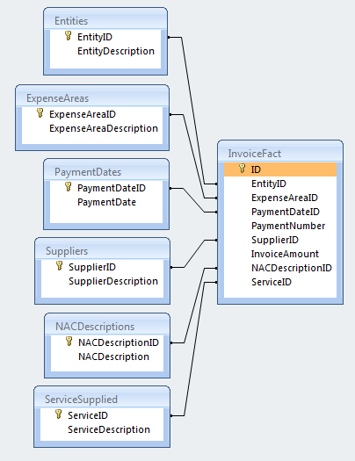
Example
The final data warehouse
  1 fact table
  6 dimensions
Should any of these dimensions be metadata?
Suppose we add invoices from another government department
  Could we use the same fact table?
  Would any new dimensions be needed?
  Would there be any conformed dimensions?

Slide 14
Families of fact tables
Real-world DW systems are made up of families of fact tables using a constellation of conformed dimensions
Businesses with a logical flow have fact tables that each represent a stage in the flow, e.g.
  Materials purchasing
  Materials delivery
  Materials inventory
  Bill of materials
  Manufacturing process control
  Manufacturing costs
  Packaging
  Trans-shipping to warehouse
  Finished goods inventory
In these cases each stage of the process has its own fact table and set of associated dimensions

Slide 15
Transactions and snapshots
Some structures are common to DW for many different applications
  Transactions
  Snapshots
A transaction is a single fact representing a single business operation, e.g. a sale, a phone call, a bank deposit...
These are generally low-level records and have a structure that seldom changes because the transaction capture system usually returns only one amount in a transaction
New transaction types are added by adding values to dimensions, not to the fact
Transaction-level data allows behaviour to be analysed, e.g. time-of-day analyses, queue analyses and basket analyses

Slide 16
Transactions and snapshots
Snapshot facts show summary data at the end of a specific reporting period, e.g. weekly or monthly
The application that creates the snapshot goes through the transaction fact to calculate the current status (this might take some time...)
A current rolling snapshot stores a daily snapshot for each day of a set period, e.g. 36 months
Transaction facts are operational facts; snapshots are management facts
Snapshot fact structure is related to the transaction fact structure but will have many summary and calculated measures

Slide 17
Stars and snowflakes
Although the star schema is good for high-performance data access, some DW designers try to over-normalise their schema by allowing the dimensions to use look-up tables
This leads to a snowflake schema with the fact connected to dimensions which may themselves have one or more dimensions
This is sometimes not a good idea
  Users are often confused by the added detail
  Writing the user interface becomes more difficult
  It slows down the query because it adds complex joins
  It can cause problems with indexes in dimensions

Slide 18
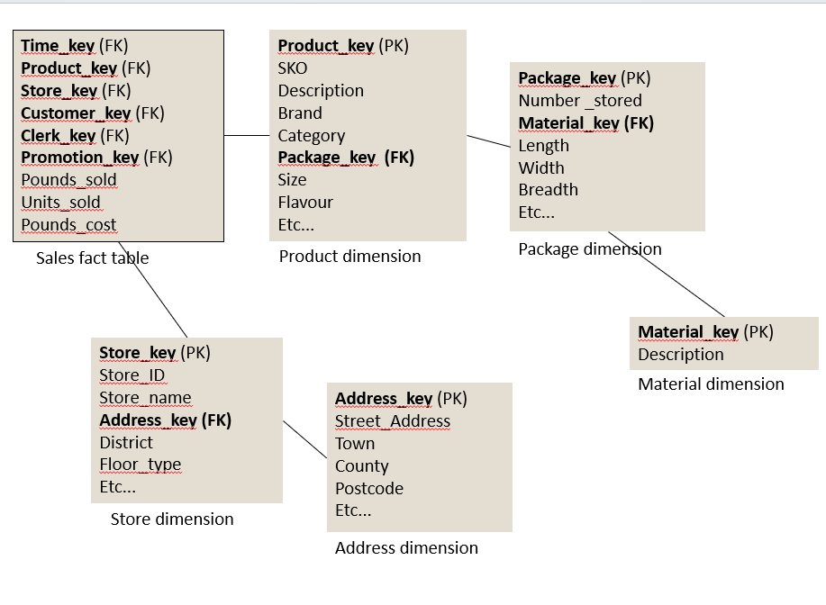

Slide 19
Tips for generating schema
Identify everything you might possibly want to record
Decide whether these things are look-up tables (dimensions), important entities (facts) or numerical attributes of important entities (measures within facts)
Identify all of the user groups who might want to use your data warehouse
Imagine the questions that your users might want to ask
Work out which dimensions are used by more than one fact; these are your conformed dimensions
Decide if your dimensions need their own look-up tables; if so then you have a snowflake schema, not a star schema; snowflaking is allowed, but it may not be the best solution

Slide 20
Questions & Answers

