Slide 1
Beckhard – Change Equation
By Nicholas George.

Slide 2
Who Is Richard Beckhard?
Was a pioneer in the field of organizational development.
Began the Organizational Network Development in 1967.
Was an adjunct professor at the MIT Sloan School of Management from 1963 – 1984.
Died on December 28, 1999.

Slide 3
What Is The Change Equation?
Known as the Change Equation also the Change Model and Change Formula.
Was created in 1987 by Beckhard & Harris.
Simple but powerful tool that gives the user a quick, first impression of possibilities and conditions to change of an organisation.

Slide 4
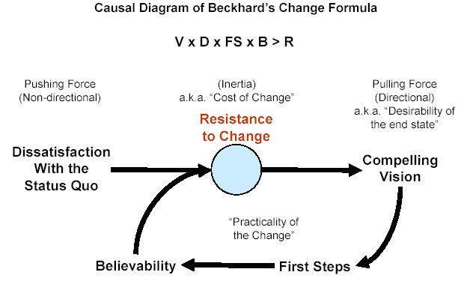
Change Equation Model

Slide 5
Change Equation Model
Vision of the Future. It is essential that employees understand the future of the organisation.
Dissatisfaction with the Present. Must be clear why things need to change.
First Steps. All the required steps to perform a transformation are known.
Believability. The first three variables need to form a believable package. A vision and a plan without resources is just a ‘fantasy’.
Resistance to Change. Involving people who are affected by the change.

Slide 6
Change Equation Model
The first two variables combine to provide the primary forcing function for change.
The dissatisfaction pushes the individuals to change but does not provide a direction. They know they are not happy but don’t know how to make it better.
The vision pulls the individuals to change and provides a direction for change. Why don’t we like the current system/situation? What will the new system/situation do for us? Beckhard calls this the “desirability of the end state.”

Slide 7
Change Equation Model
The model has two very practical applications:
Before the change:
When planning a major change, planning teams need to make sure all elements / variables are built into their plans.
During the change:
Use it as trouble-shooting tool for figuring out why people are resisting the change.

Slide 8
References
http://www.resourcesystemsconsulting.com/blog/archives/81
http://www.greatleadershipbydan.com/2009/01/beckhards-change-equation.html

