Slide 1






Quality Assurance and Service Improvement: Learning from the Lucy Letby Case
(Countess of Chester Hospital, UK)
Student Name: Utsav Patel
Student ID: 2431966
Programme: MSc Public Health and Social Care in Practice
Assignment Title: Component 1 – Individual Presentation
Module: Quality Assurance and Service Improvement (LCHS7006)
Lecturer: Shepherd Ziko
(RCNi, 2025)

Slide 2
Learning outcomes:
Case Overview
Context and Background Details
Swiss Cheese Model Evaluation
Root Cause Assessment (RCA)
Ishikawa (Fishbone) Diagram Review
Donabedian SPO Model Discussion
Policy and Governance Shortcomings
Impact on Quality, Efficiency, and Equity
Key Takeaways and Quality Improvement Actions
Component 2 Report Outline
Summary

Slide 3








Introduction to the Case
The Countess of Chester Hospital NHS Foundation Trust offered acute and neonatal care to communities across Cheshire and North Wales, operating a Level 2 neonatal unit between 2015–2016 (NHS England, 2023).
Internal Safety Concerns
Formal Investigation and Conviction
Systemic Failures Exposed
A significant rise in unexplained neonatal collapses and mortality from June 2015 to June 2016 prompted internal safety concerns and incident reviews (Thirlwall Inquiry, 2023).
Major failures in leadership, clinical governance, risk management, and escalation processes within the Trust were subsequently highlighted (Nuffield Trust, 2024).
The BBC (2024) reports that Lucy Letby, a neonatal nurse at the Countess of Chester Hospital, was convicted of killing seven infants between 2015 and 2016 and of attempting to murder six others.
This case exposes fundamental breakdowns in organisational quality assurance and patient-safety systems (Health Foundation, 2021), necessitating a thorough analysis using systems-based safety models to identify root causes, policy failures, and impacts on service delivery.

Slide 4



Background and Context
Between 2015 and 2016, clinicians repeatedly observed neonatal collapses, leading to internal reviews and the ongoing Thirlwall Public Inquiry (Thirlwall Inquiry, 2023).
Critical Care Unit
The neonatal unit was responsible for premature and high-risk infants across the Cheshire region, operating under stringent national neonatal service specifications (NHS England, 2023).
2. Ignored Warnings
Senior paediatricians' repeated concerns were dismissed by executives, significantly delaying external investigation (Nuffield Trust, 2024).
3. Unescalated Concerns
Warning signs including mortality clustering and deviations from baseline outcomes were not escalated to regulatory bodies such as the CQC (CQC, 2023).
The case is now considered a defining example of NHS quality assurance breakdown and policy non-compliance (The King’s Fund, 2022), spotlighting systemic governance failures across leadership, risk assessment, and organisational culture (Health Foundation, 2021).

Slide 5


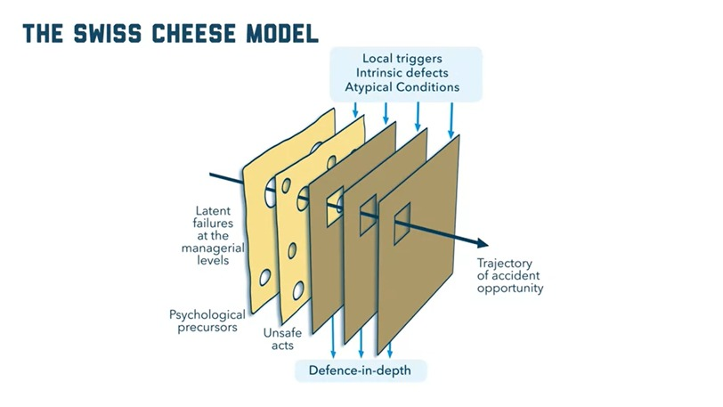


Systems-Based Safety Model: Swiss Cheese Model
The Swiss Cheese Model illustrates how multiple organisational defence layers can fail when their latent weaknesses align, leading to catastrophic harm (Reason, 2000).
(Reason, 2000)
These layers typically encompass governance, staffing, clinical processes, communication pathways, and frontline decision-making (BMJ Quality and Safety, 2020). The model focuses on system vulnerabilities rather than individual blame, aligning with modern safety-culture principles (Health Foundation, 2021).
In the Letby case, failures in leadership response, incident detection, escalation policy, staffing levels, and neonatal clinical oversight all aligned, permitting harm to occur (Nuffield Trust, 2024). The Swiss Cheese Model provides a robust framework to map the interacting system failures underpinning this tragic case (Thirlwall Inquiry, 2023).

Slide 6

Swiss Cheese Model Applied to the Case
Safety Layer (Barrier) | Intended Role | Failure / “Hole” in the Barrier | Sources
Individual Practice | Ensure safe, ethical, and professional care in line with NMC and GMC codes | Letby’s deliberate harmful actions went undetected due to lack of monitoring and early warning systems | (CQC, 2024; Reason, 2000)
Team Supervision | Senior consultants and managers monitor unusual patterns in patient outcomes | Doctors raised multiple concerns about abnormal deaths, but management ignored or dismissed them | (The Guardian, 2024; NHS England, 2023)
Leadership and Management | Ensure accountability, transparency, and response to safety issues | Senior managers prioritised hospital reputation over patient safety, silenced whistle-blowers, and failed to trigger investigations | (The King’s Fund, 2023; NHS England, 2023)
Organisational QA Systems | Maintain effective governance, incident reporting, and Duty of Candour compliance | Weak incident reporting, no timely Root Cause Analysis (RCA), and inadequate whistle-blowing protection | (Health and Social Care Act, 2014; CQC, 2024)
External Oversight (CQC, NHS England) | Provide independent monitoring and early detection of risks | Delayed CQC response and poor communication between the Trust and regulators | (CQC, 2024; WHO, 2022)

Slide 7
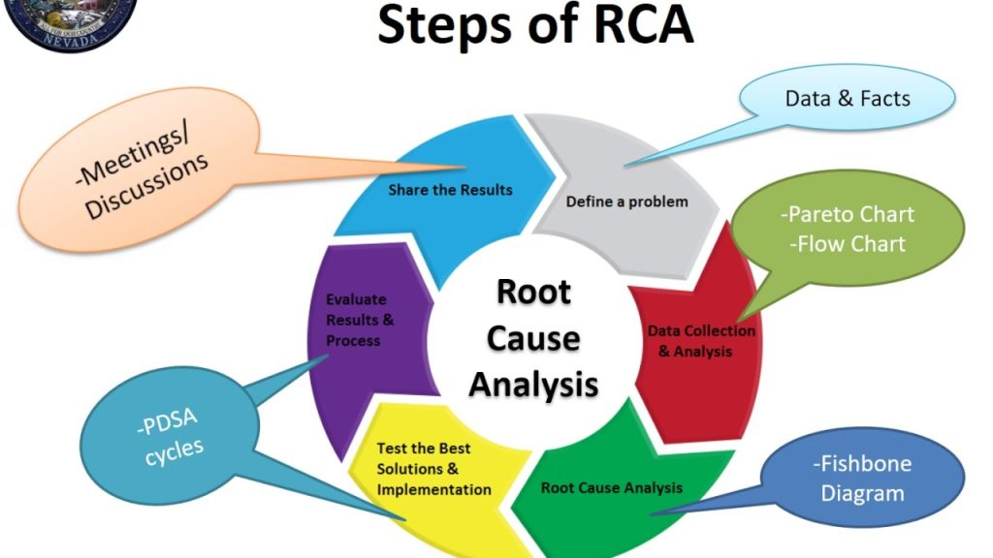
Root Cause Analysis (RCA) Overview
Root Cause Analysis (RCA) is a structured methodology engaged to identify the core system errors that contribute to adverse
events in healthcare settings (NHS England, 2022).
Standard Components
Typical RCA components include event mapping, contributing-factor analysis, and the identification of corrective actions (NHS England, 2022).
Focus Beyond Blame
RCA focuses on contributing factors such as human, organisational, environmental, and process issues, rather than assigning individual blame (BMJ Quality and Safety, 2020).
(Conformance1, 2025)
Given the complexity of patient needs in environments such as neonatal care, RCA is essential in high-risk settings (Health Foundation, 2021). Its application aids in identifying systemic failures underpinning recurrent neonatal collapses (CQC, 2023).

Slide 8
RCA Applied to the Letby Case
Delayed Pattern Recognition
Failure to conduct timely RCA after the initial collapses prevented early recognition of alarming patterns (Thirlwall Inquiry, 2023).
Breach of Policy
Leadership failed to escalate repeated incidents to external regulators, thereby breaching national incident-reporting policy (CQC, 2023).
Undermined Governance
Consultants’ concerns were dismissed and recorded as “unhelpful,” severely undermining clinical governance (Nuffield Trust, 2024).
Missed Safety Signals
A lack of structured mortality review meetings allowed critical safety signals to be overlooked (NHS England, 2023).
Perpetuated Unsafe Conditions
The absence of effective RCA would have identified early system weaknesses, but this inaction unfortunately perpetuated unsafe conditions (Health Foundation, 2021).

Slide 9

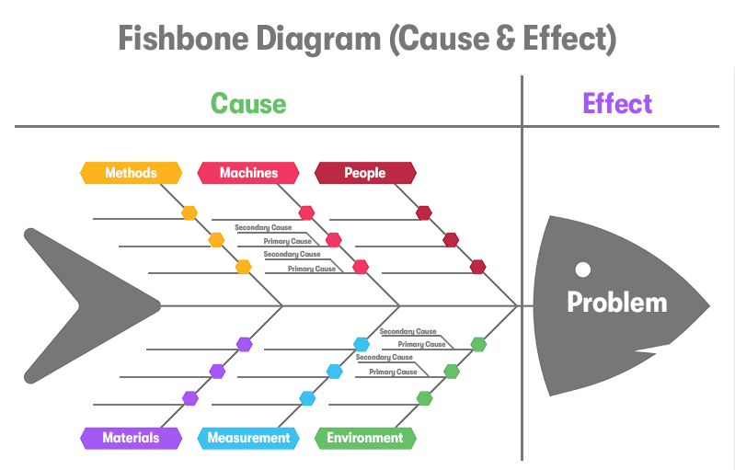
Fishbone (Ishikawa) Analysis: Causes of System Failure in the Lucy Letby Case:
1️⃣ People
Leadership inaction, poor supervision, and staff fear of reporting safety concerns (The King’s Fund, 2023; CQC, 2024)
2️⃣ Policies and Procedures
Weak clinical governance and lack of escalation or whistle-blowing framework (NHS England, 2023; Conformance1, 2025)
3️⃣ Processes
Delayed incident reporting and absence of timely RCA or safety audits (CQC, 2024; Conformance1, 2025)
4️⃣ Environment
Understaffed neonatal unit, heavy workload, and poor communication across teams (WHO, 2022; The Guardian, 2024)
5️⃣ Equipment / Technology
Lack of real-time digital monitoring or data audit tools to detect anomalies (WHO, 2022; NHS England, 2023)
6️⃣ Culture
Fear, silence, and lack of trust in senior management discouraging whistle-blowing (The King’s Fund, 2023; Purple Griffon, 2024)
(Purple Griffon, 2024)

Slide 10






Donabedian Model (Structure–Process–Outcome)
The Donabedian Model offers a system for checking quality in healthcare, examining how structure influences process, which in turn affects outcomes.
Process
Rejected clinical concerns, failure to follow escalation protocols, weak incident learning (CQC, 2023).
Structure
Staffing shortages, limited neonatal capacity, weak governance systems (NHS England, 2023).
Outcome
Avoidable harm, loss of public trust, downgraded neonatal services (Thirlwall Inquiry, 2023).
This demonstrates a systemic breakdown across all quality dimensions within the Countess of Chester Hospital case (Health Foundation, 2021).

Slide 11
Policy and Governance Failures: Impact on Quality and Service Delivery
Policy / Area | Policy Expectation | Observed Issue in the Case | Impact on Service Delivery | Souces
Duty of Candour (Health and Social Care Act, 2014) | Hospitals must inform families when care causes harm. | Management failed to disclose repeated neonatal deaths to families. | Loss of public trust and breach of ethical duty. | (Health and Social Care Act, 2014; CQC, 2024)
Whistle-blowing and Freedom to Speak Up Policy | Staff should report safety concerns without fear. | Doctors were discouraged from reporting; some faced intimidation. | Culture of fear → suppressed early intervention. | (NHS England, 2023; The King’s Fund, 2023)
Clinical Governance Framework (CQC) | Continuous monitoring and risk assessment of patient safety. | Absence of external audits or timely CQC escalation. | Poor oversight → unsafe care continued. | (CQC, 2024; WHO, 2022)
Leadership and Accountability (NHS Improvement) | Senior leaders must act on safety data and staff concerns. | Hospital leaders prioritised reputation management over safety. | Compromised decision-making → delayed action. | (NHS Improvement, 2023; The Guardian, 2024)
Workforce and Staffing Policy | Safe staffing levels and competence assured by Trust boards. | Understaffed neonatal unit with insufficient supervision. | Reduced care quality and increased staff burnout. | (NHS England, 2023; The King’s Fund, 2023)

Slide 12



Impact of Root Causes and Policy Failures
Efficiency of Services: Operational Disruption
Quality of Care: Patient Safety Compromised
Patient safety was severely compromised due to ignored staff warnings and the critical failure to act on incident reports.
Significant resource strain was observed through prolonged investigations, escalating legal costs, and high staff turnover, severely disrupting normal service delivery.
A catastrophic breakdown in clinical governance directly led to repeated, preventable infant deaths.
Ineffective processes, characterised by delayed Root Cause Analysis (RCA), poor communication, and a lack of coordinated leadership, drastically increased inefficiency.
A pervasive lack of continuous improvement culture resulted in chronic non-compliance with NHS quality standards (CQC, 2024; NHS England, 2023; The King’s Fund, 2023).
Repeated safety incidents triggered ward closures and a profound erosion of staff confidence, leading to extensive operational disruption (NHS Improvement, 2023; WHO, 2022).
Equity in Service Provision: Unequal Protection
Families were unjustly denied information under the Duty of Candour, representing a critical failure of transparency and justice.
Vulnerable patients, particularly infants, faced unequal protection due to systemic negligence and a disregard for established protocols.
Staff inequality became evident as whistle-blowers faced intimidation and a complete lack of support, stifling vital disclosures. (Health and Social Care Act, 2014; The Guardian, 2024; NHS England, 2023).

Slide 13

Outline of Component 2 Report
1️⃣ Introduction
→ Overview of Lucy Letby case, aims, and rationale for quality improvement. (CQC, 2024; NHS England, 2023)
2️⃣ Identification of Quality Issues and Root Causes
→ Analyse governance, leadership, and communication failures using RCA and Fishbone.
3️⃣ Theoretical Frameworks / Models
→ Apply Swiss Cheese, RCA, Fishbone, and Donabedian models to explain system failures. (Reason, 2000; Donabedian, 1988)
4️⃣ Policy and Governance Analysis
→ Examine Duty of Candour, Freedom to Speak Up, and leadership accountability gaps.
(NHS England, 2023; The King’s Fund, 2023)
5️⃣ Impact on Service Provision
→ Assess effects on quality, efficiency, and equity in NHS service delivery. (CQC, 2024; WHO, 2022)
6️⃣ Recommendations and Service Improvement Plan
→ Suggest policy reform, leadership training, and PDSA cycle for continuous improvement.(IHI, 2023)
7️⃣ Conclusion
→ Summarise key lessons: system-based safety, accountability, and transparency.

Slide 14

Conclusion:
The Lucy Letby case serves as a crucial turning point for leadership accountability, transparency, and patient-centred care within the NHS.
Summary of Findings
Key Lessons Learned
The case exposed deep systemic failures in patient safety, leadership, and governance Within the Countess of Chester Hospital setting. Poor communication, lack of accountability, and weak clinical governance were identified as key root causes. (CQC, 2024)
Effective quality assurance demands strong leadership, an open reporting culture, and timely incident management. The Donabedian Model confirms that weak structure and poor processes lead to unsafe outcomes. (Reason, 2000; Donabedian, 1988)
Implications for Future Practice
Final Reflection
Strengthen policy enforcement (Duty of Candour, Freedom to Speak Up). Build a Just Culture focusing on learning, not blame. Embed continuous improvement cycles (PDSA) to sustain safe and equitable care. (NHS Improvement, 2023)
"True quality assurance in healthcare is not just about detecting errors — it’s about building resilient systems that prevent harm, empower staff, and maintain public trust."

Slide 15
References:
Care Quality Commission (2023): Care Quality Commission (2023) Improvement cultures in health and adult social care settings: rapid literature review.
Access link: https://www.cqc.org.uk/sites/default/files/202307/202307-RapidLiteratureReview-improvement.pdf Consulted on: 10 November 2025.
Care Quality Commission (2024): Care Quality Commission (2024) Inspection summary – The Countess of Chester Hospital NHS Foundation Trust.
Retrieved from: https://www.cqc.org.uk/provider/RJR/inspection-summary Date accessed: 10 November 2025.
Countess of Chester Hospital NHS Foundation Trust (2016): Countess of Chester Hospital NHS Foundation Trust (2016) Annual report and accounts, 2015/16. Chester: CoCH NHS FT. URL: https://www.coch.nhs.uk/media/133225/abdb_3091_coch-annual-report-2015-16-min-1-.pdf Accessed: 10 November 2025.
Donabedian (1988) Donabedian, A. (1988) ‘The quality of care: how can it be assessed?’, JAMA, 260(12), 1743–1748. Source: https://jamanetwork.com/journals/jama/article-abstract/374139 Viewed on: 10 November 2025.
Health Foundation (2021) The Health Foundation (2021) Quality improvement made simple: key information on health care improvement. London: THF.
Online: https://reader.health.org.uk/qi-made-simple-2021 Access date: 10 November 2025.
Health Foundation (2022) The Health Foundation (2022) Creating and sustaining continuous organisational improvement.
Available online: https://www.health.org.uk/reports-and-analysis/briefings/building-an-organisational-culture-of-continuous-improvement Date consulted: 10 November 2025.
King’s Fund (2022) The King’s Fund (2022) Public satisfaction with the NHS and social care: 2022 findings.
Source link: https://www.kingsfund.org.uk/insight-and-analysis/reports/public-satisfaction-nhs-and-social-care-2022 Checked on: 10 November 2025.
NHS England and The King’s Fund (2025) NHS England and The King’s Fund (2025) NHS workforce: summary overview. Available at: https://www.kingsfund.org.uk/insight-and-analysis/data-and-charts/nhs-workforce-nutshell Accessed: 10 November 2025.
Purple Griffon (2024) Purple Griffon (2024) Ishikawa (fishbone) diagram: guidance and explanation. Obtained from: https://purplegriffon.com/blog/fishbone-diagram-ishikawa Last accessed: 10 November 2025.
RCNi (n.d.) RCNi (no date) Lucy Letby – related articles and resources. Available at: https://rcni.com/keywords/lucy-letby Retrieved: 10 November 2025.
Reason (2000) Reason, J. (2000) ‘Human error: models and management’, BMJ, 320(7237), pp. 768–770. Accessible via: https://www.bmj.com/content/320/7237/768 Access date: 10 November 2025.

