Slide 1
Entrepreneurial Education

Slide 2
Objectives
By the end of this session you will be able to:
  Identify the main characteristics of an entrepreneur
  Critically evaluate the main approaches to identifying entrepreneurial characteristics

Slide 3
What do you think an Entrepreneur is?

Slide 4
So you want to be an Entrepreneurial Educator?
What is Entrepreneurship?
How do you define an entrepreneur?

Slide 5



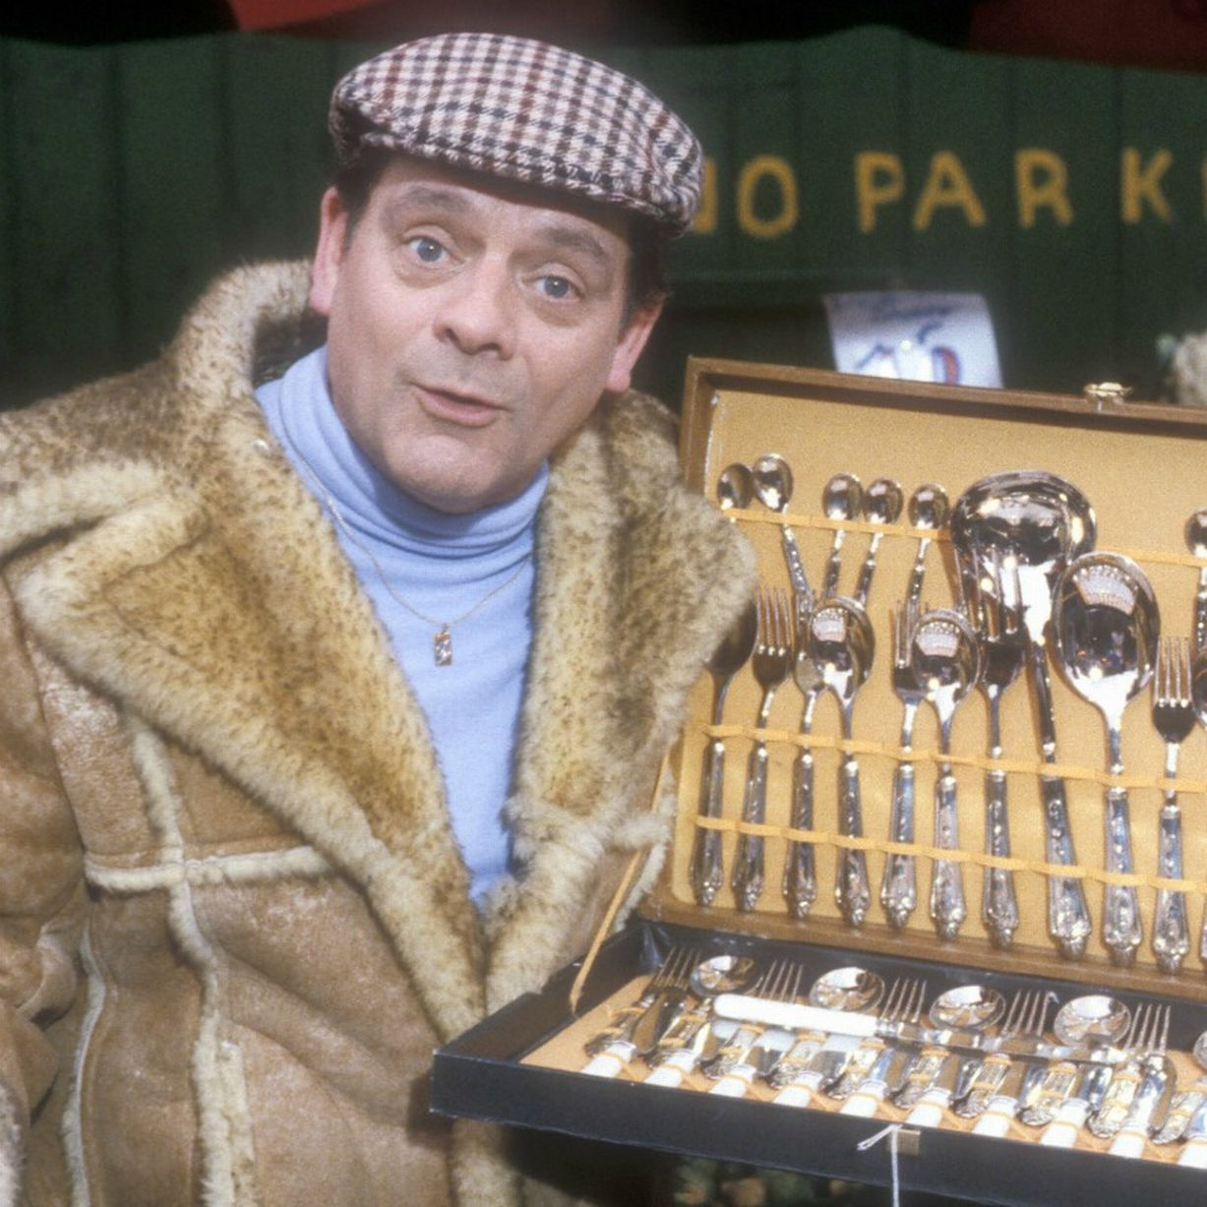


Traditionalist views
Do these people meet your definition?
What are their main characteristics?
Is this really an Entrepreneur?
Notes:
Peter Kilby suggests that the entrepreneur is like the heffalump in the Winnie the pooh books in that no one has captured him and no one who has seen him can agree on his characteristics.

Slide 6
So how does your definition compare?
Stevenson (1990) defines entrepreneurship as;
Pursuing an opportunity regardless of the resources currently available.
Timmons (1980) defines entrepreneurship as;
A way of thinking and acting that is opportunity obsessed, holistic in approach and leadership balanced for the purpose of value creation and capture

Slide 7
What do the academics say about entrepreneurs and Entrepreneurship?

Slide 8
Psychological traits
Risk taking ability
Need for achievement
Control
Desire for Autonomy
Deviancy
Creativity and Opportunism
Intuition

Slide 9
Entrepreneur Personality Types
Innovator - Imagination
New Designer/Enabler - Intuition
Leader - Authority
New Entrepreneur - Will
Animateur - Sociability
Adventurer - Energy
Change Agent - Flexibility
Can you think of examples for each type?
(Kirby 2003)
Notes:
Innovators able to change whole industries through their originality, strong imaginations lead to new innovations – sir Terence Conran
Enablers intuitively able to predict what people want or need, and make sure the right product is available at the right time – Mary Quant
Leaders Don’t actually develop anything but inspire others through their natural authority– John Harvey Jones
New Entrepreneurs redevelop existing ideas into cheaper, more desirable, more powerful or more efficient products – Jack Dangoor
Animateurs use the force of their personality to build networks and develop ideas – Nelli Eichner
Adventurer go their own way and have the drive and energy to see themselves through – Anita Roddick
Change agents create new forms of business to meet the specific needs of individuals – Steve Shirley

Slide 10
Different views of types of Entrepreneur
Chell Et al 1991
Entrepreneurs
Quasi-Entrepreneurs
Administrators
Caretakers
Davis 2013
Zombie
Smith 1967
Craftsman
Inventors
Opportunist
Notes:
Norman Smith in the entrepreneur and his firm 1967 sees entrepreneurs as three distinct types on a spectrum with the archetypal craftsman being a loner with limited social capital and the opportunist being a gregarious outgoing personality with plenty of social skills
Elizabeth Chell, Jean Haworth, Sally Brearley looked to a biological classification and identified four sub species of entrepreneur;
Caretakers have little strategic focus and no desire to grow the business where as the business owned and operated by typical entrepreneurs are typified by growth and development.
Raoul Davis suggested the term Zombie entrepreneurs who have none of the characteristics of the traditional models and are only entrepreneurs because the jobs market is tight or they cant think of anything better to do. Zombie entrepreneurs are particularly harmful because they put off investors from supporting those with genuine ideas.

Slide 11
Main Characteristics of an Entrepreneur
Commitment
Drive
Orientation
Personal responsibility
Problem Solving
Sense of Humour
Using Feedback
Tolerant
Calculated risk taking
Low need for status
Integrity
Decisiveness
Dealing with failure
Team builder
Emotionally stable
Creative
High conceptual ability
Vision
(Timmons Et al. 1985)
Notes:
Timmons suggests that these characteristics vary according to the situation the entrepreneur is in and can be learned
Some issues with this:
Western based American research possibly culturally biased
Not clear if entrepreneurs possess the attributes before starting or if they acquire them as a result of being an entrepreneur – what do you think?

Slide 12
Case Study
Read the passage on Charlie Muirhead
  Identify the personality types and main characteristics that apply to him.
  (Kirby 2003 p115)

Slide 13
Colin Jones
Entrepreneur = People who “Create opportunities for satisfaction”
If you love what you do and you love where you are doing it – then you will be successful

Slide 14
Key features…or characteristics exhibited
Intellectuality
  What I might call “Graduateness”
Close Friendships
  Good interpersonal skills, are “liked”, SOCIAL CAPITAL
Independence in Value Judgement
Rely on personal experience, trust themselves
Tolerance of ambiguity
Or able to suspend judgement until they know more, flexibility
Breadth of interest
open mind, open eyes, enquiring min
Humour
  “If you can’t take a joke..”, enjoy life, Glass half full

Slide 15
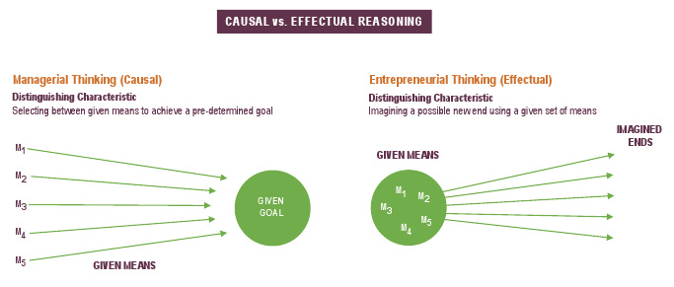
Causation Vs Effectuation
Explanation: The Chef
  Using a causation approach the client chooses a dish in advance and the chef prepares the dish by looking for the right ingredients and following the recipe.
  Using an effectual process the client asks for something to be made with the available ingredients, the chef chooses the ingredients that allow them to make a meal
  Example Which is this?

Slide 16
Professor Saras Sarasvathy
  Its all explained here
  Research 1997 = 17 states, 30 founders of companies from various industries
The entrepreneurs worked their way through a 17-page problem set over two hours, talking aloud continuously as they each solved exactly the same ten decision problems to build a company starting with exactly the same product idea.
Entrepreneurs are entrepreneurial, as differentiated from managerial or strategic, because they think effectually; they believe in a yet-to-be-made future that can substantially be shaped by human action
they realize that to the extent that this human action can control the future
Notes:
variety of industries from steel and
railroad to teddy bears and semiconductors and
bio-tech. The idea behind the study was not
merely to interview these founders, but to get
behind their stories and understand how they
reason about specific problems in transforming
an idea into an enduring firm.

Slide 17
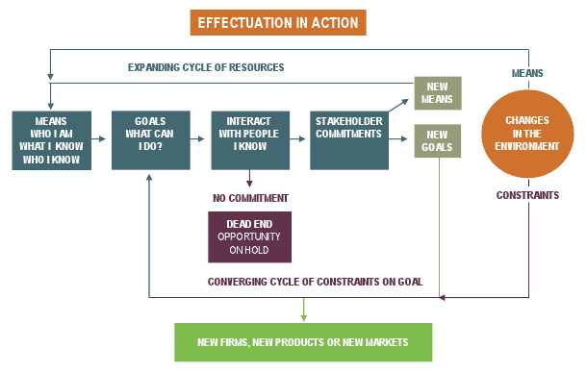
Can you think of any current examples
Notes:
Explain then ask for examples
Brexit
Future Generations of Wales Act
Global Warming

Slide 18
So what have we found
Colin Jones
Saras Sarasvathy
Resource Profile
Social Capital
  Who you know
Human Capital
  What you know
Financial Capital
  Access to Resources, what you can get your hands on
Effectuation
Who they are – know themselves their strengths, weaknesses etc – Self Efficacy
What they know – audit this – you know loads of things..
Who they know – build and develop your networks..

Slide 19
The ACRO Model
ATTITUDE
Self knowledge, belief and confidence
Motivation
Aspiration
Determination
Competitiveness
CREATIVITY
Problem solving
Lateral thinking / ideas generation
Spotting and creating opportunities
Innovation
RELATIONSHIPS
Working with others
Managing difficult situations
Negotiation, persuasion and influence
Presentation
Communication
ORGANISATION
Planning
Managing resources
Decision making
Research and understanding the environment
Managing risk
Vision and goal setting
Notes:
Entrepreneurship is not something special that a few people are born with. Entrepreneurship is a way of thinking that can be nurtured.
The ACRO model was introduced to focus on the attitudes, skills and behaviours needed to enable young people to meet the needs of business in the 21st century.
Initial research conducted by the Welsh Government identified the characteristics commonly displayed by entrepreneurs. This considered the everyday business tasks and underlying skills and attitudes of the entrepreneur.
The model breaks the characteristics down into four key dimensions and is summed up by the acronym ACRO – this covers all the important aspects of entrepreneurial behaviour

Slide 20
Developing an Entrepreneur Mindset
An entrepreneurial mind-set includes:
• aspects of personality and social identity
• personal ambition and goals
• personal confidence and resilience
• self-discipline and personal organisation
• understanding of one's own motivation
• ability to go beyond perceived limitations and achieve results
• tolerance of uncertainty, ambiguity, risk, and failure
• personal values: ethical, social and environmental awareness. QAA (2012)

Slide 21
Behaviours, Attitudes, Skills
Behaviours
Students should be able to demonstrate:
• the ability to seek out, be alert to, and identify opportunities (opportunity recognition)
• creative and innovative approaches (problem solving)
• the initiative to act on perceived opportunities while considering risk factors
(taking action)
• independent responsibility for managing projects (managing autonomously)
• the ability to reflect and persevere in challenging environments in pursuit of achieving
desired objectives or goals (personal awareness)
• use of social skills to build trust, relationships and networks and to communicate ideas
and information (networking and communication). QAA (2012)
Notes:
The educator's aim is to help students develop core behaviours for enterprise through
learning activities that enable them to practise, exhibit and develop confidence in key areas.

Slide 22
Attributes
Students should be able to:
• recognise and achieve goals and ambitions, especially in response to challenge (goals
and ambitions)
• enhance self-confidence and belief through practice of enterprising skills and behaviours
(self-confidence)
• demonstrate perseverance, resilience and determination to achieve goals, especially
within challenging situations (perseverance)
• recognise that they are in control of their own destiny (internal locus of control) and use
this understanding effectively within enterprising situations
• take action and learn both from actions and active experimentation (action orientation)
• innovate and offer creative solutions to challenging and complex problems (innovation
and creativity). QAA (2012)
Notes:
The educator's aim is to help students discover and develop personal attributes for successful
enterprise, develop an awareness of these, and find opportunities to enhance them.

Slide 23
Skills:
Students should be able to demonstrate the ability to:
• take creative and innovative approaches that are evidenced through multiple solutions
and reflective processes (creativity and innovation)
• persuade others through informed opinion and negotiate support for ideas (persuasion
and negotiation)
• manage a range of enterprise projects and situations appropriately, for example by
proposing alternatives or taking a holistic approach (approach to management)
• evaluate issues and make decisions in situations of ambiguity, uncertainty and risk
(decision making)
• use networking skills effectively, for example to build or validate ideas or to build
support for ideas with potential colleagues or stakeholders (networking)
• recognise patterns and opportunities in complex situations and environments
(opportunity recognition)
• model and propose business opportunities that take account of financial implications,
legal implications and issues of intellectual property (financial and business literacy). (QAA 2012)

Slide 24
But how?

Slide 25
HE and entrepreneurship in context
Listed by Universities UK
as one of four strategic goals for British universities
need for an enterprising culture
Engagement declined
1980
1990
1997
2000
2008
2010
Government's renewed strategy and vision to make the UK the most enterprising economy
in the world and the best place to start and grow a business
Universities encouraged to participate in programmes that
would raise students of enterprise
Entrepreneurship through innovative approaches to programme design.
Notes:
1980 – encourage students to participate in business opportunities
1990 – willingness declined
In 1997, Dearing's National Committee of Inquiry into
Higher Education13 revitalised the call, recommending that universities consider the scope for encouraging entrepreneurship through innovative approaches to programme design. – higher education innovation fund ( reach out to business and the community)
Then big rise
2010 – new gov. same need

Slide 26
No single model in University
Enterprise and entrepreneurship education may be:
• managed by a central unit
• embedded in the curriculum by subject specialist educators
• embedded in the curriculum under another name such as 'professional studies' or
'personal marketing skills'
• delivered through a careers service http://www.uwtsd.ac.uk/careers/
• led or supported through facilities such as boot camps and extra-curricular
clubs and societies.
https://www.youtube.com/watch?v=fe7J95yJbUw
http://lifedesign.uwtsd.ac.uk/category/inspiration/

Slide 27
Inspire | Demonstrate through the good examples
By practice | Lead by example – show/tell them what you do
Research – research linked to teaching | Enquiry through to research; problem solving and project work.
Outline ideas succinctly | Word limits / tutorials / presentations / outline & essay planning /dissertation proposals / Negotiable/negotiated learning
Assess own strengths or weaknesses | Peer group assessment / critical evaluation / Discussion/ tutorial/ question Marking scheme Self assessment/ profiling
Communicate effectively Build team Network | Human skills interactivity Inspiration comes from a variety Good accommodation Stimulating teaching/subject Enthusiasm Good equipment
Have ideas Make things happen Innovate | Bring relevant/new experience from outside Keep up to date/new techniques Thinking differently Utilising experience
Expose students to best practice | Alumni network Guest speakers FT/PT mix Off campus venues, events & activities
The role of the academic

Slide 28
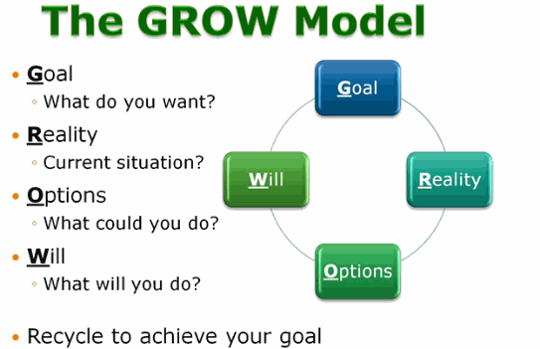
Notes:
The model was originally developed in the 1980s by performance coach Sir John Whitmore, although other coaches, such as Alan Fine and Graham Alexander, have also helped to develop it.
A good way of thinking about the GROW Model is to think about how you'd plan a journey. First, you decide where you are going (the goal), and establish where you currently are (your current reality).
You then explore various routes (the options) to your destination. In the final step, establishing the will, you ensure that you're committed to making the journey, and are prepared for the obstacles that you could meet on the way.

Slide 29
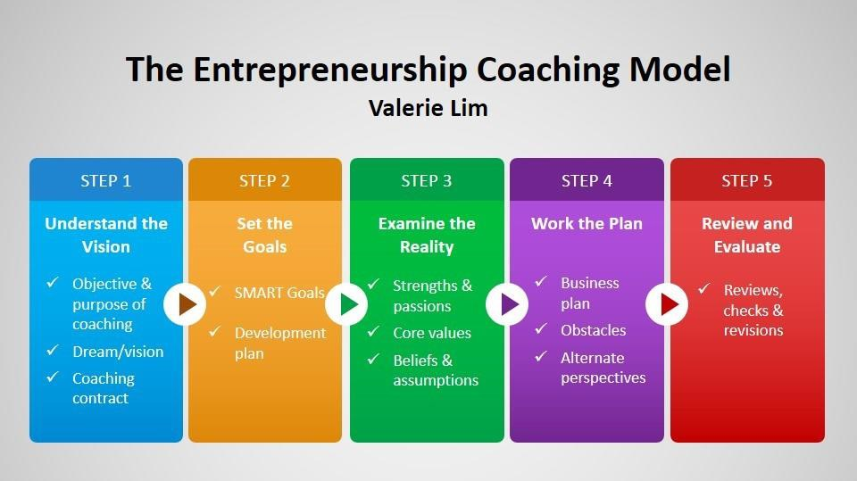
Lim (2003)
Notes:
Step one – understand what you intend to do
Step 2 – smart targets (specific, measurable, attainable, realistic, time based)
Step 3 – is the business realistic?
Step 4 business plan
Step 5 – review and evaluate

Slide 30
What type of Entrepreneur are you?

Slide 31
Task
Write down your personal characteristics, skills, values and beliefs

Slide 32
Give yourself a point for every one matched
Personal Characteristics | Interpersonal Skills | Critical and Creative Thinking Skills | Practical Skills
Optimism | Leadership and Motivation | Creative Thinking | Goal Setting
Vision | Communication Skills | Problem Solving | Decision Making
Desire for control | Listening | Recognising Opportunities | Planning and organising
initiative | Personal Relations |  | Variety of knowledge
Risk tolerance | Negotiation
Resilience | Ethics

Slide 33
The entrepreneur
Entrepreneurs can all answer the following
  Who am I?
  Who do I know?
  What do I know?
Can you construct your own Resource Profile?
  Human Capital
  Social Capital
  Financial Capital

Slide 34
Your resource profile
What experiences in your life will you be drawing upon as you develop as an educator?
How can you harvest your experiences?
Which will you choose to use and which will you choose to keep quiet about?

Slide 35
Task
In groups of 4, brainstorm what a educational entrepreneurial opportunity could look like
The entrepreneurial opportunity could be an enterprise activity or event, a ‘business studies’ topic delivered in an entrepreneurial way or something else that you could effectively use.
Now in your groups: brainstorm the possible sections that could be included in your portfolio

Slide 36
The learning experience can be an enterprise activity or event, a ‘business studies’ topic delivered in an entrepreneurial way or something else that you could effectively use.
Possible sections:
  A brief of the educational entrepreneurial opportunity– what does it look like, involve, etc.
  The learning objectives it should achieve
  The resources needed, including time
  The key/enterprise/entrepreneurial/employability skills you are developing in the learners
  How you will assess it
  How you will ensure that learners recognise the skills they are developing
  How you will evaluate it

Slide 37
Who can be an Entrepreneur?
Please watch this.

Slide 38
One more thought.
“Your time is limited, so don’t waste it living someone else’s life. Don’t be trapped by dogma – which is living with the results of other people’s thinking. Don’t let the noise of other people’s opinions drown out your own inner voice. And most important, have the courage to follow your heart and intuition. They somehow already know what you truly want to become. Everything else is secondary” Steve Jobs

Slide 39
Questions?

