Slide 1
Internal assessment and analysis

Slide 2
Learning Objectives
Describe the nature and role of an internal assessment in formulating strategies.
Discuss why organizational culture is so important in formulating strategies.
Identify the basic functions (activities) that make up management and their relevance in formulating strategies.
Identify the basic functions of marketing and their relevance in formulating strategies.
Discuss the nature and role of finance and accounting in formulating strategies.
Notes:
After studying this chapter, you should be able to do the following:
4-1. Describe the nature and role of an internal assessment in formulating strategies.
4-2. Discuss why organizational culture is so important in formulating strategies.
4-3. Identify the basic functions (activities) that make up management and their relevance
in formulating strategies.
4-4. Identify the basic functions of marketing and their relevance in formulating strategies.
4-5. Discuss the nature and role of finance/accounting in formulating strategies.
4-6. Discuss the nature and role of production/operations in formulating strategies.
4-7. Discuss the nature and role of research and development (R&D) in formulating
strategies.
4-8. Discuss the nature and role of management information systems (MIS) in formulating
strategies.
4-9. Explain value chain analysis and its relevance in formulating strategies.
4-10. Develop and use an Internal Factor Evaluation (IFE) Matrix.

Slide 3
Learning Objectives (cont.)
Discuss the nature and role of production/operations in formulating strategies.
Discuss the nature and role of research and development (R&D) in formulating strategies.
Discuss the nature and role of management information systems (MIS) in formulating strategies.
Explain value chain analysis and its relevance in formulating strategies.

Slide 4
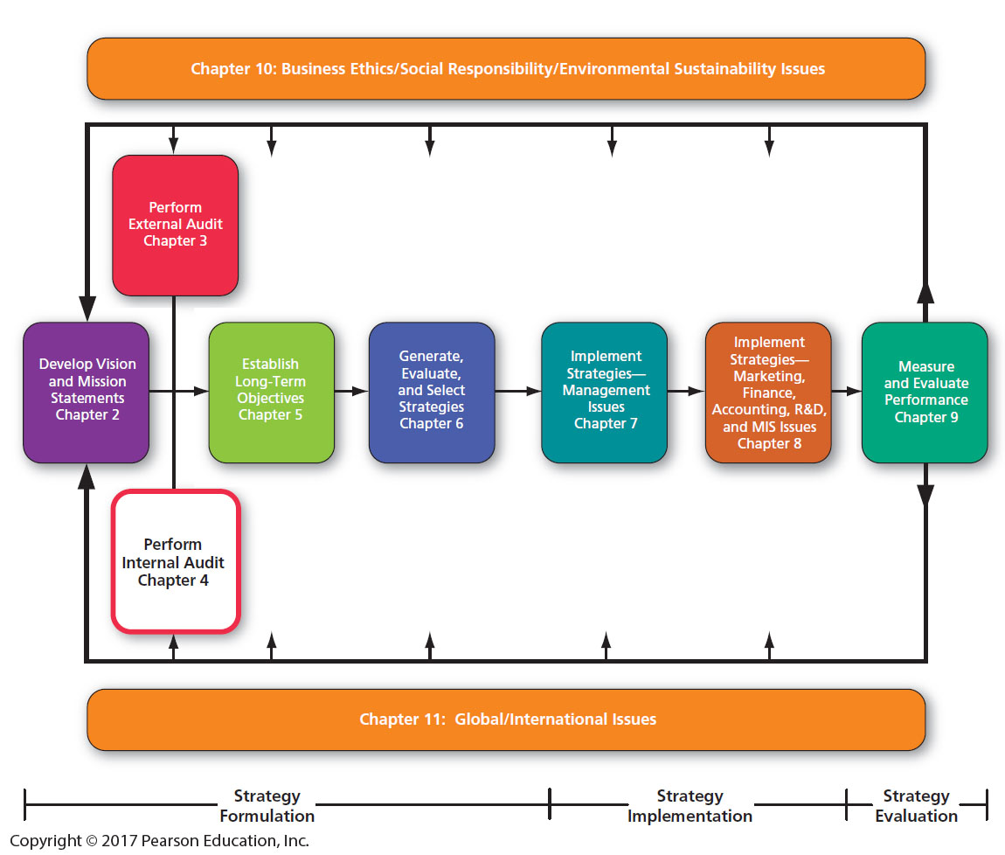
A Comprehensive Strategic-Management Model

Slide 5
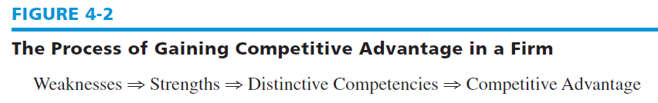
Key Internal Forces
Distinctive competencies
  A firm's strengths that cannot be easily matched or imitated by competitors
Building competitive advantages involves taking advantage of distinctive competencies.
Notes:
Strategies are designed in part to improve on a firm’s weaknesses, turning them into strengths—and maybe even into distinctive competencies that can provide the firm with competitive advantages over rival firms.

Slide 6
The Process of Performing an Internal Audit
The internal audit
  Requires gathering, assimilating, and prioritizing information about the firm's management, marketing, finance, accounting, production/operations, research and development (R&D), and management information systems operations
  Provides more opportunity for participants to understand how their jobs, departments, and divisions fit into the whole firm
Notes:
All organizations have strengths and weaknesses in the functional areas of business. No enterprise is equally strong or weak in all areas. Strategic planning is most successful when managers and employees from all functional areas work together to provide ideas and information.

Slide 7
The Resource-Based View (RBV)
The Resource-Based View (RBV) Approach
  contends that internal resources are more important for a firm than external factors in achieving and sustaining competitive advantage

Slide 8
The Resource-Based View (RBV)
Proponents of the RBV contend that organizational performance will primarily be determined by internal resources that can be grouped into three all-encompassing categories:
  physical resources
  human resources
  organizational resources
Notes:
Physical resources include all plant and equipment, location, technology, raw materials, machines; human resources include all employees, training, experience, intelligence, knowledge, skills, abilities; and organizational resources include firm structure, planning processes, information systems, patents, trademarks, copyrights, databases, and so on.

Slide 9
The Resource-Based View (RBV)
For a resource to be valuable, it must be either (1) rare, (2) hard to imitate, or (3) not easily substitutable.
These three characteristics of resources are called Empirical Indicators
These enable a firm to implement strategies that improve its efficiency and effectiveness and lead to a sustainable competitive advantage.
Notes:
The basic premise of the RBV is that the mix, type, amount, and nature of a firm’s internal resources should be considered first and foremost in devising strategies that can lead to sustainable competitive advantage.

Slide 10
Integrating Strategy and Culture
Organizational culture significantly affects planning activities.
If strategies can capitalize on cultural strengths, such as a strong work ethic or highly ethical beliefs, then management often can swiftly and easily implement changes.
Notes:
Every business entity has a unique organizational culture that impacts strategic-planning activities.

Slide 11
Organizational Culture
Organizational culture is “a pattern of behavior that has been developed by an organization as it learns to cope with its problem of external adaptation and internal integration and that has worked well enough to be considered valid and to be taught to new members as the correct way to perceive, think, and feel.”
Notes:
Remarkably resistant to change, culture can represent a major strength or weakness for any firm. It can be an underlying reason for strengths or weaknesses in any of the major business functions.

Slide 12
Cultural Products
Values
Beliefs
Rites
Rituals
Ceremonies
Myths
Stories
Legends
Sagas
Language
Metaphors
Symbols
Folktales
Heroes and heroines
Notes:
These products or dimensions are levers that strategists can use to influence and direct strategy formulation, implementation, and evaluation activities.

Slide 13
Aspects of Organizational Culture
Notes:
Table 4-2 provides some example (possible) aspects of an organization’s culture. Note that you might want to ask employees and managers to rate the degree that the dimension characterizes the firm.

Slide 14
Management
The functions of management consist of five basic activities:
  planning
  organizing
  motivating
  staffing
  controlling
Notes:
These activities are important to assess in strategic planning because an organization should continually capitalize on its management strengths and improve on its management weaknesses.

Slide 15
The Basic Functions of Management
Planning: forecasting, establishing objectives, devising strategies, and developing policies
Organizing: organizational design, job specialization, job descriptions, span of control, coordination, job design, and job analysis
Motivating: leadership, communication, work groups, behavior modification, delegation of authority, job enrichment, job satisfaction, needs fulfillment, organizational change, employee morale, and managerial morale
Notes:
Planning consists of all those managerial activities related to preparing for the future.
Organizing includes all those managerial activities that result in a structure of task and authority relationships.
Motivating involves efforts directed toward shaping human behavior.

Slide 16
The Basic Functions of Management
Staffing: wage and salary administration, employee benefits, interviewing, hiring, firing, training, management development, employee safety, equal employment opportunity, and union relations
Controlling: quality control, financial control, sales control, inventory control, expense control, analysis of variances, rewards, and sanctions
Notes:
Staffing refers to human resource (HR) activities.
Controlling refers to all those managerial activities directed toward ensuring that actual results are consistent with planned results.

Slide 17
Management Audit Checklist of Questions
Does the firm use strategic-management concepts?
Are company objectives and goals measurable and well communicated?
Do managers at all hierarchical levels plan effectively?
Do managers delegate authority well?
Is the organization's structure appropriate?
Notes:
This checklist of questions can help determine specific strengths and weaknesses in the functional area of business. An answer of no to any question could indicate a potential weakness. Positive or yes answers to the checklist questions suggest potential areas of strength.

Slide 18
Management Audit Checklist of Questions (cont.)
Are job descriptions and job specifications clear?
Is employee morale high?
Are employee turnover and absenteeism low?
Are organizational reward and control mechanisms effective?

Slide 19
Marketing
Marketing
  the process of defining, anticipating, creating, and fulfilling customers’ needs and wants for products and services
Notes:
Marketing can be described as the process of defining, anticipating, creating, and fulfilling customers’ needs and wants for products and services.

Slide 20
Functions of Marketing
Customer analysis
Selling products and services
Product and service planning
Pricing
Marketing research
Cost/benefit analysis
Distribution
Notes:
These are the seven basic functions of marketing. Each will be described on the following slides.

Slide 21
Marketing
Customer Analysis
  the examination and evaluation of consumer needs, desires, and wants
  involves administering customer surveys, analyzing consumer information, evaluating market positioning strategies, developing customer profiles, and determining optimal market segmentation strategies
Notes:
Customer analysis is the first function of marketing.

Slide 22
Selling Products and Services
Selling
  includes many marketing activities, such as advertising, sales promotion, publicity, personal selling, sales force management, customer relations, and dealer relations
Notes:
Selling products and services is the second function of marketing. Successful strategy implementation generally rests on the ability of an organization to sell some product or service.

Slide 23
Product and Service Planning
Product and Service Planning
  includes activities such as test marketing; product and brand positioning; devising warranties; packaging; determining product options, features, style, and quality; deleting old products; and providing for customer service
  important when a company is pursuing product development or diversification
Notes:
Product and service planning is the third function of marketing.

Slide 24
Pricing
Pricing
  Five major stakeholders affect pricing decisions: consumers, governments, suppliers, distributors, and competitors
  Sometimes an organization will pursue a forward integration strategy primarily to gain better control over prices charged to consumers.
Notes:
Pricing is the fourth function of marketing.

Slide 25
Distribution
Distribution
  includes warehousing, distribution channels, distribution coverage, retail site locations, sales territories, inventory levels and location, transportation carriers, wholesaling, and retailing
  especially important when a firm is striving to implement a market development or forward integration strategy
Notes:
Distribution is the fifth function of marketing.

Slide 26
Marketing Research
Marketing Research
  the systematic gathering, recording, and analyzing of data about problems relating to the marketing of goods and services
  can uncover critical strengths and weaknesses
Notes:
Marketing research is the sixth function of marketing.

Slide 27
Cost/Benefit Analysis
Cost/Benefit Analysis
  Three steps are required:
    compute the total costs associated with a decision
    estimate the total benefits from the decision
    compare the total costs with the total benefits
Notes:
Cost/benefit analysis is the seventh function of marketing.

Slide 28
Marketing Audit Checklist of Questions
Are markets segmented effectively?
Is the organization positioned well among competitors?
Has the firm’s market share been increasing?
Are present channels of distribution reliable and cost effective?
Does the firm have an effective sales organization?
Does the firm conduct market research?
Notes:
These questions about marketing must be examined in strategic planning.

Slide 29
Marketing Audit Checklist of Questions (cont.)
Are product quality and customer service good?
Are the firm's products and services priced appropriately?
Does the firm have an effective promotion, advertising, and publicity strategy?
Are marketing, planning, and budgeting effective?
Do the firm's marketing managers have adequate experience and training?
Is the firm's Internet presence excellent as compared to rivals?

Slide 30
Finance/Accounting Functions
The functions of finance/accounting comprise three decisions:
1. the investment decision
2. the financing decision
3. the dividend decision
Notes:
According to James Van Horne, the functions of finance/accounting comprise three decisions: the investment decision, the financing decision, and the dividend decision.

Slide 31
Finance/Accounting Functions
Investment Decision (Capital Budgeting)
  the allocation and reallocation of capital and resources to projects, products, assets, and divisions of an organization
Financing Decision
  determines the best capital structure for the firm and includes examining various methods by which the firm can raise capital
Notes:
After strategies are formulated, capital budgeting decisions are required to successfully implement strategies.
Firms may raise capital by, for example, issuing stock, increasing debt, selling assets, or using a combination of these approaches.

Slide 32
Finance/Accounting Functions
Dividend Decisions
  concern issues such as the percentage of earnings paid to stockholders, the stability of dividends paid over time, and the repurchase or issuance of stock
  determine the amount of funds that are retained in a firm compared to the amount paid out to stockholders
Notes:
Three financial ratios that are helpful in evaluating a firm’s dividend decisions are the earnings-per-share ratio, the dividends-per-share ratio, and the price-earnings ratio.

Slide 33
Finance/Accounting Audit Checklist
Where is the firm financially strong and weak as indicated by financial ratio analyses?
Can the firm raise needed short-term capital?
Can the firm raise needed long-term capital through debt and/or equity?
Does the firm have sufficient working capital?
Are capital budgeting procedures effective?
Notes:
Some finance and accounting questions that should be examined in any strategic analysis of the firm are given here.

Slide 34
Finance/Accounting Audit Checklist (cont.)
Are dividend payout policies reasonable?
Does the firm have good relations with its investors and stockholders?
Are the firm's financial managers experienced and well trained?
Is the firm's debt situation excellent?

Slide 35
Production/Operations
Production/operations function
  consists of all those activities that transform inputs into goods and services
Production/operations management deals with inputs, transformations, and outputs that vary across industries and markets.
Notes:
Production and operations activities often represent the largest part of an organization’s human and capital assets.

Slide 36
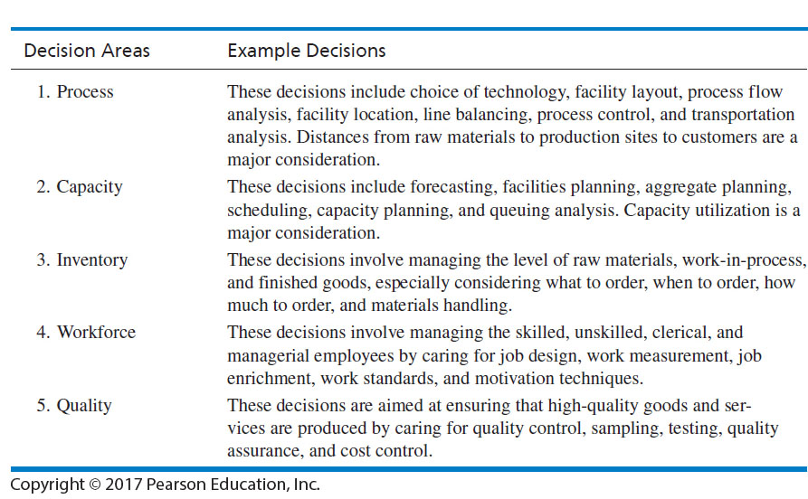
The Basic Functions (Decisions) Within Production/Operations
Notes:
Roger Schroeder suggests that production and operations management comprises five functions or decision areas: process, capacity, inventory, workforce, and quality.

Slide 37
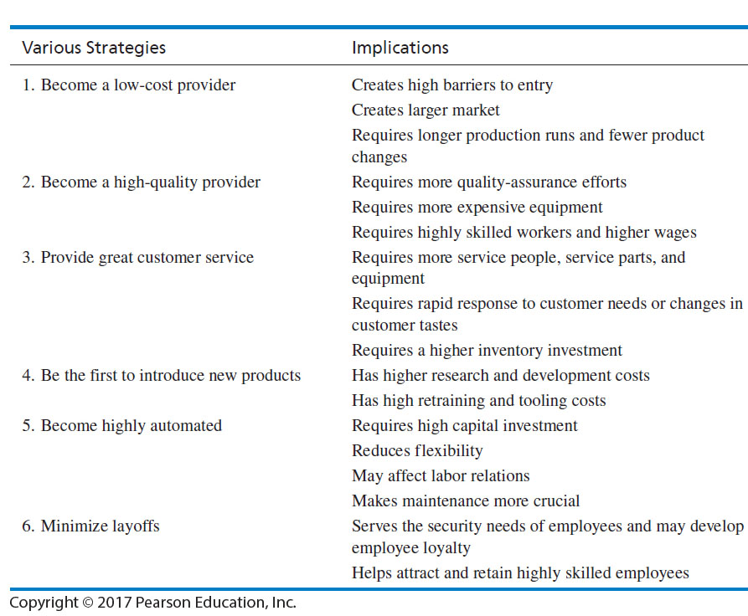
Implications of Various Strategies on Production/Operations
Notes:
James Dilworth has outlined implications of several types of strategic decisions a company might make.

Slide 38
Production/Operations
Audit Checklist
Are supplies of raw materials, parts, and subassemblies reliable and reasonable?
Are facilities, equipment, machinery, and offices in good condition?
Are inventory-control policies and procedures effective?
Are quality-control policies and procedures effective?
Are facilities, resources, and markets strategically located?
Does the firm have technological competencies?
Notes:
Questions such as these should be examined during the analysis of production and operations.

Slide 39
Research and Development Audit
Does the firm have R&D facilities? Are they adequate?
If outside R&D firms are used, are they cost-effective?
Are the organization's R&D personnel well qualified?
Are R&D resources allocated effectively?
Are management information and computer systems adequate?
Is communication between R&D and other organizational units effective?
Are present products technologically competitive?
Notes:
Organizations invest in R&D because they believe that such an investment will lead to a superior product or service and will give them competitive advantages.

Slide 40
Management Information Systems
Management Information System
  Receives raw material from both external and internal evaluation of an organization
  Improves the performance of an enterprise by improving the quality of managerial decisions
  Collects, codes, stores, synthesizes, and presents information in such a manner that it answers important operating and strategic questions
Notes:
The heart of an information system is a database containing the kinds of records and data important to managers.

Slide 41
Management Information Systems Audit
Do all managers in the firm use the information system to make decisions?
Is there a chief information officer or director of information systems position in the firm?
Are data in the information system updated regularly?
Do managers from all functional areas of the firm contribute input to the information system?
Are there effective passwords for entry into the firm's information system?
Notes:
Questions such as these should be asked when conducting an MIS audit.

Slide 42
Management Information Systems Audit (cont.)
Are strategists of the firm familiar with the information systems of rival firms?
Is the information system user-friendly?
Do all users of the information system understand the competitive advantages that information can provide firms?
Are computer training workshops provided for users of the information system?
Is the firm’s information system continually being improved in content- and user-friendliness?

Slide 43
Value Chain Analysis (VCA)
Value Chain Analysis (VCA)
  refers to the process whereby a firm determines the costs associated with organizational activities from purchasing raw materials to manufacturing product(s) to marketing those products
  aims to identify where low-cost advantages or disadvantages exist anywhere along the value chain from raw material to customer service activities
Notes:
According to Porter, the business of a firm can best be described as a value chain, in which total revenues minus total costs of all activities undertaken to develop and market a product or service yields value.

Slide 44
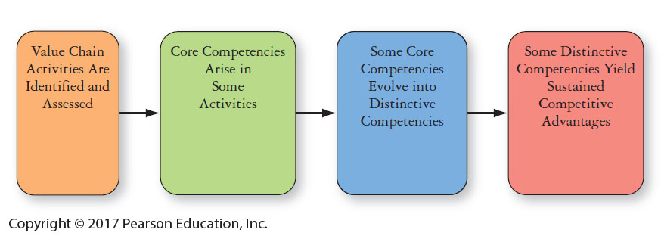
Transforming Value Chain Activities into Sustained Competitive Advantage
Notes:
More and more companies are using VCA to gain and sustain competitive advantage by being especially efficient and effective along various parts of the value chain.

Slide 45
Benchmarking
Benchmarking
  an analytical tool used to determine whether a firm's value chain activities are competitive compared to rivals and thus conducive to winning in the marketplace
  entails measuring costs of value chain activities across an industry to determine “best practices”
Notes:
Benchmarking enables a firm to take action to improve its competitiveness by identifying (and improving on) value chain activities where rival firms have comparative advantages in cost, service, reputation, or operation.

Slide 46
References
Chapter 4 from: David, F. R., & David, F. R., 2017. Strategic management: A competitive advantage approach, concepts and cases. 16th ed. Boston, MA: Pearson.
Thompson, A., Peteraf, M., Gamble, J. and Strickland, A., 2016. Crafting And Executing Strategy: The Quest For Competitive Advantage, Concepts And Cases. 20th ed. New York: McGraw-Hill Education.
Slack, N., Brandon-Jones, A., Johnston, R. and Betts, A., 2015. Operations And Process Management - Principles And Practice For Strategic Impact. 4th ed. Harlow, United Kingdom: Pearson Education Limited.

