Slide 1
Management of new Product Development
Assessment A

Slide 2
Determine what marketing knowledge is likely to be required for the development of this new product.
When developing a new product, having a solid understanding of marketing is crucial to ensure its successful launch and sustained growth. Here are some key marketing knowledge areas that are likely to be required:
Market Research: Conducting thorough market research is essential to understand the target audience, their needs, preferences, and the competitive landscape. This involves gathering data on market size, customer demographics, psychographics, buying behaviour, and trends.
Target Audience Identification: Clearly defining the target audience is vital for effective marketing. Identify the specific group of people who are most likely to benefit from and purchase your product. Develop buyer personas that outline their characteristics, motivations, and pain points.
Competitive Analysis: Analysing competitors helps you understand their products, pricing, positioning, and marketing strategies. This knowledge allows you to identify gaps, differentiators, and unique selling propositions for your product.
Product Positioning: Determine how your product will be positioned in the market and how it will differentiate itself from competitors. Clearly communicate the unique value proposition and benefits of your product to the target audience.
Pricing Strategy: Develop a pricing strategy based on factors such as production costs, target market's price sensitivity, perceived value, and competitive pricing. Consider pricing models, discounts, promotions, and pricing elasticity.
Marketing Channels: Identify the most effective marketing channels to reach and engage your target audience. This may include online channels (website, social media, search engine marketing), offline channels (print media, television, radio), or a combination of both.
Marketing Communication: Craft compelling marketing messages and develop a communication plan to effectively convey the value and benefits of your product. This includes advertising, public relations, content marketing, and sales promotions.
Branding and Packaging: Develop a strong brand identity that resonates with your target audience. Design a compelling logo, packaging, and visual elements that reflect the brand personality and positioning of your product.
Distribution Strategy: Determine the most efficient and effective distribution channels to make your product available to customers. Consider factors such as direct sales, retail partnerships, e-commerce, and logistics.
Marketing Metrics and Analysis: Establish key performance indicators (KPIs) to measure the success of your marketing efforts. Monitor metrics such as sales revenue, customer acquisition cost, conversion rates, customer satisfaction, and brand awareness. Analyse the data to make informed decisions and optimize marketing strategies.
These are just some of the essential marketing knowledge areas to consider when developing a new product. Depending on the product, industry, and target market, additional marketing expertise may be required. It's always beneficial to stay updated on the latest marketing trends and techniques to ensure the success of your product in a competitive market

Slide 3
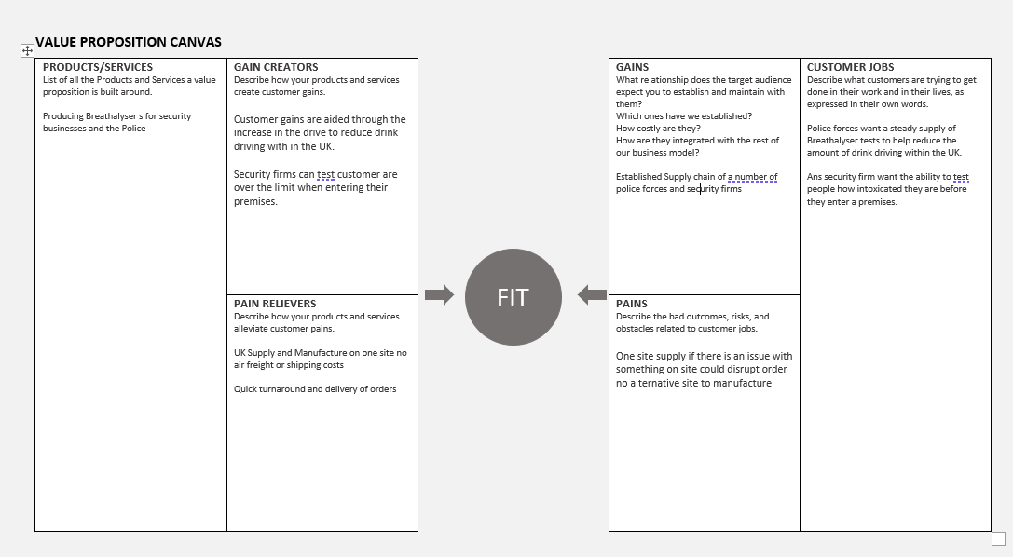
b) Present your findings from your sources of marketing knowledge, and apply this practice to the business in order to ascertain – what business are we in? what business(es) could we be in?
what business are we in?
Please see below Value proposition canvas for the business we are currently in

Slide 4
What Business are we in?
From the proposition canvas it tells us
We Supply and the manufacture of electronic breathalyzer systems.
We Supply Mainly the police and Security firms
Gain creators are we supply two well regulation and reliable sectors
Pain relivers are we are a UK base supply so non shipping or are freight cost are accrued and quick turnaround time for products
Gains are the target audience the police and security firms reliable and constant supply chain
Pains are only one site supply and machine areas could stop delivery without alternative supply.
Customer Jobs are the police are purchasing the item to try and reduce drink driving and the security firm are using them to stop intoxicated people entering their buildings.
From the Proposition canvas of the current model states the above goals of the current business.

Slide 5
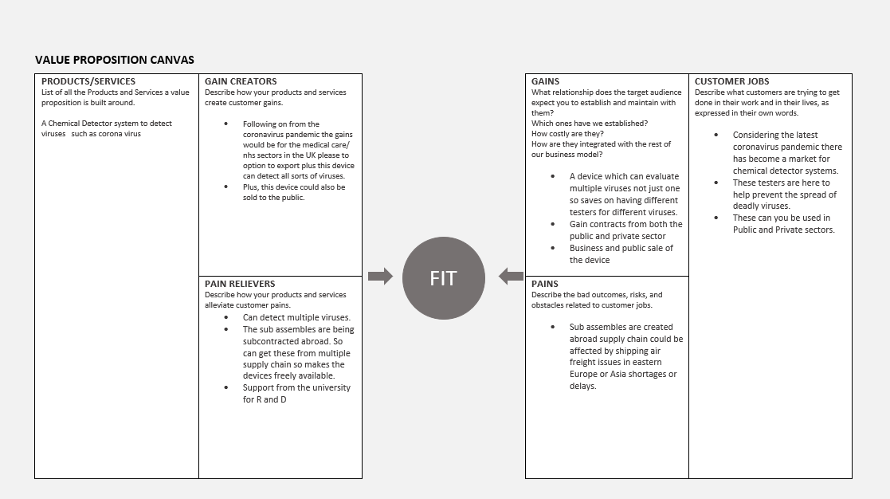
what business(es) could we be in?
Below is a Value proposition canvas of the business wee could be in with the development from the university

Slide 6
what business(es) could we be in?
From the proposition canvas it tells us
We could be in the Chemical Detectors industry
Could supply both the private and public sectors with a wide scope of customers
Pain relivers are it can detect multiple viruses / Sub assembles are done abroad and reduces cost / University are supporting with development
Gains are it can be sold to both private and public sectors and the general public so gives us a large scope of customers and can detect multiple viruses in one device.
Pains Because sub-assemblies are done abroad could in incur delays in the supply chain due to airfreight or shipping
Customer Jobs following on from the coronavirus pandemic there has become market for these type of detectors as this detector can detect multiple viruses not just one so could be influence to stop the spread of deadly viruses Can the sold in the private / Public work sectors and to the general public

Slide 7
Following on from the value proposition canvases both from what industries we are currently in and the industries we could be in.
There is significant scope to grow the business into new market following from on from the covid pandemic there is a market for chemical detectors to detect viruses to supply both public and public sector.
Which will secure the Future of the SME as sales are not just constrained to the police and security firms. Which will aid the business to grow.

Slide 8
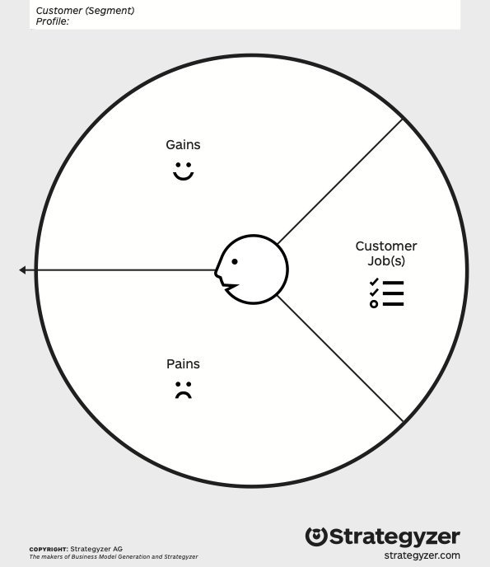
Safety / security manager Crewe station
Gains
Required
Measures and provides instant (less than 1 min) information about the subject's viral status
Automatically record result for track and trace
Not cause the virus to spread (contamination due to contact with device)
Simple to use device , obvious through semiotics
Expected
battery life to not impact normal use
Be ergonomically designed
Provide information in an understandable format
Desired
Wirelessly link to main database for record keeping
Allow for ‘live’ stream data visualisation
Create predictions based on data being recorded
Jobs
Functional job
ensure the safety of passengers using the train network, though having accurate understanding of the viral status of the crowd. With anomalies confirmed through accurate on the spot testing with the device.
Personal / emotional
Good job satisfaction , they have done everything possible to help with minimising the spread of the virus and recording track and trace information
Pains
Mass detection system detects false positives
Mass monitoring of people hard to achieve, and document
The spread of virus and no way to accurately track it
Reliance on digital technologies, flip side is not capturing any data, or not useful data
Privacy of subject - highlighting a singular person
- needs ‘live’ stream of data for individuals in crowd
managing health status of everyone.
Speed to attain viral status of individual
How to ensure all staff are conducting monitoring, and following the correct procedure
Record keeping, track and trace, reviews for future improvements
Calibration of device
Obstacles
Time to complete the task
Ease of use
Ease of roll out
Maintenance of device
Risks
Lack of control of virus spread
No data about completed test, no track and trace
Lots of data that could be GDPR breach?

Slide 9
Taxi driver in Edinburgh
Gains
Required
measures and provides instant (less than 1min) information about the subjects viral status
Not cause the virus to spread (contamination due to contact with device)
Simple to use device , obvious through semiotics
Expected
battery life to not impact usage
Be ergonomically designed
Provide information in an understandable format
Require minimum upkeep (updates etc)
Be fully mobile and not rely on connectivity to function
Desired
- Ability to download data and submit for track and trace
Technical Support centre
Easy to access manuals, training etc
Jobs
Functional
embark passengers and transport to desired location
Optimum number of passengers per shift
Provide quality service
Social
competent, professional driver
Personal/ emotional
job satisfaction by protecting them from virus
Pains
Lots of people in and out of the taxi each day, with no idea of their viral status
Only form of business therefore can’t stop working
Needs to feel safe in their job
Could be causing the virus to spread, negative social impact, also personal mental health
Cleaning the car between each person causes loss in business, increased expense, generates waste
Current plastic sheeting is unsigthly, should it be replaced after some time period?, gets damaged etc
Confidence in diagnostic, existing is just temperature measurement so lots of potential inaccuracy
Getting virus, bringing it home
Obstacles
always mobile - no network, no power,
Speed to use
Simple to use / explain to passenger
Confidence in product accurancy

Slide 10
Purchaser for Jet2 Airlines
Gains
Improve customer confidence in air travel
Minimum friction at points of contact with device and associated process
Guarantee of result and device function
Increased adoption though value for money and accuracy of device
Jobs - (buyer of value)
Functional
improve company financial performance
Keep costs to minimum whilst providing expected service level
Find best ‘deal’ for all transactions, could be service agreements, outsource etc
Social
look professional, bring advancement to company achieve kudos
Personal
wise investments made
Pains
Missed flight slots, time planes are not working
Poor budgeting, not providing shareholders with payouts, annoyed by guidelines and restrictions.
keeping up with all restrictions and guidance,
should it be product or service,
managing deployment of systems, products,
On going Training costs
loss of status(report, face) in company due to bad decisions,
technical platform not performing,
Poor ROI,
no added value to business,
reduces customer numbers.
Obstacles
How to measure ROI
Early adopter, therefore company seen as ‘too restrictive’
Barriers
is it necessary, government / airport/ health care should be doing this
Investment un-neccessary
Impacting an area of business that is plagued with un-happy customers

