Slide 1

Reflective Presentation
Elena Nicoleta Dinu

Slide 2

Introduction
This is a reflective presentation on the skills that I developed so far during this module.
In this presentation I will discuss what I learned each week, how I used these skills and also how they link to Task 1,2 and 3 from my report.
I will reflect on how these skills will help me with my studies and future job.

Slide 3


Week 1-Induction & JISC Discovery Tool
What I learned?
-How to navigate Moodle
-Submit assignments on Turnitin and assignments overview
-JISC Discovery Tool and product access (Office365)
Reflection
My JISC results chart shows areas that needs improvements and areas that I am good at. This week helped with a part of Task 1: Assessment of Digital Skills.

Slide 4

Week 2-Outlook And Task Management
What I learned?
-How to use Outlook ( email features and inbox management )
-How to create events, reminders and using the to do list
-Basics about Trello and Microsoft Planner
How I used them?
-I used the Outlook Calendar to add deadlines of my assignments
-To be organised : manage university, work and free time effectively .
Reflection
I am more organised and able to manage time effectively.
According to Microsoft(no date), 6 years later after Microsoft purchased Hotmail in 1997, their services started to be available in so many languages and to have new features. According to the same source in 2015 when Outlook became available on phones, the company had over 60 milion customers.

Slide 5


Week 3-AI & Cybersecurity Basics
What I learned?
-What is AI and what it can be used for
-AI Tools and using AI in assignments (how to acknowledge it in assignments)
-GDPR awareness( basic data protection)
-Basic knowledge of Cybersecurity ( strong passwords)
Reflection
How to acknowledge AI use in the assignments.
Helps me not to break module’s rules.

Slide 6


Week 4-Microsoft Office 365 & Word
What I learned?
-Access Office365 and download apps
-Word ( saving formats, table of contents, inserting photos, sharing documents).
-Microsoft Team- communication and collaboration
How I use them?
-In my assignments (500 words reflective writing)
Reflection
I am more confident and I know how to format academic documents.

Slide 7

Week 6-PowerPoint
What I learned?
-About layout and features.
-How to create slides using pre-made designs.
-How to apply transitions, music and animations.
- Slide Show
How I used them?
-Everything that I learned is in this presentation.
Reflection
I am confident in creating a presentation.

Slide 8

Week 7- Excel
What I learned?
-For a business use I learned: Formulas(SUM, AVERAGE and IF)
Charts, graphs and filtering data
-For a personal use I learned: budgeting sheet (Monthly payments)
How I used them?
-I used this in my Task 3: essay and spreadsheet.
Reflection
I have a better understanding on how to use Excel for business and personal use.

Slide 9

Week 8- Microsoft Forms
What I learned?
-How to create quizzes and surveys
-How I can collect and share responses on my forms.
-Analysis data and exporting it in an Excel spreadsheet
How I used them?
-I created a form that I used at the end of this presentation to collect feedback from
my peers.
Reflection
I know how to create surveys and quizzes using Microsoft Forms for getting data in my researches and my future business.

Slide 10
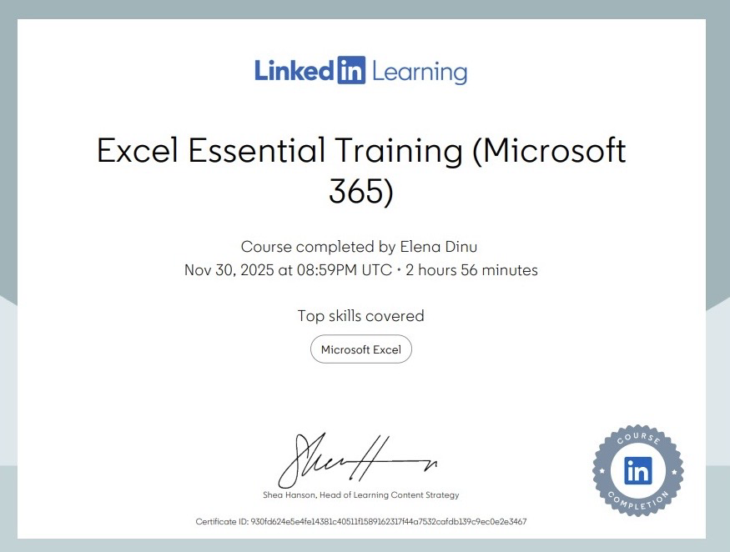
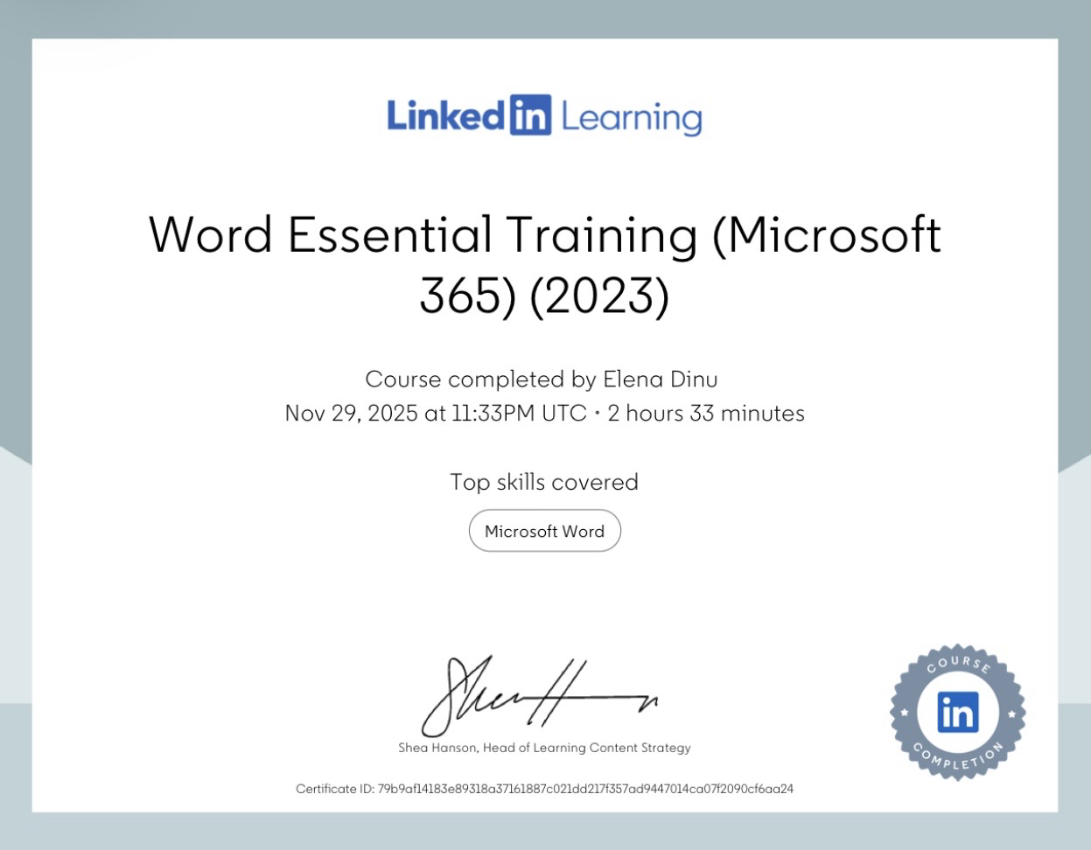
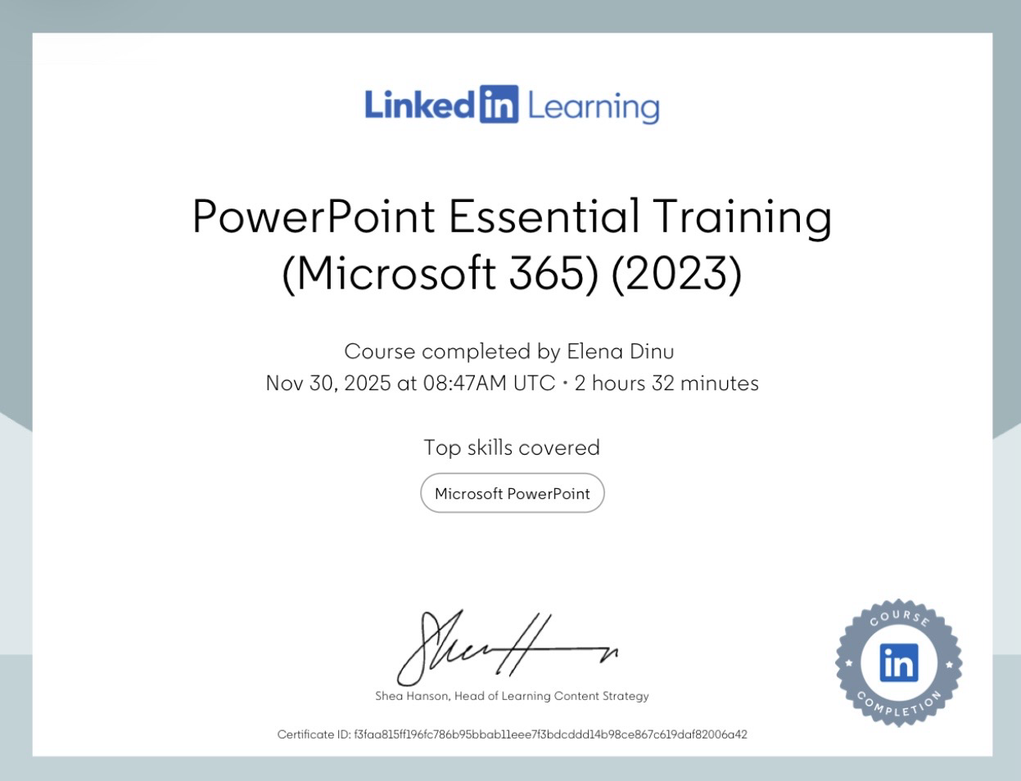
Week 9- LinkedIn & LinkedIn Learning
What I learned?
-To create and manage a LinkedIn profile
-Some Networking tips( how to make potential employers having interest on your profile)
- Where to find and complete LinkedIn Learning Certificates.
How I used them?
-I used this in my Task 2 where I need to add my LinkedIn Certificates for Office365.
Reflection
I gained extra skills on Word, PowerPoint and Excel, these making me more confident.

Slide 11

Challenges, Improvements & Future Skills To Improve
Challenges
-Being able to submit on time( even if I have them on Outlook)
Improvements
-Using other apps to make sure I submit it on time( alarms on my phone)
-Informing my family about deadlines.
Future Skills To Improve
Improving my skills in Word, Excel and PowerPoint .

Slide 12
Reference List
Microsoft .no date, Outlook.com Introduced. Available at : https://news.microsoft.com/announcement/outlook-com-introduced/ (Accessed date: 30th of November 2025)

Slide 13



