Slide 1
WEB DESIGN & ONLINE MARKETING STRATEGY
By Runa Bibi

Slide 2
Introduction
Today I will be discussing what you need to consider when designing a responsive website and several possible options to create one.
I will also be looking at different online marketing strategies to promote your brand or website.

Slide 3
Considerations when designing a website
Must be accessible to disabled users by law (disability discrimination act) or you could get sued [1]
It must also comply with section 508 which has three requirements to follow: technical i.e. website code has to compatible with technologies that assist disabled users, functional where the entire website must be “usable” for disabled users and support where any support information should be available for disabled users [2]
WCAG Accessibility Principles: Based on web content, any software used to access website and authoring content including things such as alternative text on images and non-text content, audio description for videos, text transcripts for audio etc. and background colour and foreground text should have good contrast and text should be resizable without any distortion [3]

Slide 4
Further Considerations
According the WCAG 2.0 there are four principles which create the basis of Web Accessibility:
Perceivable – All information and UI components have to be presentable to the user in such a way that is perceivable to them [4]
Operable – UI components and navigation have to be operable for user regardless of what device is being used [5]
Understandable – Information has to be understandable to the user along with the UI [6]
Robust – Content has to be robust enough to work with any current and new technologies including assistive technologies [7]

Slide 5
Jakob Nielsen’s Usability Heuristics
Nielsen came up with 10 heuristics regarding interaction design. Here are some examples:
System status visibility – The system should allow users to be aware of the status of the system using feedback where necessary [8]
Error prevention – System should be set up to prevent errors occurring in the first place [8]
Standards and consistency – Users should not have to debate whether different actions or words mean the same thing [9]
Documentation and help – It should be easy to access any documentation should the user need help with the website [9]

Slide 6
General Usability Guidelines
User will understand where to look on first visit to website [10]
User should not have to do repetitive actions [10]
Colour should not be the only way to deliver a message; it should be viewable for people who are colour-blind [11]
For a good UI, less is usually more – your design should be uncluttered [12]

Slide 7
Distinctive Brand Assets
In order to enhance your website you can use a strong unique brand to make it stand out compared to others:
Distinctive assets are the parts of your brand that customers see as unique [13]
While your brand may change over time, it is important to keep colours, logos and typography consistent [13]
Jenni Romaniuk bases a distinctive brand on “uniqueness” and “prevalence” – if your brand is not unique and similar to a competitor then customers may mistake you for them which essentially gives them free advertising [14]

Slide 8
Current Responsive Web Design Options
Free Website builders [15]
Template Modifiers [15]
Wordpress or a similar CMS [16]
Hand coding [17]

Slide 9
Free Website Builders
A website builder is a tool that lets you build a website without needing to code anything e.g. Wix [18]
Pros | Cons
No expert coding skills required [19] | No unique domain name [20]
Cheap and quick to start [19] | Limited features if you do not pay [20]
Easy to make changes [21] | May require unwanted ads to be shown [22]

Slide 10
Template Modifiers
The base of the website is already built and you edit the look of it [15]
Pros | Cons
A wide variety of templates available [23] | You could end up with many other websites that look like yours [23]
What you see is what you get [24] | Not enhanced to attract search engines [24]
Can be up and running quickly [25] | Templates can only be customised up to a point [25]

Slide 11
Wordpress or a similar CMS
A content management system is a tool which allows the user to manage and create content online without needing prior knowledge on website building [26]
Pros | Cons
Easy to use with a simple interface [27] | Needs updates – needs people to be dedicated to make sure it stays updated [27]
SEO benefits – Google prefers CMS sites as they solve SEO issues automatically [28] | E-commerce limitations – Wordpress’ e-commerce plug-ins do not have high functionality compared to others [28]
Allows scheduled publishing [29] | Security risks – hackers will find it easier to hack into CMS sites [29]

Slide 12
Hand Coding
Either yourself or an expert hand codes a website to meet your individual needs [30]
Pros | Cons
Unique design [31] | Takes longer to develop [31]
Higher level of security possible [32] | More expensive [33]
Able to meet your own needs from the start [32] | Changes can take time [33]

Slide 13
Evaluation of current responsive web design options
Criteria | WordPress | Adobe Dreamweaver | Hand coding | Wix | GoDaddy
Professional layout and design | 4 | 5 | 5 | 4 | 4
Responsive to mobile devices | 4 | 4 | 3 | 5 | 4
Blog integration | 4 | 3 | 3 | 4 | 3
E-commerce integration | 2 | 2 | 3 | 3 | 3
E-mail marketing integration | 3 | 2 | 4 | 3 | 3
Allow non-technical personnel access to update the site via a GUI. | 3 | 4 | 4 | 4 | 2
No hosting maintenance required. | 4 | 2 | 3 | 4 | 3
As reasonable as possible (suitable for SMEs). | 4 | 3 | 4 | 4 | 3
Total | 28 | 25 | 29 | 31 | 25

Slide 14
Final design recommendation
I would recommend a free website builder such as Wix to start with for a responsive website as you can choose to pay later depending on what you require
It provides many templates and means you have a quick start up for your business so you are able to advertise your business as soon as possible
I will demonstrate how this works by creating a website of my own

Slide 15
My website
I have chosen to create a website about myself as an online resume
The following are screenshots of my website and web design principles and guidelines considerations

Slide 16
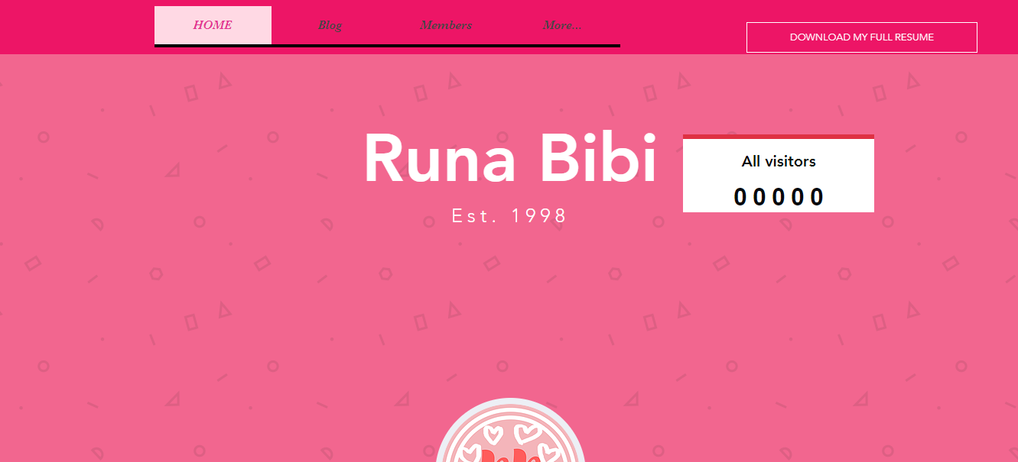
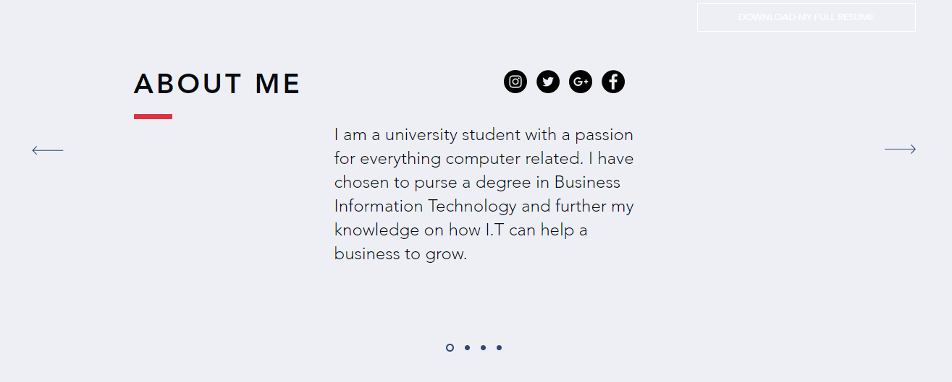
Home Page

Slide 17
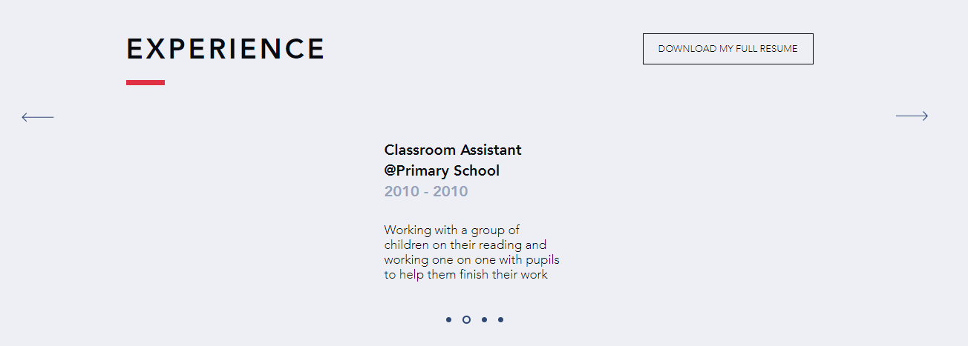
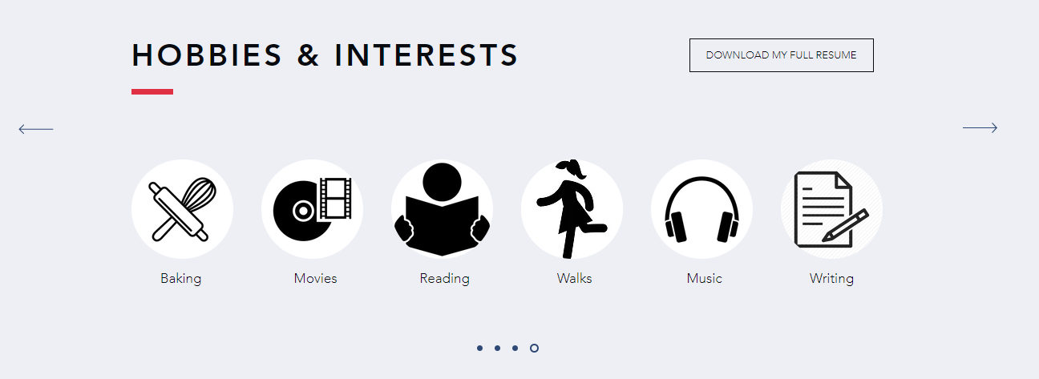
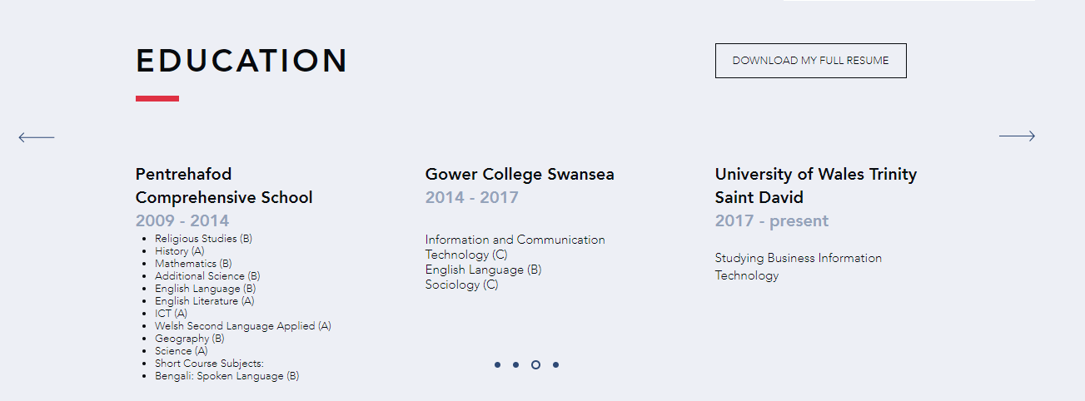
Home Page cont.

Slide 18
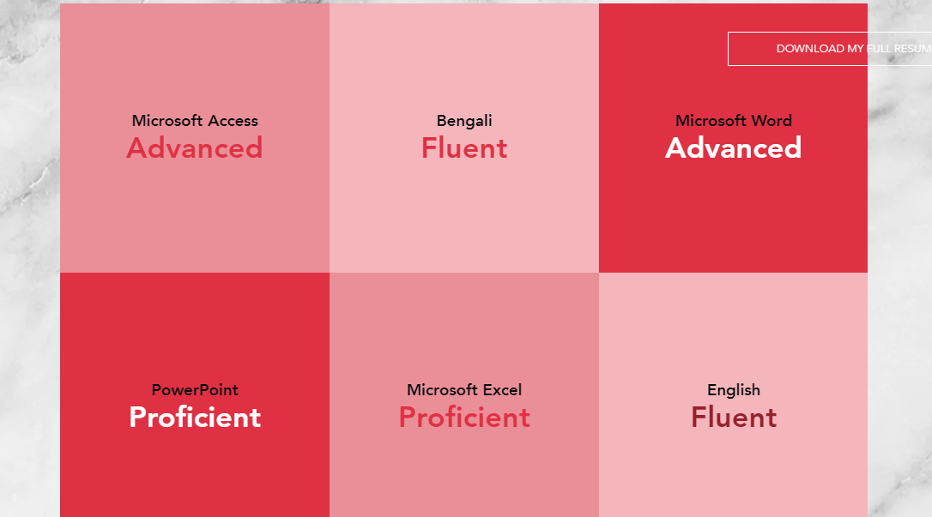
Home Page cont.

Slide 19
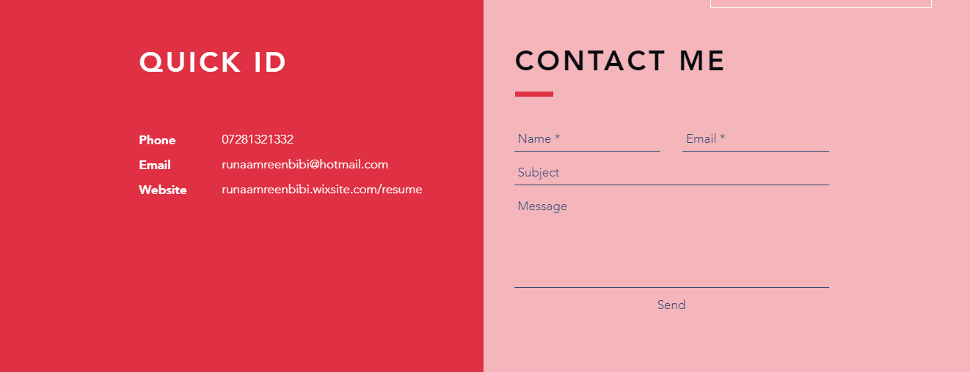
Home Page cont.

Slide 20
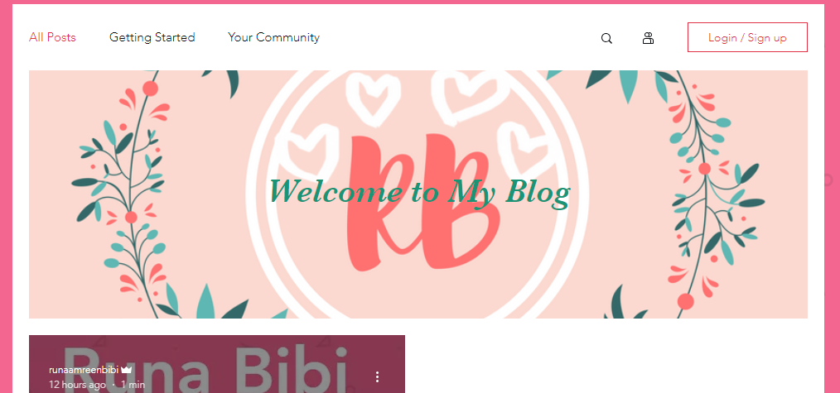
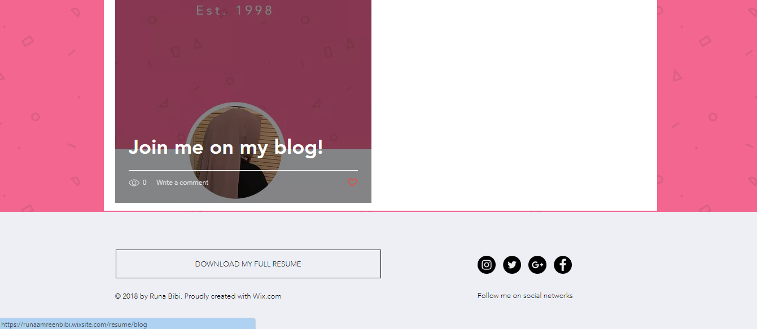
Blog

Slide 21
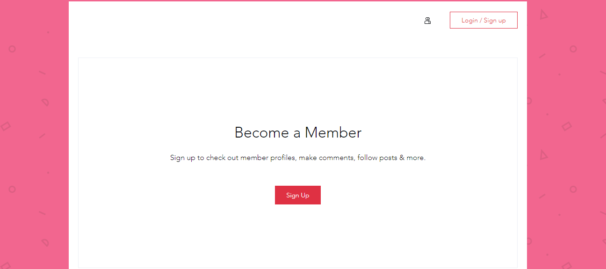
Members

Slide 22

Photo Gallery

Slide 23


Vlogs

Slide 24
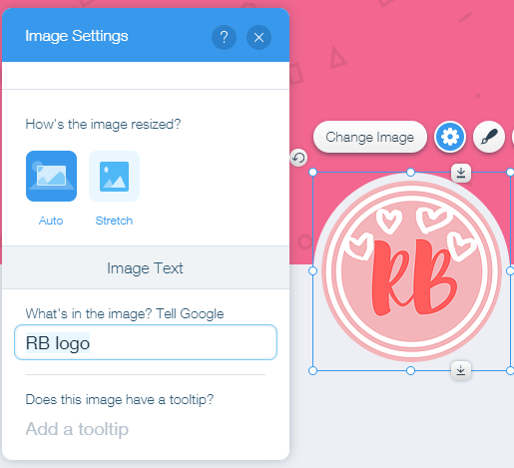
Added alt text to images

Slide 25
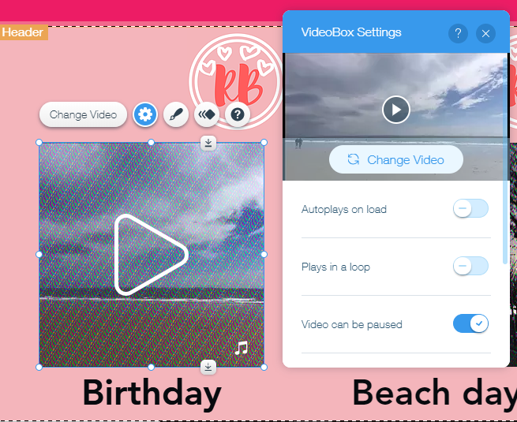
Disabled autoplay on videos

Slide 26
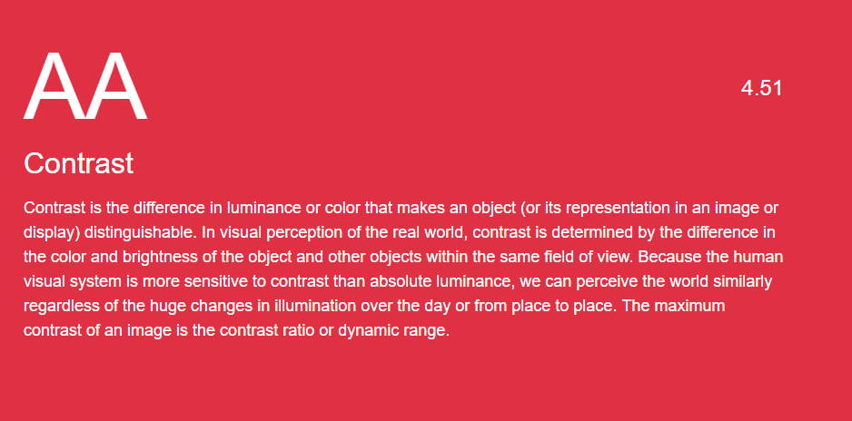
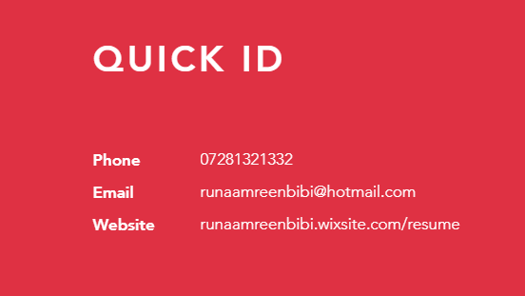
Made sure the contrast between the foreground and background was good
[34]

Slide 27
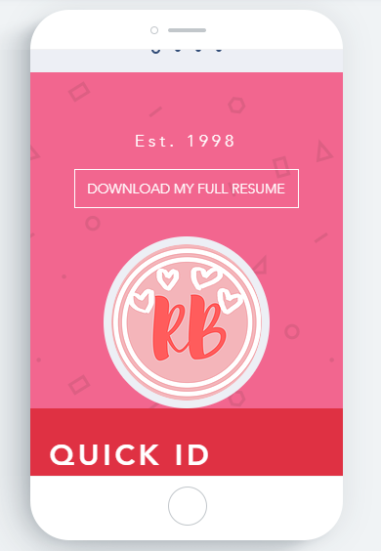
It also let me edit in mobile view

Slide 28

Used my own logo as a way of creating a distinctive brand

Slide 29
Online Marketing Options

Slide 30
SEO & SEM
SEO is Search Engine Optimisation [34]
It is a means of increasing the traffic to your website by organic search engine results [35]
You can implement SEO by making sure you publish good content, use metadata and alt tags [36]
Natural SEO will mean long term results as if you have quality content people will keep coming back to your site whereas if you pay for your SEO and one day stop paying, you will become invisible to users [37]
SEM (Search Engine Marketing) is a combined method of promoting a website using organic and paid search listings [38]

Slide 31
Google page ranking & content marketing
This is in reference to Google’s own organic search ranking which considers over 200 factors [39]
Content marketing is a way of marketing that focuses on creating quality content consistently to attract a “clearly defined audience” [40]

Slide 32
Link building & domain authority
This is a method of having other websites link back to your own [41]
Some ways you can strengthen your link is by posting contextual information, include social media marketing and build relationships with other websites [42]
Domain Authority predicts where a website will rank on several search engine result pages [43]

Slide 33
Google Analytics
This is a web analytics service that gives reports on statistic regarding SEO and marketing purposes [44]
It breaks down data into: Acquisition, Behaviour and Conversions [45]
Acquisition refers to how you receive website traffic, behaviour is what users do on your website and conversions shows where people go to after they enter your site [45]

Slide 34
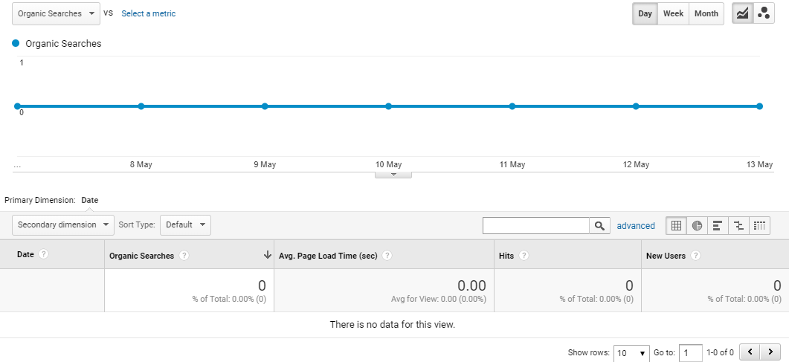
Example of Google Analytics using my website

Slide 35
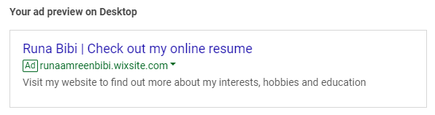
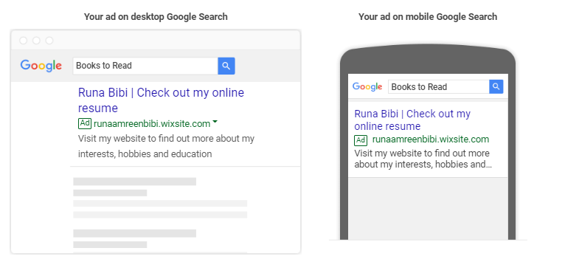
Example of Google Adwords using my website

Slide 36
Blog Platforms
There are many blog platforms available. Here are some ranked on criteria:
 | Wordpress.org | Wix | Tumblr | Ghost
User control | 5 | 4 | 4 | 3
Backup & Security | 3 | 4 | 3 | 3
Pricing | 4 | 3 | 5 | 2
Setup | 3 | 2 | 4 | 3
Extra features? | 4 | 3 | 4 | 2
Themes | 4 | 2 | 5 | 2
Good for beginners? | 4 | 4 | 5 | 2

Slide 37
Wix Blog
Wix also provides an in-built blog system as shown here:

Slide 38
Social Media Marketing
A social media business page allows you to increase website traffic, raise brand awareness, increase communication with audiences and create an identity for your brand [46]
You can also boost posts on social media to get them more noticed, this is shown on the next slide with Facebook.

Slide 39
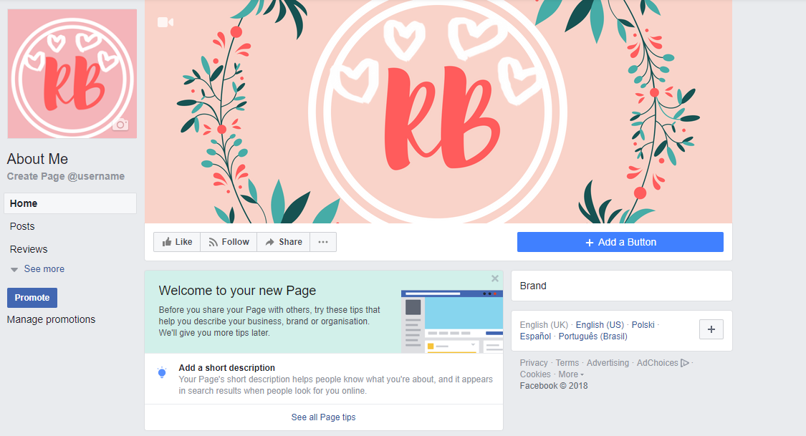
Business Facebook page

Slide 40
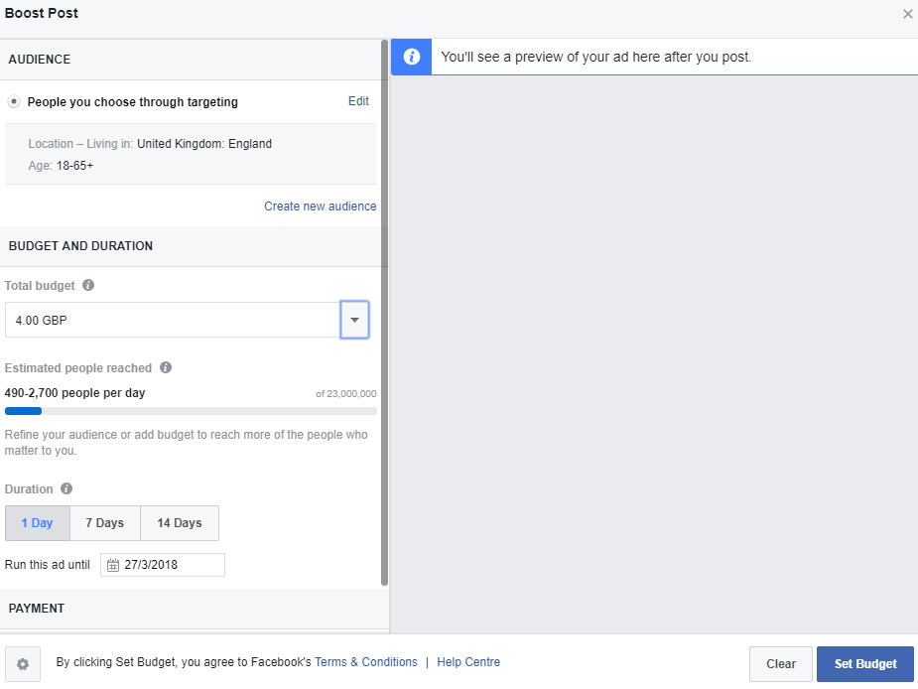
Boosting a post on Facebook

Slide 41
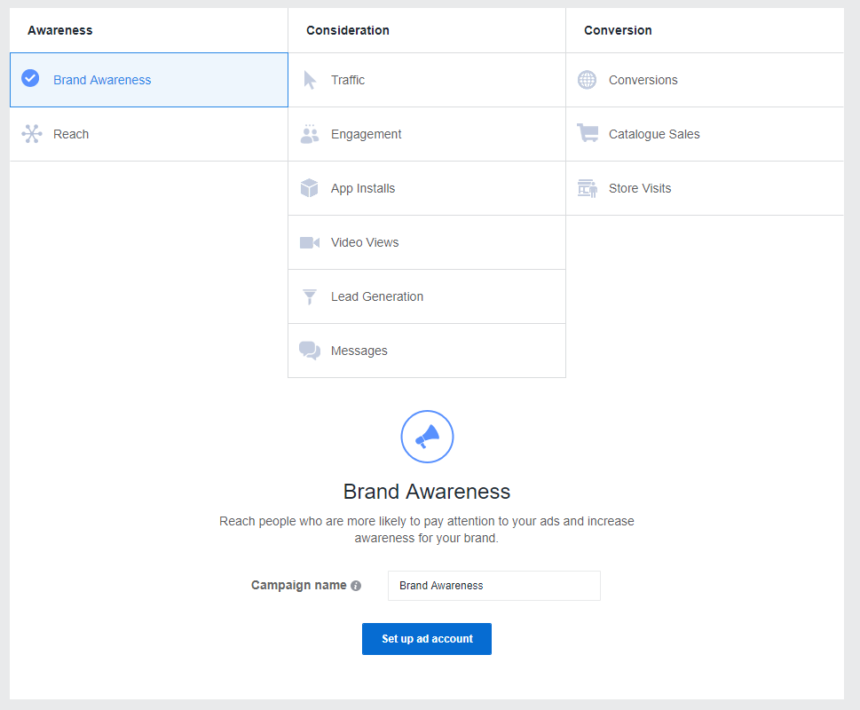
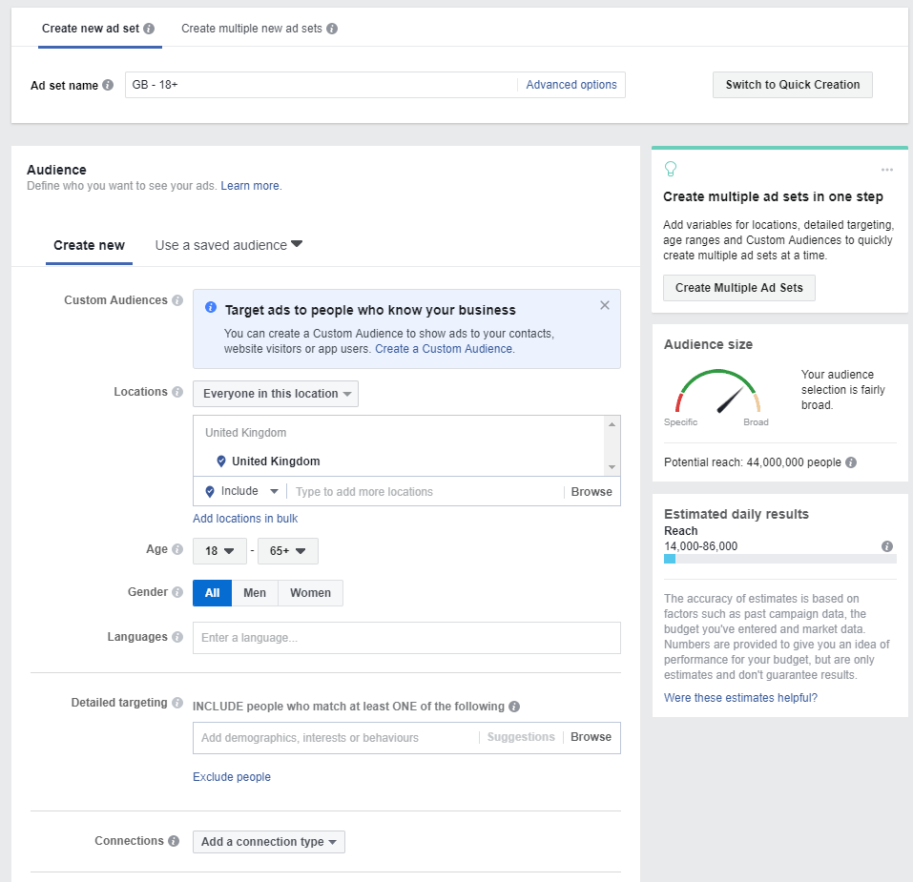
Ads on Facebook

Slide 42
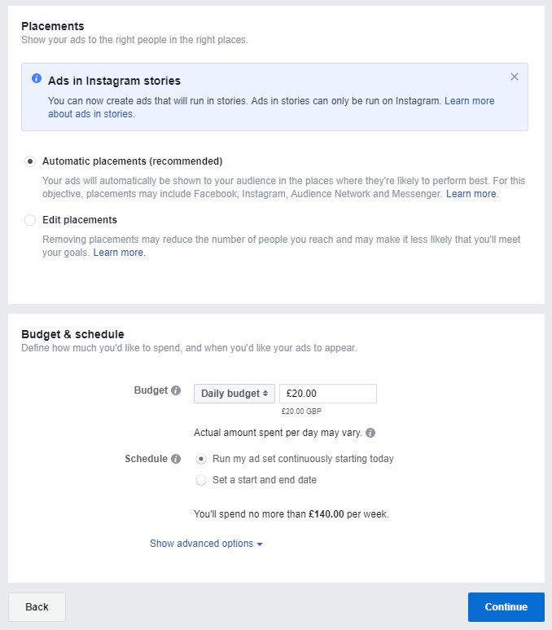
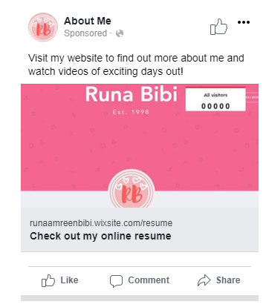
Ads on Facebook cont.

Slide 43
Social Media Management Software
These will allow you to manage several social media platforms in one place e.g. schedule posts and track analytics [47]
Some popular ones to use are: Hootsuite, Hubspot, Tweetdeck, Buffer and MeetEdgar [48]
I used Buffer to manage Facebook and Google+ posts using research on the best times to post on each.

Slide 44
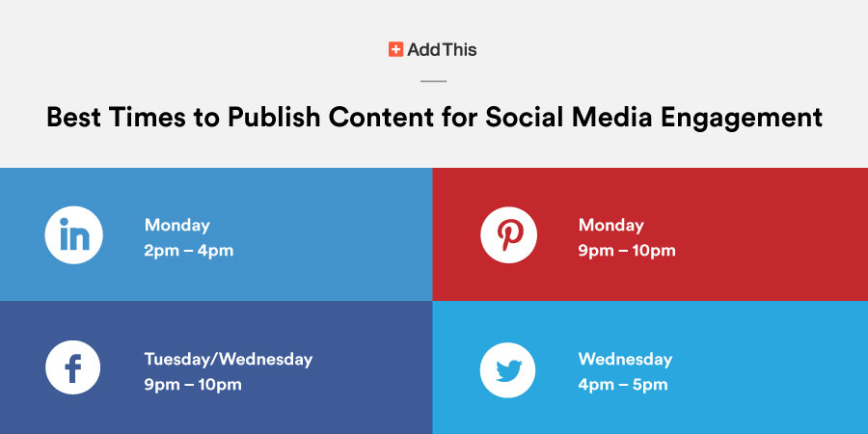
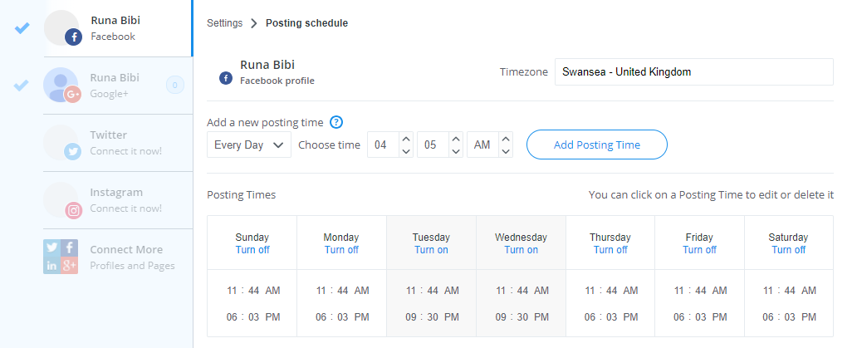
Social Media Management using Buffer
[49]

Slide 45
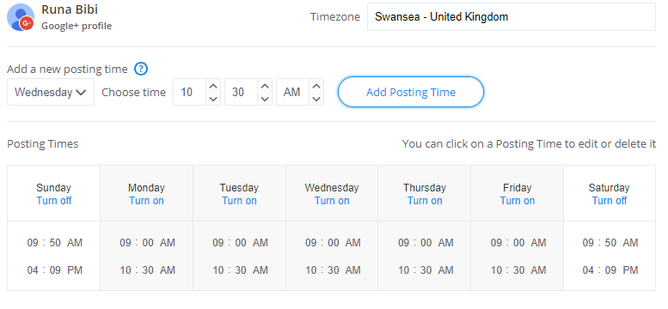
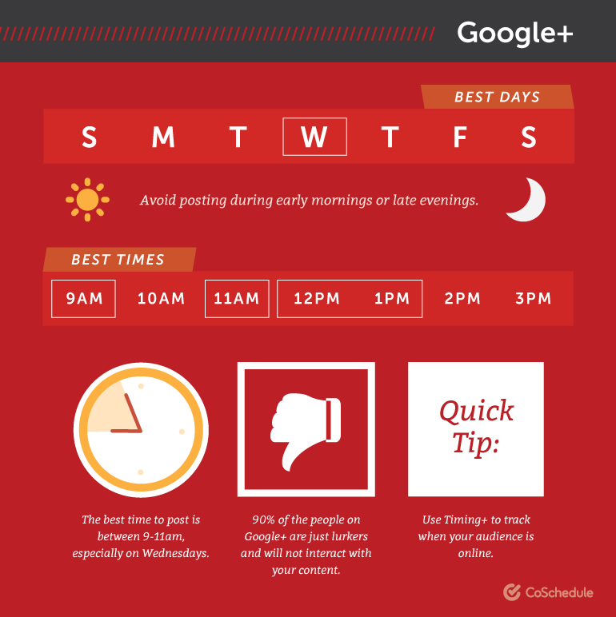
Social Media Management using Buffer
[50]

Slide 46
Email Marketing
Using email to promote a product or a service [51]
Some benefits of email marketing are: it’s very cheap, you can reach a large audience quickly, you can deliver messages targeted specifically for subscribers who meet a certain criteria and it’s easy to start up [52]
Some popular platforms to use are MailChimp, SendGrid and Constant Contact [53]
Some legal requirements for email marketing include: having permission to send the emails, state your email is an advertisement, include an opt-out and do not send misleading/false information [54]

Slide 47
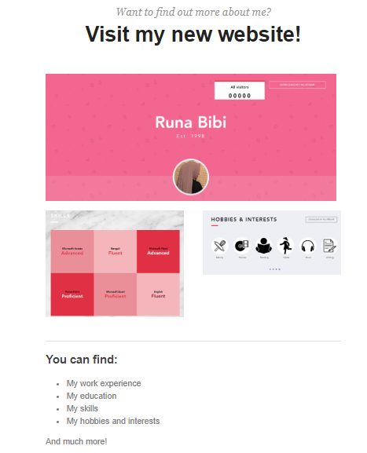
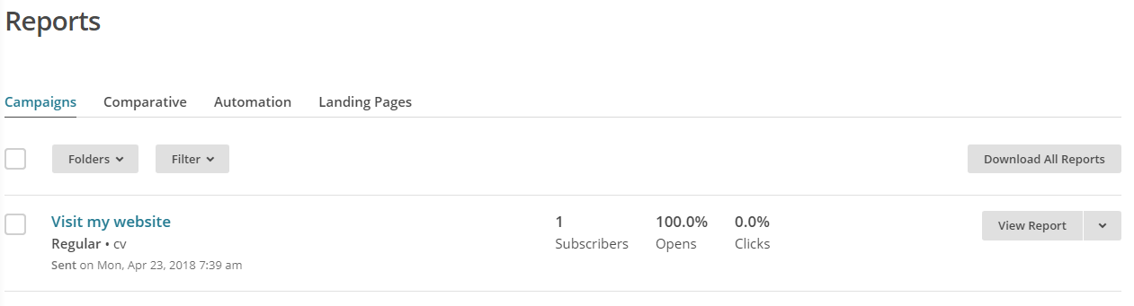
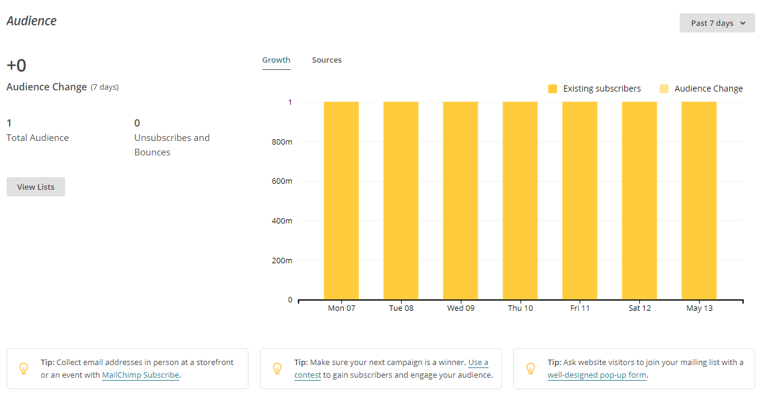
E-mail marketing using MailChimp

Slide 48
E-commerce options
Some options for e-commerce are Shopify, BigCommerce, Volusion and Magento [55]
I would choose Shopify for my brand as I have tested it before and it is easy to use and has many add-ons that help enhance your e-commerce platform.

Slide 49
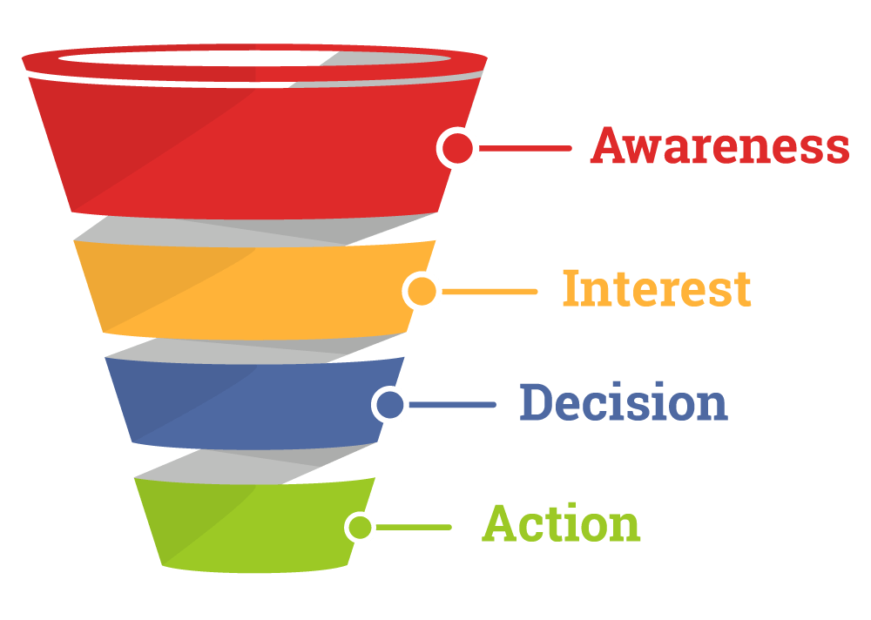
Sales Funnelling
This is the buying process customers go through when purchasing a product [56]
Awareness – People made aware
of the product [58]
Interest – People show interest in the
product [59]
Decision – You help the customer decide
why they should choose your product [59]
Action – The customer either decides to buy
or not buy your products [59]
[57]

Slide 50
Creating a Sales Funnel
There are several steps you can take to create a sales funnel:
Create a good landing page – This is the first impression user’s will get of your website [60]
Provide an opportunity for customers to buy your product [60]
Offer a chance to upscale that product or service [60]
Also offer a downsize option [60]

Slide 51
Click Funnel & Conversion Marketing
This is a platform which is used to create leads and increase “sales conversion” for your website [61]
Conversion marketing is when you change a visiting customer to a paying customer on your website [62]

Slide 52
Conclusions and Recommendations
In conclusion, for SMES I would recommend a free website builder to start with and to use an accessibility friendly template (available on Wix)
If you are experienced at coding, you could use hand coding or hire someone to custom build your website so it fully meets your needs (although this will take much longer and be more expensive)
Make sure to consider user accessibility and try to create a distinctive brand
To enhance the traffic to your website, use social media platforms and ads
Email marketing is also very popular right now for businesses, as 86% of people in business prefer using email to communicate [63] so choose an email marketing platform to distribute email campaigns and raise awareness for your brand/product

Slide 53
References
[1] Pinsent Masons, "Disabled access to websites under UK law," [Online]. Available: https://www.out-law.com/page-330. [Accessed 12 February 2018].
[2] T. Hornor, "What is Section 508?," [Online]. Available: https://www.sitepoint.com/designing-disabilities-section-508-international-accessibility-compliance-beginners/. [Accessed 12 February 2018].
[3] S. Abou-Zahra, "Accessibility Principles," [Online]. Available: https://www.w3.org/WAI/intro/people-use-web/principles. [Accessed 12 February 2018].
[4] W3C, "Web Content Accessibility Guidelines (WCAG) 2.0," [Online]. Available: https://www.w3.org/TR/WCAG20/. [Accessed February 12 2018].
[5] O. Revilla, "The four principles," 3 March 2010. [Online]. Available: http://www.oneguidelineaday.com/wcag-20/about-the-four-principles/. [Accessed 12 February 2018].
[6] D. Rømen and D. Svanæs, "Validating WCAG versions 1.0 and 2.0 through usability testing with disabled users," Universal Access in the Information Society, vol. 11, no. 4, p. 376, 2012.
[7] P. Brophy and J. Craven, "Web Accessibility," Library Trends, vol. 55, no. 4, p. 958, 2007.

Slide 54
[8] J. Nielsen, "10 Usability Heuristics for User Interface Design," 11 July 2013. [Online]. Available: https://www.designprinciplesftw.com/collections/10-usability-heuristics-for-user-interface-design. [Accessed 13 February 2018].
[9] J. Nielsen, "10 Usability Heuristics for User Interface Design," 5 January 1995. [Online]. Available: https://www.nngroup.com/articles/ten-usability-heuristics/. [Accessed 13 February 2018].
[10] D. Travis, "List of home page usability guidelines," [Online]. Available: https://www.userfocus.co.uk/resources/homepagechecklist.html. [Accessed 13 February 2018].
[11] HHS, "Standard and Usability Guidelines," [Online]. Available: https://webstandards.hhs.gov/guidelines/30. [Accessed 13 February 2018].
[12] SSW, "Rules to Better Interfaces (General Usability Practices)," [Online]. Available: https://rules.ssw.com.au/rules-to-better-interfaces-(general-usability-practices). [Accessed 13 April 2018].
[13] J. Sellers, "Your Brand Isn't Unique - But Is It Distinct?," [Online]. Available: https://blog.brandfolder.com/blog/your-brand-isnt-unique-but-is-it-distinct/. [Accessed 13 February 2018].
[14] J. Major, "Five tips for identifying and managing your brand assets," 5 September 2013. [Online]. Available: http://www.thedrum.com/opinion/2013/09/05/five-tips-identifying-and-managing-your-brand-assets. [Accessed 13 February 2018].

Slide 55
[15] How2BuildAWebsite, "5 Ways to Build a Website," [Online]. Available: http://how2buildawebsite.com/how-to-build-a-website/types-of-a-website/. [Accessed 13 February 2018].
[16] Erich, "Six Different Ways To Build a Website," 20 April 2016. [Online]. Available: https://allwebcodesign.com/alternative-to-web-builder-programs.htm. [Accessed 13 February 2018].
[17] Quackit, "2 Ways to Create Websites," [Online]. Available: https://www.quackit.com/create-a-website/2_ways_to_create_websites.cfm. [Accessed 13 February 2018].
[18] Website.com Solutions Inc, "What is website builder? How does website builder work?," [Online]. Available: https://www.website.com/website-builder-and-web-design/what-is-website-builder-how-does-website-builder-work. [Accessed 14 February 2018].
[19] A. Escalona, "The Pros and Cons of Using Website Builders," [Online]. Available: https://www.templatemonster.com/blog/pros-cons-using-website-builders/. [Accessed 14 February 2018].
[20] J. Douglas, "Pros and Cons of Free Website Builders," 21 October 2016. [Online]. Available: https://www.hostgator.com/blog/pros-cons-free-website-builders/. [Accessed 14 February 2018].
[21] Gerald, "Pros and Cons of Drag and Drop Website Builders," 9 February 2018. [Online]. Available: https://www.dragdropr.com/blog/pros-cons-drag-and-drop-website-builders/. [Accessed 14 February 2018].

Slide 56
[22] Simbla, "Pros and cons of Website Builders," [Online]. Available: https://www.simbla.com/pros_and_cons_of_website_builder. [Accessed 14 February 2018].
[23] Unidad22, "PROS & CONS OF TEMPLATE & CUSTOM WEBSITES USING WORDPRESS," [Online]. Available: https://unidad22.com/pros-cons-of-template-custom-websites-using-wordpress/. [Accessed 14 February 2018].
[24] Entheos, "Pros & Cons of Website Templates," [Online]. Available: https://www.entheosweb.com/website_design/website_templates.asp. [Accessed 14 February 2018].
[25] The Web Showroom, "Website Templates v Professional Web Design," [Online]. Available: https://www.thewebshowroom.com.au/website-templates-custom-web-design/. [Accessed 14 February 2018].
[26] M. Rouse, "content management system (CMS)," [Online]. Available: https://searchcontentmanagement.techtarget.com/definition/content-management-system-CMS. [Accessed 14 February 2018].
[27] S. Davis, "The pros and cons of using a CMS to build your website," 2017 May 24. [Online]. Available: https://flickerleap.com/pros-cons-using-cms-build-website/. [Accessed 14 February 2018].
[28] InformaticsInc, "The Pros and Cons of a WordPress Content Management System," September 2014. [Online]. Available: https://www.informaticsinc.com/Blog/20140911/198/The-Pros-and-Cons-of-a-WordPress-Content-Management-System.aspx. [Accessed 14 February 2018].
[29] Optimus01, "Content Management Systems (CMS) Pros And Cons," [Online]. Available: https://www.optimus01.co.za/content-management-systems-cms-pros-and-cons/. [Accessed 14 February 2018].

Slide 57
[30] Prime Design Solutions, "THE DIFFERENCE BETWEEN TEMPLATE AND CUSTOM-BUILT WEBSITES," 24 February 2014. [Online]. Available: https://www.primedesignsolutions.com/learning-center/difference-template-custom-built-websites/. [Accessed 14 February 2018].
[31] R. Ulrich, "TEMPLATES VS. CUSTOM BUILT WEBSITES," 11 January 2018. [Online]. Available: https://www.atilus.com/templates-vs-custom-built-websites/. [Accessed 14 February 2018].
[32] J. Weaver, "The 5 Biggest Benefits of Custom Website Development," [Online]. Available: https://www.deltaquestmedia.com/blog/benefits-custom-website-development. [Accessed 14 February 2018].
[33] N. Stamoulis, "Weighing the Pros and Cons of Custom Website Design," 11 September 2011. [Online]. Available: https://www.searchenginejournal.com/weighing-the-pros-and-cons-of-custom-website-design/32600/. [Accessed 14 February 2018].
[34] Search Engine Land, "What Is SEO / Search Engine Optimization?," [Online]. Available: https://searchengineland.com/guide/what-is-seo. [Accessed 15 February 2018].
[35] Moz, "What is SEO?," [Online]. Available: https://moz.com/learn/seo/what-is-seo. [Accessed 15 February 2018].
[36] M. Ross, "Best Practices: Search Engine Optimization and Usability," 4 April 2016. [Online]. Available: https://blogs.mtu.edu/webmaster/2016/04/best-practices-search-engine-optimization-and-usability/. [Accessed 15 February 2018].

Slide 58
[37] Zero Gravity Marketing, "NATURAL VS. ORGANIC SEO: WHAT’S THE DIFFERENCE?," [Online]. Available: https://zerogravitymarketing.com/natural-vs-organic-seo-whats-the-difference/. [Accessed 15 February 2018].
[38] BigCommerce, "What is SEM (Search Engine Marketing)?," [Online]. Available: https://www.bigcommerce.co.uk/ecommerce-answers/what-is-sem-search-engine-marketing/. [Accessed 15 February 2018].
[39] Quora, "What is "Google page ranking"?," [Online]. Available: https://www.quora.com/What-is-Google-page-ranking. [Accessed 15 February 2018].
[40] Content Marketing Institute, "What Is Content Marketing?," [Online]. Available: https://contentmarketinginstitute.com/what-is-content-marketing/. [Accessed 15 February 2018].
[41] WordStream, "Learn the Basics of Quality Link Building for SEO," [Online]. Available: https://www.wordstream.com/link-building. [Accessed 15 February 2018].
[42] V. Patel, "4 Ways to Successfully Link Build to Increase Website Traffic," 10 August 2015. [Online]. Available: https://www.entrepreneur.com/article/249358. [Accessed 15 February 2018].
[43] Moz, "Domain Authority," [Online]. Available: https://moz.com/learn/seo/domain-authority. [Accessed 15 February 2018].
[44] M. Rouse, "Google Analytics," [Online]. Available: https://searchbusinessanalytics.techtarget.com/definition/Google-Analytics. [Accessed 16 February 2018].

Slide 59
[45] N. Shivar, "What Does Google Analytics Do? And What Can I Do With Google Analytics?," 4 December 2016. [Online]. Available: https://www.shivarweb.com/2977/what-does-google-analytics-do/. [Accessed 16 February 2018].
[46] Wordstream, "Social Media Marketing for Businesses," [Online]. Available: https://www.wordstream.com/social-media-marketing. [Accessed 16 February 2018].
[47] M. de Cunha, "The 9 Best Free Social Media Management Tools in 2018," [Online]. Available: https://www.wordstream.com/blog/ws/2018/01/17/best-free-social-media-management-tools. [Accessed 16 February 2018].
[48] Forbes, "15 Social Media Management Tools That Can Help Your Business Thrive," 15 May 2017. [Online]. Available: https://www.forbes.com/sites/forbesagencycouncil/2017/05/15/15-social-media-management-tools-that-can-help-your-business-thrive/#65d407932b13. [Accessed 16 February 2018].
[49] G. Hwang, "Best Times to Publish Content for Social Media Engagement," 6 October 2015. [Online]. Available: http://www.addthis.com/blog/2015/10/06/best-times-to-publish-content-for-social-media-engagement/#.WrjdbijwaUk. [Accessed 16 February 2018].
[50] N. Ellering, "What 23 Studies Say About The Best Times To Post On Social Media," [Online]. Available: https://coschedule.com/blog/best-times-to-post-on-social-media/#google. [Accessed 16 February 2018].
[51] S. Ward, "What Is Email Marketing?," February 1 2018. [Online]. Available: https://www.thebalancesmb.com/email-marketing-2948346. [Accessed 16 February 2018].

Slide 60
[52] C. Wilson, "10 benefits of email marketing," [Online]. Available: https://www.pure360.com/10-benefits-of-email-marketing/. [Accessed 16 February 2018].
[53] J. Boitnott, "Five of the Best Email Marketing Platforms You'll Find in 2017," [Online]. Available: https://www.inc.com/john-boitnott/five-of-the-best-email-marketing-platforms-youll-find-in-2017.html. [Accessed 16 February 2018].
[54] Campaign Monitor, "Understanding Email Laws and Regulations," [Online]. Available: https://www.campaignmonitor.com/resources/guides/understanding-emails-laws-regulations/. [Accessed 16 February 2018].
[55] ipost parcels, "The ten best e-commerce platforms for small businesses," [Online]. Available: https://www.ipostparcels.com/resources/the-ten-best-ecommerce-platforms-for-small-businesses. [Accessed 16 February 2018].
[56] ringDNA, "What is a Sales Funnel?," [Online]. Available: https://www.ringdna.com/inside-sales-glossary/what-is-the-sales-funnel. [Accessed 16 February 2018].
[57] M. Zhel, "The Beginner’s Guide to a Sales Funnel," 19 July 2016. [Online]. Available: https://www.mailmunch.co/blog/sales-funnel/. [Accessed 16 February 2018].
[58] Ignite Visibility, "THE 5 STAGES OF THE SALES FUNNEL (AND THE TOOLS YOU SHOULD BE USING)," [Online]. Available: https://ignitevisibility.com/tools-using-every-stage-sales-funnel/. [Accessed 16 February 2018].

Slide 61
[59] DMG Online Marketing, "Sales Funnel – Four Key Areas," [Online]. Available: http://dmgonlinemarketing.com/sales-funnel/. [Accessed 16 February 2018].
[60] B. Horn Ainsley, "5 Steps to Building Your First Online Sales Funnel," 15 December 2015. [Online]. Available: https://www.entrepreneur.com/article/245730. [Accessed 16 February 2018].
[61] BareNakedScam, "What is Click Funnels? – Is it worth it?," [Online]. Available: https://barenakedscam.com/click-funnels. [Accessed 17 February 2018].
[62] V. Beal, "conversion marketing," [Online]. Available: https://www.webopedia.com/TERM/C/conversion_marketing.html. [Accessed 17 February 2018].
[63] A. Finn, "35 Face-Melting Email Marketing Stats for 2018," [Online]. [Accessed 18 February 2018].

