Slide 1
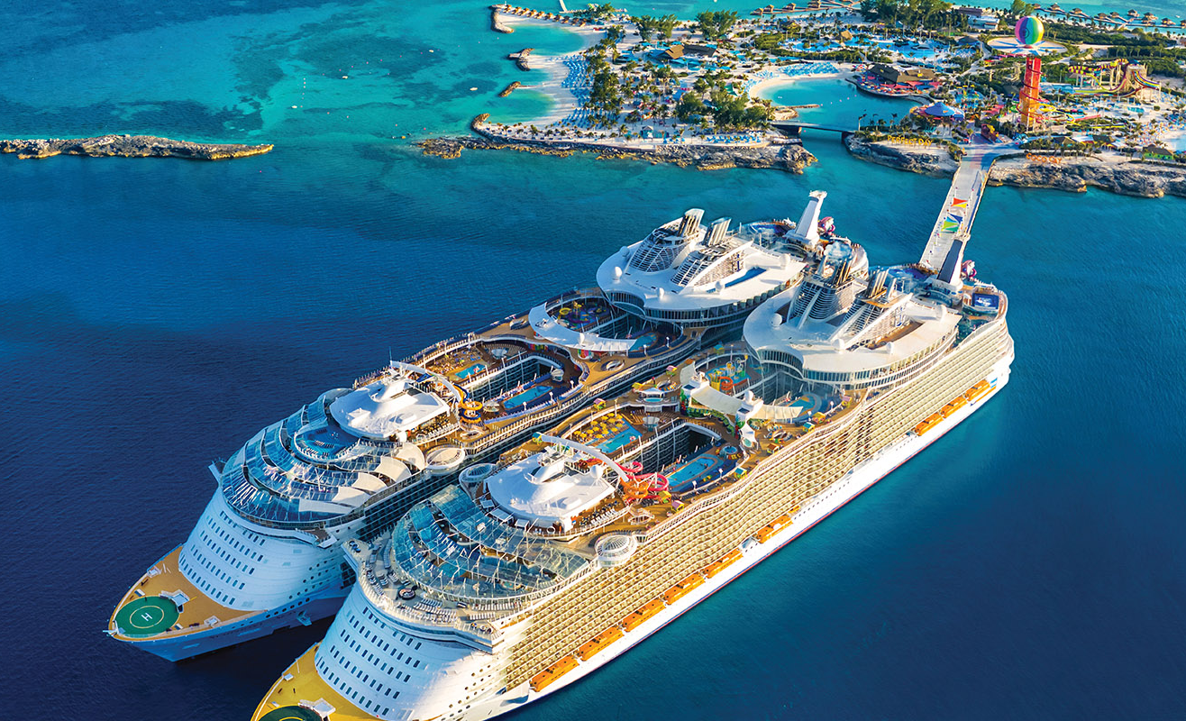


Royal Caribbean
international
Digital skills and research methods
(BMSW4003_LON)

Slide 2

LECTURE : BALENDRAN KANDASEMY
group
Member´s
Corina tugulschii
2121528
Vitalii tugulschii
1906242
Corina maria
2112064
Mihail pecica
2124360
Ermelindo Pereira
2124215

Slide 3
Table of contents
Background of the organisation
Royal Caribbean international and the Early history
Future Vision
01
CHALLENGES BEFORE THE MODERN TECHNOLOGY
Organisation challenges
Progress
02
INSIGHTS TO THE MODERN TECHNOLOGY INTRODUCED
Introducing the Voom internet
How does the Voom internet work?
03
04
THE IMPACT OF THE TECHNOLOGY INTRODUCED
Positives impacts of Voom internet
5 ways royal Caribbean´s app changes cruising
Lessons from the case study
Challenges faced and Solutions
Results
05
Notes:
© Copyright TechEnfim

Slide 4
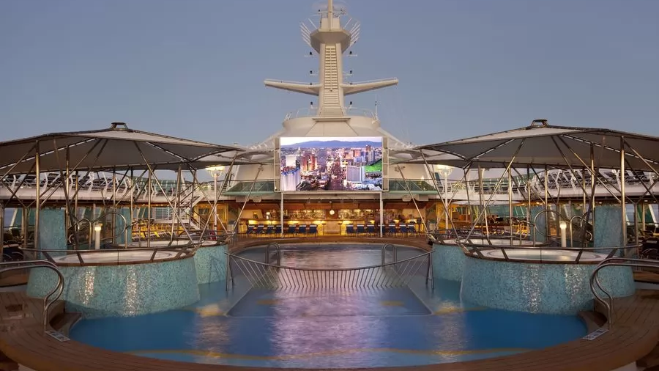
Background
of the organisation
Student
Corina tugulschii
2121528

Slide 5
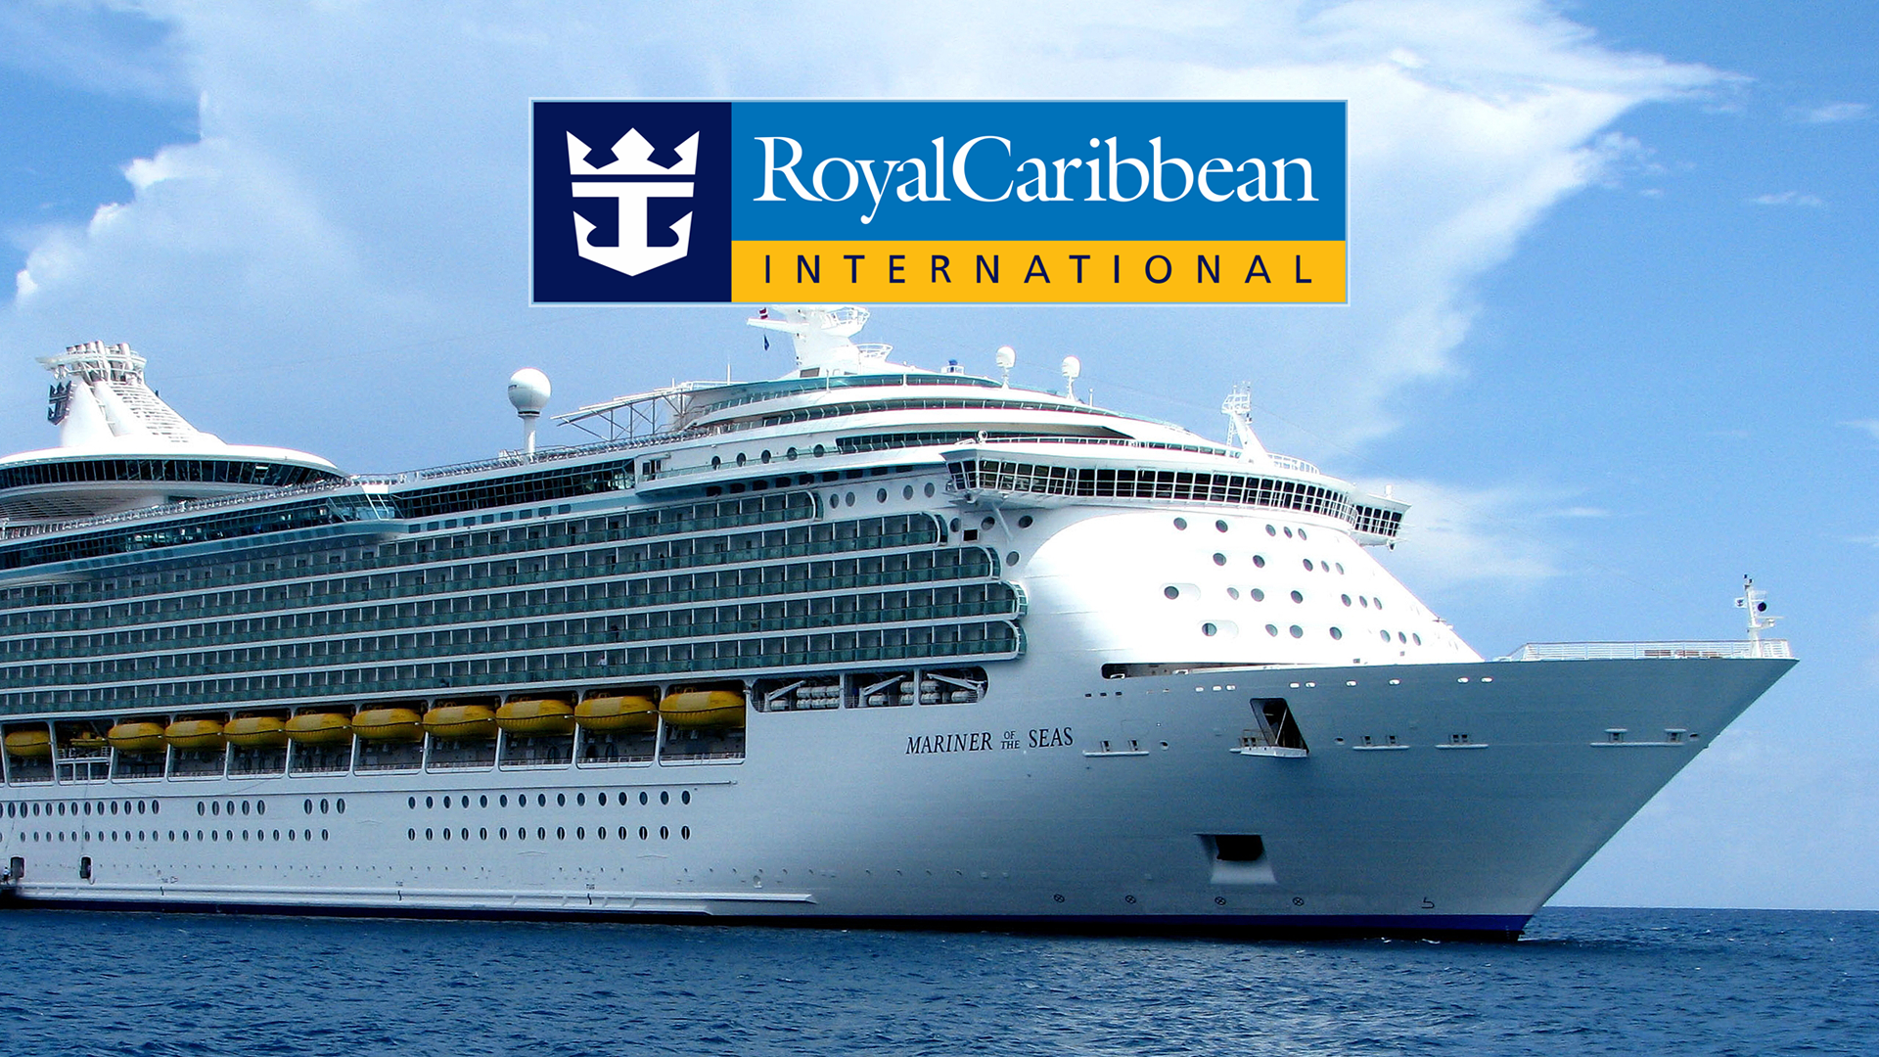
Royal Caribbean international
Royal Caribbean Cruises is a leisure cruise company
(Comyn-Watteau et al.2016,p55)
Aiming at being competitive in the luxury leisure business
(Comyn-Watteau et al.2016,p55)
Over 41 ships , carry 5000 passenger,300 destinations
(Benckendorff, Sheldon and Fesenmaier, 2014, p. 221)
STUDENT: Corina tugulschii
2121528

Slide 6

Early history
Was Established in 1968
(Quelch, 2016, p.55)
In 1970 – launched first cruise line
Royal Caribbean has built their own brand
Student: Corina tugulschii
2121528

Slide 7

Future vision
Empower and enable their employees
Deliver best vacation experience to guests
Generating superior returns to their stakeholders
Enhancing the wellbeing of communities
Student:Corina tugulschii
2121528
(Quelch,2016,p.56).

Slide 8
CHALLENGES
BEFORE
THE MODERN TECHNOLOGY
Student
Vitalii tugulschii
1906242

Slide 9



Organisation challenges
Voyager cruise
RCI (Press Kits, n.d).
Check-in in time
difficulty to supervise the staff
Student:Vitalii tugulschii
1906242

Slide 10



progress
Internet on board
(Sloan, 2021)
Improvement of Comunication
New technology
Student:Vitalii tugulschii
1906242

Slide 11

INSIGHTS
TO THE MODERN
TECHNOLOGY INTRODUCED
Student:
Corina maria
2112064

Slide 12
Introducing voom
“
Voom is a high- speed internet service that claims to be The fastest on The sea.
(SES S.A, 2022)

Slide 13

How Does The
Voom internet
Work ????
Passengers may communicate with their friends and family all around The world
Using a distinct type of satellite technology
Connectivity from almost anywhere onboard.
Communication signals to ships in the middle of the ocean
Student:Corina maria
2112064
(SES S.A, 2022)

Slide 14
Inside internet voom
Two WiFi packages: Surf and Surf & Stream
Guests can use as many devices as they wish with Voom packages
"Surf" is a decent option for minimal requirements
"Surf and Stream" is The quicker option
Student:Corina maria
2112064
(Royal caribbeanblog, 2021)
TÍTULO AQUI

Slide 15
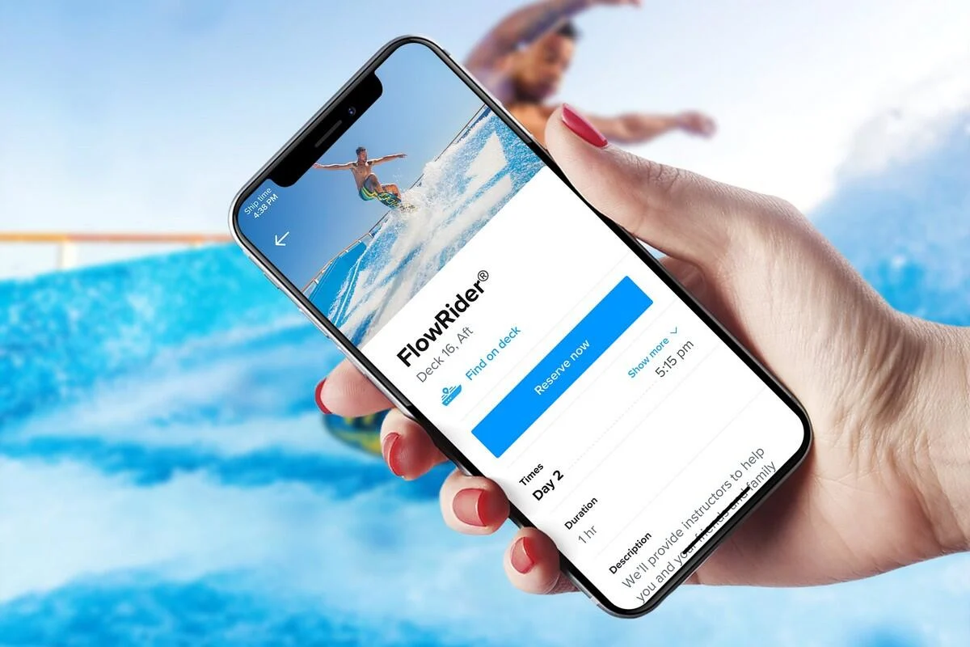
THE IMPACT
OF THE TECHNOLOGY
INTRODUCED
Student:
Mihail Pecica
2124360

Slide 16





high-speed in your hands
Working/studyng online
positive
stay connected And share The joy
Impact of VOOM internet
Book your cruises
Less people on duties
Student:Mihail Pecica
2124360
(Voom, n.d)

Slide 17
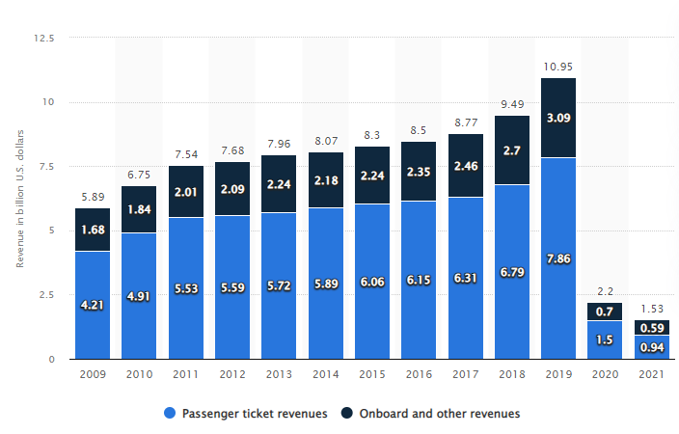
REVENUE OF ROYAL CARIBBEAN (IN BILLIONUS.DOLLARS)
In 2020 and 2021 decline due to Coronavirus
In 2021 tickets generated 12% of revenue from 2019
Student:Mihail Pecica
2124360
(Statista, n.d.)

Slide 18

t
M
g
m
j

Slide 19





Daily planning
Check- in
Enhanced features and scheduled arrival
Digital key and stateroom controls
Reinvented safety briefing
On board account
Student:Mihail pecica
2124360
(Royal caribbean international, 2022)
Notes:
© Copyright TechEnfim

Slide 20
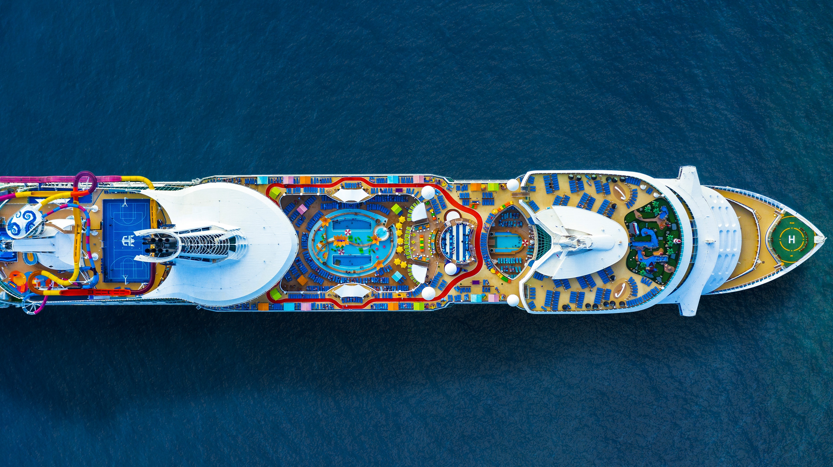
LESSONS
FROM THE CASE
STUDY
Student:
Ermelindo Pereira
2124215

Slide 21
Challenges faced
Increase their incomes
Avoid lines
Deal with covid-19
i.
Attract young passengers
Improve experience on board
Student: Ermelindo Pereira
2124215

Slide 22
solutions
Internet on board
introducing new experiences on board
Introducing the technology
Check- in
Student:Ermelindo Pereira
2124215
Globaldata, 2022)

Slide 23
results
best onboard customer experience
more younger passengers
Higher financial income
03
01
02
Increase in customers
Work ; Family; Friends
Connection with social media
Student:Ermelindo Pereira
2124215
(Globaldata, 2022)

Slide 24
References
Anon, (2021). Royal Caribbean app walkthrough and tips - TOP TRAVEL LINK. [online] Available at: https://toptravellink.com/royal-caribbean-app-walkthrough-and-tips/ [Accessed 2 Apr. 2022].
benckendorff, P.J., Sheldon, P.J. and Resenmaier, D.R. (2014) Tourism Information Technology. 2nd ed. Wallingford, UK: CABI
Comyn- Watteau, I.et.al (2016) conceptual Modeling. Japan: SPRINGER
Globaldata, 2022. Globaldata. [Online]
Available at: https://store.globaldata.com/report/case-study-royal-caribbean-using-technology-to-provide-an-immersive-guest-experience-in-the-cruise-industry/#tab-key-players
[Accessed 02 April 2022].
Quelch, J.A (2016) Consumers, Corporations, and Public Health. New York: Oxford University Press.
Royal Caribbean International (n.d) Press Kits. Available at: https://www.royalcaribbeanpresscenter.com/press-kit/91/innovation-ingenuity-and-adventure-are-part-of-the-dna-of-royal-caribbean-international/ (Accessed: 25 March 2022)

Slide 25
References
Royal caribbeanblog, 2021. Royal caribbeanblog. [Online]
Available at: https://www.royalcaribbeanblog.com/2021/05/04/what-the-difference-between-royal-caribbeans-voom-surf-and-voom-surf-and-stream
[Accessed 01 April 2022]
Royal Caribbean international, 2022. Royal Caribbean SEAVIEWS. [Online]
Available at: https://www.royalcaribbean.com/blog/5-ways-royal-caribbeans-app-changes-cruising/
[Accessed 02 April 2022]
SES S.A, 2022. SES. [Online]
Available at: https://www.ses.com/blog/behind-scenes-royal-caribbean-cruise-lines-fastest-internet-sea
[Accessed 01 April 2022].
Statista. (n.d.). Royal Caribbean Cruises: revenue by segment 2021. [online] Available at: https://www.statista.com/statistics/224272/royal-caribbean-cruises-revenue-by-segment/ [Accessed 6 Apr. 2022].
Sloan G. (2021)’ Is the Voom internet on Royal Caribbean cruise ships’,Thepointsguy.co.uk, 23 June. Available at: https://thepointsguy.co.uk/guide/royal-caribbean-cruise-voom-internet-speed-test/ (Accessed: 20 March 2022).
Voom. (n.d.). Fastest Cruise Wi-Fi and Internet at Sea: Voom | Royal Caribbean Cruises. [online] Available at: https://www.royalcaribbean.com/gbr/en/booked/cruise-ship-wifi?country=GBR [Accessed 28 Mar. 2022].

Slide 26

Thank you!!!

