Slide 1

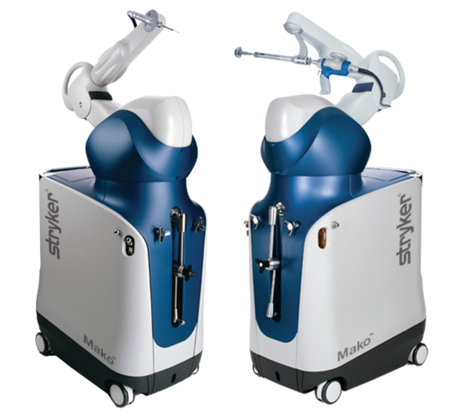
Digital skills and research methods
PRESENTATION- MAKO ARM ASSISTED TECHNOLOGY
10-12-2020
Lecturer : Modak Koushik
University of Wales Trinity Saint David

Slide 2
Made by
Name Student ID Topic
Bozica Katic 2008115 -Introduction and
-Background of the organisation
Rahela Rebeca Vasilciuc 2014050 -Challenges before introducing modern
technology and
-Conclusion
Madona Igdinoba 1815861 - Insights of modern technology
Oana Palacean. 2013436. - Impacts of modern technology
Simeon Eze Duku Nnorm 2010851 - Lessons drawn from the case study
Digital Skills and Research Methods
University of Wales Trinity Saint David

Slide 3
Contents
- Introduction
Background of the organisation
Challenges before introducing modern technology
Insights of modern technology
Impact of modern technology
Lessons drawn from the case study
Conclusion

Slide 4

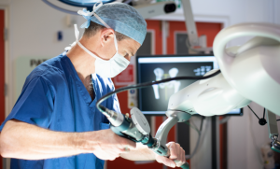
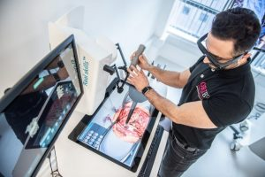
INTRODUCTION
Use of modern technology
ROBOTIC TECHNOLOGY
3D TECHNOLOGY

Slide 5
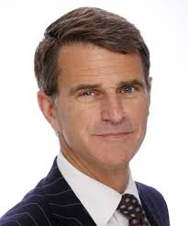

Background of the organisation
Non- profit organisation
Led by Professor Rob Middleton
Established: October 2015. (Becker’s Spine, 2020)
Funded by

Slide 6
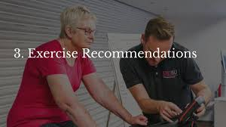
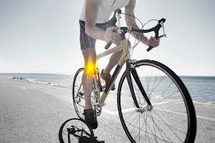
CURRENT STATUS AND SERVICE
1 of 3 in UK and 1 of 23 in-world (Dorset lep)

Slide 7
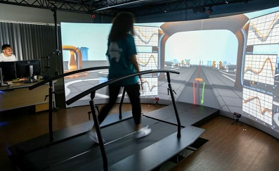
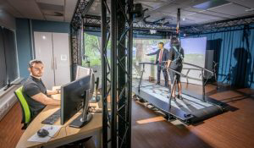
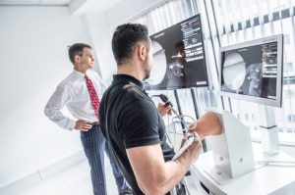
Monitoring the improvement of recovery for patients after surgery: GRAIL
Testing of modern technology devices
Provide training in Virtual Reality Environment (VRE)
•Virtual reality arthroscopy (VRE for Hipp arthroscopy training) - only one in the world
(Dorset lep,2016)
•Simulator K (VRE for total knee replecement) – first centre in EU (Dorset lep,2016)

Slide 8
OBJECTIVES
In the next few years, it will allow all people to use mako robotic technology during surgery
MISSION AND VISION
Produce high quality researched outcomes
Stay world-class research institute with new, innovation ideas!

Slide 9

Challenges
Rahela Rebeca Vasilciuc
( Mako clinical evidence ,2018, volume 5)
Need for more opiate analgesics
More time in hospital discharge
More need for in-patient physical
therapy sessions
And more postoperative pain
Blood loss

Slide 10

Insights of modern technology
Madona Igdinoba
Research aim
To understand how Mako medical laboratory achieved it’s goals.

Slide 11

Mako medical aims
-To use state of art
-Medical and IT equipment to facilitate
-Establish proven results

Slide 12

Scientific and Medical objectives
-Saving lives
-Investing to make most significant changes
-Professional analytics and diagnostic

Slide 13

General Insight
Medical expertise
Provide client based atmosphere
Adequate training atmosphere for personal development (for workers)
Workers to be equipped and tech-compliant

Slide 14

Personal input
Mako can detect
Overgrowth of tissues (Sclerosis)
Disease of the brain
Allergies
Autoimmune sicknesses , ex , Diabetes Mellitus and Rheumatoid arthritis

Slide 15

Impacts (Pros and Cons)
Oana a Palacean
Personalised surgical plan
Prosthesis is individually optimised ( more precise)
Healing time shorter
Less chance of implant failure
Safety is improved
Blood loss reduced
(Dounchis J. ;(2020))

Slide 16

Surgical time longer
Any computerised system is only as good as the information that is input in.
It’s a new technology
(Dounchis J,2020)

Slide 17
Lessons draw from the case of study
Before we proceed to lessons drawn or learnt from the case study,
first we need to know who founded the organisation and in what year.Mako Robotic ( Arms and Knees) Surgery Technology was founded by " Rony Abovitz", in the year 2004.Mako Traditional technology was mainly on Arms & knees replacement which was less affordable and with much pain on the patients while on Modern technology ( Robotic Arms & Knees) replacement is more affordable with less pain and faster healing when inserted. With Modern Technology for Mako organisation, there is rooms Continuous Research and Innovation. With Modern technology, Mako can meet up demands of it's customers or Clients While with Traditional Technology, it won't be able to meet up with it's customers or clients demand.
Simeon Eze Duru Nnorm

Slide 18

Conclusion
In Mako’s case , we proceed to observe and learn that it’s a very effective way to fix yourself . True, the surgery has a longer limit than an usual hip or knee replacement surgery, (Suarez-Ahedd;2020)but its more precise and effective . We learned that whoever is doing this surgery will heal faster, will regain their strength faster and they don’t need too many physical sessions to walk again . It’s a miracle technology .
(Illgen R. ROBOTIC ASSISTED THA (2018) )

Slide 19
References
national MadeatUni campaign, Available at: http://www.beckersspine.com/orthopedic (Accessed: 17. November 2020)
Tamezzina Ellis ,( 2020) Head of the business development, online , available at: ://www.manchesterhipandknee.com/pdfs/outcomes-mako-total-knee-replacements.pdf
https://www.stryker.com/us/en/joint-replacement/systems/Mako_SmartRobotics_Overview.html#know-more
Becker’s Spine, (2020) England university orthopedic research institute featured in national MadeatUni campaign.Available at: http://www.beckersspine.com/orthopedic (Accessed: 17. November 2020).
2.Dorset lep, (2016) Bournemouth university’s orthopaedic research institute unveils world-class laboratory andequipment. Available at: https://www.dorsetlep.co.uk (Accessed: 07. December 2020)
Mako clinical evidence,(2018) Volume 5 . Mako total hip arthoplasty . Online Available at: https://www.manchesterhipsurgeons.co.uk/pdfs/outcomes-mako-total-hip-replacements.pdf

