Slide 1
Boethius
‘Last of the Romans, first of the Scholastics’
-Lorenzo Valla

Slide 2
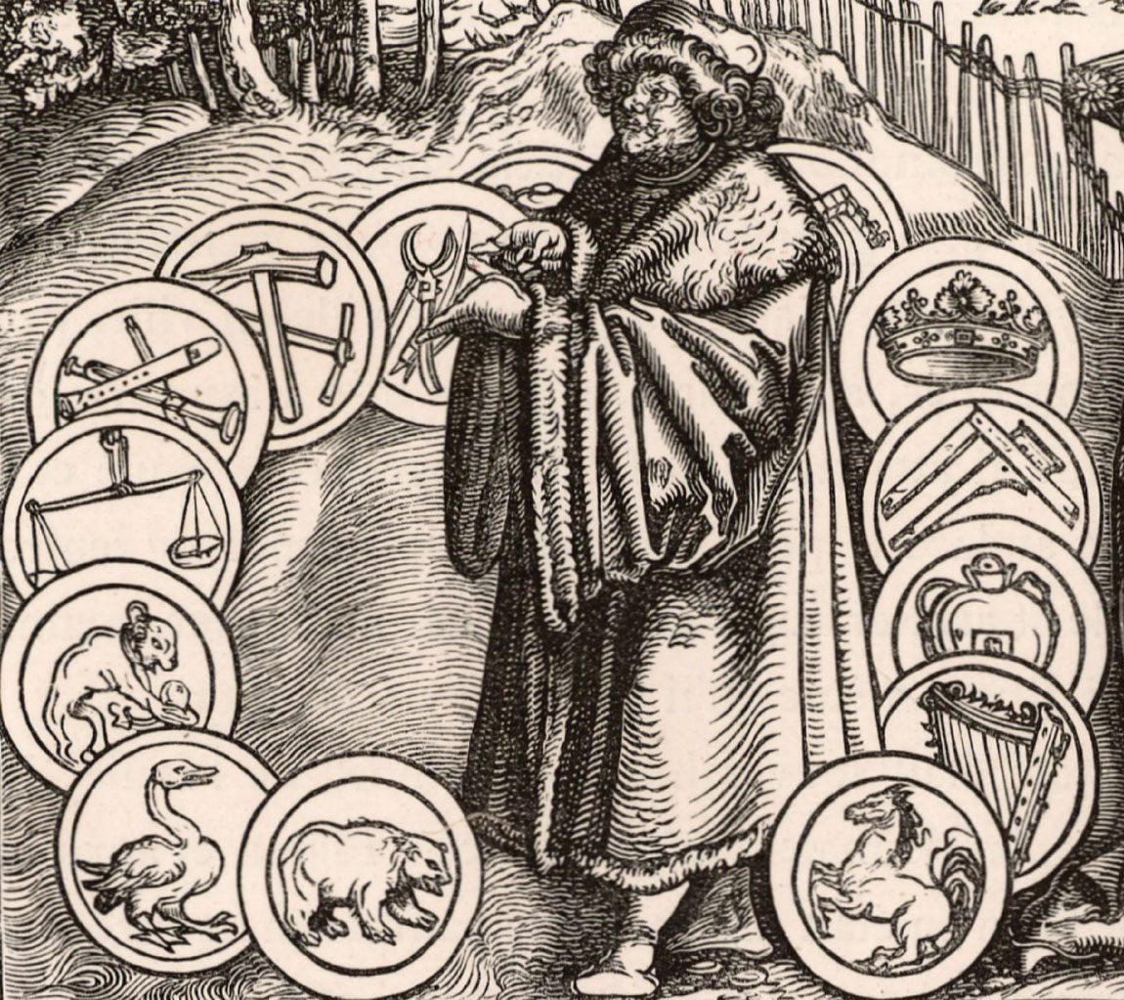
Biography
The exact date of Boethius’ birth is unknown, but scholars place it around 480CE, coinciding with the deposition of the last Western Roman Emperor. He was born to a wealthy and influential Roman patristic family, with his father being a consul.¹
When his father died, he was adopted into an even more wealthy and influential family by Symmachus who instilled in him a great love of literature and philosophy.
Boethius’ intellectual talents were noticed by King Theodoric of Ostrogoth Italy and entered his service at a young age, becoming a senator by 25 which was an impressive feat. ²
Boethius, woodcut, 1537.
https://www.britannica.com/biography/Anicius-Manlius-Severinus-Boethius/images-videos#/media/1/71328/123053

Slide 3
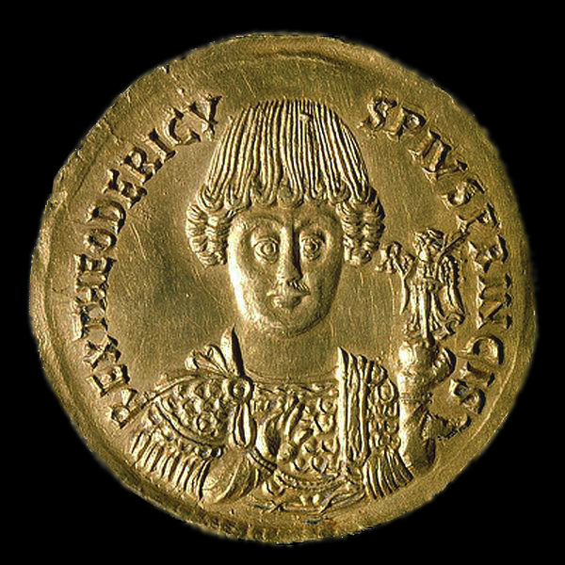
Biography
Boethius’ career under King Theodoric was hugely successful and brought him great wealth, honour, and distinction. In 510CE Boethius was made Consul and in 522, both of his sons were made joint consuls; which Boethius took great pride in. He likened being sat between both of his sons in the senate as like winning a great military triumph. (Consolation of Philosophy 2.3 8)
Boethius found himself as one of the most respected men in Rome, possibly becoming its prefect along with Symmachus after his tenure as consul. ²
His learnedness proved useful to Theodoric, who sometimes gave him small tasks such as constructing a water clock for the King of the Franks, to investigate his captain of the guard on an alleged fraud case and to aid in the reconciliation between the many religious controversies of the time.
Medallion (or coin) featuring Theodoric, c. CE 491–501
https://commons.wikimedia.org/wiki/File:Teodorico_re_dei_Goti_(493-526).png

Slide 4
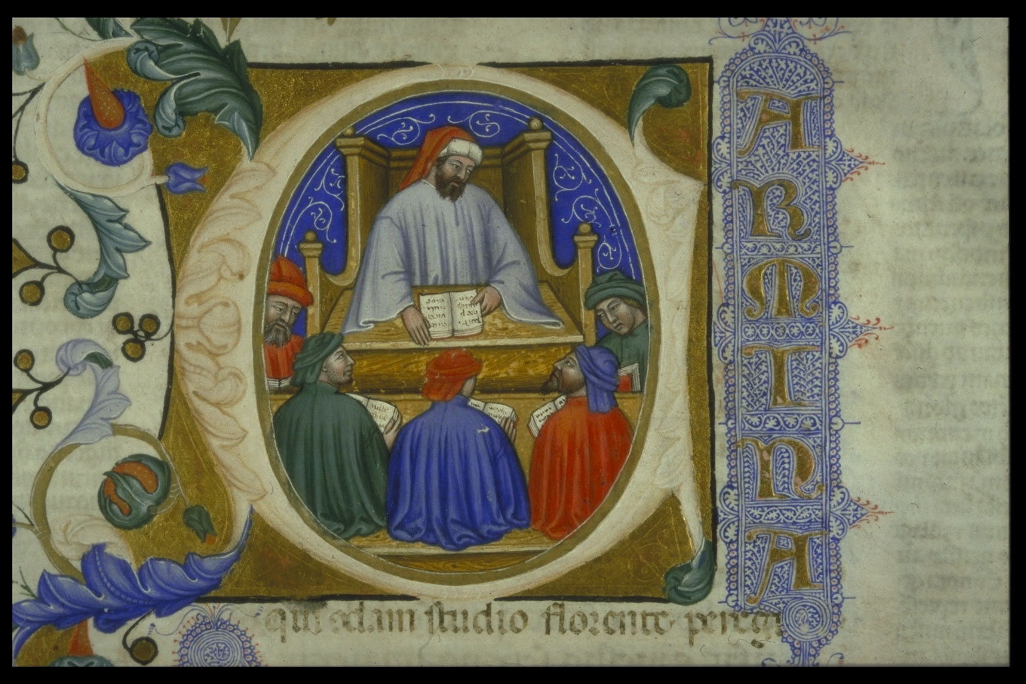
Biography
The Ostrogothic Kingdom of Italy was split into two capitals. The city of Rome had been diminishing for a long time and so King Theodoric shifted all administrative and important roles to the town of Ravenna and used Rome as a ceremonial and leisure capital. The Roman institutions of government, like the Senate, still stood but had lost all its potency.
Boethius’ residence in Rome meant that he could dedicate most of his time into scholarly and philosophical works, away from Ravenna where would have to live a more political life.
The breadth and depth of these works are a testament to Boethius’ education and would prove to be foundational and essential to Latin Medieval scholasticism.
He wrote works ranging from theological treatises, music, mathematics, philosophy and a whole host of commentaries on the many ancient texts he translated into Latin which would serve as some of the only surviving copies available to later scholars.
Boethius teaching his students, from a manuscript of the Consolation of Philosophy,1385. https://www.gla.ac.uk/myglasgow/library/files/special/exhibns/treasures/boethius.html

Slide 5
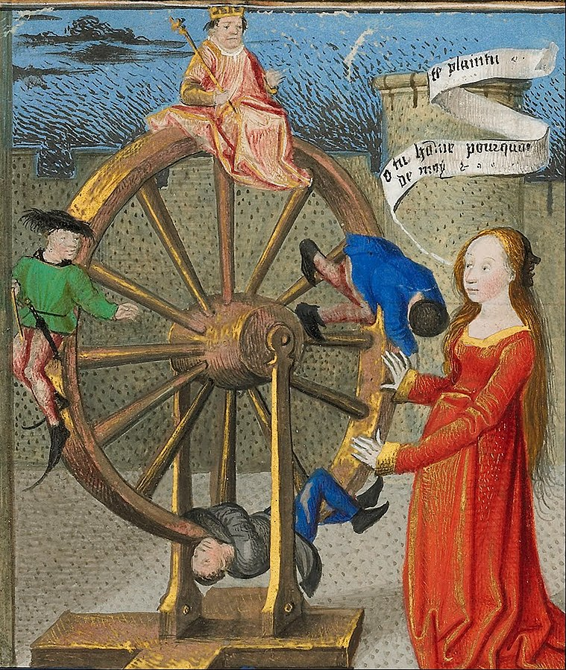
Biography
In 522, the year of his two sons’ consulships, Boethius moves to Ravenna and takes up the position of ‘Master of Offices’ which makes him the intermediary between King Theodoric and his court officials. Boethius, now had very real influence in Ostrogothic politics.
Boethius’ personality of standing up for the oppressed and challenging of corruption quickly led to his swift downfall.
In his Consolation of Philosophy, he writes: ‘I have devoted myself to no political office without having the common interests of all good men at heart. As a result, harsh and implacable dissensions arose with men of no principle.’(Consolation of Philosophy 1.4 8-9)
His life as a learned and principled man of leisure in Rome worked to his detriment in the increasingly tense and corrupt climate of the Ostrogothic court.
Fortune turning the wheel of fate, as seen in his Consolation of Philosophy. Boethius had to rise to the top to be brought down to the bottom. https://commons.wikimedia.org/wiki/File:Co%C3%ABtivy_Master_(Henri_de_Vulcop%3F)_(French,_active_about_1450_-_1485)_-_Philosophy_Consoling_Boethius_and_Fortune_Turning_the_Wheel_-_Google_Art_Project.jpg

Slide 6
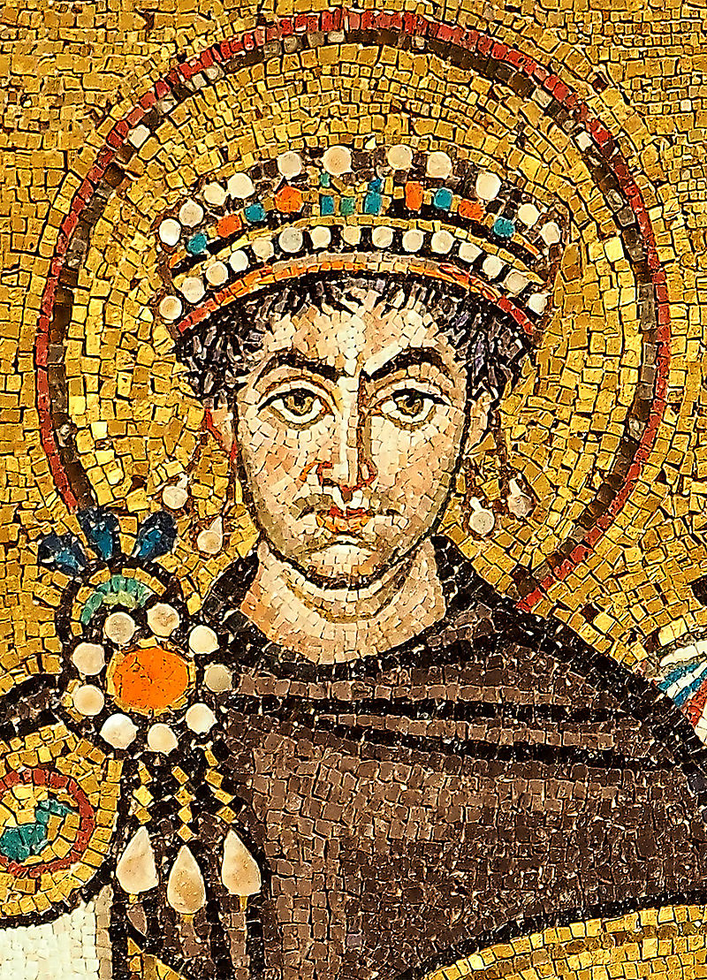
Biography
Boethius’ power and respectability at the time was almost directly linked to that of Theodoric’s. In the East, the strength of the Eastern Roman Empire started to grow, and with renewed persecutions against Arianism, the Arian king Theodoric started to grow increasingly paranoid of his Catholic Roman subjects as they could seek to supplant him with emperor Justinian.
Boethius’ troubles came to a head with the accusation by a senator against Senator Albinus of sending treasonous letters to people in Constantinople who were close to emperor Justinian. Boethius stood and defended this senator but was then himself accused of writing letters in which he dreamt of ‘Roman freedom’. In addition, he was accused of suppressing evidence against Albinus as well as the practicing of magic. Boethius, who saw his actions as defending the Senate, was judged by them and found guilty. This forms the basis for much of the Consolation of Philosophy as he tries to reason why good deeds are often punished.
Mosaic depicting a crowned Justinian, Ravenna. https://en.wikipedia.org/wiki/Justinian_I#/media/File:Mosaic_of_Justinianus_I_-_Basilica_San_Vitale_(Ravenna).jpg

Slide 7
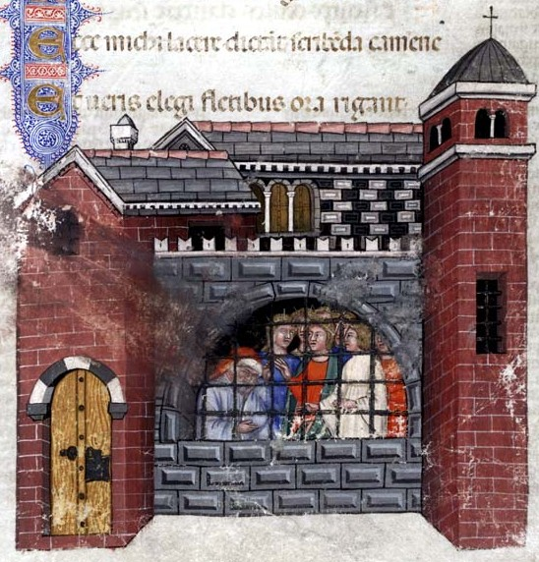
The Consolation of Philosophy
By far Boethius’ most famous work is De consolatione philosophiae which he wrote whilst in prison waiting to be executed.
In the book, philosophy, which is depicted by a woman, appears to Boethius as he laments to himself whilst listening to the muses of poetry. Philosophy banishes the muses, brings Boethius out of his daze, diagnoses his illnesses of the spirit and provides a series of therapies in order to cure him.
The literature is steeped in references to platonic thought, Cicero and the writings of Saint Augustine of Hippo
  For example, the separation between the literary self and the author themselves. Boethius the prisoner, by the end of the book, still hasn’t been fully cured; but the fact that Boethius the author has written the book implies a completion of the course of therapy and has been cured.
  The distinction between two selves is parallel to young Augustine and Augustine the narrator in his Confessions.³
Boethius in prison, from a manuscript of the Consolation of Philosophy,1385.
https://commons.wikimedia.org/wiki/File:Boethius_imprisoned_Consolation_of_philosophy_1385.jpg

Slide 8
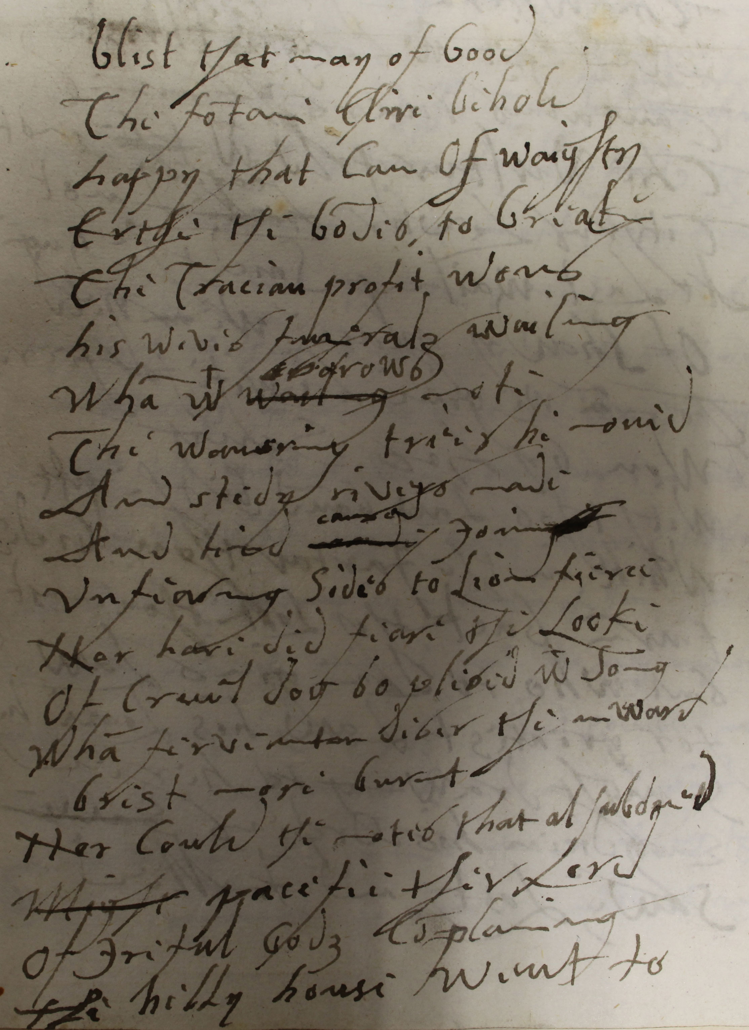
The Consolation of Philosophy
In the first few centuries following the death of Boethius, his Consolation was read very little.
The person widely credited with making it mainstream, as it were, was Alcuin of York who likely brought a manuscript containing the treatise from Italy to the court of Charlemagne. Alcuin repeatedly paraphrases the Consolation in his letters to Charlemagne and included it in his teaching curriculum. This inspired a whole host of different commentaries on the work, and it remained a seminal document for the cultural history of western Europe.
The Consolation was translated into Old English by King Alfred the Great, into Middle English by Geoffrey Chaucer, and even early modern English by Queen Elizabeth I. figures such as Dante Alighieri and C.S. Lewis have acknowledged its influence on their works. ⁴
‘Blist that may of Good
The fontaine Clire behold
happy that Can of weighty
Erthe the bondes to breake…’
Queen Elizabeth’s own translation of the poem in book 3 chapter 12.
https://www.nationalarchives.gov.uk/education/resources/elizabeth-monarchy/elizabeths-translation-of-the-consolation-of-philosophy/

Slide 9
Translation and Commentary Works
Boethius sought to spend his career bringing the whole of Hellenistic philosophy into Latin. This monumental task included the works of both Plato and Aristotle, intending to write commentaries for all of them.
This ambitious endeavour was never fully realised, but he did translate a great deal of platonic and Aristotelian writings into Latin and accompany them with detailed commentaries.
For the scholars and students for the following eras and his own, he provided an invaluable service. The translations are faithful to the original Greek whilst also maintaining an emphasis on the literal translations rather than literary, which helped with the clarity of the work. His commentaries were largely unoriginal and would consist of citing a great deal of other writers from all schools such as Porphyry. Therefore, his contribution to the study of logic was mostly synthesising the teachings of various philosophers.
His translations of Porphyry and of Aristotle would be the basis of western writings on Neoplatonism and Aristotle right up until they were rediscovered hundreds of years later.⁴

Slide 10
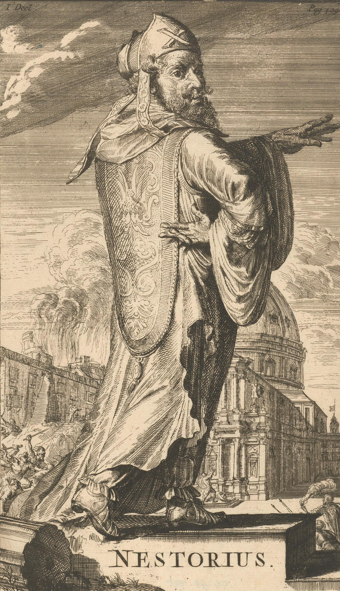
Opuscula Sacra
Boethius was also a well accomplished theologian and authored many theological tractates.
In Tractate V (Against Eutyches and Nestorius), he is perturbed by the lack of logical rigour displayed at a council in which Eutyches argues for the case that Christ had only a divine nature (Nestorianism). Boethius clarifies the actual definitions of ‘nature’ and ‘person’ in order to show the incorrectness of Eutyches and Nestorianism and to find a compromise between them (that conforms with the Roman Catholic faith). His display that logic was the essence of a sound theological argument showed his love for rational arguments in a philosophical style.
Considering the religious tensions in Ostrogothic Italy, Boethius did not pay heed it seems that his king was an Arian. In Italy at the time, asserting that Christ has two natures and espousing orthodox views of the Trinity was an attack on the Monophysite beliefs that the Arian king Theodoric held very dear.
Either, it seems, Theodoric did not know that Boethius was a spokesperson for Chalcedonian Roman Christianity, or he did know and underestimated his fervour. In any case, it may be that his disapproval of Monophysite Christianity was remembered by Theodoric and may have hastened his condemnation and death. ⁴
Nestorius by Romeyn de Hooghe 1688
https://commons.wikimedia.org/wiki/File:Nestorius_Hooghe_1688.png

Slide 11
Opuscula Sacra
His theological treatises had a great affect on medieval philosophy and theology.
His greatest impact was on the topics of logic, ontology, and metaphysics.
These topics were widely taught in schools and Boethius’ name would dominate each of them. A student of theology would spend much of their student life studying works that draw from, or are written by, Boethius due to his role as a great preserver and a bridge between Hellenic and scholastic philosophy.⁵
Because of his huge and widespread influence, it is not unreasonable that he has been called the schoolmaster of medieval Europe.⁶

Slide 12
Legacy
Even though many of his other works survived in Medieval universities for a great many years, it was his Consolation of Philosophy that cemented Boethius into the foundations of Western theology and philosophy. ⁴
It has, like its author, such a breadth of genius that it can be enjoyed from many different academic perspectives, whether through philosophy, theology, literacy or poetry there are so many references to other works and hidden meanings that it is worthy of study for anyone. The nature of what is being tackled in the story is relatable to anyone in any time and philosophy’s therapies work for not just Boethius. Therefore, it has remained so prominent even in the modern day.
That pervasiveness has made him a huge influence for great doctors of the church such as Saint Thomas Aquinas who changed the face of Roman Catholicism forever.

Slide 13
Bibliography
Kaylor, Noel Harold, A Companion To Boethius In The Middle Ages (Leiden: Brill, 2012).
Marenbon, John, Boethius, ‘Life, Intellectual Milieu, and works’, (Oxford: Oxford University Press, 2003)
McMahon, Robert, Understanding The Medieval Meditative Ascent: Augustine, Anselm, Boethius, & Dante (Washington, D.C: Catholic University of America Press, 2006), pg. 211-212
Boecio, Anicio Manlio Torcuato Severino, and P. G Walsh, The Consolation Of Philosophy (Oxford: Oxford University Press, 2008), p. xliii-xlvi, xxii-xxiv, xxvii-xxx
Marenbon, John, The Cambridge Companion To Boethius (Cambridge: Cambridge University Press, 2009)
Herman, Arthur, Cave And The Light (New York: Random House, 2013)
Chadwick, H. (1990). Boethius: The Consolations of Music, Logic, Theology, and Philosophy. Clarendon
"Anicius Manlius Severinus Boethius | Roman Scholar, Philosopher, And Statesman", Encyclopedia Britannica, 2021 <https://www.britannica.com/biography/Anicius-Manlius-Severinus-Boethius> [Accessed 25 September 2021]
Reiss, Edmund, Boethius (Boston: Twayne Publishers, 1982)
Images Used
Anicius Manlius Severinus Boethius, Woodcut, 1537 <https://www.britannica.com/biography/Anicius-Manlius-Severinus-Boethius/images-videos#/media/1/71328/123053> [Accessed 26 September 2021]
Coin Depicting Flavius Theodoricus (Theodoric The Great) <https://commons.wikimedia.org/wiki/File:Teodorico_re_dei_Goti_(493-526).png> [Accessed 26 September 2021]
of Genoa, Gregorius, Initial Depicting Boethius Teaching His Students, 1385 <https://commons.wikimedia.org/wiki/File:Boethius_initial_consolation_philosophy.jpg> [Accessed 26 September 2021]
Master, Coëtivy, Philosophy Consoling Boethius And Fortune Turning The Wheel, 1460 <https://commons.wikimedia.org/wiki/File:Co%C3%ABtivy_Master_(Henri_de_Vulcop%3F)_(French,_active_about_1450_-_1485)_-_Philosophy_Consoling_Boethius_and_Fortune_Turning_the_Wheel_-_Google_Art_Project.jpg> [Accessed 26 September 2021]
Milošević, Petar, 2015 <https://commons.wikimedia.org/wiki/File:Mosaic_of_Justinianus_I_-_Basilica_San_Vitale_(Ravenna).jpg> [Accessed 26 September 2021]
of Genoa, Gregorius, Miniatures Of Boethius Imprisoned, 1385 <https://commons.wikimedia.org/wiki/File:Boethius_imprisoned_Consolation_of_philosophy_1385.jpg> [Accessed 26 September 2021]
"Elizabeth’s Translation Of The Consolation Of Philosophy - The National Archives", The National Archives, 2021 <https://www.nationalarchives.gov.uk/education/resources/elizabeth-monarchy/elizabeths-translation-of-the-consolation-of-philosophy/> [Accessed 26 September 2021]
de Hooghe, Romeyn, Portret Van Nestorius, 1688 <https://commons.wikimedia.org/wiki/File:Nestorius_Hooghe_1688.png> [Accessed 26 September 2021]

