Slide 1
Module Code:ACCC5023
Module Name: Network Operating Systems and Services
Week Number-1(Lesson 1)
Title: Internetworking addressing systems

Slide 2
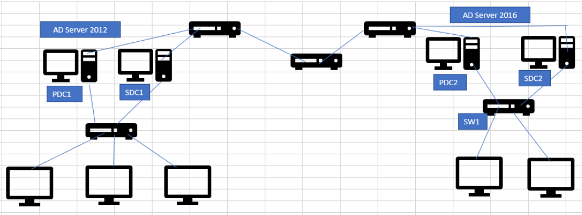
Setup a Network
In this module, hardware pre-installed.
Your job is to:
  install the operating system and configurations → enable functional network
Servers, client computers, multiple location

Slide 3
Manage a Network
Manage, security (users, restriction…), resources (printers, files, ..)
Best practices
Servers, client computers, multiple location

Slide 4
Module Learning Outcomes
AIM(S):
To provide students with a sound understanding of the concepts, principles, skills and techniques required to manage and deploy network resources in a Network Operating Systems environment, e.g. Windows, or Linux.
Learning Outcomes:
Upon the successful completion of this module, the student should be able to:
Apply a systematic understanding of network operating system environments to deploy, manage and maintain critical network services and resources.
Analyse a given network to produce suitable security audit/disaster recovery strategy.

Slide 5
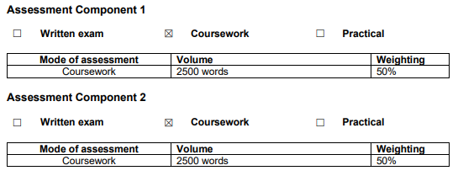
Assessment

Slide 6
Lesson Aims
OSI and TCP IP Layers
IP addressing
Subnetting

Slide 7
OSI Model
The OSI (Open Systems Interconnection) model was created by the ISO to help standardize communication between computer systems. It divides communications into seven different layers, which each include multiple hardware standards, protocols, or other types of services

Slide 8
Seven Layers of OSI
Layer 7 - Application.
Layer 6 - Presentation.
Layer 5 - Session.
Layer 4 - Transport.
Layer 3 - Network.
Layer 2 - Data Link.
Layer 1 - Physical.

Slide 9
TCP/IP Layers
TCP/IP stands for Transmission Control Protocol/Internet Protocol, which is a set of networking protocols that allows two or more computers to communicate.
Layer 5 - Application.
Layer 4 - Transport.
Layer 3 - Network.
Layer 2 - Data Link.
Layer 1 - Physical.

Slide 10
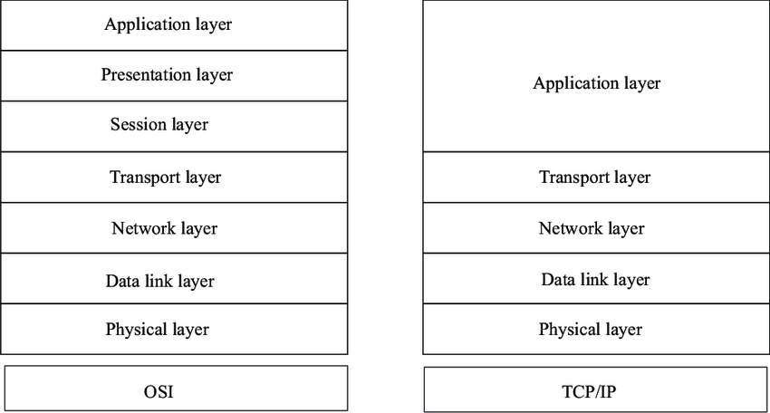
OSI and TCP/IP

Slide 11
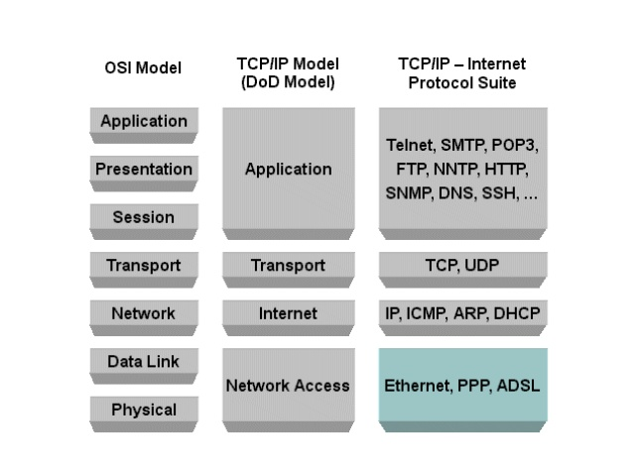
TCP/IP Protocol Suite

Slide 12
IP Addressing
An IP address, or simply an "IP," is a unique address that identifies a device on the Internet or a local network. It allows a system to be recognized by other systems connected via the Internet protocol. There are two primary types of IP address formats used today — IPv4 and IPv6
Internet Protocol version 4 (IPv4).Currently used version of Internet Protocol.
Internet Protocol version 6 (IPv6) replacement for IPV4.

Slide 13
IPV4
An IPv4 address is a 32-bit address that uniquely and universally defines the connection of a device (for example, a computer or a router) to the Internet.
• Connectionless protocol
• Fragments (divides) packets where necessary
• Addressing via 32 bit Internet addresses

Slide 14
IPV6
Maintains good features of IPv4, discards bad ones.
• Not compatible with IPv4
• Compatible with all other Internet protocols including
TCP, UDP, ICMP, DNS, etc.
• Main features:
– Long addresses (128 bits) ⇒ supports billions of hosts.
– Simplified, fixed size header ⇒ routers can process packets faster.
– Support for authentication and privacy
– Better support for type of service.

Slide 15
The IP address can be classify into two classes:
Public address:
This address considered as any valid address assigned to any user, and the organization who is responsible for registering IP ranges called Internet Service Providers (ISPs), and this address will be unique.
Private Address:
Any number or address assigned to a device on a private TCP/IP Local Area Network that is accessible only within the Local Area Network.

Slide 16
Internet addresses
Each network interface connected to the Internet has a unique address consisting of two parts:
Network address, address of the network within the Internet (used by gateways for routing IP packets between networks).
Host address, address of the computer within the network (used for delivering packets to a particular network interface within the network).

Slide 17
Internet address format
The 32-bit IP address is separated into four 8-bit octets, allowing each octet to have a value ranging from 0 to 255.
Furthermore, the IP address is logically separated into two distinct components: the network ID and the host ID. The network ID is used to identify the subnet upon which the host resides. The host ID is used to identify the host itself within the given subnet.
IP addresses can be displayed in three typical formats:
Binary notation Binary notation is the format that systems on the network use to process the address. An example of binary notation is 11000000.10101000.00000001.01100100.
Hexadecimal notation Hexadecimal notation is the format typically used when identifying IPv6 addresses. An example of hexadecimal notation of an IPv4 address is C0.A8.01.64
Dotted-decimal notation Dotted-decimal notation is the format that is typically used for displaying the IP address in a human-readable format. An example of dotted-decimal notation is 192.168.1.100

Slide 18
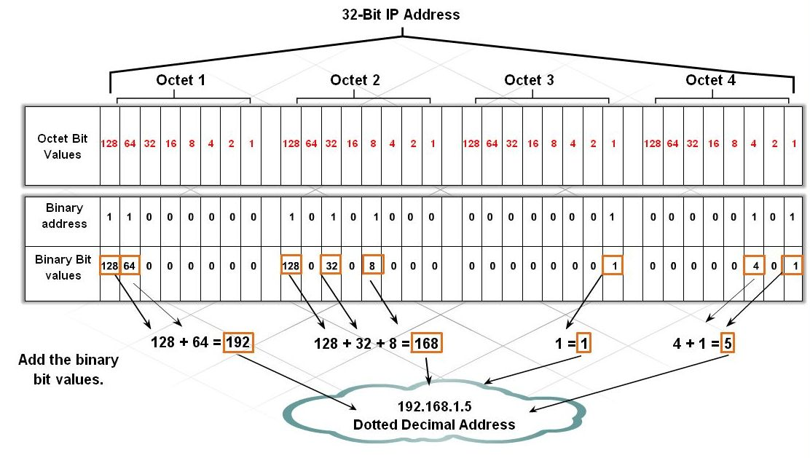
Internet address format

Slide 19
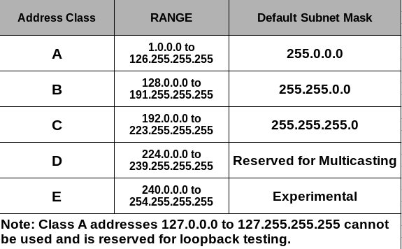
IP Classes

Slide 20
IP Class format

Slide 21
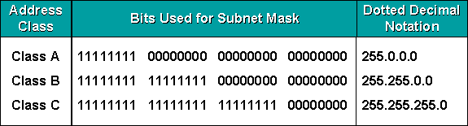
Subnet Mask
A mask is a 32-bit binary number that is expressed in dotted decimal notation. By default, a mask contains two fields, the network field and the host field. These correspond to the network number and the locally administered part of the network address. When an administrator subnets, they are adjusting the way they view the IP address. Table 1: Default masks for classful addressing

Slide 22
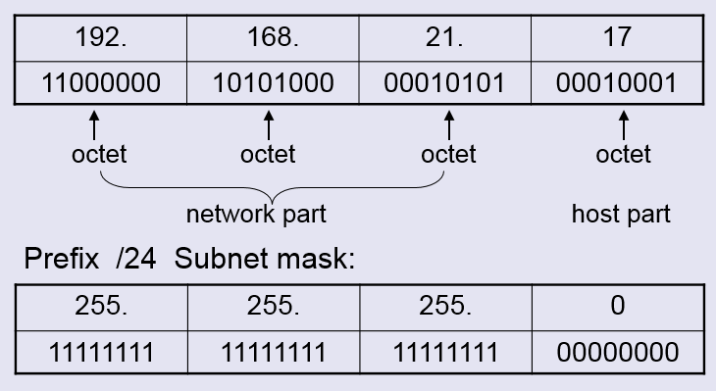
Subnet Mask
Routers and hosts still assume class subnet masks by default:
Class A /8 255.0.0.0
Class B /16 255.255.0.0
Class C /24 255.255.255.0

Slide 23
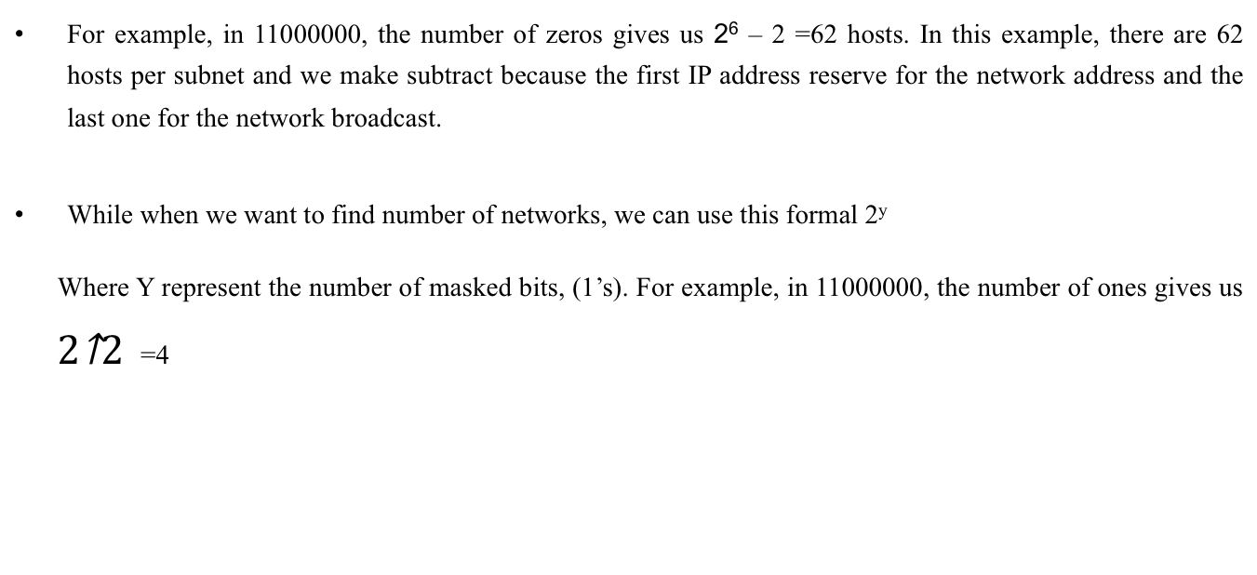
Subnetting
There three important things about subnetting:-
Network address – the first one
Broadcast address – the last one
Host addresses – everything in between
As well as, to find the number of hosts per subnet. We can use formal 2^{x} -2, where (x) is the number of unmasked bits (0’s) .
For example, in 11000000, the number of zeros gives us 2⁶ – 2 =62 hosts. In this example, there are 62 hosts per subnet and we make subtract because the first IP address reserve for the network address and the last one for the network broadcast.
While when we want to find number of networks, we can use this formal 2^{y}
Where Y represent the number of masked bits, (1’s). For example, in 11000000, the number of ones gives us =4

Slide 24
CIDR
Classless Inter Domain Routing (CIDR) is a method for assigning IP addresses without using the standard IP address classes like Class A, Class B or Class C. In CIDR , an IP address is represented as A.B.C.D /n, where "/n" is called the IP prefix or network prefix. The IP prefix identifies the number of significant bits used to identify a network.
Example, 192.9.205.22 /18 means, the first 18 bits are used to represent the network and the remaining 14 bits are used to identify hosts.

Slide 25
References
Andrew S Tanenbaum, David J. Wetherall ( 2013) Computer Networks, Pearson
Anttalainen, Tarmo(2003), Introduction to Telecommunications Network Engineering.
https://web-b-ebscohost-com.ezproxy.uwtsd.ac.uk/ehost/ebookviewer/ebook/bmxlYmtfXzg3NzM0X19BTg2?sid=2327383a-5654-4205-9324-0a82e27ed6e0@pdc-v-sessmgr02&vid=5&format=EB&rid=7
Todd Lammle (2016), CCNA Routing and Switching Complete Study Guide: Exam 100-105, Exam 200-105, Exam 200-125 Sybex

