Slide 1
Name: Joselynn Toon (2519891)
Lecturer: Prabjot Sahota
Module: Professional development within health and social care
Module code: LCHS4009
Assignment title: Self awareness presentation

Slide 2
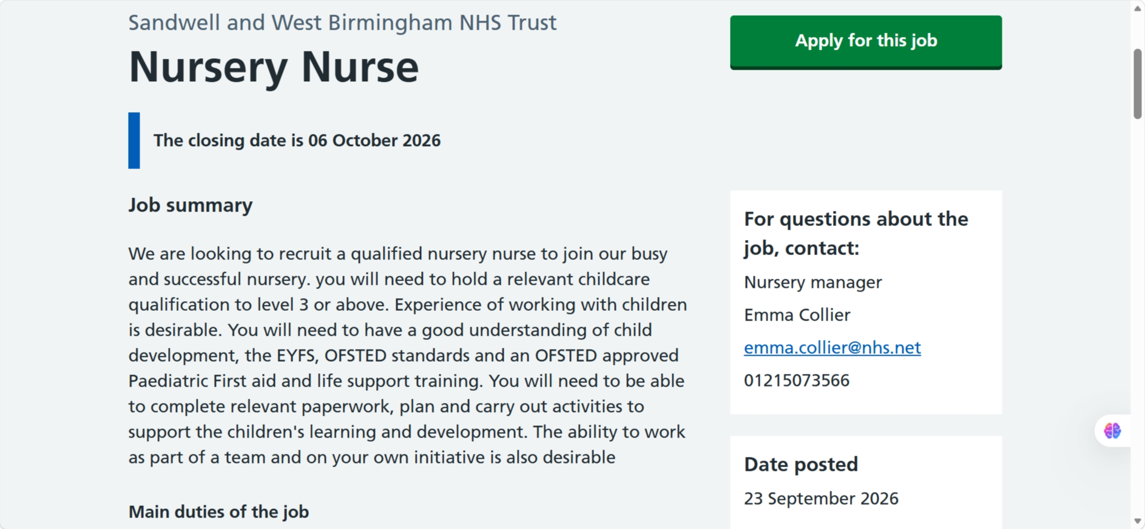

Introduction
I have chosen to pursue a career as a nursery nurse within the UK Health and Social Care sector.
NHS jobs, (2026)
I have chosen this role as I have a strong passion for helping and supporting children and their families, I would like to make a positive impact to young children's lives and emotional well being. I have personal experience caring for young children and a natural ability to connect well with young children.
I find the job role found above suitable as this job role includes working with children aged 3 months – 5 years and liaising with their parents and being understanding of the children's needs and emotions.
On the following slides I will conduct a personal SWOT analysis.

Slide 3
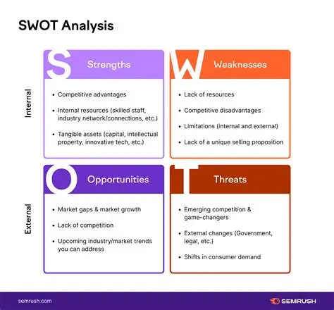
What is a SWOT Analysis ?
A SWOT analysis is a framework used to identify strengths, weaknesses, opportunities and threats to support you with planning and decision making, (CIPD,2026).

Slide 4

Strengths
Personal qualities - Kind, patient, empathetic, calm under pressure, naturally good at connecting with children and making them feel safe both emotionally and physically, excellent at working with people of all different backgrounds.
Relevant experience - Previous experience working with young children and understanding their individual emotional and physical needs.
Education/studies - Health and Social Care (Level 4), First aid qualification, Food safety hygiene.
Aswell as the above I have a local advantage of living in Birmingham close to some Major hospitals and I also hold a UK driving licence, so travel is not an issue.

Slide 5
Weaknesses
Limited formal work experience – Not previously worked in a clinical children's environment.
Health conditions – I have Fibromyalgia and ADHD which can affect my energy levels, focus as work ability at times.
Anxiety with forms – I struggle with paperwork due to pain in hands, this makes me anxious if I have a deadline to fill out paperwork.
Qualifications – Currently do not have any childcare or early years qualifications.

Slide 6
Opportunities
Education – Continue at University and get my childcare qualification, gain more knowledge and potential work placement opportunities.
NHS Vacancies and high demand – There is a high demand for paediatric support staff across the Uk and multiple NHS jobs offers.
Volunteering – Loads of hospitals offer voluntary placements, which is a great way to gain experience and references.
Support – Loads of support I can access including at the university and at the local job centre, I can get help and support from work coaches.

Slide 7
Threats
Personal limitations – Due to personal health conditions, I could be at a disadvantage compared to a person without health concerns. Aswell as this my lack of experience could put be at a disadvantage.
Competitive field – Their will be many applicants for the NHS job roles; I need to ensure I stand out with a strong application and interview skills, and my lack of relevant references could be a potential concern.
Paperwork and deadlines - Due to struggling with paperwork I could be at a disadvantage compared to others, I also have my own children, so I need to ensure my family life doesn’t get in the way of my work life and deadlines.

Slide 8
Practical examples
I strongly believe I have more strengths than weaknesses, and I can use these to overcome the threats I may come across with my chosen career.
I may have no experience in a hospital setting; however, I do have extensive personal experience working with and supporting children and I am very determined and care focused. I will volunteer at a local children's hospital alongside doing a childcare qualification to gain more hands-on experience.
Due to my own health concerns, I am highly empathetic and have a personal understanding of how it feels to manage certain health challenges. I will be extra compassionate and have a high patience level.

Slide 9
Conclusion
To sum up, I feel my journey to becoming a Nursery Nurse is not defined by what I lack but by my strengths and what I can bring: genuine compassion, proven resilience and a deep passion for connecting with and helping both children and their families.
I understand that I will face some challenges regarding my limited work experience as-well as my own personal health and family life, however I am very confident I can overcome these with the right support and embracing the opportunity’s available to me such as extra qualifications and work experience.
I am highly dedicated and look forward to making a meaningful difference to the lives of young children and their carers.

Slide 10
References
CIPD (2026) SWOT analysis. Available at: SWOT analysis | Factsheets | CIPD (Accessed on 7th October 2026).
NHS Jobs (2026) Nursery Nurse – Sandwell and West Birmingham NHS Trust. Available at :Job Advert (Accessed on 1st October 2026).

