Slide 1

360-degree feedback
Student: Mihaita Robert Nedelea
Student Number: 2129063
Module: Developing Relationships and Workplace Achievement
Module Code: BMSW5102
Lecturer Name: Ehsan Khajeh

Slide 2
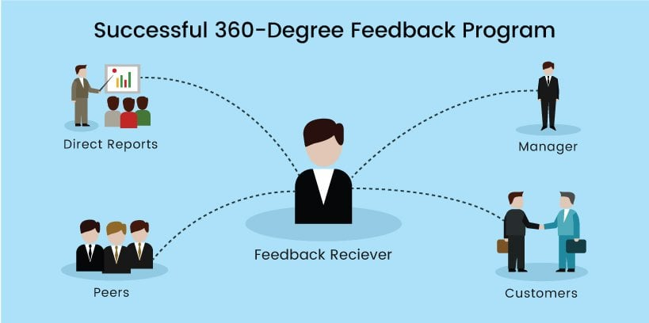
The concept of 360 – degree feedback
The idea of 360-degree feedback is getting feedback on a person's performance from a variety of sources, such as peers, superiors, subordinates, and external stakeholders, in addition to the person themselves. This all-encompassing method offers a balanced perspective of a person's areas of strength and development (Alimo-Metcalfe,1998).

Slide 3

The importance of the concept of 360-degree feedback to employees
360-degree feedback is an effective instrument for growth on both a personal and professional level. By highlighting their areas of strength and growth, it provides employees with a comprehensive understanding of their performance. This encourages self-awareness and offers chances to improve abilities (Brutus, 1999).
Employee engagement and job satisfaction can increase when they receive constructive criticism and are acknowledged for their contributions (Brutus, 1999).

Slide 4
The importance of the concept of 360-degree feedback to employers
Employers obtain a thorough understanding of an employee's performance through 360-degree feedback. Decisions about opportunities for training, development, and promotions are made more effectively as a result. Additionally, it harmonises individual performance with corporate objectives and fosters a culture of continual development (Sahoo, 2012).
Businesses are better able to pinpoint problems and make targeted improvements when they recognise systemic problems or deficiencies in leadership and skill development (Sahoo, 2012).

Slide 5
The benefits of 360-degree feedback implementation to employees
Personal growth
Employees have a path for ongoing professional development and self-improvement with 360-degree feedback.
Job satisfaction
Identifying areas for growth and accomplishments boosts motivation and job satisfaction (Sahoo, 2012).
Skill enhancement
Employees can concentrate on pertinent training and development initiatives when they receive clear feedback that highlights skill development areas.

Slide 6
The benefits of 360-degree feedback implementation to employers
Performance optimization
Resource allocation and development can be focused by identifying high-performing individuals and areas for improvement.
Talent management
Identifying future leaders and important contributors for succession planning is made easier with the effective use of 360-degree feedback.
Enhanced organizational effectiveness
An effective feedback process boosts output and ensures that goals are met strategically (Sahoo, 2012).

Slide 7
Key issues involve whilst implementing the concept
Clear communication and education
Clearly define the goal and procedure. Give a succinct and clear justification for the introduction of 360-degree feedback. Emphasise how it supports both personal growth and organisational objectives (Chivers, 1999).
Offer training and Workshops for employees
Organise specialised training sessions to introduce the 360-degree feedback process to staff members. Provide real-world examples and demonstrations to make sure everyone understands (Huggett, 1998).

Slide 8

Key issues involve whilst implementing the concept
Assure confidentiality of feedback
Share with others the precise steps taken to ensure that feedback providers remain anonymous. Insist that each respondent's answers be kept private.
Build trust in the process
Talk about the achievements or case studies of businesses that have successfully incorporated 360-degree feedback. Give instances of successful feedback-related personal and professional development (Huggett, 1998).

Slide 9

Key issues involve whilst implementing the concept
Feedback quality and specificity
Provide guidelines for giving specific feedback
Clearly define the kind of feedback that is expected. Urge raters to provide detailed information about actions, outcomes, and behaviours.
Encourage actionable input
Stress the value of feedback that can result in noticeable advancements. Invite raters to offer workable fixes or development tactics (Morgan, 2005).

Slide 10

Key issues involve whilst implementing the concept
Balancing positive and constructive feedback
Encourage a balanced approach
Insist on how important it is to acknowledge accomplishments and strengths. Emphasise the importance of addressing areas that require improvement while doing so.
Focus on growth and improvement
Remind attendees that constructive criticism can be an asset for both career and personal growth. Remind people that criticism is not always a bad thing, but rather a chance for improvement (Morgan, 2005).

Slide 11

Conclusion
360-degree feedback provides a thorough analysis of performance from many angles. It helps staff members and the company grow on both a personal and professional level, gives a forum for honest dialogue, mutual respect, and ongoing development. Stress that getting involved actively improves the feedback process's efficacy. Promote an environment where people work together and take turns being responsible for each other's personal and professional growth.

Slide 12
references
Alimo-Metcalfe, B. (1998) ‘360 Degree Feedback and Leadership Development’, International journal of selection and assessment, 6(1), pp. 35–44.
Brett, J.F. and Atwater, L.E. (2001) ‘360 degree feedback: accuracy, reactions, and perceptions of usefulness’, Journal of applied psychology, 86(5), pp. 930–942.
Brutus, S., London, M. and Martineau, J. (1999) ‘The impact of 360-degree feedback on planning for career development’, The Journal of management development, 18(8), pp. 676–693.
Chivers, W. and Darling, P. (1999) 360-degree feedback and organisational culture. London: Institute of Personnel and Development.
Huggett, M. (1998) ‘360-degree feedback - great expectations?’, Industrial and commercial training, 30(4), pp. 128–130.
Morgan, A., Cannan, K. and Cullinane, J. (2005) ‘360 degree feedback: a critical enquiry’, Personnel review, 34(6), pp. 663–670
Sahoo, C.. and Mishra, S. (2012) ‘Performance management benefits organizations and their employees’, Human resource management international digest, 20(6), pp. 3–5.

