Slide 1
Computer Architecture & OS ACCA4022
Week 2: Session 1:
Introduction to Computer Components - 1

Slide 2
Learning Outcome
By the end of this session, students should be aware of:
Computer hardware & software
Computer components
Computer peripherals
System devices

Slide 3
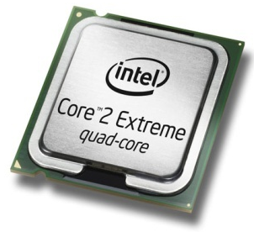
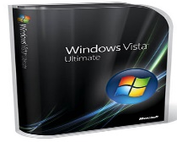
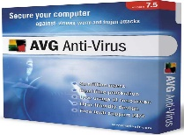
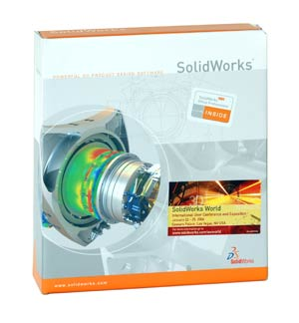
Hardware & Software (Recap)
Hardware
Software
All of the electronic and mechanical equipment in a computer is called the hardware. Examples include:
  Motherboard
  Hard disk
  RAM
  Power supply
  Processor
  Case
  Monitor
  Keyboard
  Mouse
The term software is used to describe computer programs that perform a task or tasks on a computer system. Software can be grouped as follows:
System software - Operating System etc
Applications Software - Word, SolidWorks etc
Utility programs - Antivirus etc.

Slide 4
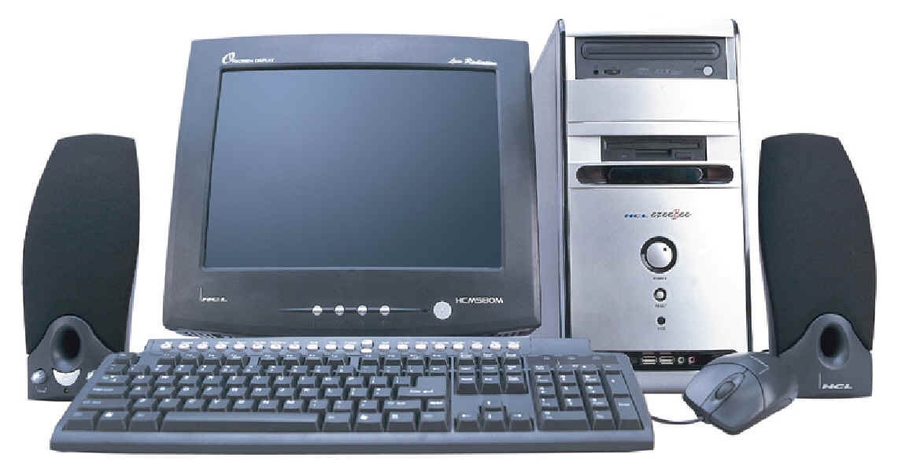
PC Components
Computer system - collection of electronic and mechanical devices operating as a unit. The main parts are:
  System unit
  Monitor
  Keyboard
  Mouse
  Speakers
2
1
5
3
4

Slide 5
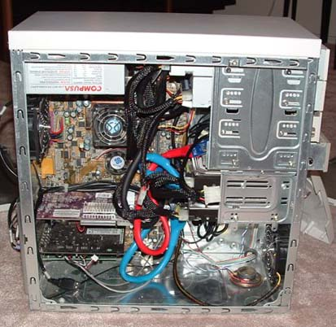
PC Components
The system unit is the main container for system devices. It protects the delicate electronic and mechanical devices from damage. Typical system unit devices include:
  Motherboard
  CPU (Processor)
  Memory
  Disk drives
  Ports - USB etc.
  Power supply
  Expansion cards - sound card, network card, graphics card etc.

Slide 6
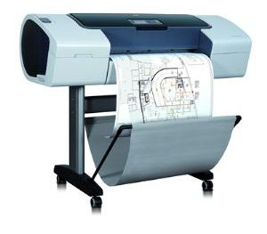
Peripherals
Peripherals are devices that connect to the system unit using cables or wireless technologies. Typical peripherals include:
  Monitor
  Keyboard
  Printer
  Plotter
  Scanner
  Speakers
Plotter

Slide 7
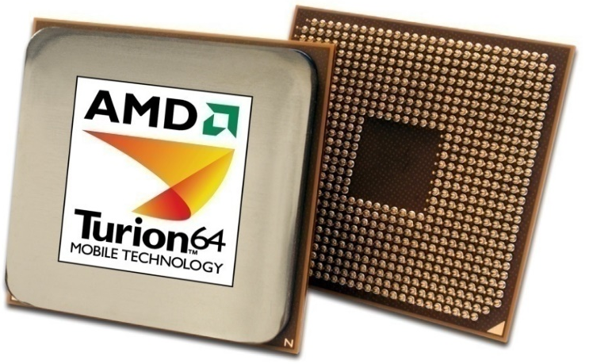
System Devices
Processor:
An integrated circuit (IC) supplied on a single silicon chip. It’s function is to control all the computers functions. The main processor manufacturers are:
  AMD - Athlon and Turion (mobile)
  Intel - Pentium and Centrino (mobile)

Slide 8
System Devices
Computer program:
Is a series of instructions. When a program is run, the processor carries out these instructions in an orderly fashion. Typical instructions include:
  Arithmetic - addition, subtraction etc
  Logical - comparing data and acting according to the result
  Move - move data from place to place within the computer system - memory to the processor for addition - memory to a printer or disk drive etc.

Slide 9
System Devices
Processor speed:
measured in megahertz (MHz) or Gigahertz (GHz) - the speed of the system clock (clock speed) within the processor and it controls how fast instructions are executed:
1 MHz - 1 million clock ticks every second
1 GHz - 1 billion clock ticks every second
Latest trend - multi-core processors can have two, three or four processor cores on a single chip.

Slide 10
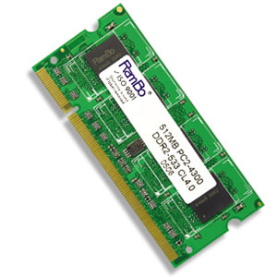
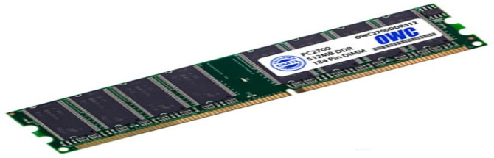
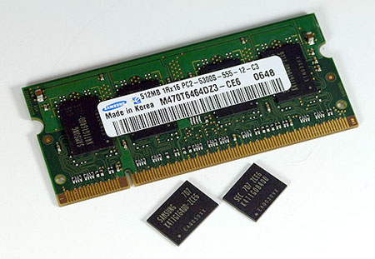
System Devices
Random Access Memory (RAM)
Primary storage - main computer memory. Data, programs currently in use are held in RAM
Volatile - contents of memory are lost if the computer is turned off
Module - memory IC’s on a circuit board

Slide 11
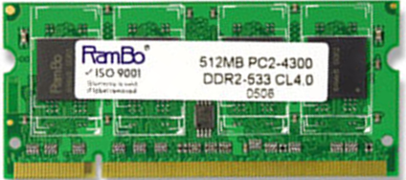
System Devices
Memory is sold in modules:
  DIMM’s (Dual Inline Memory Module) for desktop computers
  SODIMM’s (Small Outline Dual Inline Memory Module) for notebook computers.
DIMM’s and SODIMM’s are available in modules of 256MB, 512MB, 1GB, 2GB
The current technology is called DDR (Double Data RAM) and there are three types: DDR1, DDR2, DDR3
Any particular computer system is only compatible with one type.
Module capacity
Module name
Module type
Module
speed

Slide 12
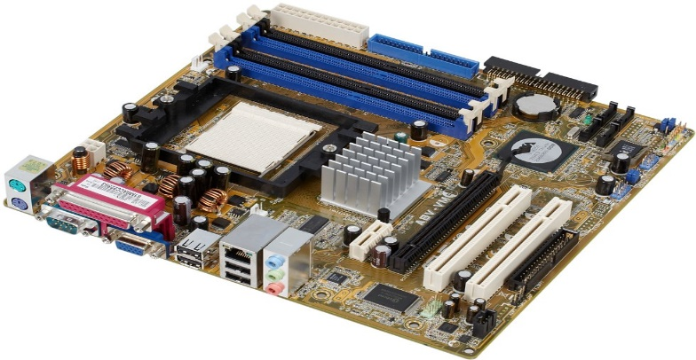

System Devices
Motherboard
Mainboard or system board - the main circuit board for the computer system. All device in the computer system will either be part of the motherboard or connected to it.
Memory Sockets
Processor Socket
Chipset
PCI Slots
Ports
Graphics Slot
Processor socket - different processors require different sockets and a motherboard must be chosen to suit the processor intended for use:
  Socket 478 - Intel Pentium IV
  Socket 775 - Intel Dual Core and Core Duo
  Socket 754 - AMD Athlon
  Socket 939 - AMD Athlon 64
  Socket AM2 - AMD Athlon X2

Slide 13
System Devices
Chipset - controls data flow around the computer. It consists of two chips:
Northbridge - data flow between memory and processor - data flow between the processor and the graphic's card
Southbridge - controls data flow to the devices - USB, IDE, SATA, LAN and Audio - controls PCI slots and onboard graphics

Slide 14
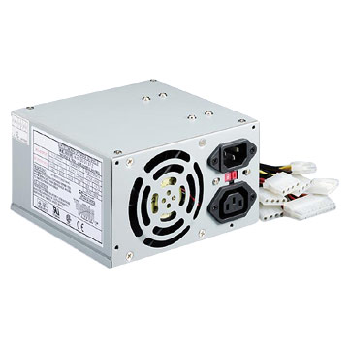
System Devices
Power Supply:
A computer power supply has a number of functions:
Converts Alternating current (AC) Direct current (DC)
Transforms mains voltage (240 Volts) to the voltages required by the computer. The main voltages are:12 volts for the disk drives as they have motors and 3.3 and 5 volts for the circuit boards in the computer

Slide 15
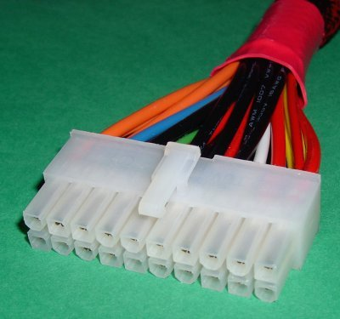
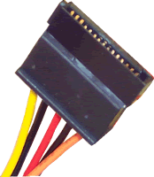
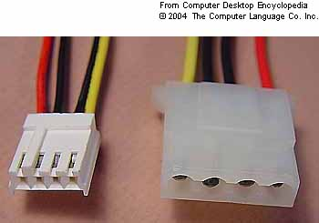
System Devices
  Uses Advances Power Management (APM) to allow the computer go into a standby mode
  Some have a switch to toggle between 240 volt supplies and 110 volt supplies.
  The main connections are:
1 | Main connector | Connects to the motherboard and supplies the 3.3 and 5 volt supply for the board.
2 | Molex connector | Connects IDE hard drives and optical drives.
3 | Berg connector | Connects floppy disk drives
4 | SATA connector | Connects SATA drives
3
4
1
2

Slide 16
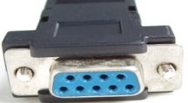
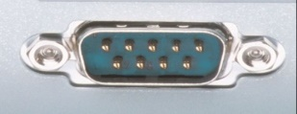
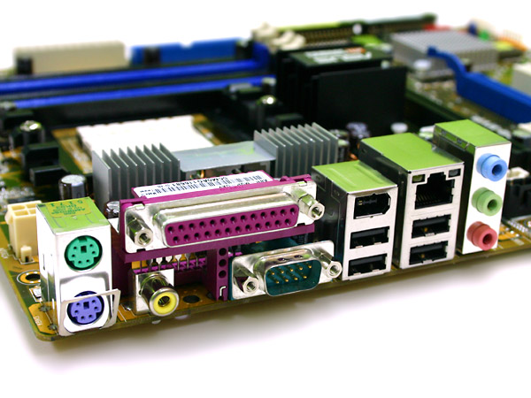
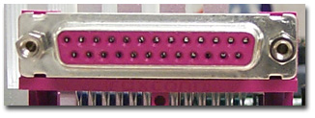
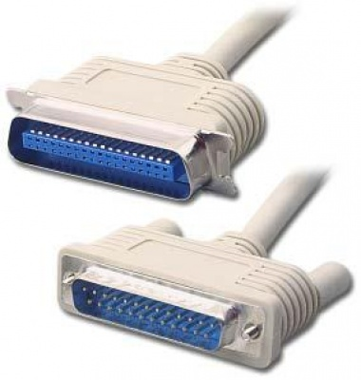
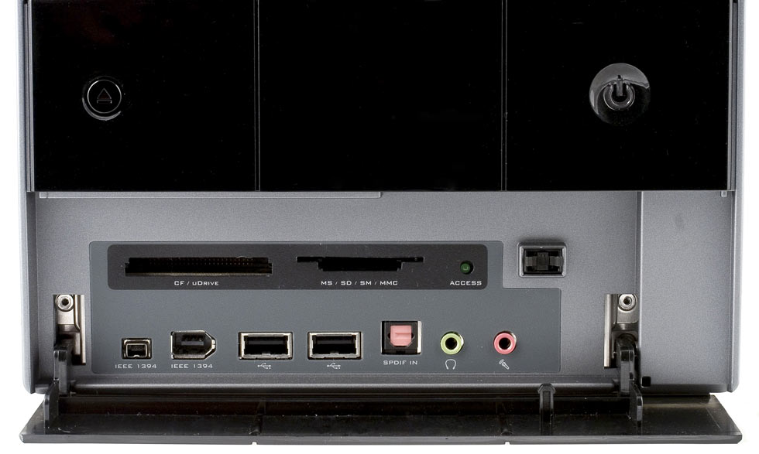
System Devices
Ports:
  Serial port - a 9-pin port. Often called Com ports - Com1, Com2 etc. Mice and external modems were connected to these ports. They are turquoise in colour.
Computer ports are interfaces between peripheral devices and the computer. They are mainly found at the back of the computer but are often also built into the front of the computer chassis for easy access.
Ports at the rear of the computer
  Parallel port - a 25-pin port used to connect printers, scanners, external hard disks, zip drives etc. to the computer. Burgundy in colour, they are often called LPT ports - LPT1, LPT2 etc.
Ports at the front of the computer

Slide 17
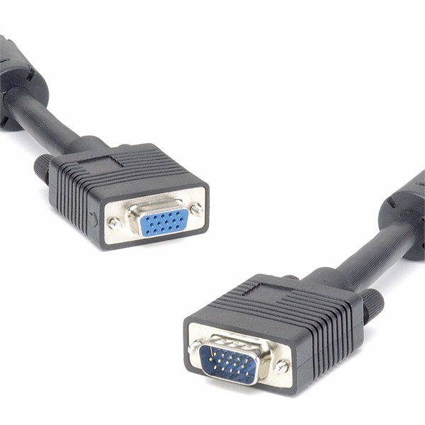
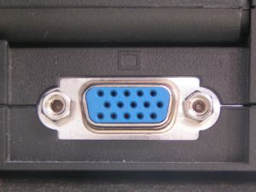
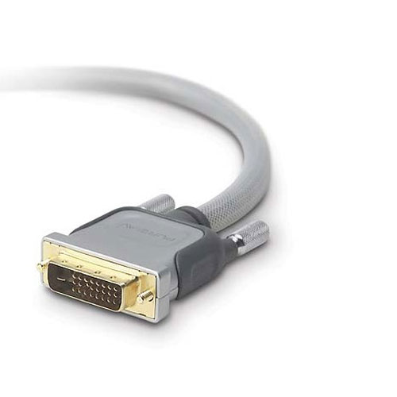
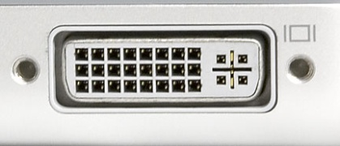
System Devices
  Video port - used to connect a monitor to the computer system. There are two types:
VGA port - This is a 15-pin port and is blue in colour. It is an analogue port and is being replaced by the DVI port.
DVI port - white in colour, it is a digital port. This means that no conversion is necessary between the computer and the monitor and that means that images can be produced more quickly on the monitor

Slide 18
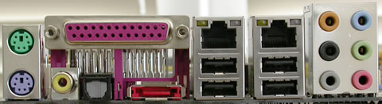
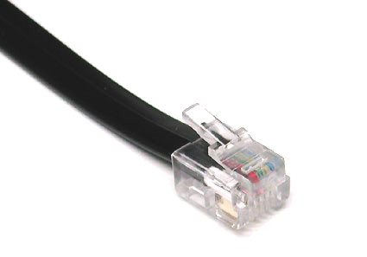
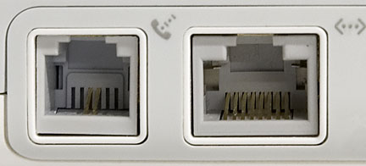
System Devices
  PS/2 port - used to connect keyboards and mouse to the computer. The keyboard port is purple and the mouse port is green
  Modem port - used to connect a modem to a telephone line. RJ11 is the technical term for the port.
  USB port - intended to replace Serial, Parallel and PS/2 ports with a single standard. 127 devices can be connected to a single USB port. Hot swappable - devices can be connected and disconnected while the computer is on. There are different USB standards in use:
USB 1 - original standard - transfer data of 1.5MBps.
USB 2 - current standard - transfer rate of 60MBps.
USB3 - future standard (2009) transfer rate of 600MBps.

Slide 19
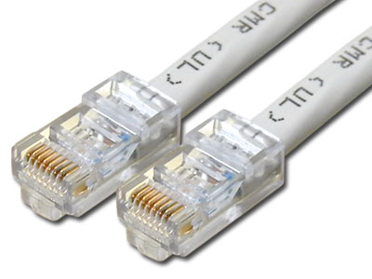
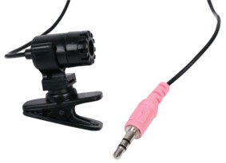
System Devices
  Ethernet port - used to connect to a network. Known as RJ45, it is larger than a modem port.
  Audio ports - used to input and output audio from the computer. Three mini jack ports but there may be more:
    Light blue - Line in - connect external devices
    Lime - Connect the speakers to this port.
    Pink - Connect a microphone to this port.

Slide 20
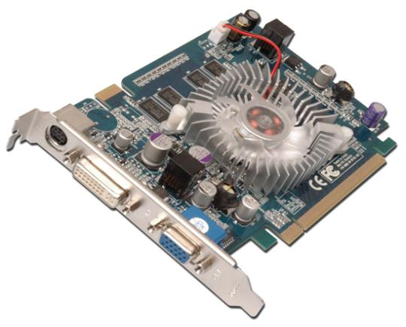
System Devices
Graphics card:
1 | Processor and fan | Graphics card handles it’s own processing making it almost independent of the processor.
2 | Board connector | AGP or PCI-Express
3 | Memory | Graphics card has it’s own memory. This makes it much faster. Most new cards use DDR3 memory.
4 | DVI connector | Digital output is supplied through this port.
5 | VGA connector | Analogue output is provided through this port.
3
1
4
2
5

Slide 21
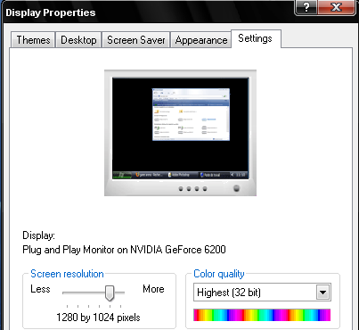
System Devices
Graphic card - screen images are made up of dots called pixels (picture elements). The graphics card must process each of these pixels to create the image.
The resolution of a screen is the number of pixels being displayed. Typical resolutions include:
  800 x 600 - 480,000 pixels
  1024 x 768 - 786,432 pixels
  1280 x 1024: - 1,310,720 pixels
  1600 x 1200: - 1,920,000 pixels

Slide 22
System Devices
There are two types of graphic card available:
  AGP (accelerated graphics port) - the older technology but still available. It can output in analogue or digital or both.
  PCI-Express - the newer technology - faster than AGP. Allows for two graphics cards to improve the performance - called Scalable Link Interface (SLI). PCI-Express can also output in analogue or digital or both.
  These cards are mutually exclusive and the choice is made according to the graphics slot on the motherboard.

Slide 23
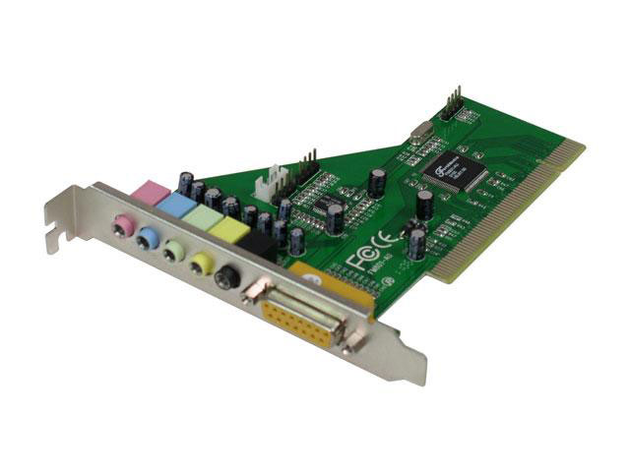
System Devices
Sound card
1
2
3
1 | PCI connector | Connects the sound card to a PCI slot
2 | MIDI socket | Musical Instrument Digital Interface port is used to connect digital musical instruments to the computer.
3 | Audio jacks | These are used to connect microphones, speakers, stereo systems etc to the computer.

Slide 24
System Devices
The main functions of a sound card are:
  To use a DAC (digital to analogue converter) to prepare audio for speakers etc.
  To use an ADC (analogue to digital converter) to convert the audio coming into the computer.
A sound card can be connected to the following:
  Analogue input devices - Microphone, Radio, Tape deck, Record player etc
  Headphones and speakers
  Output to tape etc.

Slide 25
References
W. Stallings, Computer Organisation and Architecture, London: Pearson, 2016
I. Englander, The architecture of Computer Hardware, Systems Software & Networking – An Information Technology Approach, London: John Wiley & Sons, 2014
M. M. Mano, Digital Logic and Computer Design, India: Prentice-Hall, 2003
V. Vijayendran, Fundamentals of Microprocessor – 8085, Chennai: S. Viswanathan (Printers & Publishers), PVT. LTD, 2004

Slide 26
Any Questions?

