Slide 1
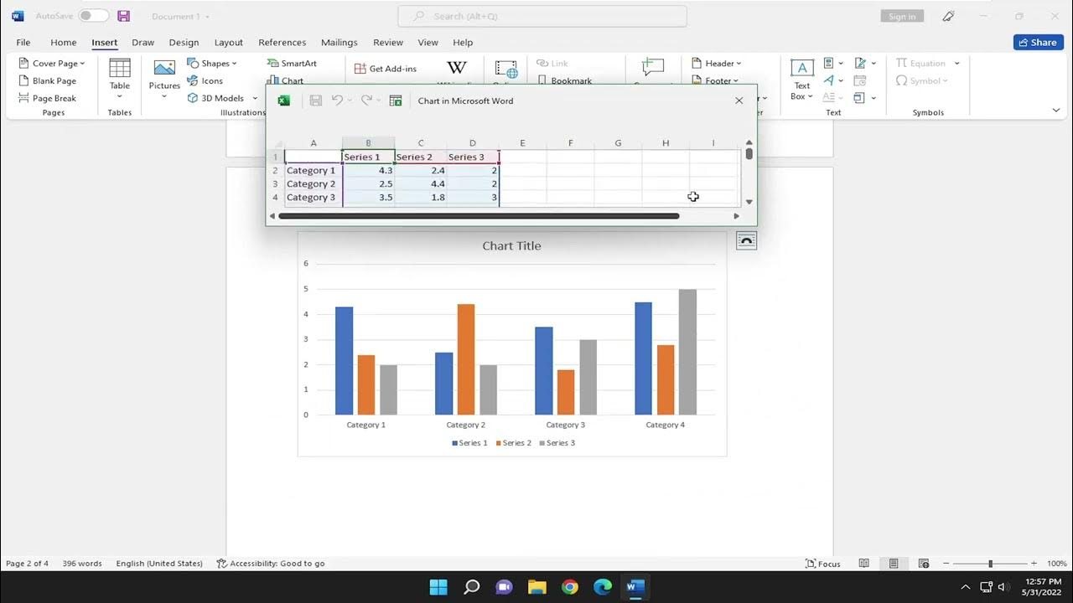
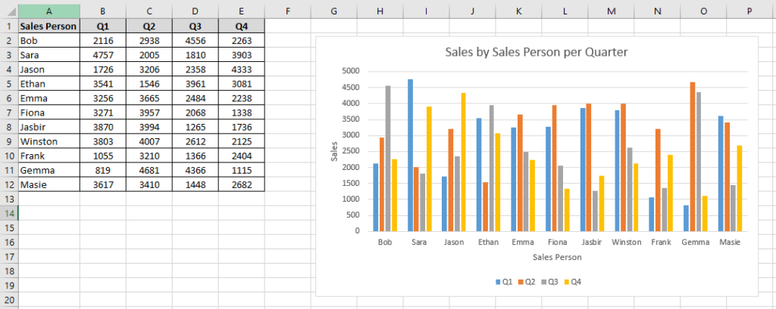
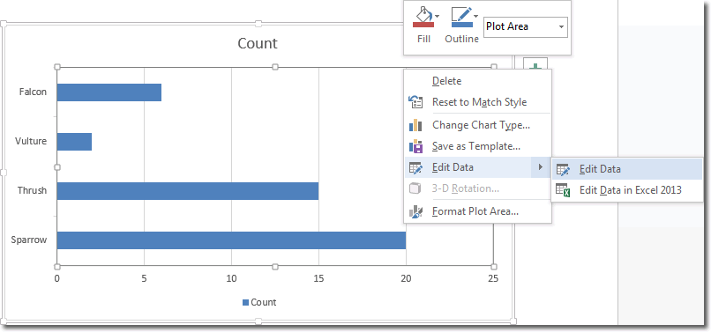
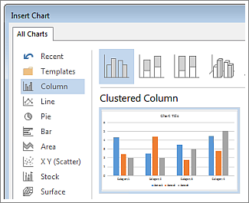
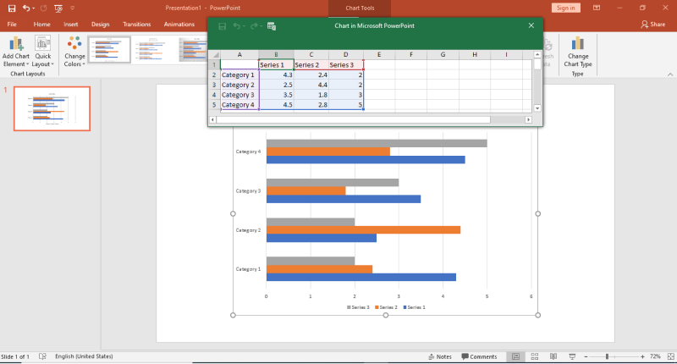
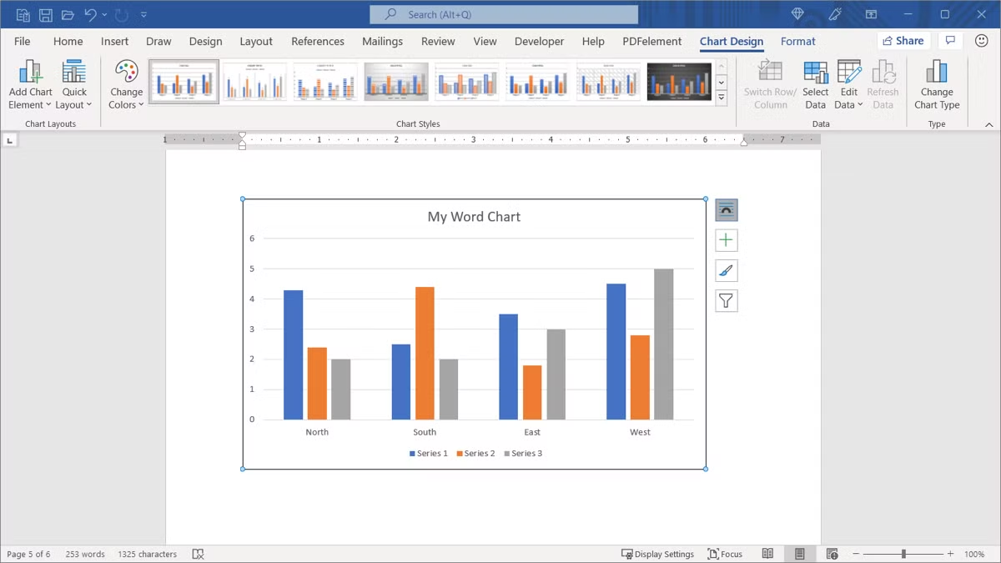
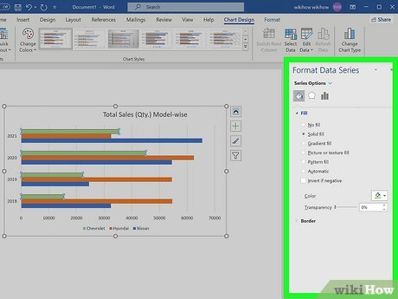
How to create a chart in a Word document
In a Word document, charts are a graphical representation of data that is used to display in a visual and easily understandable format. This can be used to show trend data series and display a large or complex data set (Microsoft, 2025). To create a chart in a Word document, at first, it is important to open the Word document and navigate to the Insert tab, then select a chart and select chart types and then input the data into this chart, and lastly, the chart is automatically updated to the modified data. A chart will help to visualise the relevant data in a great way. It also helps to effectively reflect one's own data or information.
How to create a chart in a Word document
Steps
Open the Insert Tab: To create a chart in a Word document, one has to open the Word document’s Excel sheet step by step. The first step is to open spreadsheet applications such as Word and Excel. Then locate the insert tap and click on it in the ribbon menu.
Select chart: the next step is to select a chart within the Insert tab. Then find the Illustrations or chart and lastly click on the chart tab to select the chart. After selecting the types of charts, click on the ok button to select the chosen chart.
Choose types of a chart: After completing the two important steps after selecting a chart, a dialogue box or menu bar will appear and it will offer to select the chart types that include column, line, pie, scatter or bar, etc. After selecting the chart types among the huge types, it can help an individual to represent the data.
Enter correct data: After selecting the chart type, the window of the spreadsheet will open. This is where one can effectively put the correct data. After entering the correct data, it will replace the default sample data with one’s actual data. The chart in the Word document will update in real time as one can modify the data in the spreadsheet.
Chart updates: After one can enter the modified data or any changes in the Word Excel sheet or the spreadsheet, then the chart will also automatically update to effectively reflect the changes Universalclass, 2025). If one can try to make any changes in future, it also dynamically changes the data sheet.
Close spreadsheet: After one has put the data or information in the data sheet or entered all necessary data, and this chart in Word will be displayed accordingly, just close the spreadsheet window.
Customise: After completing all the required steps to create an effective chart with data or information, one can customise the chart through its appearance. One can also make it perfect through using data labels, adding the tiles or name, changing colours in this chart or changing to visually attractive using various chart tools. The changes will appear when one can use the chart tools and click on this colouring chart.
Reference
Computerhope, (2025) How to create a chart or graph in Microsoft word. Available at: https://www.computerhope.com/issues/ch001895.htm (Accessed: 29 July 2025).
Microsoft (2025) Microsoft Support. Available at: https://support.microsoft.com/en-us/office/present-data-in-a-chart-58516b99-55fc-4f45-ac81-cc6868a18a8a (Accessed: 29 July 2025).
Universalclass, (2025) Using charts in PowerPoint 2019 UniversalClass.com. Available at: https://www.universalclass.com/articles/computers/using-charts-in-powerpoint-2019.htm#:~:text=When%20you%20change%20this%20content%20in%20the,in%20the%20visual%20graph%20representation%20as%20well. (Accessed: 29 July 2025).

