Slide 1
BMSW6101
Emergent Leadership Skills
Week 1
Understanding Leadership

Slide 2
Learning Objectives
Review the evolution of leadership
Examine the different perspectives on leadership
Understand the impact of culture on leader effectiveness

Slide 3
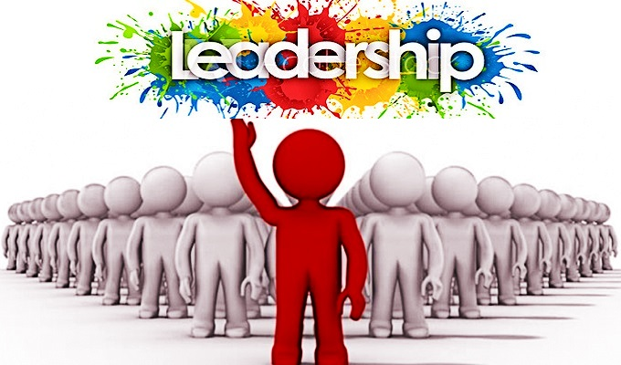
Class Discussion
Can you define leadership?
Each person to give you his or her definition of leadership, and to describe his or her personal beliefs about effective leadership.

Slide 4
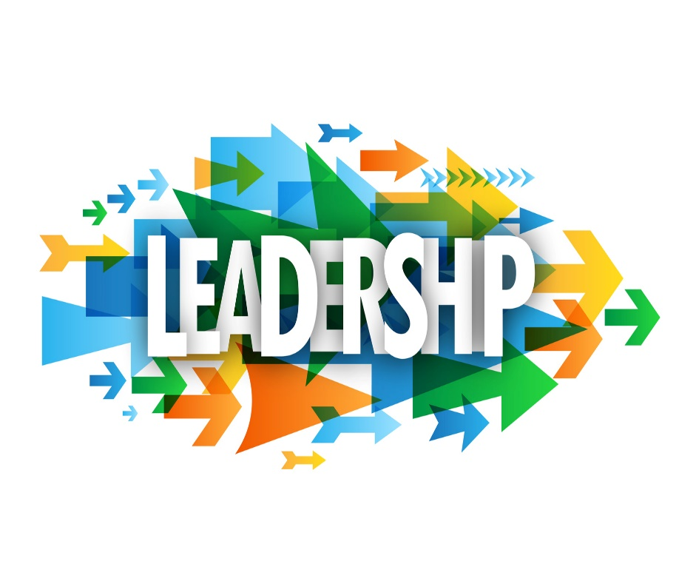
Introduction
Leadership is exciting but carries with it many responsibilities.
Leadership is a mutual influence process.
Leadership demands placed on individuals who are leaders.
This session examines different ways of looking at leadership.

Slide 5
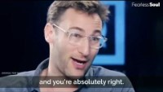
Leadership According to Leadership Guru
Simon Sinek

Slide 6
The Evolution of Leadership
Trait Approach
Behaviour Approach
Situational Approach
Relational Approach
“New Leadership” Approach
Emerging Leadership Approaches

Slide 7
How to Think about Leadership
As an approach
- A general way of thinking about leadership, not necessarily based on research.
As a theory or model
- A way of explaining how leadership works, using hypotheses, principles, or propositions that can be tested.

Slide 8
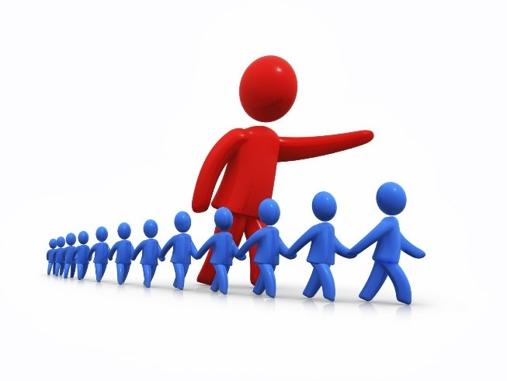
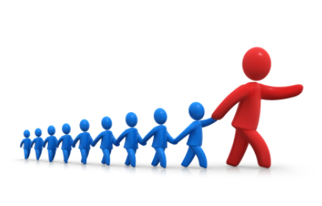
Class Discussion
Everyone is asked to be a leader.
What sort of leadership roles are you called on to play in your life?

Slide 9
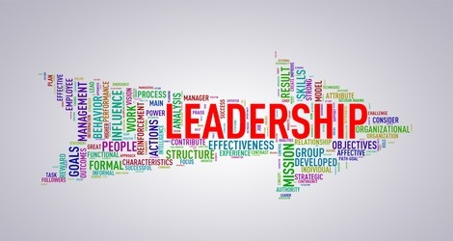
Leadership Explained
Leadership is a Trait.
Leadership is an Ability.
Leadership is a Skill.
Leadership is a Behaviour.
Leadership is a Relationship.
Leadership is an Influence Process.

Slide 10
Leadership Explained (1)
Leadership Is a Trait
  Trait: Bringing influencing qualities.
  Belief that traits are innate.
  All people have unique traits.
  Right trait in right situation.

Slide 11
Leadership Explained (2)
Leadership Is a Ability
  Ability: Capacity to lead.
  Ability is both natural and acquired.
  Leadership as ability example: UCLA coach John Wooden.
  We can develop our abilities through hard work and practice.

Slide 12
Leadership Explained (3)
Leadership Is a Skill
  Skill: Competency to accomplish task.
  Know what to do and how to do.
  Can be studied and learned.

Slide 13
Leadership Explained (4)
Leadership Is a Behaviour
  Behavioural dimension.
  Leadership behaviours are observable and require two behaviours:
      Task behaviours.
      Process behaviours.
  Effective leaders combine these two behaviours in the optimum way.

Slide 14
Leadership Explained (5)
Leadership Is a Relationship
  Collaboration between leaders and followers.
  Not linear but an interactive event.
  Ethical implication of including followers’ interests.

Slide 15
Leadership Explained (6)
Leadership Is an Influence Process
  Influence the group to achieve common goal.
  Interactive event between leader and followers.
  Giving leadership ethical dimension.

Slide 16
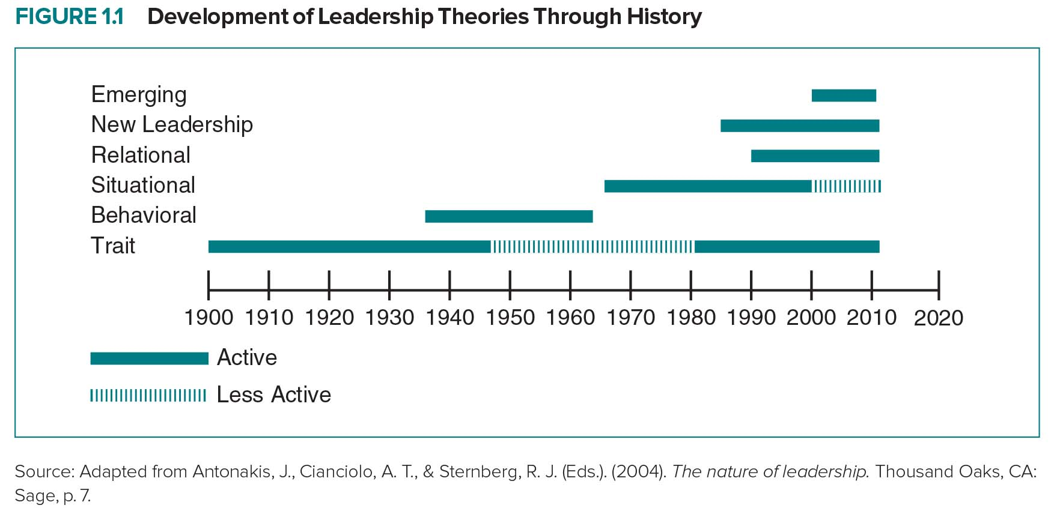
Development of Leadership Theories Through History

Slide 17
Emerging Leadership Approaches
A diverse range of approaches to leadership is emerging during the 21st century:
  Adaptive leadership examines how leaders help people address problems, face challenges, and adapt to change.
  Authentic leadership is an approach that looks at the authenticity of leaders and their leadership and is currently enjoying strong interest.
  Spiritual leadership considers how leaders use values, a sense of “calling,” and membership to motivate followers.
  Servant leadership emphasizes the “caring principle” with leaders as “servants” who focus on their followers’ needs in order to help these followers become more autonomous, knowledgeable, and like servants themselves.
  Gender-based studies, which have gained much momentum as women continue to become more dominant in the workforce, especially on a global level, view how one’s gender affects and differentiates one’s leadership.

Slide 18
Universal Leadership Attributes
Positive Leader Attributes
Trustworthy Foresighted Positive Builds confidence Intelligent Win-win problem solver Administratively skilled Excellence oriented | Just Plans ahead Dynamic Motivational Decisive Communicative Coordinator | Honest Encouraging Motivator Dependable Effective bargainer Informed Team builder
Negative Leader Attributes
Loner Irritable Ruthless | Asocial Nonexplicit Dictatorial | Noncooperative Egocentric
Source: Adapted from House, R. J., Hanges, P. J., Javidan, M., Dorfman, P. W., & Gupta, V. (Eds.). (2004). Culture, leadership, and organizations: The GLOBE study of 62 societies. Thousand Oaks, CA: Sage, pp. 677–678. Reprinted with permission.

Slide 19
Practicing Leadership
There is a strong demand for leadership today.
People want effective leadership.
Effective leadership is intentional and creates change for the common good.
The challenge is to be prepared to lead when called on.

Slide 20
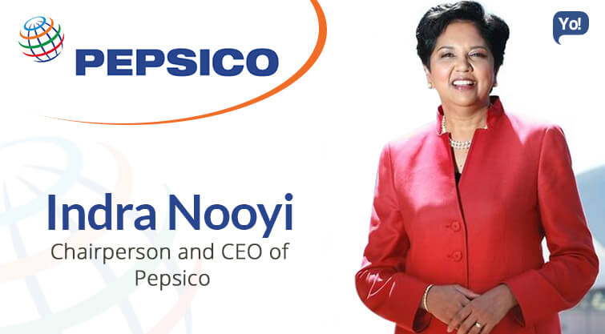
Leadership Snapshot
Indra Nooyi, CEO of PepsiCo
  One of the top female executives in the US.
  Grew up in Madras, India; always pushed conventional boundaries.
  Completed a Master’s in Management from Yale University.
  Worked for Boston Consulting Group (BCG), Motorola, and Asea Brown Boveri (ABB) before joining Pepsi.
  Chief dealmaker in acquiring Tropicana and Quaker Oats.
  Creating healthier products such as Pepsi Next.

Slide 21
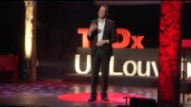
Great Leadership Starts With Self-leadership
https://www.youtube.com/watch?v=vlpKyLklDDY

Slide 22
Leadership vs. Management
  Purpose of management is to structure functions within organizations.
  Frederick Taylor: Key figure in management theory.
  Barnard’s conceptualization of authority.
  Difference between leadership and management.

Slide 23
Leadership vs. Management
Summarising the views of scholars who have attempted to differentiate between leading and managing, Kent draws attention to the following characteristics:
  managers do things right; leaders do the right things;
  managing is an authority relationship; leading is an influence relationship; and
  managing creates stability; leading creates change.

Slide 24

Stop Managing, Start Leading
https://www.youtube.com/watch?v=d_HHnEROy_w

Slide 25
The Dark Side of Leadership
Use of influence for personal ends.
Characterized by “toxicity”.
Current examples in world.
Leadership is complex and has many dimensions.
Demand for effective leadership.

Slide 26
Case Study – King of the Hill
Denny Hill's career as a high school swimming coach didn't start out well. The seniors on his team quit in the first season because he required them to come to all the workouts. The team only won three meets the whole season. That was 40 years ago. Since that time, the high school chemistry teacher's success as a swimming coach has been extraordinary: his winnings include more than 900 boys' and girls' dual meets and a phenomenal 31 state titles.
Denny is noted for creating a team effort out of what is usually considered an individual sport He begins every season with a team sleepover, followed by "Hell Week." a two-week grueling regimen in which team members swim at least 5 miles a workout and 10 miles a day. He acknowledges this is a bonding experience for the swimmers, regardless of their skill, because they are all in the same boat."
Denny passes the mantle of leadership onto his team members. Seniors are expected to be mature leaders who inform the freshmen of the team goals and expectations. Juniors are to be role models, while sophomores serve as quiet leaders who are still learning but have a foundation in the team culture. Even the freshmen members have a job: They are required to pay attention to the coaches and other team members as they learn the team's culture and what's expected.
Denny holds a 20-minute team meeting each Monday where every member has the opportunity to present a rose or a complaint to anyone on the team including the coaches. He is tough on swimmers and makes them work, but when they need support he is always there to put an arm around them. Denny also uses humor, often making jokes that help take the edge off long, hard workouts. And despite his teams' successes, Denny isn't about winning; he's more about preparing to win-telling his swimmers that by preparing to win, everything takes care of itself. When you do win, he says, you've done it the right way.

Slide 27
Case Study – King of the Hill
What leadership traits account for Denny Hill's success?
How would you describe Denny Hill's leadership abilities?
Leadership includes administrative skills, Interpersonal skills, and conceptual skills. How does Denny Hill stack up on these skills?
How does Denny Hill integrate task and relationship behaviours in his leadership
From a relational perspective, how would you describe Denny Hill's leadership?
In what way does Denny Hill's coaching exemplify leadership as an influence process?

Slide 28
Summary
All of us at some time will be asked to show leadership.
Leadership is demanding and rewarding.
Leadership is complex and multidimensional.
Leadership is a trait, ability, skill, behaviour, relationship, and influence process.
How you think about leadership will influence the way you practice leadership.

Slide 29

Any Questions?
Thank You ☺

