Slide 1
Presentation on
Shortage staff in Hospitality industry
Student name: Rahima begum
Student ID: 2121103

Slide 2
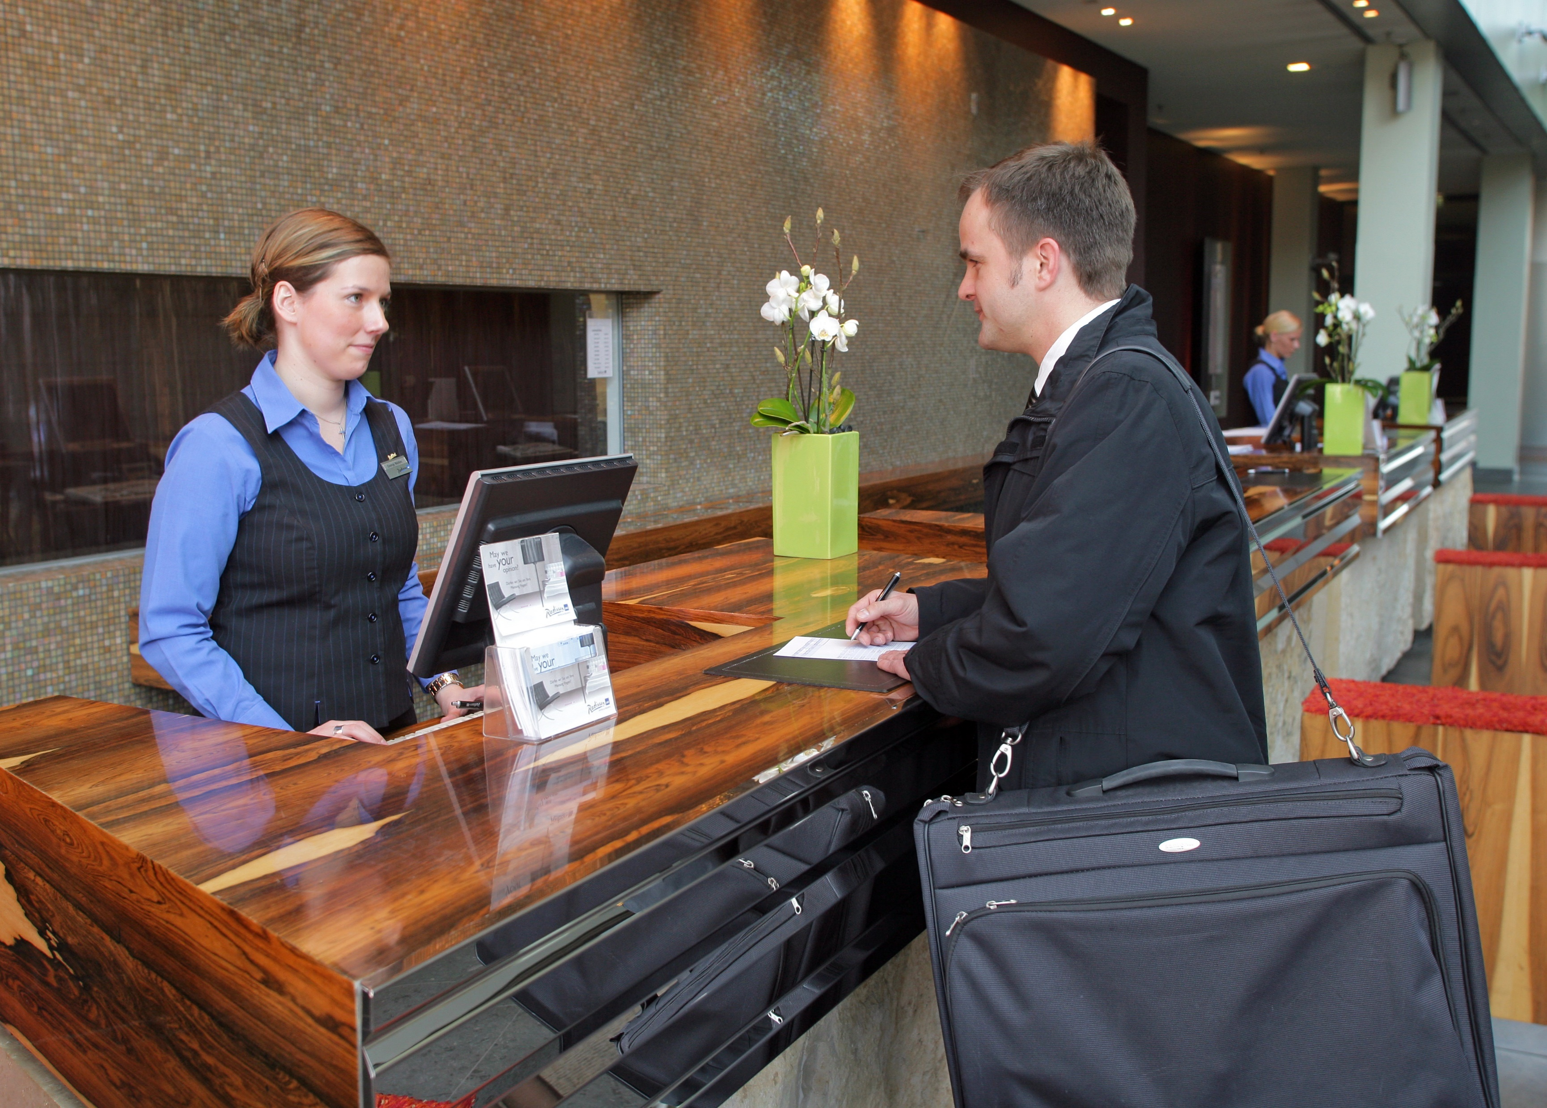
Introduction
In hospitality industry the staff shortage has a very negative impact on the performance and it ruins the reputation of this industry. It is a common case in this sector. However this problem can be reduced through application of smart management and with the smart investment in the technology. This problem has become severe after the outbreak of Covid 19 pandemic, as may people lost their job during this pandemic. In this presentation the reasons behind this problem and different ways of solution will be discussed.

Slide 3

Reasons behind staff shortage in Hospitality
Poor scheduling
work culture
Less opportunity of Training and career progression
Workload
Pandemic effect.
Security of Job .

Slide 4
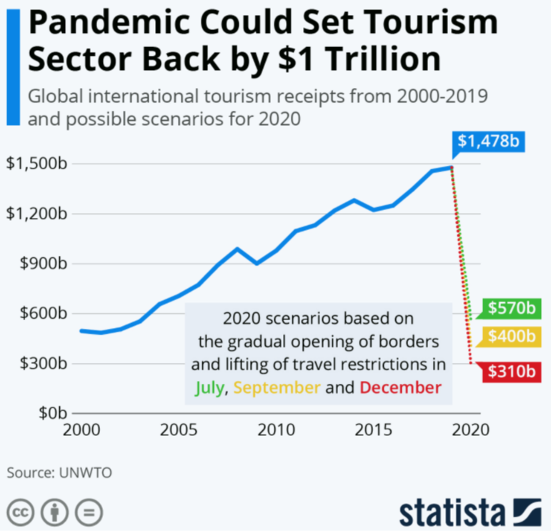
Pandemic effect
Shortage of staff become severe after the outbreak of Covid-19 Pandemic when million of staffs lost their lost job and became unemployed suddenly. This case was common in hotel, transportation, restaurants, Airline Industry. if it is compared with other industry with hospitality industry, it is found that the rate in very high in hospitality sector (Eisenhauer, 2022).

Slide 5
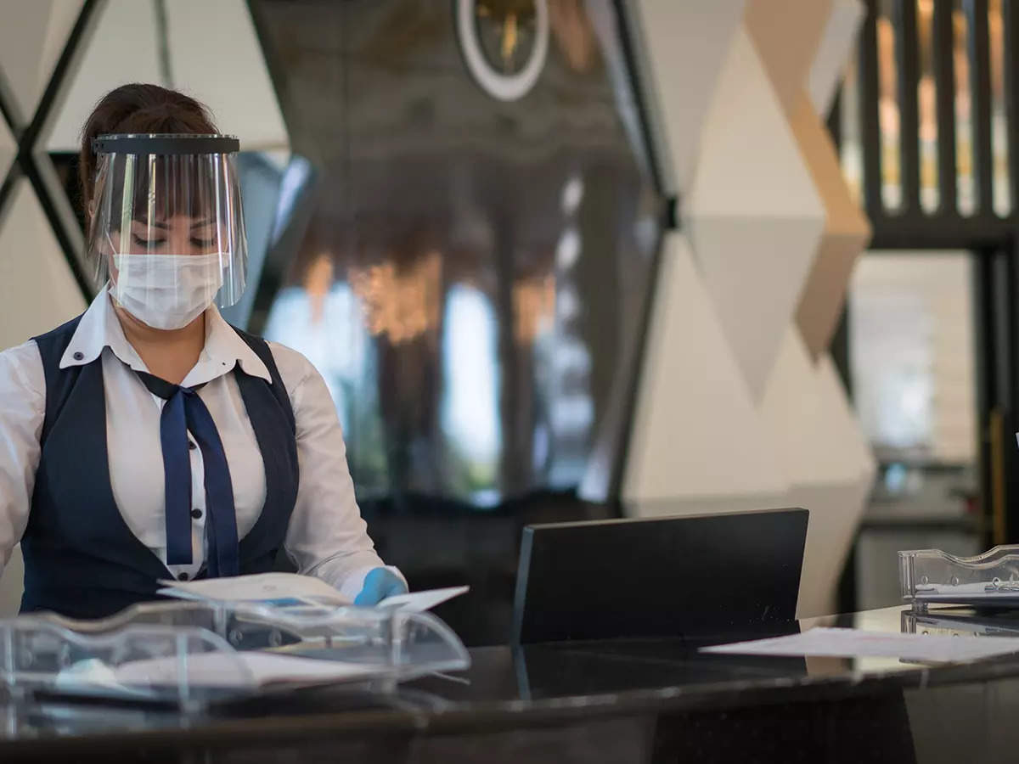
Pandemic effect (Cont…)
It cause many people hopeless during the pandemic at that situation. Most of them even did not get any compensation at all from their companies where they worked for. The scenario has been changed over night. As common people even could not permitted to go outside during the pandemic. So hospitality sector passed 1 year alomost without any customer (Kanwar and Sharma, 2016). It that situation it was quite impossible for company to pay the staff as there were no revenue generation.

Slide 6

Jab security
Job safety in common preference of all kinds of employees in every sector of the world. Hospitality sector is not different at all. People noticed what happed with the employees of Hospitality industry Covid-19 pandemic. Due to this problem many people still not interested in to work in this hospitality industry (Slotosch, 2022).

Slide 7
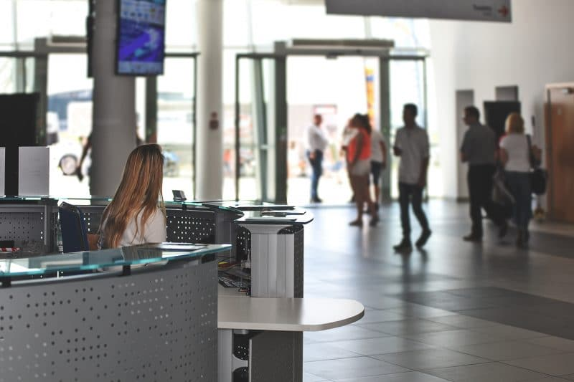
Poor scheduling
Hospitality sectors in different form other business sector in term of scheduling of working. Most of the workers have to work in different shifts in month in hospitality sector especially in transportation, hotel industry which is not commo in other business sector. Many people are not used to with this and many do not like that, as it has a negative impact on mental and physical health (Atadil and Lu, 2021).

Slide 8
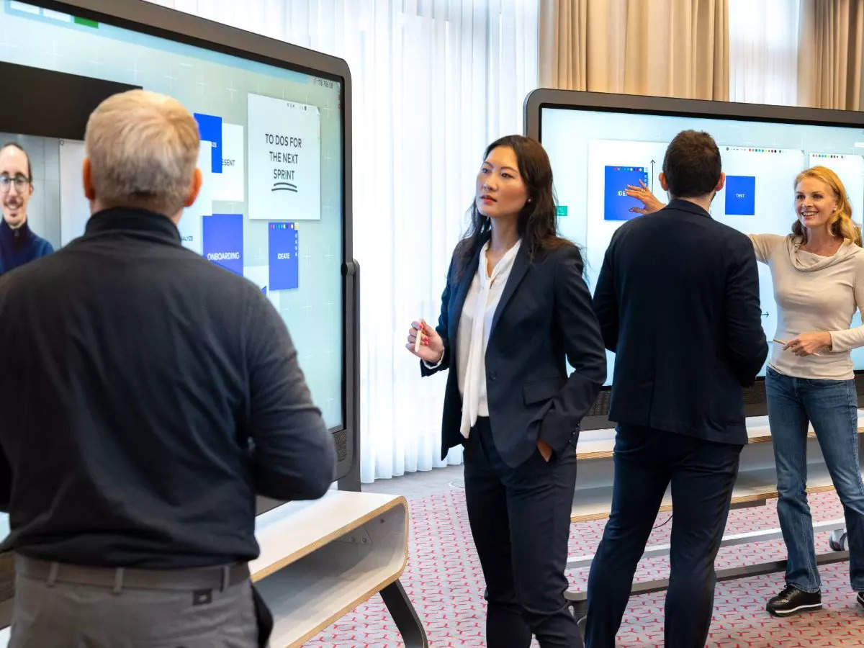
workload
During vacations the workload is huge in hospitality industry. Because the number of consumers become suddenly boom during the vacations if it compared with other common days. At that situation it is difficult for the employees of hospitality industry. It is also not possible for management to recruit instant and faces shortage of staffs (Gallup, 2022).

Slide 9

work culture
As it is known that the work culture is quite different form other business industry. Due to different workplace culture many employee are not interested to work in this sectors (Ponting, 2021). For example, an employee of transportation industry has to travel one place to another place to do this job Or a tourist guide have to travel with the travelers with force them to stay away from their family for long time.

Slide 10

Way to sort out this problem
ensuring job security
Establishing training and development
Ensure healthy and friendly workplace
Smart work scheduling
lessen the workload during the vacation
Ensure financial security for the employees

Slide 11

Conclusion
I always wish to work in the hospitality sector specially in Hotel industry. It is my dream to work in five star hotel as employee. After the pandemic this sector in booming day by day. I believe hospitality industry will sort this problem very soon. My ultimate plan is to open a five star hotel chain in London. Before that I will work for a Five star hotel in London to earn and gather experience as well. Then I will open my own hotel chain.

Slide 12
References
Atadil, H.A. and Lu, Q., (2021). An investigation of underlying dimensions of customers’ perceptions of a safe hotel in the COVID-19 era: Effects of those perceptions on hotel selection behavior. Journal of Hospitality Marketing & Management, 30(6), pp.655-672.
Deloitte, 2015. Becoming irresistible: A new model for employee engagement. [online] Deloitte Insights. Available at: <https://www2.deloitte.com/us/en/insights/deloitte-review/issue-16/employee-engagement-strategies.html> [Accessed 15 October 2022].
Eisenhauer, T., 2022. 7 Employee Engagement Tips from the Best Hotel in the World. [online] Axero Solutions. Available at: <https://axerosolutions.com/blog/7-employee-engagement-tips-from-the-best-hotel-in-the-world> [Accessed 16 October 2022].
Gallup, I., 2022. State of the Global Workplace Report. [online] Gallup.com. Available at: <https://www.gallup.com/workplace/349484/state-of-the-global-workplace-2022-report.aspx> [Accessed 16 October 2022].
Gallup, I., 2022. The World's $7.8 Trillion Workplace Problem. [online] Gallup.com. Available at: <https://www.gallup.com/workplace/393497/world-trillion-workplace-problem.aspx> [Accessed 16 October 2022].
Kanwar, D. and Sharma, P., 2016. "employee engagement: identifying gaps in hospitality industry" to "employee engagement: an overview." South Asian Journal of Marketing &amp; Management Research, 6(10), p.70.
Lee, J., 2012. Antecedents and consequences of employee engagement: Empirical study of hotel employees and managers (Doctoral dissertation, Kansas State University).
Lee, Y., Kim, S. and Kim, S., 2013. The Impact of Internal Branding on Employee Engagement and Outcome Variables in the Hotel Industry. Asia Pacific Journal of Tourism Research, 19(12), pp.1359-1380.
Ncube, F. and Jerie, S., 2012. Leveraging employee engagement for competitive advantage in the hospitality industry. A comparative study of hotels A and B in Zimbabwe. Journal of Emerging Trends in Economics and Management Sciences, 3(4), pp.380-388.
Shen, H. and Jiang, H., 2019. Engaged at work? An employee engagement model in public relations. Journal of Public Relations Research, 31(1-2), pp.32-49.
Slotosch, A., 2022. FRHI Hotels & Resorts Wins 2015 Employee Engagement Ragan Award - Beekeeper. [online] Beekeeper. Available at: <https://www.beekeeper.io/blog/frhi-hotels-resorts-wins-2015-ragan-award-employee-engagement/> [Accessed 16 October 2022].
Wang, C., Xu, J., Zhang, T.C. and Li, Q.M., 2020. Effects of professional identity on turnover intention in China's hotel employees: The mediating role of employee engagement and job satisfaction. Journal of Hospitality and Tourism Management, 45, pp.10-22.
Ponting, S.S.A., (2020). Organizational identity change: impacts on hotel leadership and employee wellbeing. The Service Industries Journal, 40(1-2), pp.6-26.

