Slide 1
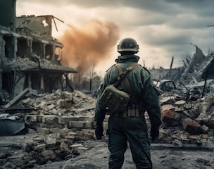
POST-TRAUMATIC STRESS DISORDER DURING AND AFTER
II WORLD WAR
A PSYCHOLOGICAL LEGACY OF TRAUMA (1939-1950)
Notes:
Good Morning everyone
Today, we will dive into the psychological impacts of World War II, particularly focusing on post-traumatic stress disorder, or PTSD.
This presentation will examine the experiences of soldiers, civilians, and Holocaust survivors, highlighting on how this era shaped our understanding of trauma.

Slide 2
CONTENTS PAGE
1-TITLE AND SUBTITLE
3- WHAT IS PTSD
4- PSYCHOLICAL IMPACT ON SOLDIERS
9- TRANSGENERATIONAL EFFECTS
5- PSYCHOLOGICAL IMPACT ON CIVILIANS
6- SPECIAL FOCUS: HOLOCAUST SURVIVORS
7- CHILDREN IN WWII
10- ADVANGES IN UNDERSTANDING PTSD POST-WWII
11- CONCLUSION
12 – 14 REFERENCES
8- GENDER AND AGE DIFFERENCES IN PTSD
15- DECLARATION ACKNOLEDWE I USE OF AI

Slide 3
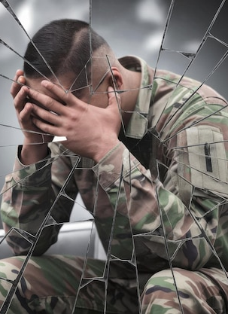
WHAT IS PTSD?
PTSD
Is a condition caused by exposure to extreme trauma.
INTRUSIVE THOUGHTS & MEMORIES:
Flashbacks with reminders of the traumatic event, thinking that what happened in pass is happening in that moment
EMOTIONAL DETACHMENT: When the individual feels disconnected from their emotions or experiences a reduced ability to feel and express emotional responses
NIGHTMARES:
When the individual is dreaming and, in their dreams, they remember all what happened in that traumatic event
HYPERVIGILANCE:
The individual is always in state of heightened alertness and sensitivity to potential threats or danger in the environment.
Notes:
While PTSD as a formal diagnosis came later in 1980’s, the symptoms were evident in those who lived through WWII. From soldiers in combat to civilians enduring bombings or victims of the Holocaust in persecution. This era offers crucial insights into the human response to extreme trauma.

Slide 4
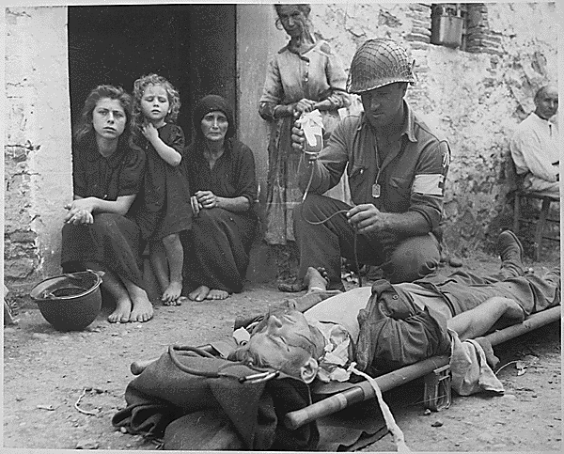
PSYCHOLOGICAL IMPACT ON SOLDIERS
SOLDIERS FACED
Witnessing loss of comrades
SYMPTOMS DOCUMENTED
Emotional Numbness
Severe injuries and disfigurement.
Hypervigilance
Nightmares and Flashbacks
Constant threat of death
Notes:
Combat during WWII was merciless, and soldiers were pushed to their limits. Soldiers often displayed emotional numbness and hypervigilance. While camaraderie provided some relief, many struggled with re-integrating into society after the war. Term like “shell shock” underscored the lack of understanding PTSD, which affected countless veterans in silence.

Slide 5
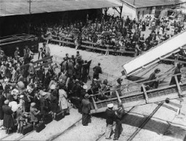
PSYCHOLOGICAL IMPACT ON CIVILIANS
TRAUMAS ENDURED
BOMBING RAIDS
DISPLACEMENT AND REFUGEE CRISES
CIVILIANS SYPMTOMS
CHRONIC ANXIETY
AVOIDANCE BEHAVIOURS
LOSS OF LOVED ONES
DEPRESSION AND GRIEF
Notes:
Civilians, often overlocked in wartime narratives, faced extraordinary trauma. Entire cities were reduced to rubble, and the psychological effect of displacement and loss shaped post-war generations.

Slide 6
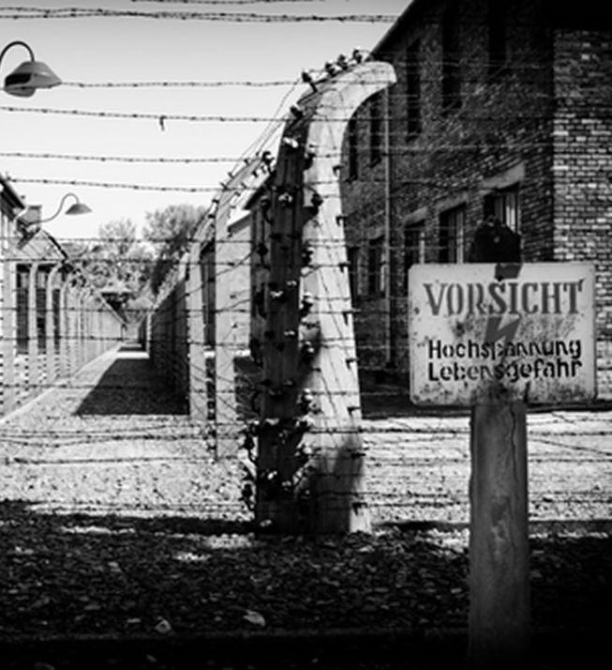
SPECIAL FOCUS:
HOLOCAUST SURVIVORS
TRAUMA EXPERIENCES
- Concentration Camps
- Family separation and loss
PSYCHOLOGICAL EFFECTS
- Intrusive memories
Difficulty forming emotional connections
- Prolonged terror
Survivor’s guilt
Notes:
Holocaust survivors faced multifaceted trauma. The horrors of the camps or the isolation of hiding deeply affected their mental health, with many suffering from intrusive memories and survivor’s guilt well into their later years. The Holocaust survivors represents one of the most profound examples of wartime trauma . Their resilience is inspiring, but their struggles with PTSD symptoms, persisted long after liberation
.

Slide 7
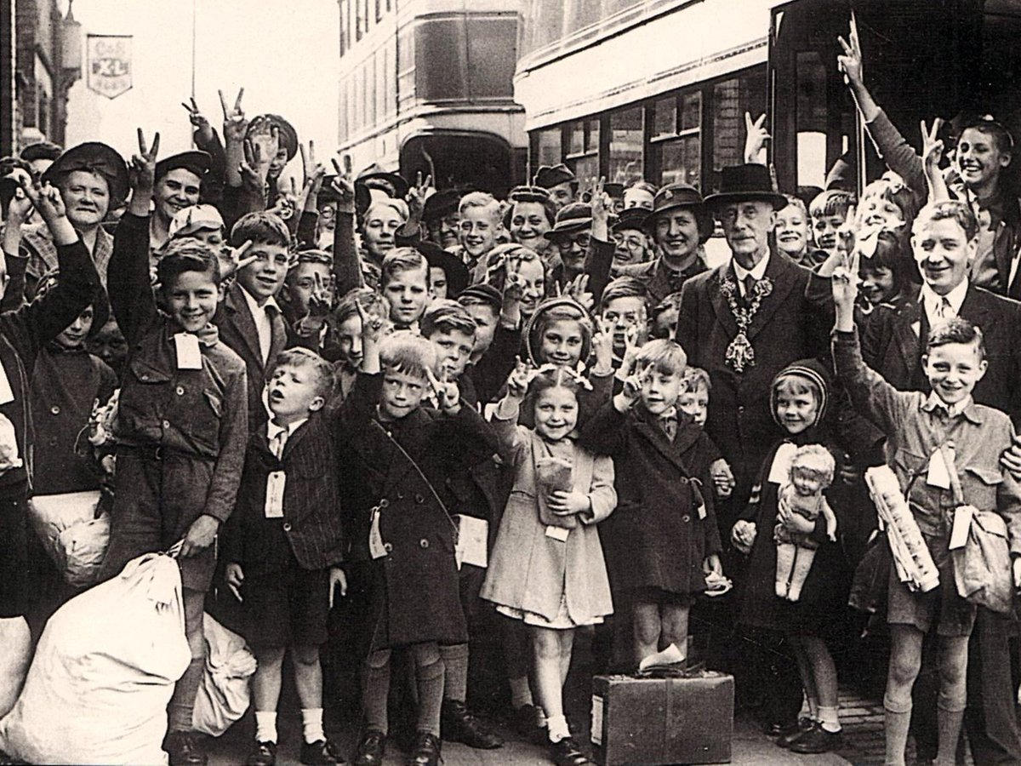
CHILDREN IN WORLD WAR II
TRAUMA TYPES
SEPARATION FROM FAMILY
WITNESSING VIOLENCE
LONG –TERM EFFECTS
PSYCHOGENIC AMNESIA
HYPERVIGILANCE
FORCED CONSCRIPTION
ANXIETY DISORDERS
Notes:
Children during WWII faced unique vulnerabilities. Their developmental stages amplified the impact of traumatic events, leaving them with long – term psychological effects.

Slide 8
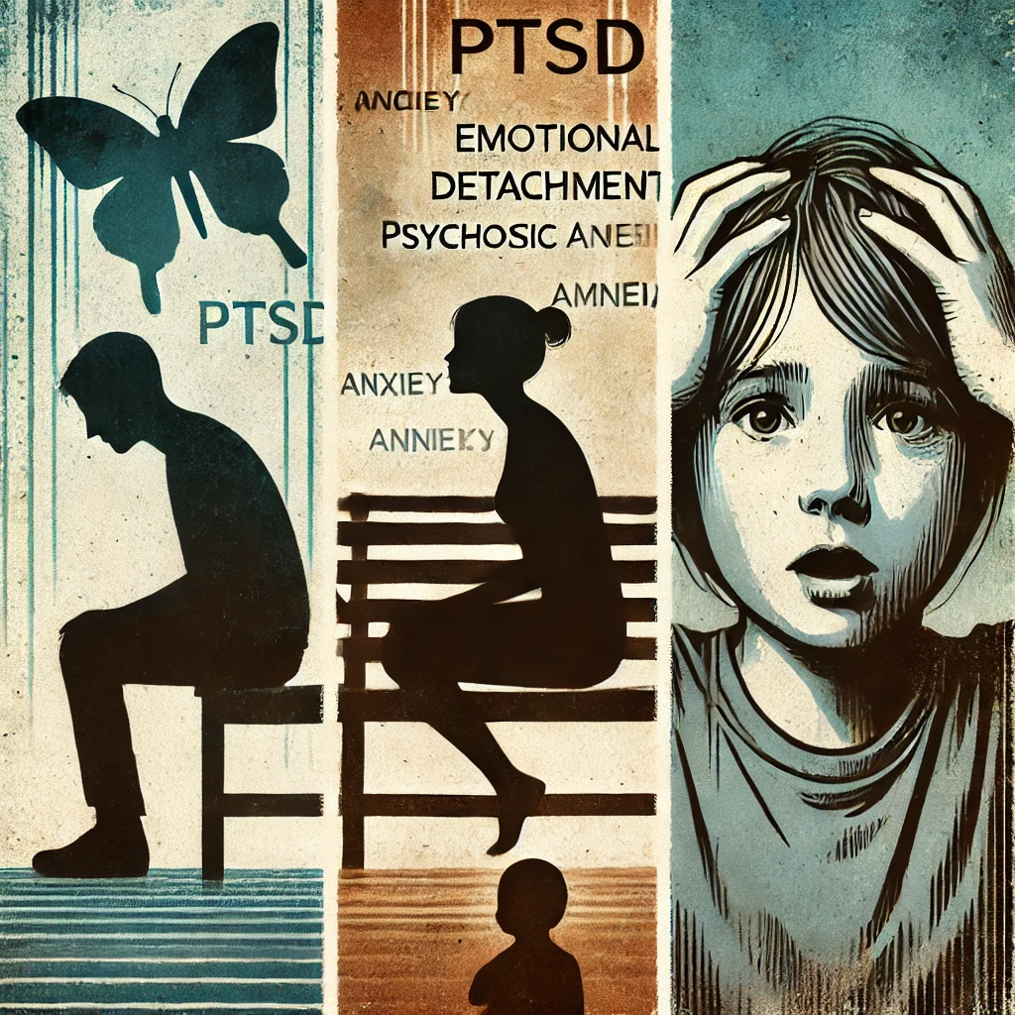
GENDER AND AGE DIFFERENCES IN PTSD
MEN
MORE LIKELY TO REPORT EMOTIONAL DETACHMENT
WOMEN
HIGHER RATES OF ANXIETY AND AVOIDANCE
CHILDREN
GREATER INCIDENCE OF PSYCHOGENIC AMNESIA
Notes:
Age and gender played a significant roles in PTSD presentation. Men often coped through detachment, while women exhibited higher anxiety levels. Children, particularly vulnerable, showed unique symptoms like amnesia.

Slide 9
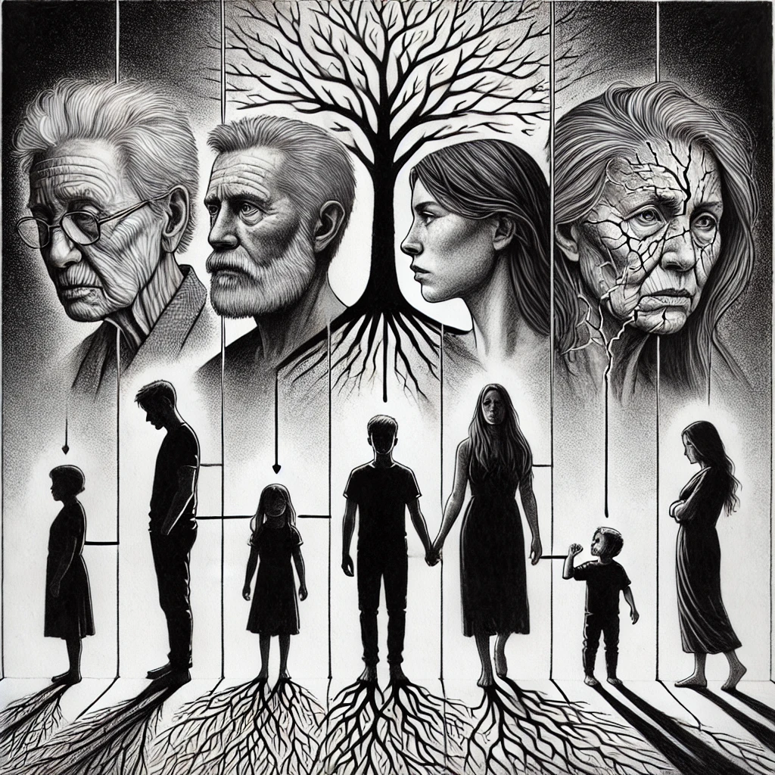
TRANSGENERATIONAL EFFECTS
TRAUMA PASSED THROUGH
ANXIETY
RESILENCE SHAPED BY FAMILY NARRATIVES
EFFECT ON DESCENDATNTS
EMOTIONAL RESPONSES
PARENTING STYLES
Notes:
Trauma did not stop with the survivors. Through emotional and behavioural patterns, their experiences influenced their children, often creating cycles of anxiety but also resilience

Slide 10
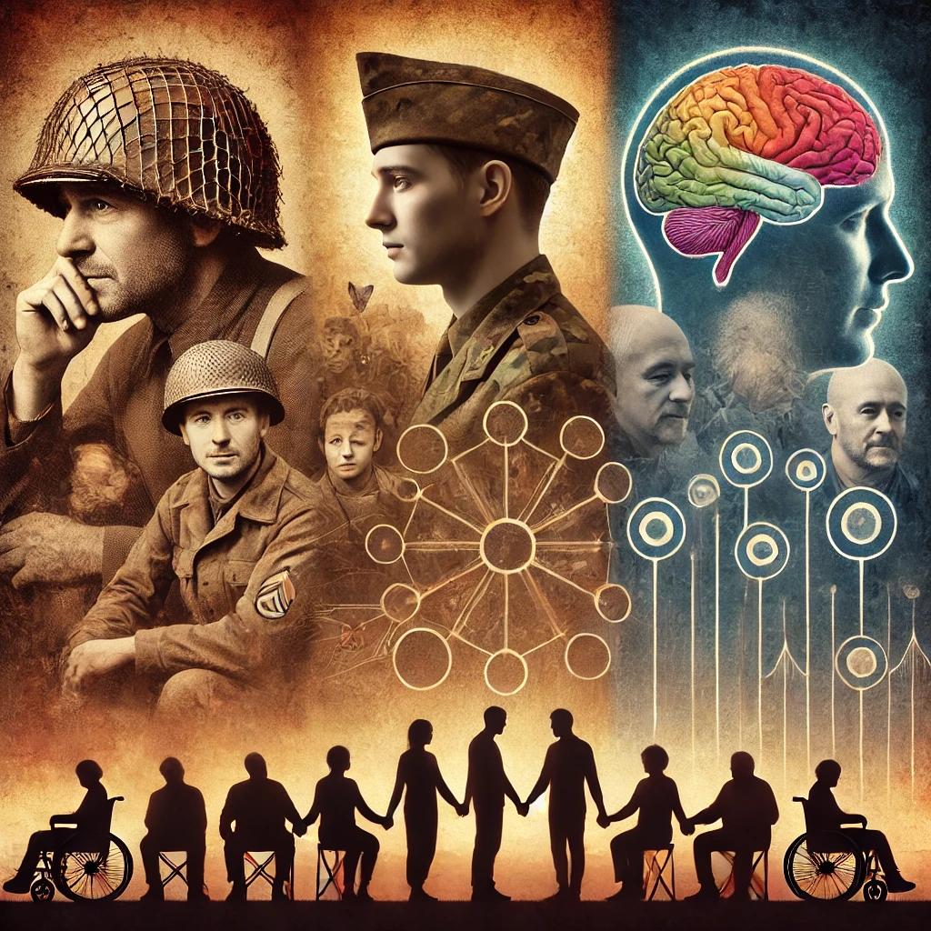
ADVANCES IN UNDERSTANDING
PTSD POST – WORLD WAR II
KEY MILESTONES
PTSD FORMALLY RECOGNISED IN THE 1980’S
THERAPEUTIC PROGRESS
COGNITIVE BEHAVIOURAL THERAPY (CBT)
LESSONS FOR MODERN MENTAL HEALTH
RECOGNISING DIVERSE TRAUMA EXPERIENCES
RESEARCH: VETERANS FROM WWII, CIVILIANS IN WAR ZONES
EYE MOVEMENT DESENSITISATION AND REPROCESSING (EMDR)
TAILORED INTERVENTIONS FOR SYMPTOM CLUSTERS
EMPHASISING LONG-TERM CARE AND COMMUNITY SUPPORT
Notes:
It took decades to fully understand PTSD, yet we now have transformative treatments. The experiences of WWII survivors underline the importance of personalising mental health care. Recognising unique symptoms patterns and fostering community support are critical to effective recovery.

Slide 11
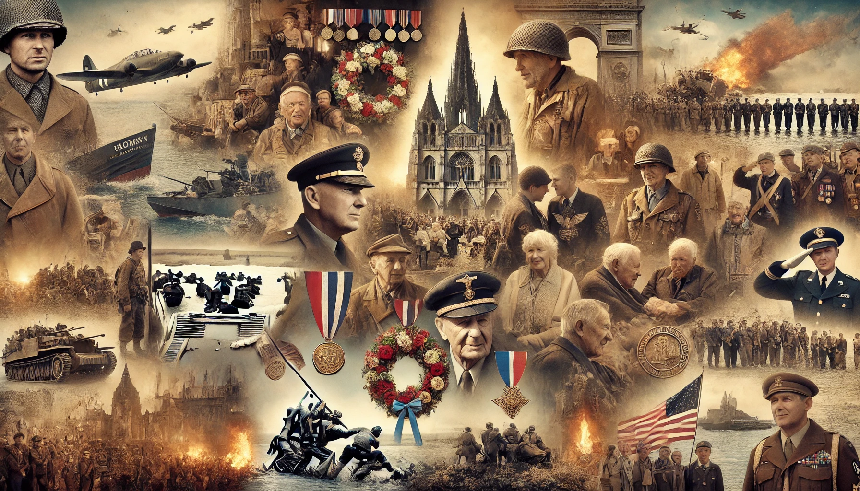
CONCLUSION
WORLD WAR II SHAPED MODERN UNDERSTANDING PTSD
DIVERSE EXPERIENCES
IMPORTANCE OF LONG – TERM MENTAL HEALTH CARE
ROLE OF CUMULATIVE STRESS
Notes:
To conclude, the Holocaust provides profound lessons about the enduring impacts of trauma. These findings not only honour survivor's experiences but also inform more effective treatments for traumatised populations worldwide.
The psychological scars of WWII have not only shaped individual lives but also laid the groundwork for our understanding of trauma. These lessons remind us of the resilience of the human spirit and the importance of addressing mental health proactively.

Slide 12
REFERENCES
WEBSITES
Freepik. (n.d.). Concepto de guerra: Hombre militar en uniforme de la Segunda Guerra Mundial contra un fondo de edificios destruidos. Retrieved January 2, 2025, from https://www.freepik.es/imagen-ia-premium/concepto-guerra-hombre-militar-uniforme-segunda-guerra-mundial-contra-fondo-edificios-destruidos-soldado-pie-medio-ruinas-ciudad-destruida-despues-explosion-nuclear_141209976.htm
Freepik. (n.d.). Soldado estresado sentado con la cabeza en las manos detrás de un vidrio roto: Concepto de salud mental militar. Retrieved January 2, 2025, from https://www.freepik.es/imagen-ia-premium/soldado-estresado-sentado-cabeza-manos-detras-vidrio-roto-concepto-salud-mental-militar_341269925.htm
Universidad Complutense de Madrid. (n.d.). Atención sanitaria en el campo de batalla: SGM. Retrieved December 27, 2024, from https://www.ucm.es/historiadelasalud/atencion-sanitaria-en-el-campo-de-batalla-sgm
United States Holocaust Memorial Museum. (n.d.). Refugees. Retrieved December 26, 2024, from https://encyclopedia.ushmm.org/content/es/article/refugees

Slide 13
March of the Living UK. (n.d.). Auschwitz-Birkenau. Retrieved December 29, 2024, from https://www.marchoftheliving.org.uk/location/auschwitz-birkenau/
Lancashire Post. (n.d.). Evacuees who spent their war years living in Lancashire. Retrieved January 3, 2025, from https://www.lep.co.uk/heritage-and-retro/retro/evacuees-who-spent-their-war-years-living-in-lancashire-2894092
DOCUMENTS
Jelinek, L., Wittekind, C. E., Moritz, S., Kellner, M., & Muhtz, C. (2013). Neuropsychological functioning in posttraumatic stress disorder following forced displacement in older adults and their offspring. Psychiatry Research, 210, 584–589. https://doi.org/10.1016/j.psychres.2013.06.037.
Rzeszutek, M., Dragan, M., Lis-Turlejska, M., Schier, K., Holas, P., Pięta, M., ... & Szumiał, S. (2023). Long-lasting effects of World War II trauma on PTSD symptoms and embodiment levels in a national sample of Poles. Scientific Reports, 13, Article 17222. https://doi.org/10.1038/s41598-023-44300-6.

Slide 14
Glück, T. M., Tran, U. S., Raninger, S., & Lueger-Schuster, B. (2016). The influence of sense of coherence and mindfulness on PTSD symptoms and posttraumatic cognitions in a sample of elderly Austrian survivors of World War II. International Psychogeriatrics, 28(3), 435–441. https://doi.org/10.1017/S104161021500143X.
Kuwert, P., Glaesmer, H., Eichhorn, S., Grundke, E., Pietrzak, R. H., Freyberger, H. J., & Klauer, T. (2014). Long-term effects of conflict-related sexual violence compared with non-sexual war trauma in female World War II survivors: A matched pairs study. Archives of Sexual Behaviour, 43(6), 1059–1064. https://doi.org/10.1007/s10508-014-0272-8.
Rzeszutek, M., Lis-Turlejska, M., Krajewska, A., Zawadzka, A., Lewandowski, M., & Szumiał, S. (2020). Long-term psychological consequences of World War II trauma among Polish survivors: A mixed-methods study on the role of social acknowledgment. Frontiers in Psychology, 11, Article 210. https://doi.org/10.3389/fpsyg.2020.00210.
Ritter, A. (2019). Escape from traumas: Emigration and Hungarian Jewish identity after the Holocaust. The American Journal of Psychoanalysis, 79, 577–593. https://doi.org/10.1057/s11231-019-09223-0.
Rzeszutek, M., Dragan, M., Lis-Turlejska, M., Schier, K., Holas, P., Pięta, M., ... & Szumiał, S. (2023). Long-lasting effects of World War II trauma on PTSD symptoms and embodiment levels in a national sample of Poles. Scientific Reports, 13, Article 17222. https://doi.org/10.1038/s41598-023-44300-6.

Slide 15
DECLARATION ACKNOLEDWE I USE OF AI
I acknowledge the use of CHATGPT, https://chatgpt.com/c/67790f94-2158-8010-97a5-bd88db26350d on 04th January 2025 to get an image represents information. I used the prompt(s):
Collage capturing the emotional and historical essence of World War II , includes Veterans and Soldiers, Historical Events, Civilians and Survivors , Memorials and Tributes , Generations …
Image represents the Key aspects of PTSD understanding and treatment advancements, integrating historical and modern elements alongside community care

