Slide 1
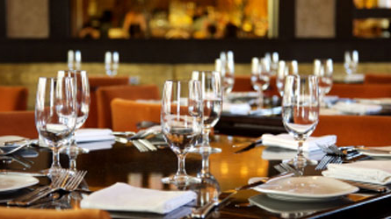
Hotel Placement – Food & Beverage Operations
(M4X01918_BIRM)
Student : Andreea Ionela Moldoveanu
Student number: 1815215
Lecturer: Jazz

Slide 2
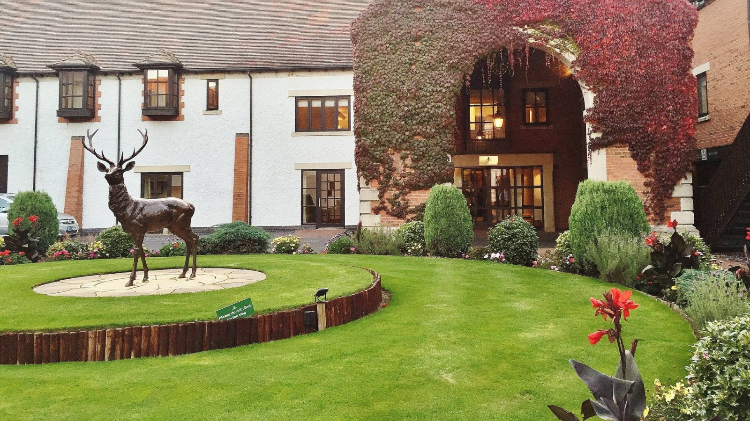
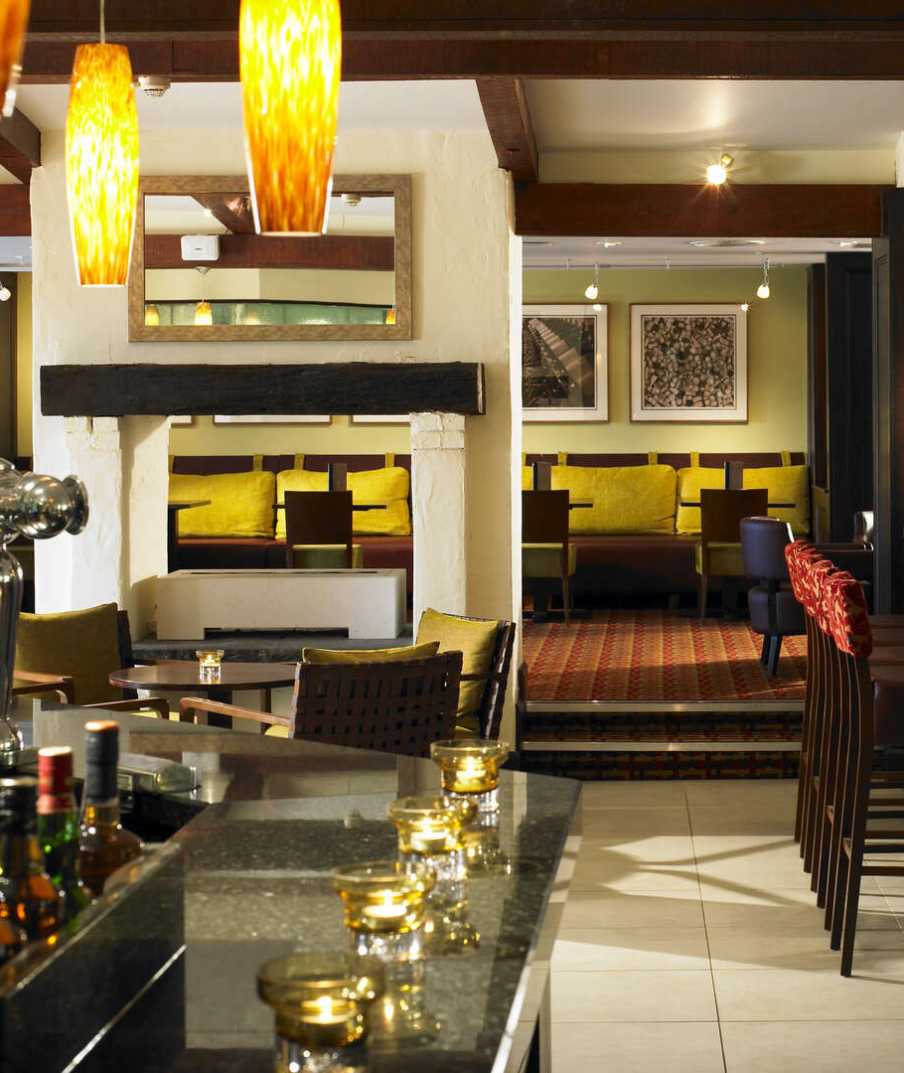
Activity: Food & Beverage Operations at Forest and what they are doing for achieving their future goals in this hotel.

Slide 3


Food & Beverage Operations
Food and Beverage Operations
Terrace for Golf Club
Meeting Rooms
Room Service
Zest Bar
Cast Iron Restaurant

Slide 4

Food & Beverage Processes
These services contains a lot of activities. Starting with the raw material that is received, and organize F&B, continuing with the inventory of all the products received and finishing with keeping the service quality. Also, refers to events that the employees must know how to manage and to analyze the results that the organization has. This thing is important for the future, to know what they must do and to conclude the policies from the future.

Slide 5

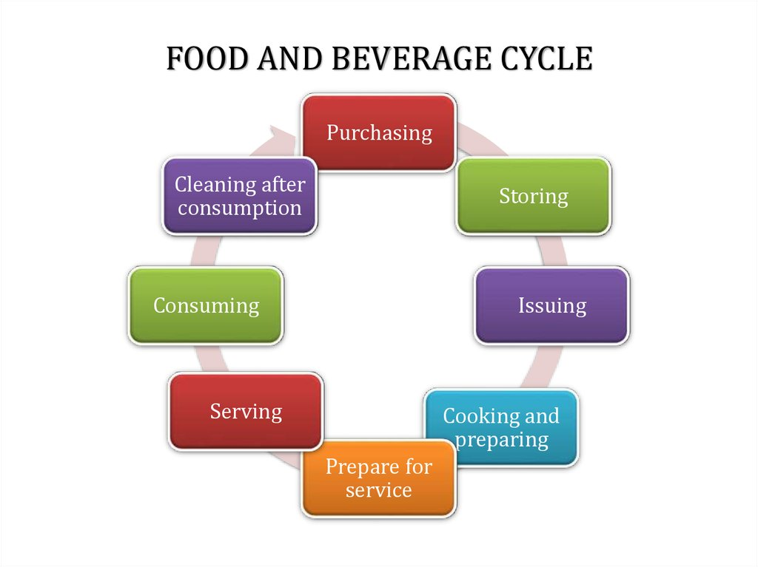

Slide 6

4. Preparation and Presentation
1.Procuring
2. Collecting
3. Stockpile
At Forest of Arden, the purchase of products is influenced by the size of F&B, possibility and Size of Depository that at Forest is huge and they have cold room for drinks, for fruits, for vegetables. Another thing that influence the purchasing is number of guests.
They receive the products form suppliers. They check the quality and quantity and sign some papers for receiving. and store them.
They bring up to date the stockpile and control the old and new products that are in the stockpile. The old ones are putted in front and the new ones in the back of the old ones
The bar tenders are preparing cold beverages like cocktails. The chefs are preparing the hot food. The F&B is arranging the tables, decorate the restaurant and dishes.

Slide 7
5. Consuming
Being a 4 star hotel, Forest of Arden is delivering services at high standards, in specially because there are a lot of meetings rooms, guests that are coming for playing golf, and so one. It is hard to keep high standards but not impossible.
This is for customers. After they finish, the waiter is bringing the note for paying and clean the table. The employees make the stockpile and keeps updated.

Slide 8

Food & Beverage Standards
They check the temperatures of fridges, also they write the temperatures in a paper, twice per day. Also, they check the expiring date of the products, every day.
Responsibility: hygienic, safety, tidy and fresh foodstuff.
They use HACCP

Slide 9

Managing Buffets, Banquets, and Catered Events
Factors:
1.Type of Ceremony
2.Involvment of different persons
3.Ceremony demands
4.Decors
5. Menu
6. Serving equipment
7. Serving Norms
Forest of Arden Managers are taking seriously all of these factors and doing their best for delivering the best services. In this way, the guests are happy and the business is safe.

Slide 10

Food and Beverage is the most and critical area because is about the health of guests. At Forest of Arden, the managers are very carefully with everything and they assure every day that all the operations are made in a correct way.

Slide 11

Academic Medicine, 1935. Food and Beverage Analysis. 10(6), p.385.
Adams, D., 2001. Principles of Food, Beverage and Laboure Cost Controls20014Paul Dittmer, Gerald G. Griffin. Principles of Food, Beverage and Laboure Cost Controls. J. Wiley, 1999 . 560 pp., ISBN: 0 471 29325 3 £35.50. International Journal of Contemporary Hospitality Management, 13(3), pp.159-160.
Bansal, T., 2016. Food And Beverage Operations. New Delhi, India: I.K. International Publishing House Pvt. Ltd.
Filtration & Separation, 2006. Food & Beverage: quality, cost and legislation key concerns. 43(2), p.4.
Hayes, P. and Forsythe, S., 2013. Food Hygiene, Microbiology And HACCP. New York, NY: Springer.
Kocatepe, D., 2017. Food security in Food & Beverage sector. Journal of Food Science and Nutrition Therapy, 3(1), pp.007-008.
Ojugo, C., 2010. Practical Food & Beverage Cost Control. Clifton Park, NY: Delmar, Cengage Learning.
Ninemeier, J., n.d. Management Of Food And Beverage Operations.

