Slide 1

Skanda Vale
Writing a reflexive Journal
Dr A davis

Slide 2
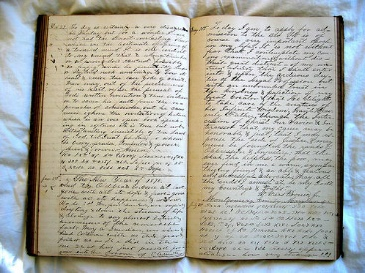
The reflexive Journal : assessment details
If you attend the Skanda Vale overnight field trip on Monday the 22.2 – returning 23.2, you will be required to submit a 2000 word reflexive journal via Moodle; date TBC.
This journal will include making explicit and in a coherent fashion, your thoughts, feelings and opinions on how you found the experiential encounter at the ‘ashram’ and whether your particular project aims were realised – or not.
You will be permitted to use the ‘first person’ ‘I’ throughout your journal but must support any claims and arguments that you make in accordance with standard referencing conventions set out by your particular school (i.e. Harvard).

Slide 3
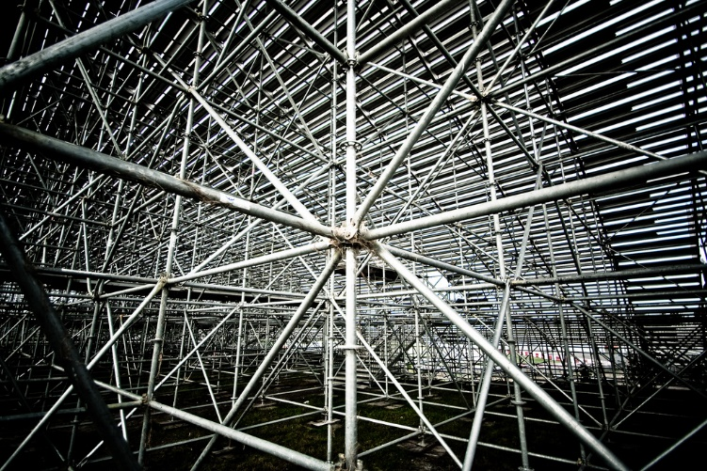
The reflexive Journal: structure and content
Your journal outline should already be underway – or at the very least you will have had the opportunity in class to discuss your particular interests and methodological approach.
When you make your physical notes ‘in the field’ (a good solid A5 lined journal book is recommended) try and avoid writing it up in a diary format.
Try instead to write up your journal in the form of an extended and reflexive essay.
Remember: you will not only be assessed on how well you describe your experiences but how thoroughly you critically evaluate your own ‘subject position’.

Slide 4

The reflexive Journal: ‘subject position’ and ‘reflexivity’.
The ‘subject position’ includes making explicit your own ‘assumptions’ and ‘preferences’ and how they have impacted on your choice of project and potential criticisms that you might have toward certain practices you encounter at the Ashram.
Your ‘subject position’ includes evaluating and making explicit in your journal how your emotions, opinions and attitudes have informed your project choice and conversely whether your encounters and experiences at Skanda Vale may have changed or altered your perspective.
Reflexivity is ‘… the idea that a person’s thoughts and ideas tend to be inherently biased. In other words, the values and thoughts of a person will be represented in their work’ (Investopedia).

Slide 5

The reflexive journal : a qualitative rationale (methodology)
For qualitative (reflexive work) to be viewed on an equal footing with quantitative data in the social sciences it must provide something extra to our explanatory and interpretive manifold.
In part at least it does this by revealing in a ‘reflexive’ manner the biases of the researcher – their ‘subject position’ far better than in the ‘quantitative’ discussions that supplement quantitative explanations in the social sciences i.e. sociology.
In making explicit or VISABLE our assumptions, biases and prejudices other academics are better able to critically assess the role of these biases in the formation and CONSTRUCTION of our arguments and explanations.
The reflexive journal is a key part of the methodological ‘tool kit’ which social anthropologists and social archaeologists routinely use in order to achieve this ‘visibility’.

Slide 6
The reflexive journal : academic perspectives
Ortlipp (2008: 695) writes that ‘The problem of bias in qualitative research particularly is still debated in methodology texts’ … ‘whether or not it needs to be “controlled,” and how it might be accounted for’
Ortlipp (2008: 695) observes ‘I chose to make my experiences, opinions, thoughts, and feelings visible and an acknowledged part of the research process through keeping reflective journals and using them in writing up the research ... [and] how reflective journals were used in engaging with the notion of creating transparency in the research process, and explore the impact of critical self-reflection on research design’
The role of reflexivity in ethnographic research attempts to make explicit and visible ‘… how the researcher’s own experiences, values, and positions of privilege in various hierarchies have influenced their research interests, the way they choose to do their research, and the ways they choose to represent their research findings’ (Harrison, MacGibbon, & Morton, 2001: 325).

Slide 7

The reflexive journal : concluding thoughts
Your task in order to achieve 50% of your module assignment mark is to write and submit in a timely fashion, an informative and ‘coherent’ piece in the form of a ‘reflexive journal’ which presents to the reader and marker a ‘sense of place’ and how you have fully understood the importance of making visible the ‘…various choices and decisions researchers undertake during the process of researching” (Muck & Breuer 2003: 3).
If you are open and candid about the process of assumptions, opinions and attitudes that have shaped your research methods/project, then you will have gone some way to achieving your academic goals.

Slide 8

Skanda Vale
‘The official name for the community at Skanda Vale is “The Community of the Many Names of God” (henceforth “the Community”). The Community’s emblem carries symbols from a number of different religious traditions and includes the Hindu symbol “om,” the Muslim crescent and star, the Christian cross, the Buddhist wheel, and the Zoroastrian fire symbol’ (Warrier 2010: 261).
‘The vast majority of monks and nuns forming the Community are white Europeans from Christian or secular backgrounds. These individuals, when entering monastic life, undergo not the Hindu renunciatory ritual but instead take Franciscan vows of obedience, chastity, and poverty. They are attired in robes which bear some similarity to the habit of Franciscan monks’ (2010: 261).

Slide 9

Check list
Provide a 2000 word reflexive journal via turnitin and Moodle no later than 17.3.
Ensure it explores the role of your ‘subject position’ in the construction of your project ‘design’ in a reflexive and ‘transparent’ fashion.
Make sure your emotions, attitudes and assumptions are explored and made transparent for the reader to form judgments about what went into your project design.
Create a ‘sense of place’.
Reference your work and show the marker that you have attempted to research the importance of reflexivity in modern ethnographic and anthropological methodologies.
Nonetheless, try and enjoy it. Let your writing skills loose. Pictures or fragments of poems and other literary and artistic forms can be used in moderation, providing they underscore your point. BE CREATIVE!

Slide 10
Some suggested Reading
Davies, C (2002) Reflexive Ethnography: A guide to researching selves and others. Routledge London.
Harrison, J., MacGibbon, L., & Morton, M. (2001). Regimes of trustworthiness in qualitative research: The rigors of reciprocity. Qualitative Inquiry, 7(3), 323-345.
Mruck, K., & Breuer, F. (2003, May). Subjectivity and reflexivity in qualitative research- The FQS issues. Forum Qualitative Sozialforschung, 4(2).
Ortlipp, M (2008) Keeping and Using Reflective Journals in the Qualitative Research Process: the Qualitative Report Volume 13 Number 4 December 2008 695-705.
Warrier, M (2009) The Temple Bull Controversy at Skanda Vale and the Construction of Hindu Identity in Britain: International Journal of Hindu Studies 13, 3: 261–78 © 2009.

