Slide 1
LCBB4002: Community Engagement
Reflection & Learning Styles

Slide 2
Reflection & Learning Styles
What is your understanding of reflection?

Slide 3
Definition
"a set of abilities and skills, to indicate the taking of a critical stance, an orientation to problem solving or state of mind" (Moon,1999: 63).

Slide 4
Why reflection?
Review daily events
Incidents
Important events
Positive & negative experience
Activities Routine
Eventful & meaningful incidents
Unusual incidents

Slide 5
Possible reflection
List 4 things you have learned in this module that can be used for your reflective reporting?

Slide 6
Why important to academics
This is an effective tool used to
bring theory into practice
reduce practices based on custom and practice
develop and understand your practice, decisions made, lessons learnt and implication of these for future practice
Helps academics to remains focus and centre their experience by the use of theory

Slide 7
Why Reflect?
Reflection helps learners to:
understand what they already know (individual)
identify what they need to know in order to advance understanding of the subject (contextual)
make sense of new information and feedback in the context of their own experience (relational)
guide choices for further learning (developmental)
Notes:
Boud, Cohen and Walker:
“ Reflection is an important human activity in which people recapture their experience, think about it, mull it over and evaluate it. It is this working with experience that is important in learning. ” (1985:19)

Slide 8
Break-out Groups
Discuss why reflective learning is important to you as academics.

Slide 9
Skills / attitudes for reflection
Willing to learn from experience and change things
Able to make time for reflection
Being open and honest
Willing to share and discuss your experiences
Being motivated to replay / describe / analyse experiences
Able to make an action plan

Slide 10
Break-out Groups
You will cover the following.

Slide 11
Choose an incident / experience from the module so far
Make notes on the following:
Describe the experience - who? where? what was happening?
What were your thoughts and feelings?
What was positive?
What was negative?
What have you learned?
Discuss with a colleague

Slide 12
Putting your thoughts on paper
Discuss in your pairs the experience of putting pen to paper - transferring your thoughts into writing
How easy was it?
Did it change your views in any way?
What is it like to see your thoughts written down?

Slide 13
Gibbs’s Reflective Cycle (1988)
Description
Feelings
Evaluation
Analysis
Conclusion
Action Plan

Slide 14
Description
Where was I?
Who else was there?
Why was I there?
What was I doing?
What happened?

Slide 15
Feelings
How was I feeling at the beginning?
What was I thinking about?
What did other people’s actions make me think / feel?
How did I feel about the outcome?
What do I think about it now?

Slide 16
Evaluation
What was good about the experience for me, the patient, others?
What was bad about the experience for me, the patient, for others?

Slide 17
Analysis
‘Breaking it down’
What did I do well / not so well?
What did others do well?
Did it go as expected?
Why / why not?
What theory / research helps me understand the experience?

Slide 18
Conclusion
Could I have done anything differently?
What are the key things I have learned from this incident - about me, my performance, others and their performance?
Can this be evidence of achievement of placement outcomes / competencies?

Slide 19
Action Plan
What would I do in a similar situation in the future?
What aspects of my knowledge / skills could I develop?
How will I do this?
What goals can I set myself for the future?
What outcomes / competencies do I need to focus on now?

Slide 21
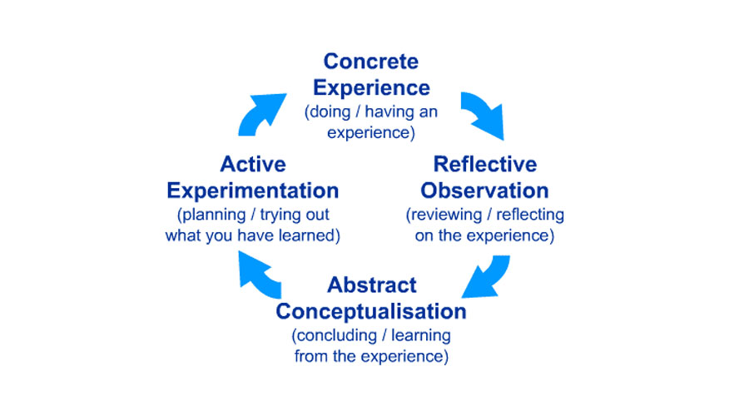
Kolb's Experiential Learning Theory

Slide 22
Kolb's Experiential Learning Theory
YouTube:
https://www.youtube.com/watch?v=J_HjW54xJ1Q

Slide 23
Break-out Groups
In your group complete the Kolb’s Inventory.
Do you agree or disagree with Kolb’s theory & where do you see yourself in this cycle?
1 hour..

Slide 24
The What? Model of structured reflection (Driscoll 2000)
https://www.youtube.com/watch?v=vGyjF9Ngd8Y

Slide 25
The What? Model of structured reflection (Driscoll 2000)
What….
..is the purpose of returning to this situation?
..happened?
..did I see / do?
..was my reaction?
..did other people do?

Slide 26
So What?
How did I feel?
How did these compare with other people’s feelings?
Do I still feel the same?
What were the effects of my actions?
What are the positive aspects?
What have I noticed about my practice?
What have other people noticed about my practice?

Slide 27
Now what?
What are the implications of this analysis – for me and others?
What if I do nothing?
What information / skills would I need to cope with similar experiences?
What help would I need to acquire these?
What is the main learning from this experience and reflection?
Is this evidence of achievement of placement outcomes / competencies?

Slide 28
Basic things to put in place to be successful
Experiment with different approaches until you find one that ‘fits’
Commit to giving time to reflection in whatever form you choose. See it as an essential aspect to your practice rather than an ‘add on’.
Start small and work up to the big issues
Be open to new ideas and new ways of thinking
Be willing to challenge your assumptions and practices

Slide 29
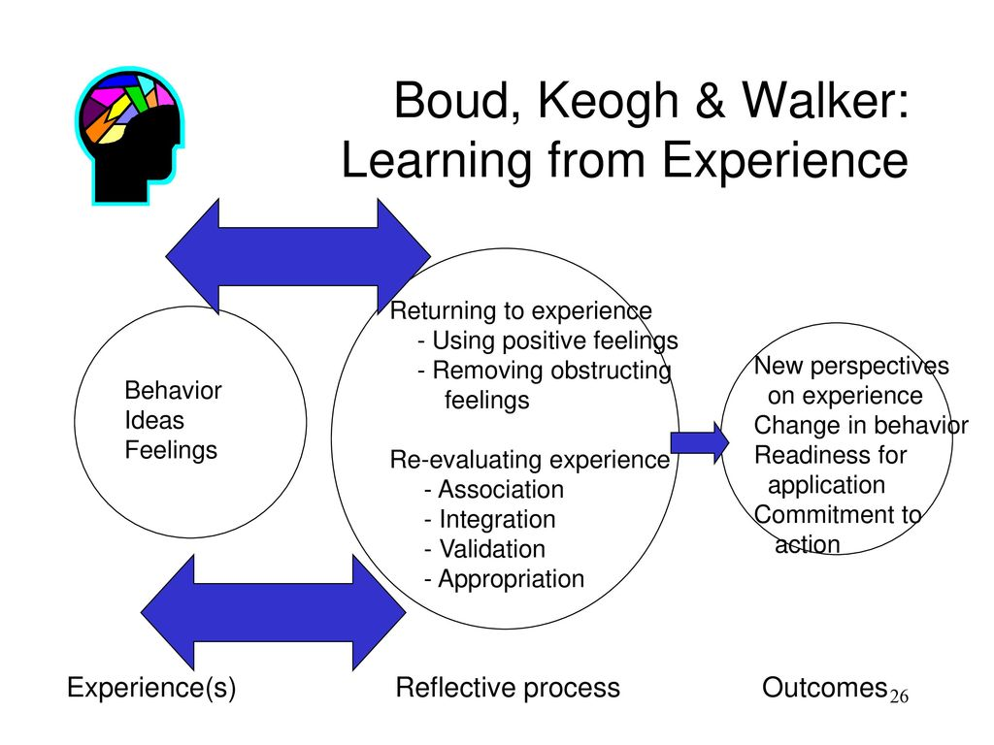

Slide 30
Boud, Cohen and Walker:
“ Reflection is an important human activity in which people recapture their experience, think about it, mull it over and evaluate it. It is this working with experience that is important in learning. ” (1985:19)

Slide 31
Reflective writing
Helps you learn from experience
Helps you build on your expertise
Developing your expertise is an important aspect of evidence based practice
Reflective writing can be used as evidence to include in your portfolio to help you achieve your academic outcomes

Slide 32
bloom's taxonomy learning
https://www.youtube.com/watch?v=ayefSTAnCR8
Reflective work: (500 words)
Compare the way you learn with Blooms Taxonomy

Slide 33
References
Driscoll J (2000) Practising Clinical Supervision. Balliere Tindall, London
Driscoll J and Teh B (2001) The potential of reflective practice to develop individual orthopaedic nurse practitioners and their practice Journal of Orthopaedic Nursing, 5, 95-103
Gibbs G (1988) Learning by Doing. A Guide to Teaching and Learning Methods. Further Education Unit, Oxford Polytechnic. Oxford cited in Jasper M (2003) Foundations in Nursing and Health Care. Beginning Reflective Practice. Nelson Thornes. Cheltenham

