Slide 1

Module Name: Effective Team Working and Communication
Module Code: BMSW4009
Assignment Name: The ability to present ourselves and our ideas is vital to being effective
Student Name: Devi Raju
Student Number: 2435195
Lecturer: Mr. Muhammad Cassamo
Deadline: 5th December 2025

Slide 2
AI Acknowledgement:
I confirm that I have not presented any AI generated materials as my own work.
I confirm that I have copies of my drafts, notes, and other resources I used, which I may be asked to prove in evidence.

Slide 3
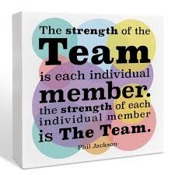
My Presentation Overview:
Introduction
  Teamwork and My Natural Role Within Teams
Areas of Reflection in Teams
Theoretical frameworks applied.
Belbin's Team roles
Team role composition analysis (strengths, weaknesses and challenges)
    Using Belbin's Team roles
    Using Thomas Kilmann Model
    Using Tuckman's Theory

Slide 4
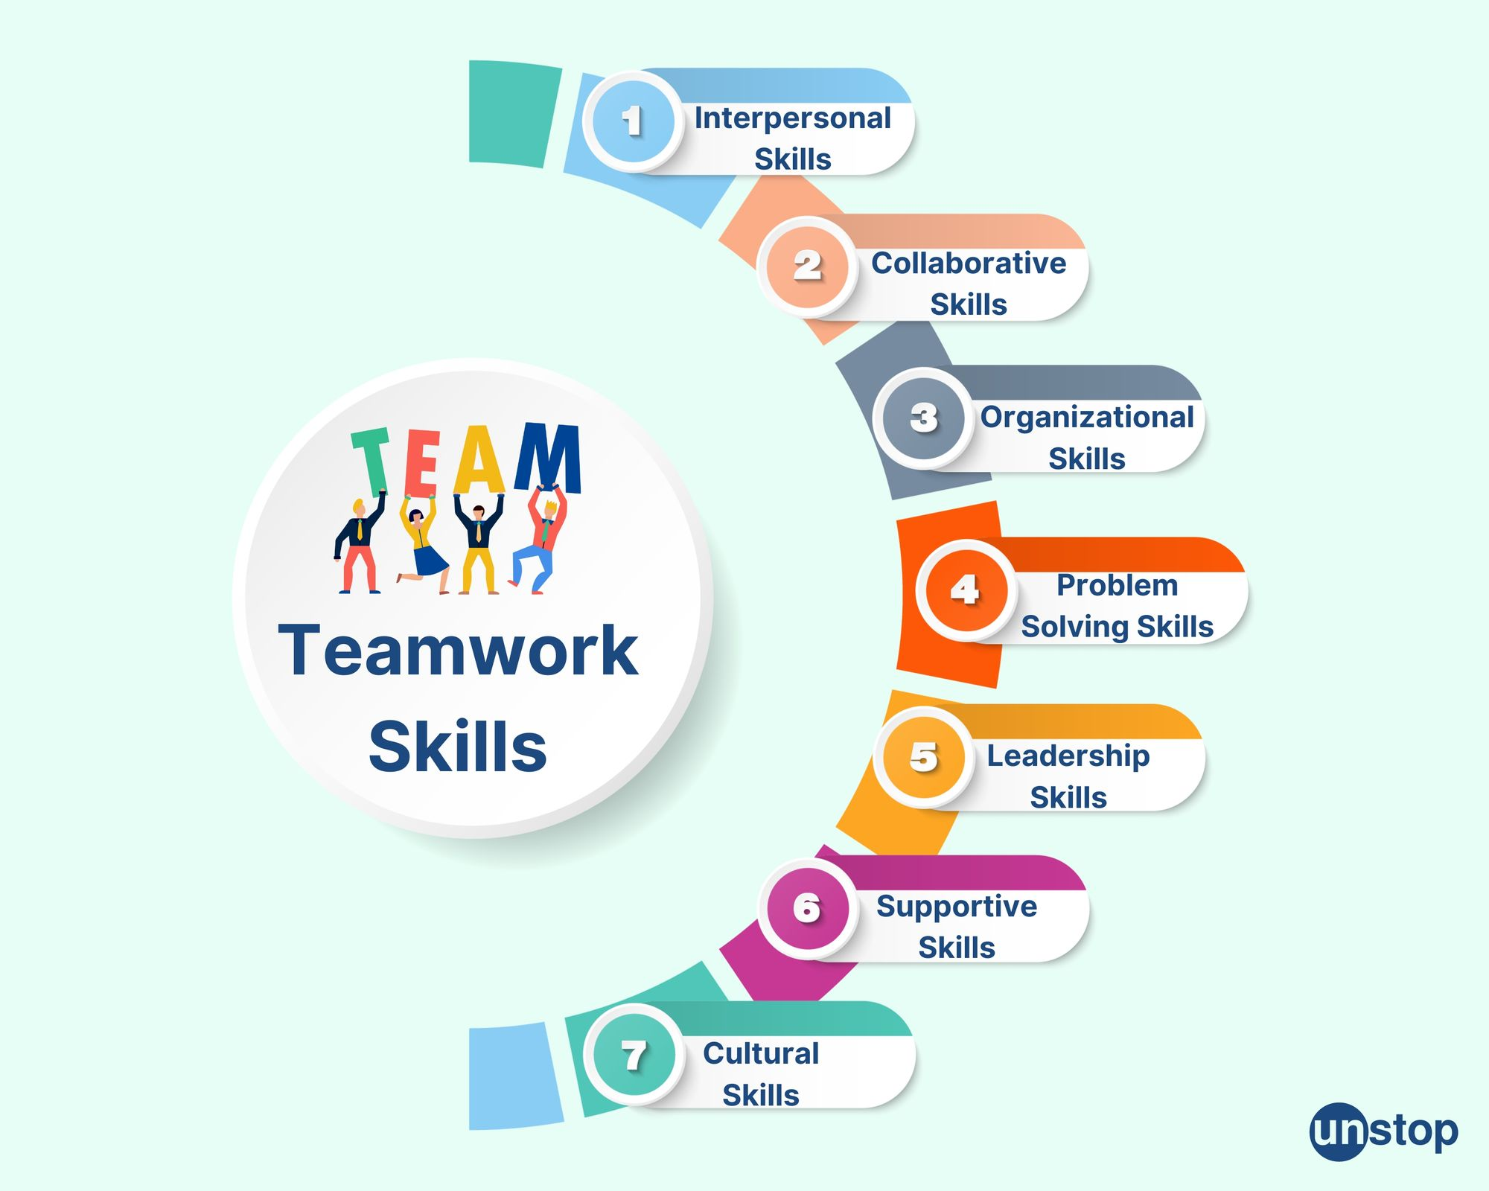
Introduction:
Teamwork and My Natural Role Within Teams:
Teamwork involves individuals collaborating toward a shared goal (e.g., group presentations).
Effective teamwork requires:
  Clear goals
  Defined roles
  Strong communication
  Cooperation
  Constructive conflict resolution
Completed Belbin’s questionnaire during Week 3 to identify natural team roles.
  Results showed I am an Implementer
    Action-oriented role
    University training can develop teamwork skills, though effectiveness varies across courses (Prada, Mareque & Pino-Juste, 2022).

Slide 5

Areas of Reflection in Teams:
Teamwork
Communication
Motivation
Conflict Management
Impact on personal development and group effectiveness

Slide 6
Theoretical frameworks applied:
Belbin’s Team Role Theory
  Helps evaluate my contributions and roles within different groups.
Tuckman’s Stages of Group Development
  Used to analyse team dynamics and progression during presentations.
Thomas-Kilmann Conflict Model
  Used to reflect on how I managed disagreements and conflict situations.
Herzberg’s Motivation Theory
  Explores factors influencing my motivation and engagement throughout the course.

Slide 7
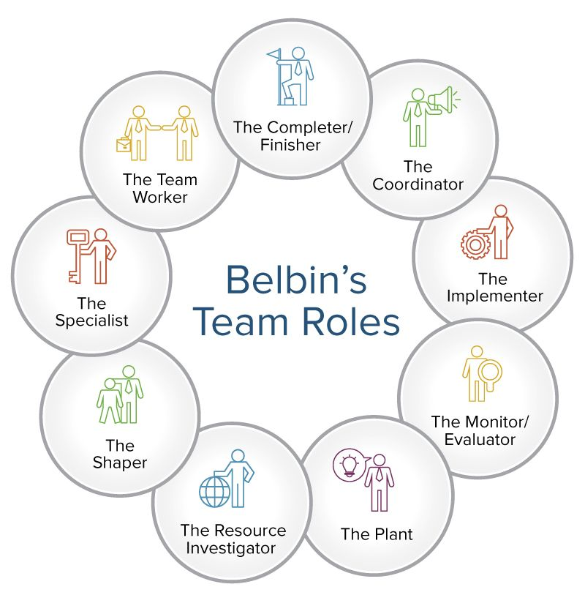
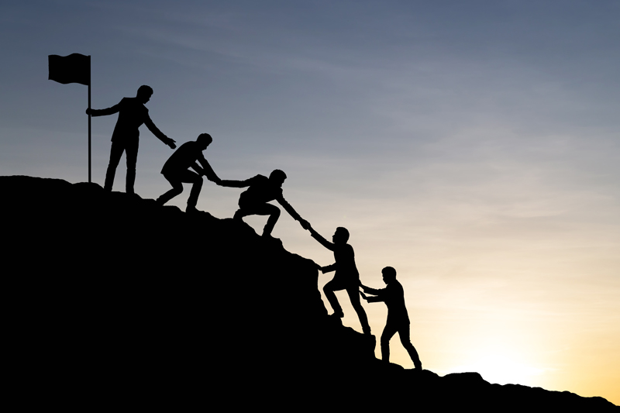
Belbin Team Roles:
Reflection on Belbin’s Implementer Role:
Identified as an Implementer - disciplined, reliable, and skilled at turning ideas into structured plans (Belbin, 2010).
Naturally turned team ideas into clear, structured tasks.
Helped the group stay organised and meet deadlines.
Ensures plans are carried out efficiently
Awareness of this has helped me become more flexible and open to change.
This insight helped me understand how I naturally contribute to team success.

Slide 8
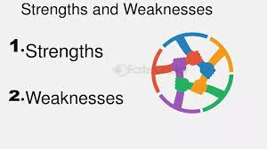
Team role composition analysis (strengths, weaknesses and challenges):
Team role composition analysis using Belbin's theory.
A process of assessing the mix of Belbin’s nine team roles within a team.
Helps understand whether the group has a balanced combination of action-oriented, people-oriented and thinking-oriented roles.
Identifies how team members complement or clash with one another.

Slide 9
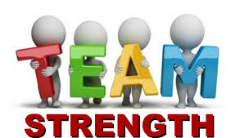
Strengths:
Strengths (implementer- Belbin):
Turned ideas into practical steps
Kept the group organised and on schedule.
Strengths (Using Thomas Kilmaan- Accommodating style):
Helped maintain harmony and reduce tension
Supported collaboration and a positive team atmosphere
Strengths (Using Tuckman’s Theory):
Helped organise tasks during Forming
Resolved disagreements in Storming.
Encourage cohesion in Norming.
Worked efficiently in Performing.
Supported a positive closure at Adjourning.

Slide 10
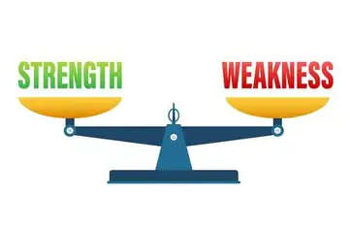
Weakness:
struggled with unexpected changes
stayed too fixed on the one original plan
Sometimes held back ideas that could improve outcomes.
Avoided speaking up during disagreements.
sometimes hesitated to voice concerns.
Found it challenging to adapt quickly to new ideas.

Slide 11
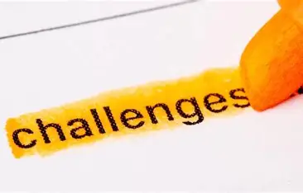
Challenges:
Imbalanced Belbin roles leading to gaps or role clashes in the group.
Conflict styles (e.g., accommodating or competing) affecting honest discussion and decision-making.
Tuckman’s stages causing early uncertainty, storming disagreements, and coordination issues under pressure

Slide 12
References:
Belbin, R.M. (2010) Team roles at work. Second edition. London; Routledge.
Sinek, S. (2023) Trust: The Basis of High Performing Teams
Stadler, S. (2019) Conflict, Culture and Communication. 1st ed. Milton: Routledge.
Thomas, K.W., 2008. Thomas-kilmann conflict mode. TKI Profile and Interpretive Report, 1(11), pp.1-11.
Tuckman, B.W. and Harper, B.E., 2012. Conducting educational research. Rowman & Littlefield Publishers.

Slide 13
Thank You

