Slide 1
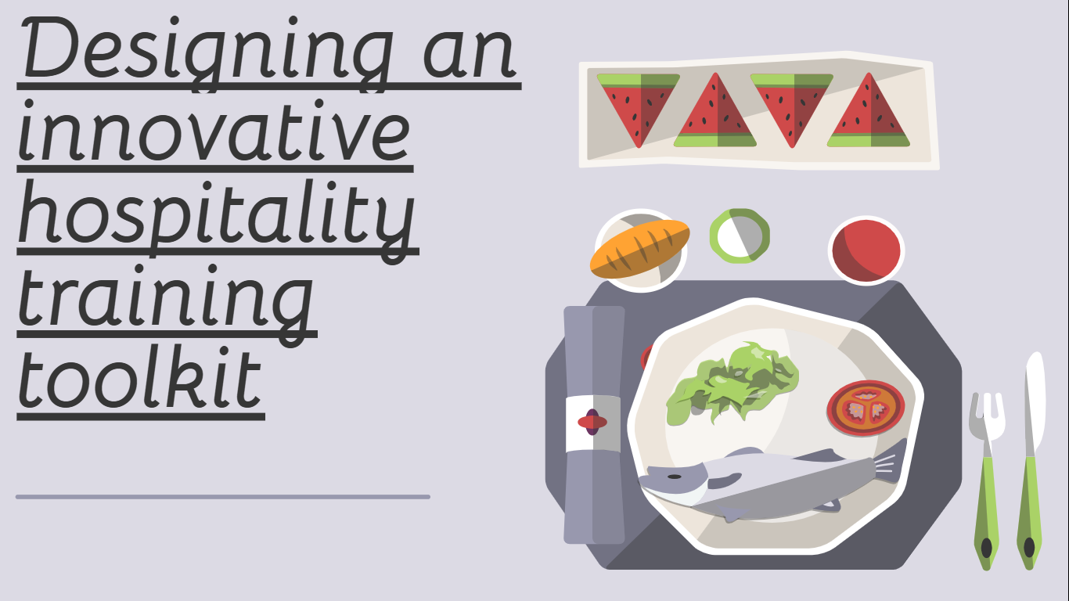

Slide 2
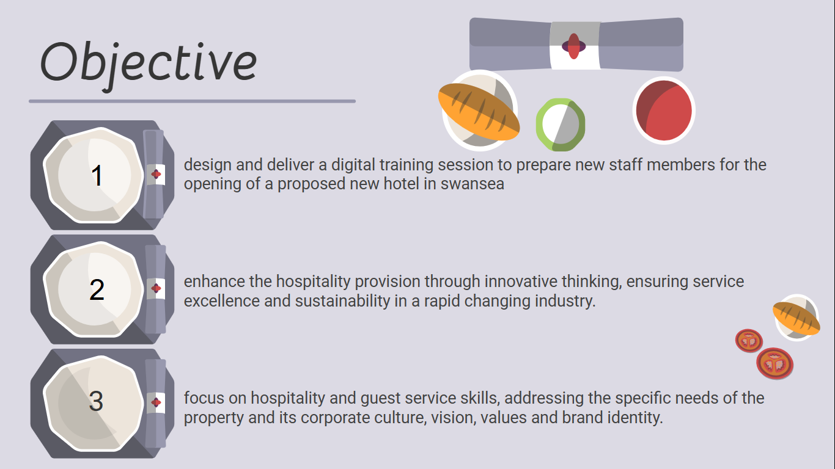
Notes:
Arwen- (speaks)
Alyssa - Today, we’ll explore innovative hospitality strategies that ensure service excellence and sustainability in a rapidly evolving industry.
Arwen- (speaks)

Slide 3
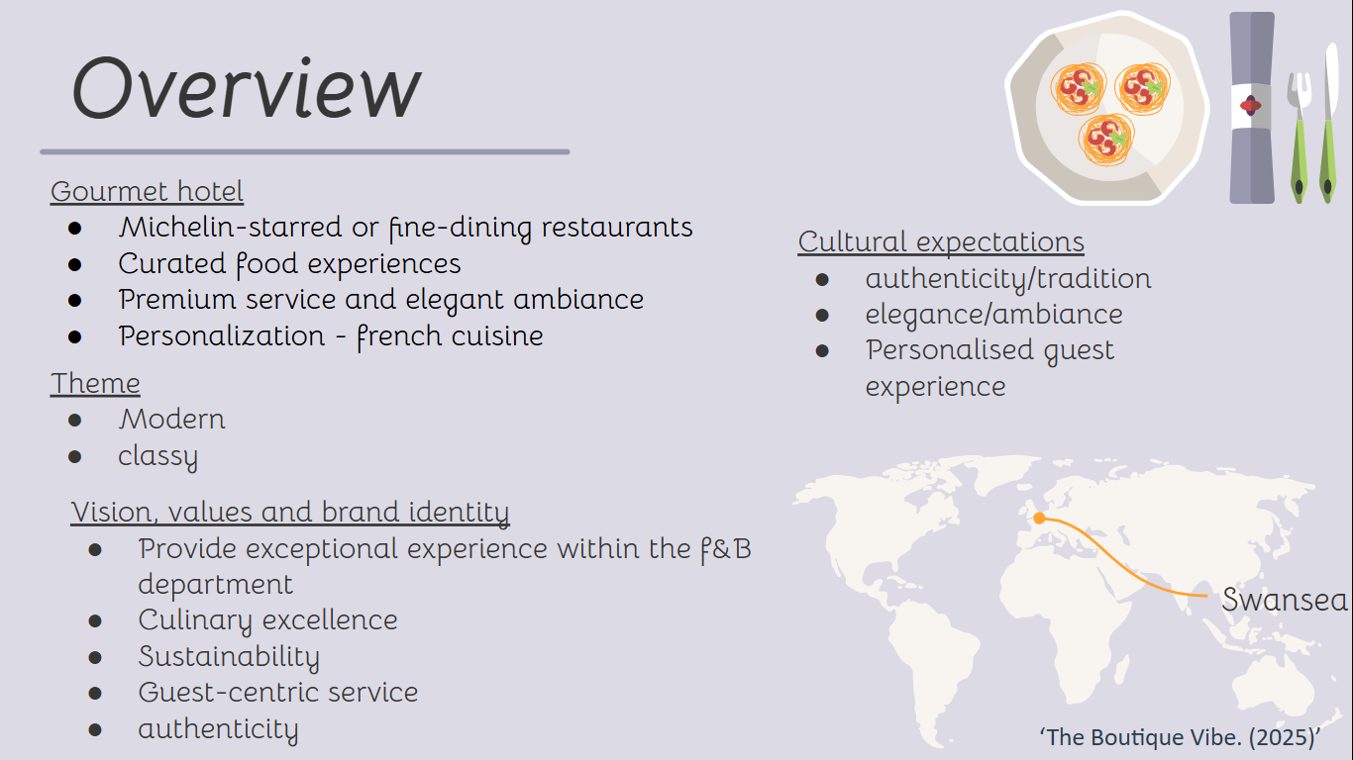
Notes:
Arwen- (Speaks)
Alyssa - The theme’s we have decided to accompany is modern and classy for our gourmet hotel. These blend innovation with timeless sophistication, ensuring a sleek design, advanced amenities and premium service. This creates a refined yet forward-thinking atmosphere, appealing to guests seeking both elegance and contemporary luxury.
Offering top-notch, inventive cuisine made with the finest ingredients, our gourmet hotel is committed to culinary perfection. While maintaining a guest-centric experience with individualised care, we place a high priority on sustainability, using locally sourced produce and reducing waste. We combine real flavours with innovative ideas in a sophisticated and elegant setting, always changing to reinvent fine dining and opulent hospitality.

Slide 4
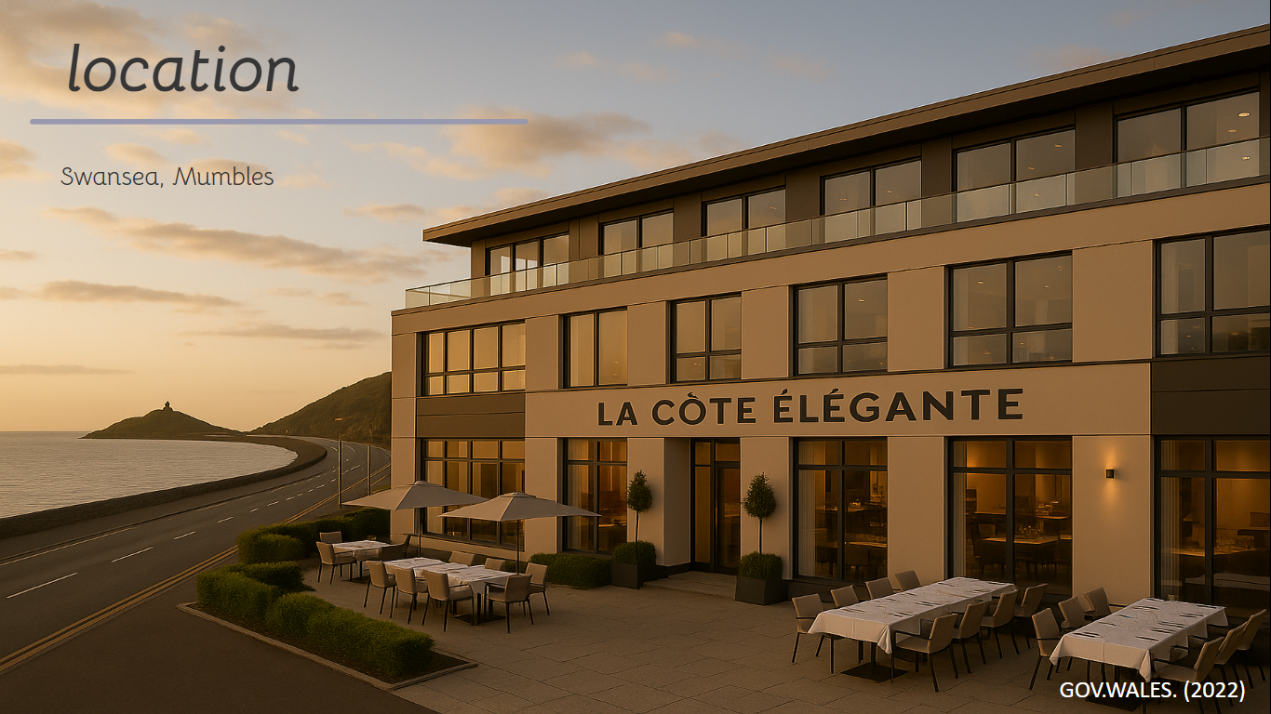
Notes:
Arwen- (Speaks)
Alyssa- With the strategic move, building a gourmet hotel in mumbles, it will bring tourism growth as the area is thriving as a tourism hub for travelers, benefiting from Swansea’s expanding hospitality sector and government-backed accommodation developments with food and cultural tourism.

Slide 5
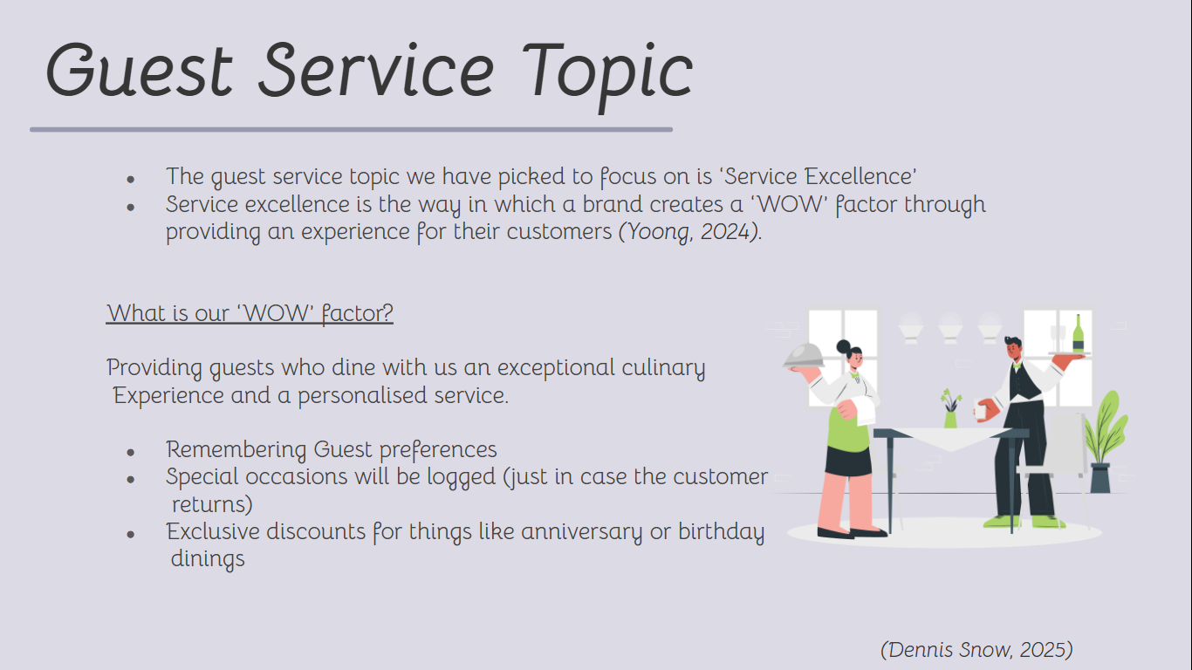
Notes:
Me- The guest service topic that we have specifically chosen to focus on is Service Excellence. Service Excellence is all about the way in which we will provide our customers and guests with a one of a kind ‘wow’ factor through giving a unique experience for every individual.
So, what is our ‘wow’ factor?
We would love to provide guests who dine with us an exceptional culinary experience along with an enhanced personal service.
How will we do this?
By remembering guest preferences, from allergens to requests.
All special occasions will be logged just in case that group or customer shall return the following year/months to celebrate again.
And along with this, exclusive discounts will be offerend for occasions such as anniversaries, birthday dining's or other personal celebrations.

Slide 6
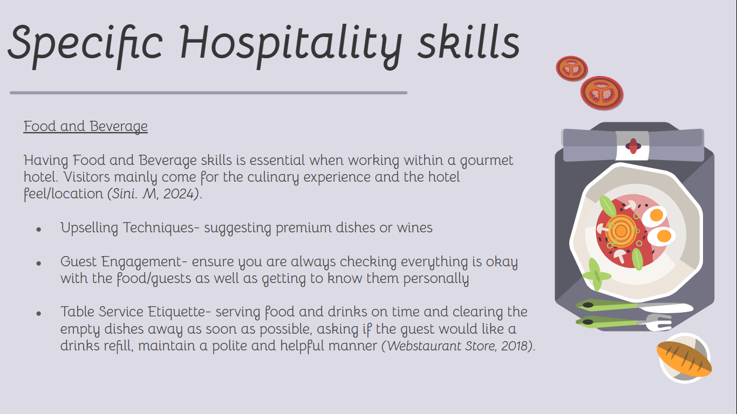
Notes:
Me- Having food and beverage skills is essential when working within the gourmet hotel industry. People will mainly visit and dine within this kind of establishment for the culinary experience, as well as the reputation of the feel and location of the hotel.
Some specific skills that are required include upselling techniques such as suggesting premium dishes or recommending some fantastic wines.
Another skill is guest engagement which is to ensure you are always checking in with guests to see if their meals are up to standard and making sure that the guest themselves are okay.
Table service etiquette is the skill of serving food and drinks to the table on time and clearing empty dishes and cups away as soon as possible. Also asking if the customer would like a refill on the drinks whilst maintaining a polite and helpful manner.

Slide 7
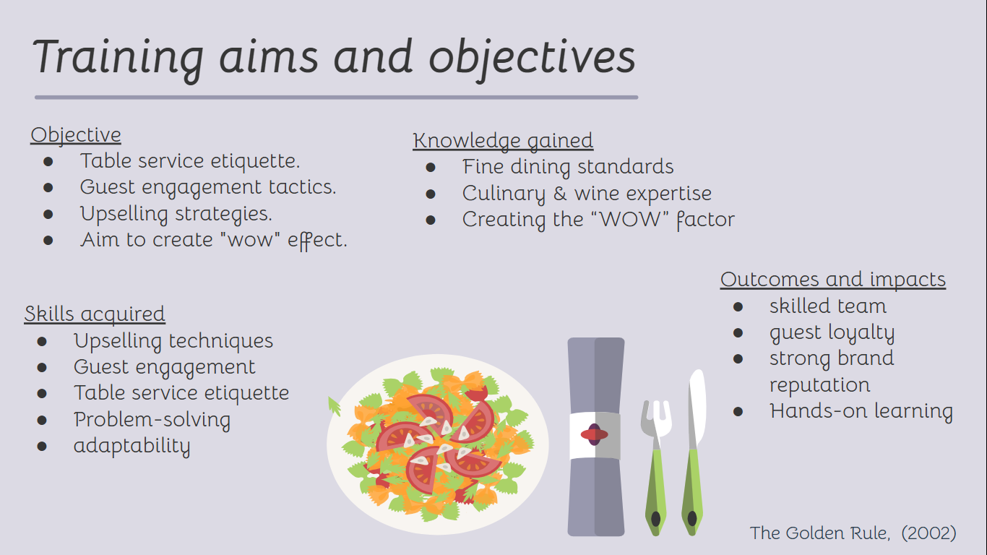
Notes:
Arwen- (speaks)
Alyssa - Staff will gain hands-on experience and learning through this training session, exploring tills, bars and tasting of food and wine to gain a better understanding of what the customers will experience before our grand opening. Furthermore, it will create long-term benefits for the hotel including a skilled team trained in all skills, guest loyalty with repeat customers, a strong brand reputation in which will increase revenue growth.

Slide 8
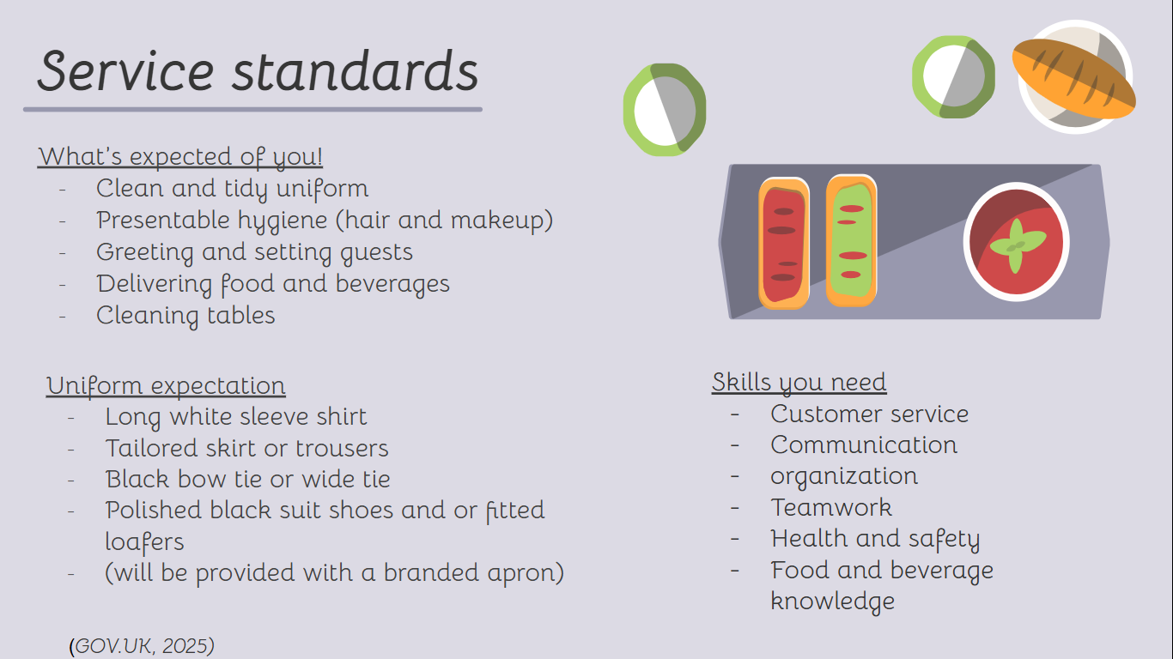
Notes:
Me- For general service standards, what we expect from you is to have a clean and tidy uniform to keep a professional look, have presentable hygiene which includes clean and tidy hair and very minimal makeup.
We expect you to always greet the guests and seat them. Deliver them their meals and beverages on time and always ask them if they are okay or even if they need anything else.
Ask the guest how their meal is and if anything needs changing.
Ensure you always clear dishes and empty glasses as soon as you see the guest is finished with their meals or whenever they have evidently left the premises.
The type of customers that we will see within the restaurant include a mix of high-end clientele who may have a high interest in fine dining, we will also see food enthusiasts, culinary tourists, romantic getaway seekers and even maybe business executives.
Your uniform expectations are as follows, a long sleeve white shirt which is to be freshly washed and ironed. A tailored skirt or trousers (whichever fits your preference). A black bow tie or a wide tie. Nice clean and polished black suit shoes or loafers and you will be supplied with a branded apron by us.
We also expect you to have a wide range of skills, some of which include customer service, communication, organization, teamwork, health and safety as well as food and beverage knowledge.

Slide 9
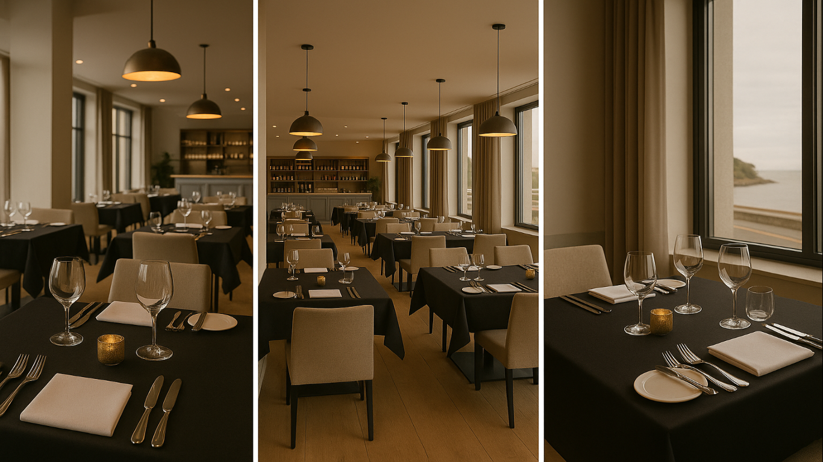
(ROLE PLAY)
Notes:
(Training Session/Role Play)

Slide 10
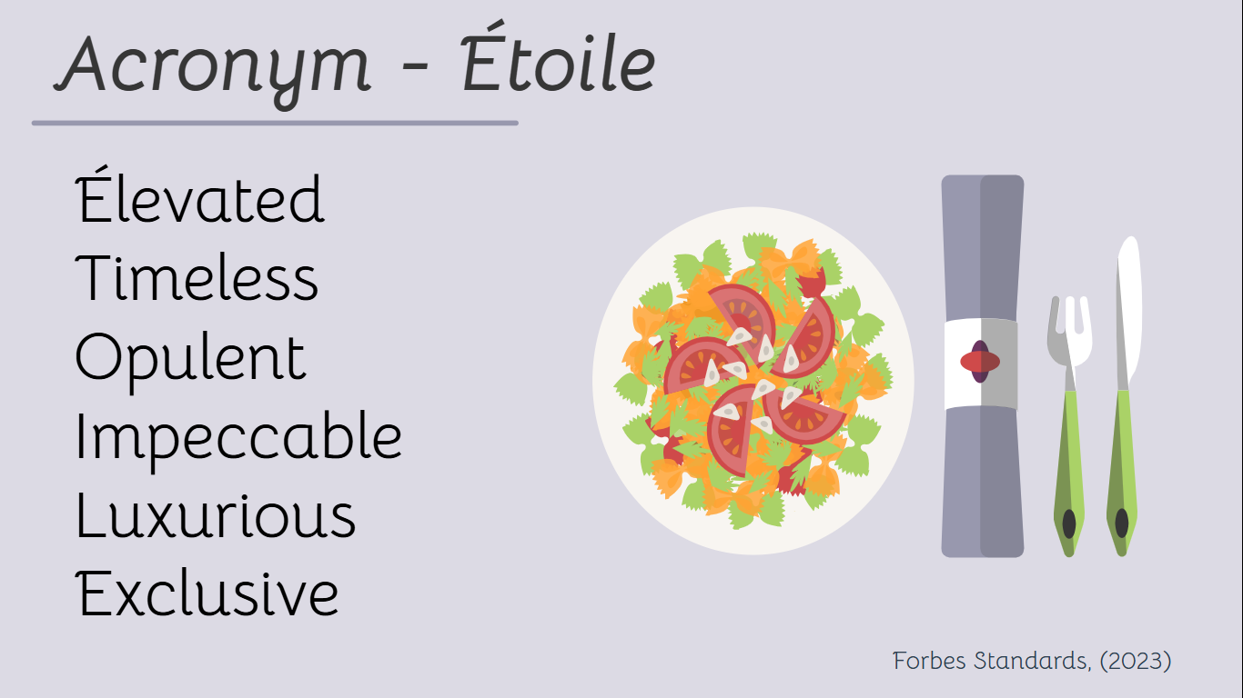
Notes:
Alyssa- The acronym for our hotel is Etoile, this stands for Elevated, Timeless, Opulent, Impeccable, Luxurious and Exclusive. This is because Our hotel offers an elevated and timeless feel, Opulent because of the luxurious essence within our restaurant, Impeccable as we always strive to offer a luxurious and 5* standard of service. And then finally, exclusive because you can’t find service like this anywhere else. Etoile fits in with our chosen topic as it is a word originating from the French language and our hotel includes a 5* gourmet French restaurant. As you would have heard within the role play during the final interaction, the host mentions 'you were an etoile today’ which is indication the customer was a star to serve today. We always try to incorporate our acronym wherever we can.
Arwen- (speaks)

Slide 11

Notes:
Thank you!

Slide 12
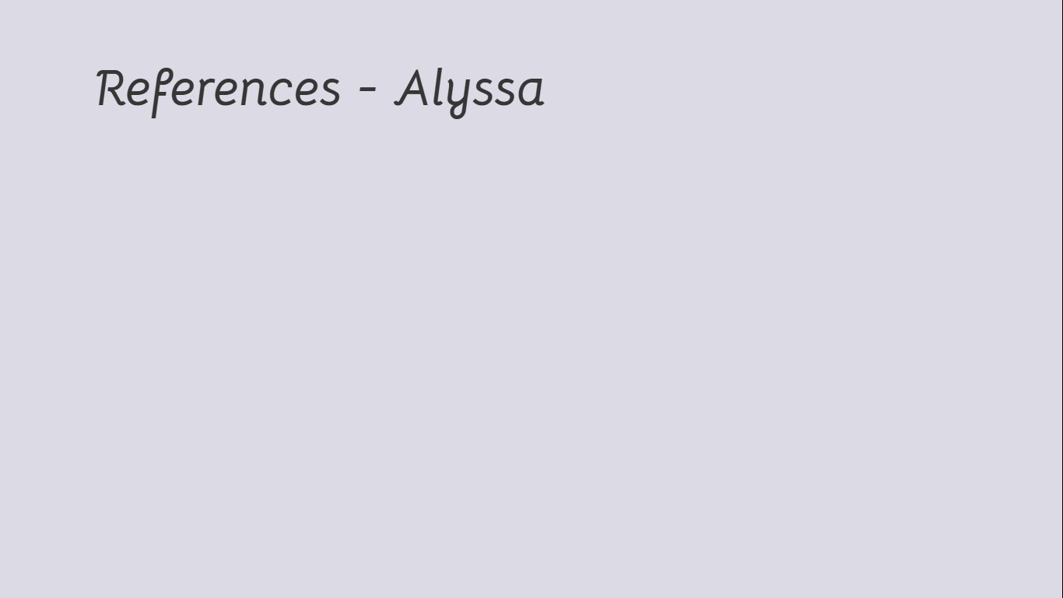
Dennis Snow (2025). Service Excellence Lessons. [online] YouTube. Available at: https://www.youtube.com/watch?v=GPwgvpDyjIw
GOV.UK (2025). Service Standard - Service Manual - GOV.UK. [online] www.gov.uk. Available at: https://www.gov.uk/service-manual/service-standard.
Sini. M (2024). RoomRaccoon Hotel Software. [online] RoomRaccoon. Available at: https://roomraccoon.com/blog/food-and-beverage-in-hotels/.
Webstaurant Store (2018). Fine Dining Etiquette: Server Tips for Fine Dining Restaurants. [online] WebstaurantStore. Available at: https://www.webstaurantstore.com/article/90/fine-dining-etiquette-for-servers.html.
Yoong, K. (2024). What is service excellence? The service excellence definition for 2020. [online] hospitalityinsights.ehl.edu. Available at: https://hospitalityinsights.ehl.edu/what-is-service-excellence.
Notes:
References:^

