Slide 1
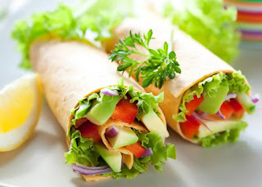
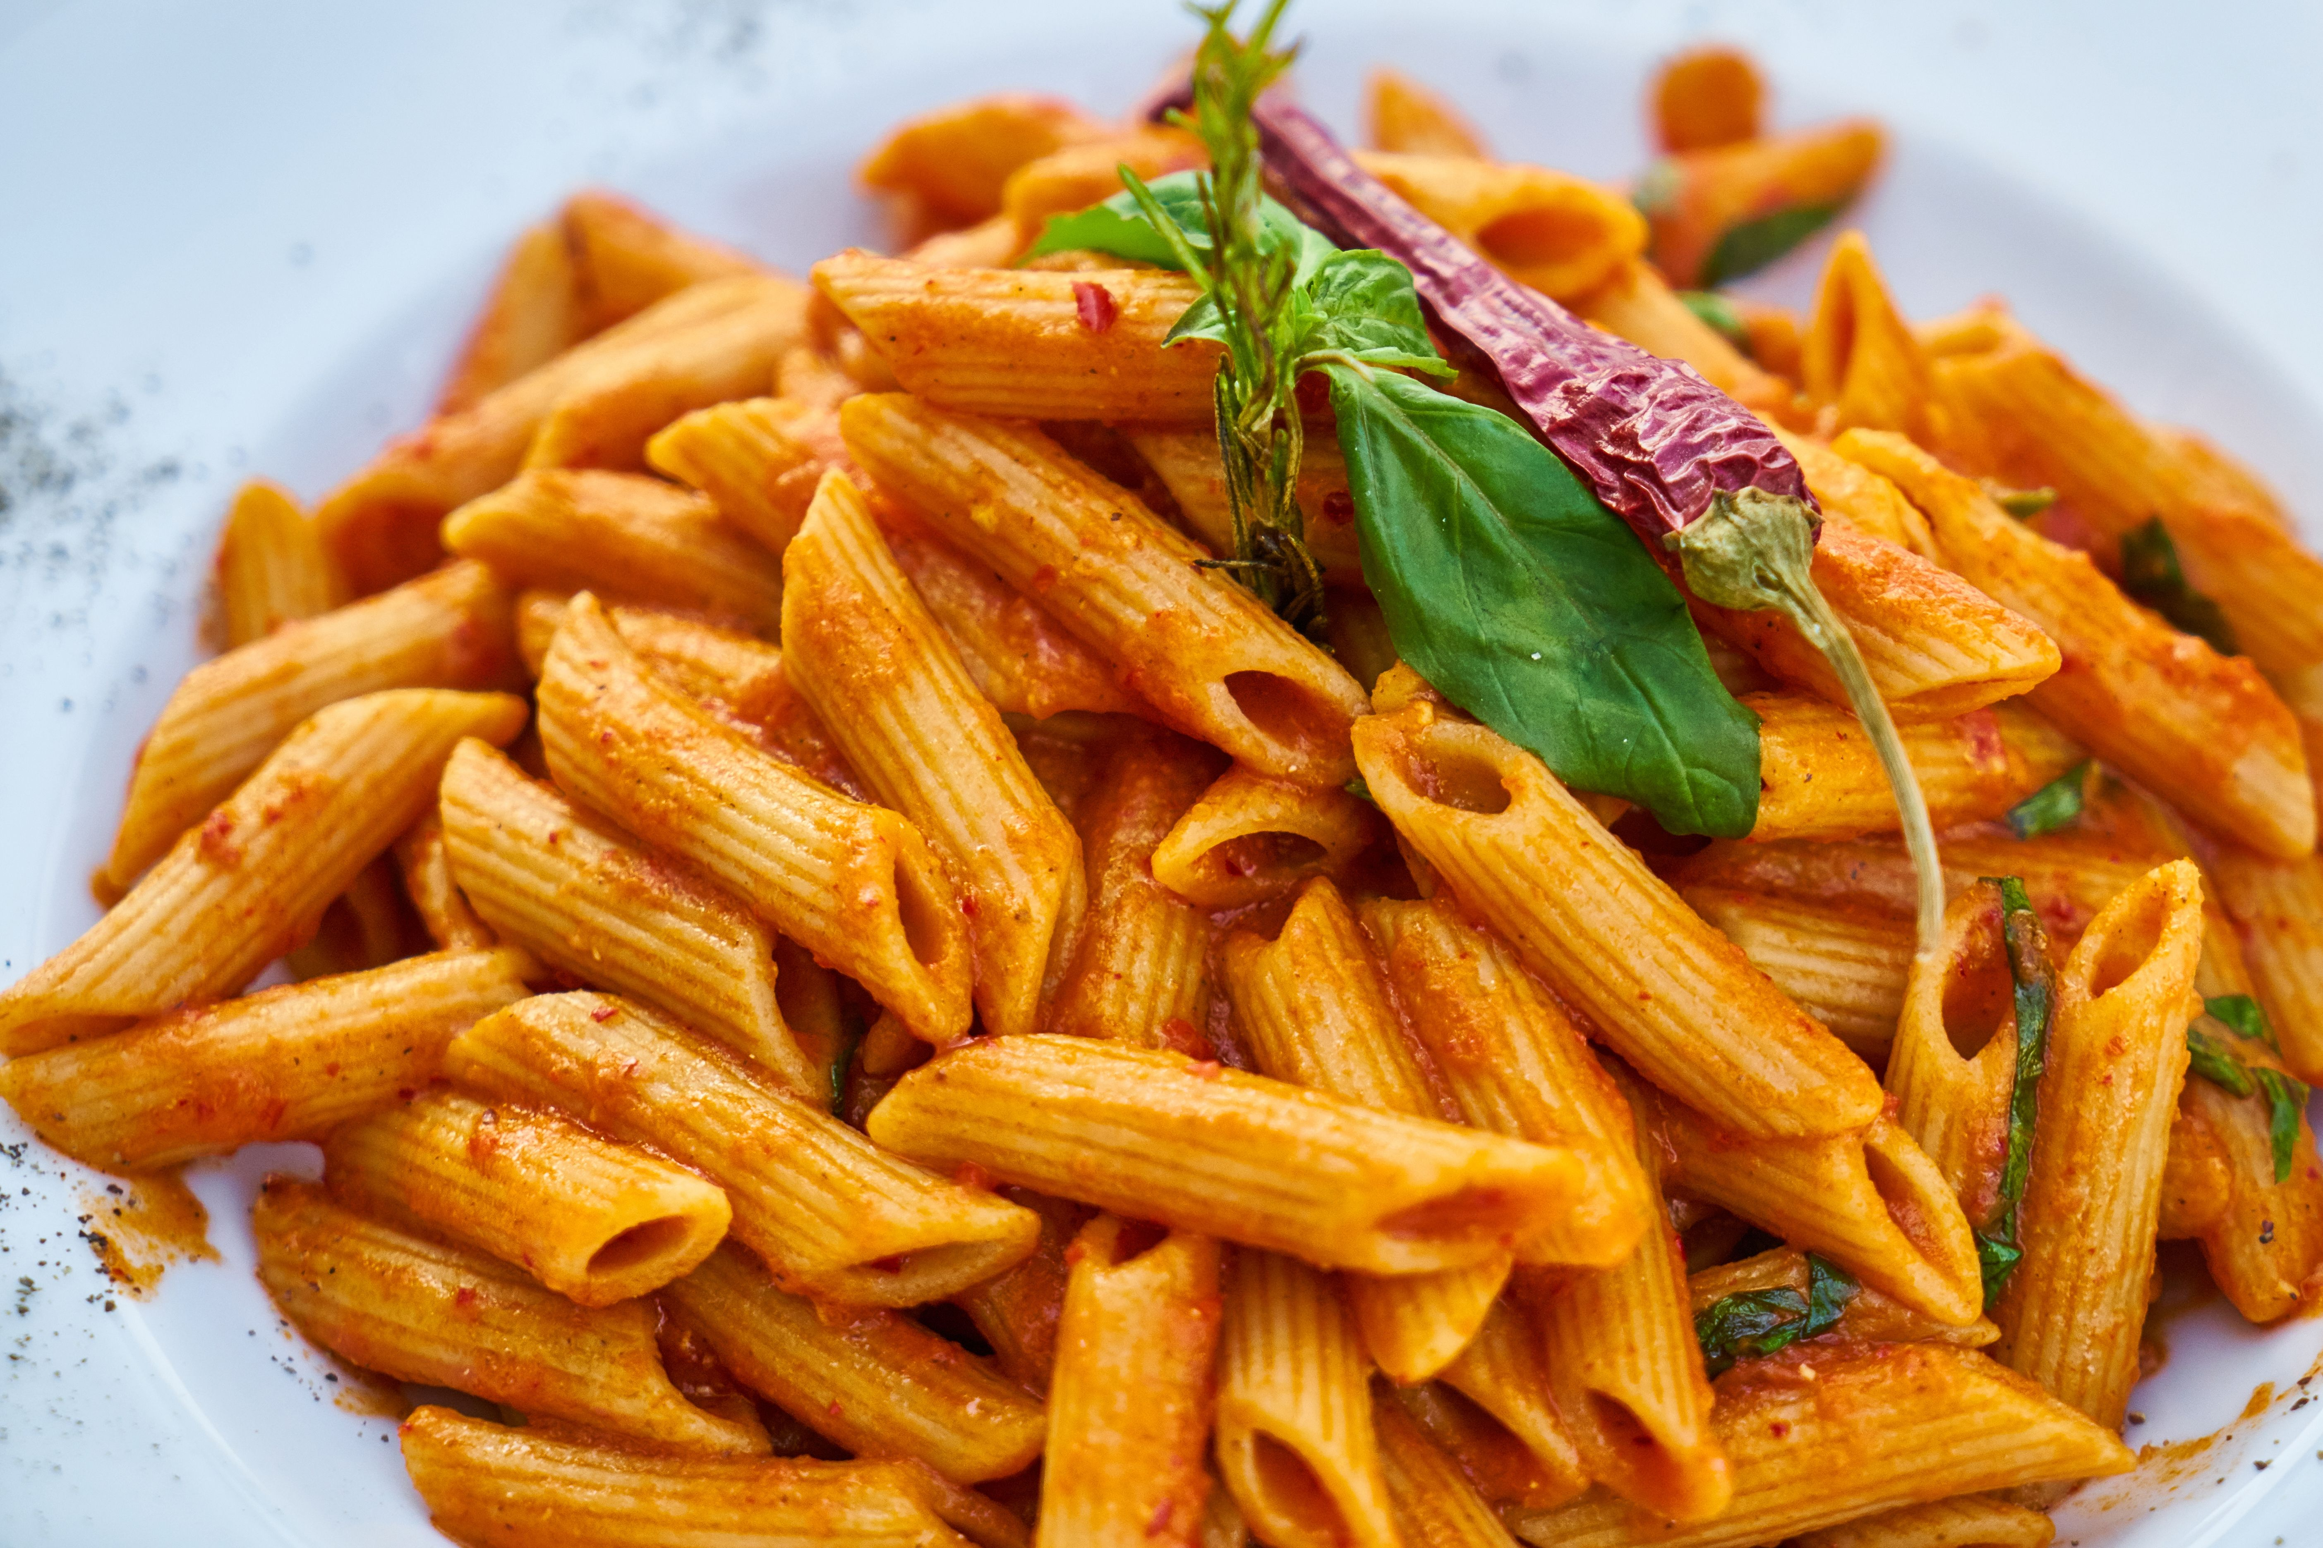
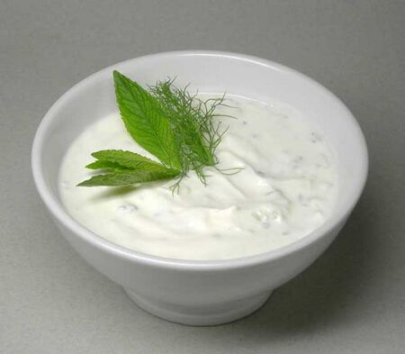

FreshBite Meals
MENU
Breakfast
Porridge Bowl V £3.80
Breakfast Wrap £4.20
Fresh Fruit Pot £2.50
Lunch
Chicken Salad Box £6.00
Veggie Pasta Bowl V £5.50
Soup of the Day £3.90
Snacks
Granola Bar £1.80
Greek Yoghurt Cup £2.20
Banana Bread Slice £2.50
Drinks
Fresh Orange Juice £2.80
Iced Coffee £3.20
Herbal Tea £2.00

Slide 2
NEW Digital Skills ( LCLM4002_BIRM)
Muhammad Aurangzaib Ayub
Student Number: 2533688
I chose this scenario because I found it interesting due to the nature of the business being close to my own business model. I wanted to showcase my creative side and hoped to deliver a great menu possible, using skills I currently have or developed is the last 6weeks.
I decided to use Microsoft PowerPoint to create my document, I personally believe it offers a wider range of tools and templates. I think; if used for example Microsoft Word, it would have taken me a lot longer to produce the menu and would not be able to change the background design and colours.
I took the key information provided on the scenario and put it into my PowerPoint to make a basic template to work with, then moved onto splitting the information and giving relevant headings to each sectioned area of the menu. I tried to make the menu appeal to the eye by using various methods from; visual photos of products, using colour for text and changing the background. I decided to use bold heading and bold format for the pricing of each item which will help customer see the type of product’s e.g Breakfast, Lunch and Snacks etc and the price of what they are buying clearly.
I believe pictures speak volumes for your business; pictures can help give customers an idea of what you are selling to them.
Reference
I used 4 photograph images from Bing for the menu to that is linked to my computer
Bing, 2026 Photographic images by Bing is licensed under CC BY-NC

