Slide 1

Business Plan
Title: Your Dream Wedding
Name of the Students and ID Number:
Vasilka Sarandalieva 2113113
Julia Petrencikova 2110746
Liliana Costache 2111821
Albert Sefa 2112523
Emanuel Adewale 2107386
Module: Managing Enterprise in the 21st Century
Modul code: BMSW 4006
Lecture name: Rajesh Kumar

Slide 2
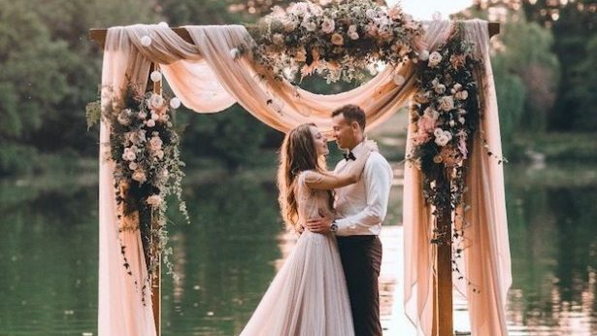
Your Dream Wedding
Tailored decoration for your special day….

Slide 3

BUSINESS OVERVIEW
COMPANY-YOUR DREAM WEDDING
SERVICES- WEDDING DECORATION
LEGAL STRUCTURE- PARTNERSHIP FROM 5 PEOPLE
LOCATION- SMALL HOMEBASED OFFICE WITH GARDEN-SHOWROOM
MISSION- RECOGNISE AS FIRST –CLASS WEDDING SERVICE PROVIDER
VISION- EXPAND THE VARIETY OF SERVICES THAT WE OFFER

Slide 4

What do we offer and why are we unique
Simplicity for those tired of searching through one million options, we offer 3 packages for your dream wedding, no more listing through hundreds of pages
Our packages are tailored to suit your needs and budget
We offer exceptional customer experience with our free consultation and excellent customer service
We give you a choice ( hire/purchase, full package including the dressing of the venue/ hire of decoration only for those on budget)
Excellent customer reviews
Nationwide

Slide 5
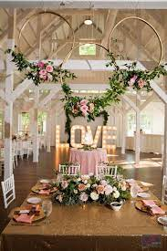
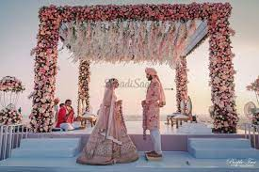
Our packages
GOLD
Free Consultation
Hire or Purchase the wedding decoration (table decoration, all other decoration such as centrepieces, love letters, all-inclusive)
Dressing and removal of the venue decorations
Alteration
Sweet Car/ Fromage
Flowers (real/artificial, for the venue and including bouquets and buttonholes)
Pay monthly
SILVER
Free consultation
Hire of the wedding decoration (table decoration such as centrepieces, love letters, all inclusive)
Dressing and removal of the venue decorations
Flowers
BRONZE
Free consultation
Hire of the wedding decoration only (table decorations such as centrepieces, love letters, all-inclusive)

Slide 6
Market Audit-Competitor’s Analysis
What is a market audit?
The purpose of a market audit is to analyze a company's market program and recommend improvements based on the current state of the program.
Performs a strengths and weaknesses analysis of a company.
Competitors
Katrina Otter Weddings. 15 years in the wedding industry and it is located in London
Weddings by Mary. 20 years in the industry. Located in Essex
Audrey Ametis Weddings. 6 years of experience. Located in London
These 3 main competitors business models are going to help us improve and grow our business by analyzing their business strategies using PESTEL and SWOT analysis.

Slide 7
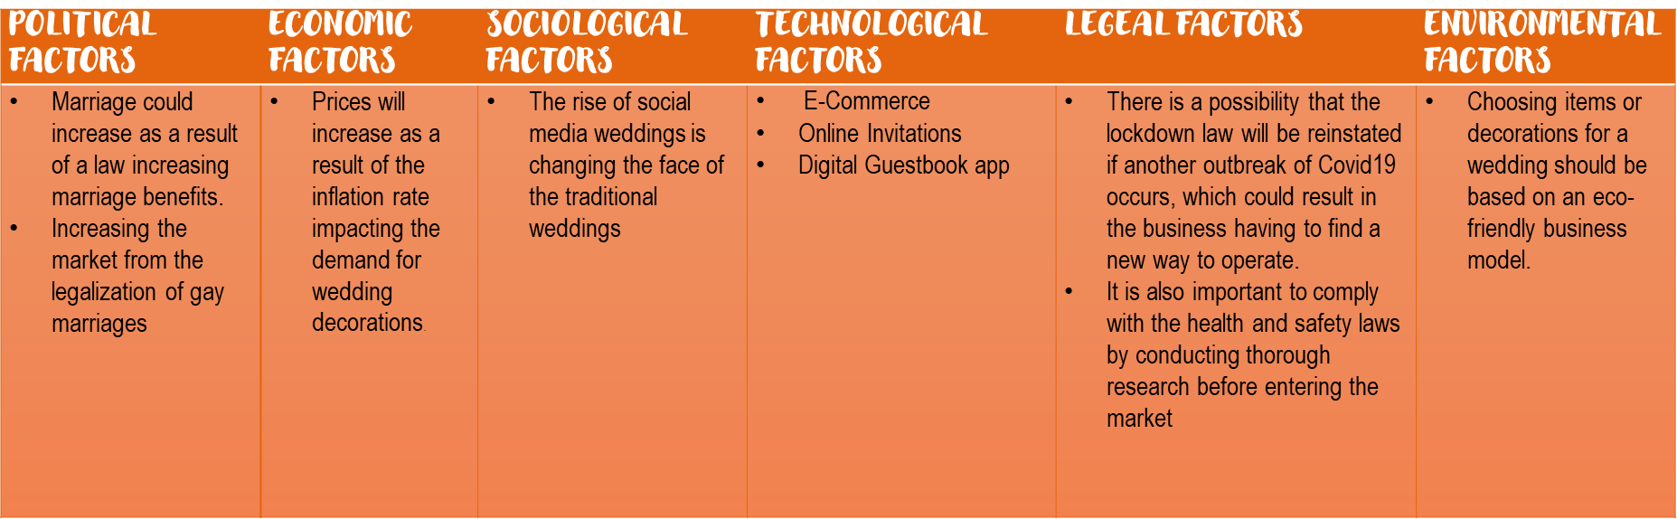
PESTEL analysis

Slide 8
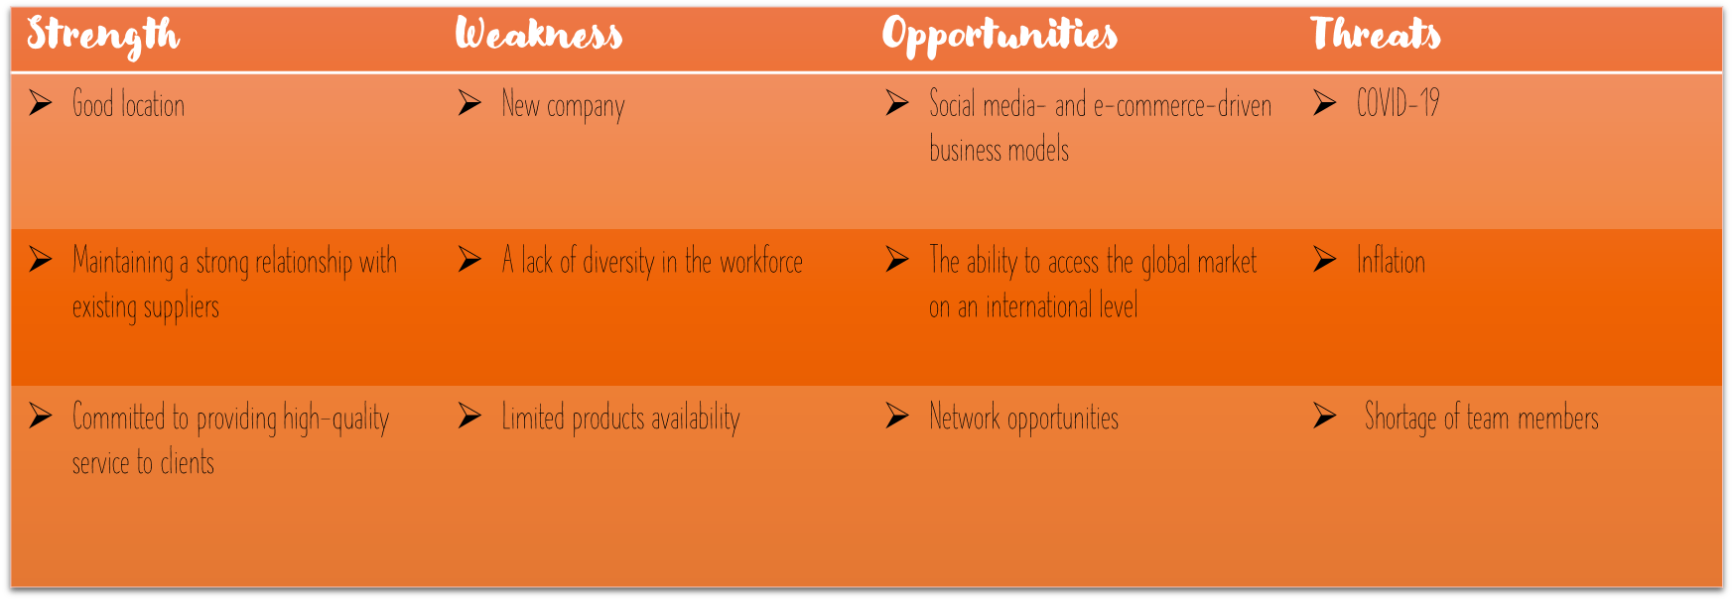
Swot analysis

Slide 9
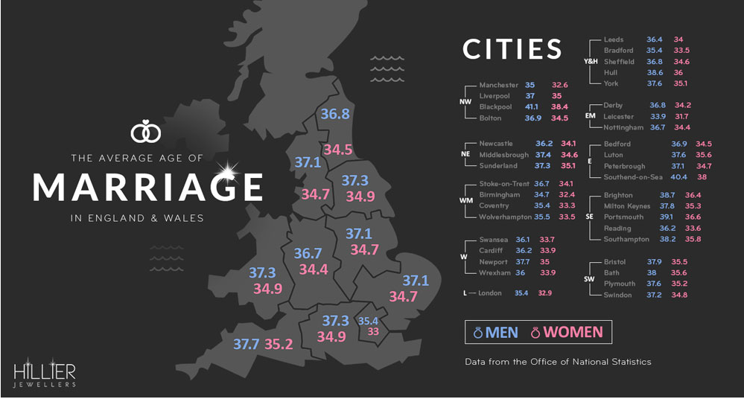
The average age of marriage in the modern day
Source: https://www.vowsandvenues.org.uk/what%E2%80%99s-average-age-marriage-uk

Slide 10
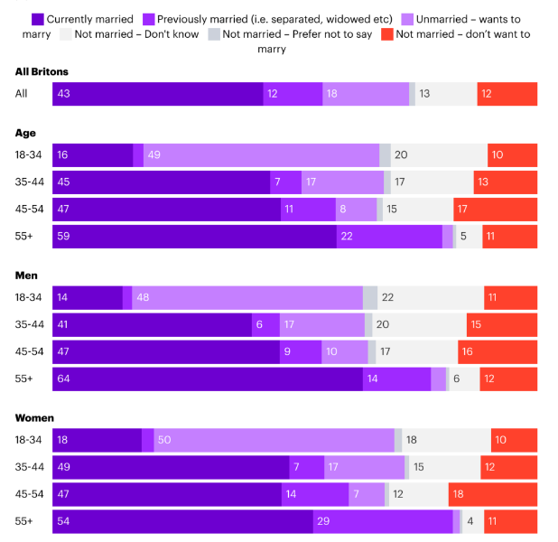
What is the percentage of people being married
Source:https://yougov.co.uk/topics/lifestyle/articles-reports/2022/06/28/do-britons-still-want-get-married?utm_source=twitter&utm_medium=social&utm_campaign=website_article

Slide 11

MARKETING AND SALES PLAN
Advertising our unique services at:
www.yourdreamwedding.uk
Facebook and Instagram page: your dream wedding
E-mail: yourdreamwedding@gmail.com
Phone: 056567756
Office: Birmingham, Solihul, Newtown Road 12

Slide 12

Management team
The management team will have members each tasked with overseeing different components of the business.
As a wedding décor company we will have multiple people overseeing different sectors for example one person may manage the finance side of the business, including monitoring the business accounts and tracking revenue.
Whilst another will be tasked with managing the customer service side of the business this is Important due to the fact most clients will be newlyweds and engaged couples and each consumer will have different preferences and wishes to make their special day unique to them.
Another facet will manage and oversee the sourcing of goods and materials needed to fulfil the obligations of the client and will contact suppliers in order to make sure all the necessary stock (eg balloons and banners )is available and can be sourced in a timely manner to appease the clients.
Finally there will be someone to oversee the set-up and on the day parts of planning the wedding to make sure everything operates smoothly and the clients have the wedding of their dreams.

Slide 13
Financial Plan
Notes:
A financial plan is crucial when applying for funding. The main goal is to understand how business finance works. It’s very important for entrepreneurs and investors as well. It is an essential element for obtaining development funds.

Slide 14
Monthly Cashflow
 | Jan | Feb | Mar | April | May | June | Jul | Aug | Sept | Oct | Nov | Dec | Total
Investment by owner | 30.000 |  |  |  |  |  |  |  |  |  |  |  | 30.000
Grant | 50.000 |  |  |  |  |  |  |  |  |  |  |  | 50.000
Sales Income | 0 | 100.000 | 106.000 | 102.000 | 100.000 | 135.000 | 120.000 | 140.000 | 130.000 | 150.000 | 150.000 | 180.000 | 1.413.000
Total income | 80.000 | 100.000 | 106.000 | 102.000 | 100.000 | 135.000 | 120.000 | 140.000 | 130.000 | 150.000 | 150.000 | 180.000 | 1.493.000
Wages | 0 | 2.000 | 2.000 | 2.000 | 2.000 | 2.000 | 2.000 | 2.000 | 2.000 | 2.000 | 2.000 | 5.000 | 25.000
Utilities | 1.500 | 1.500 | 1.500 | 1.500 | 1.500 | 1.500 | 1.500 | 1.500 | 1.500 | 1.500 | 1.500 | 2.500 | 19.000
Phone/Internet | 250 | 250 | 250 | 250 | 250 | 250 | 250 | 250 | 250 | 250 | 250 | 250 | 3.000
Decorations | 5.000 | 5.000 | 6.500 | 5.500 | 4.800 | 7.000 | 5.800 | 8.500 | 6.900 | 9.000 | 9.000 | 10.500 | 83.500
Advertising | 1.500 | 2.500 | 3.000 | 2.500 | 2.500 | 3.500 | 3.000 | 4.000 | 4.500 | 5.000 | 5.000 | 6.500 | 43.500
Table attire | 2.000 | 3.000 | 3.000 | 3.000 | 3.000 | 3.000 | 3.000 | 3.000 | 3.000 | 3.000 | 3.000 | 5.000 | 37.000
Total Outgoing | 10.250 | 14.250 | 16.250 | 14.750 | 14.050 | 17.250 | 15.550 | 19.250 | 18.150 | 20.750 | 20.750 | 29.750 | 211.000
Icoming less outgoing | 69.750 | 85.750 | 89.750 | 87.250 | 85.950 | 117.750 | 104.450 | 120.750 | 111.850 | 129.250 | 129.250 | 150.250 | 1.282.000
Notes:
The aim of the monthly cash flow is to represent an overview of the financial activity. Business are relying on monthly cash flow statements to closely monitor their income and outcome and profit. This report is of an outmost importance because it enables you to meet the financial obligations and allows you to plan.
As you can see from the table, the cashflow is positive and that means that our business is successful with a high rate of expansion in the future.

Slide 15
Report of profit & loss
Gross Total Income | 1.493.000
Total Expenses | 211.000
Gross Profit | 1.282.000
Tax 20% | 256.400
Net Profit | 1.025.600
Partner profit / 5 | 205.120
Notes:
The Profit & Loss account will show you the total income and expenses and whether your business has earned more income than expenditure for running costs. In my case, according to the table and the amounts obtained, our business is productive. As you can see, our net profit is high and the partner profit is consistent.

Slide 16

Conclusion
In conclusion, we believe we have done the necessary research and have highlighted the necessary steps and constructed a business plan that will lead to a successful business as we have highlighted the gap in the market and the need for wedding planners in the current generation of social media and everyone wanting a grand and memorable wedding
we have also looked at the pros and cons and obstacles we may face as a small business by including a swot and pestel analysis
We offer a human connection with clients through our 1 on 1 consultations that we offer for free making our clients feel more involved and giving more control of making their dreams come to life
And we have also have a management team who will oversee all parts of the business to assure our clients that their big day turns out perfect

Slide 17
References
Bendle, N and Campana, R. (2018) Nouveau Event Planning: The Wedding Extravaganza Harvard Business Review Case Study Available at: https://embapro.com/frontpage/pestelcase/17766-wedding-extravaganza
Cradduck, P. (2018) Social: 3 Ways Sociological Factors Can Impact The Events Industry Available at https://grapevineeventmanagement.co.uk/news/2018/11/6/social-3-ways-sociological-factors-can-impact-the-events-industry

