Slide 1
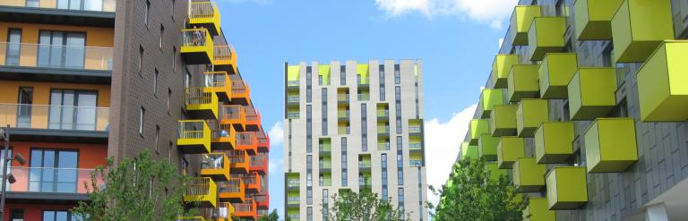
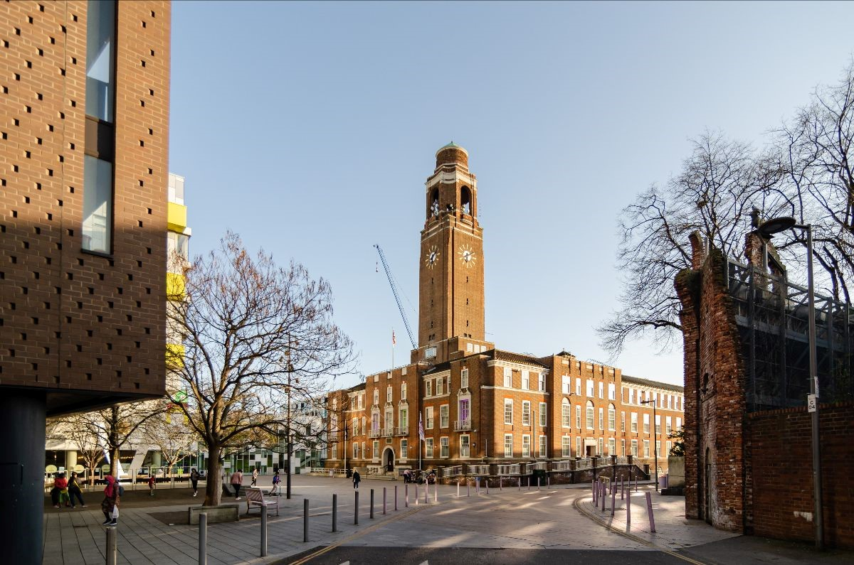
Community Care and development
NAME: Aissatu Bangura
ID: 2019279
LECTURER: Jolly Nwankwo
MODULE: BMHP6022
(Council,2024)
(Council,2024)

Slide 2
AI ACKNOWLEDGEMENTS
I confirm that I have not used any AI tools in the research and creation of this assignment. I confirm that I have not presented any AI generated materials as my own work. I confirm I have copies of my drafts, notes, and other resources I used, which I may be asked to provide in evidence.

Slide 3


Community
A community can be characterized as a group of people who have similar qualities, interests, or values who live in a reasonably close geographic region.
This concept goes beyond geographic proximity to include a sense of identity and belonging among its members.
(Habitat for humanity,2023)
(admin, 2021)

Slide 4

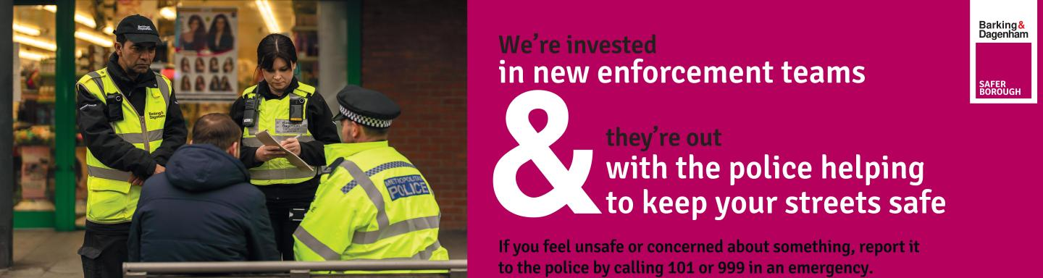
Introduction
There were 187,000 people living there as of the 2011 census. Dagenham, Chadwell Heath, and Barking are the three principal towns of the borough.
The municipal government is the Barking and Dagenham London Borough Council. The 2012 Summer Olympics were held in six London boroughs, including Barking and Dagenham.(Council,2024)
Aim
To make Barking and Dagenham a safer place by lowering marginalization and daily crime rates.
(Marsh, 2024)
2/7/20XX
4

Slide 5
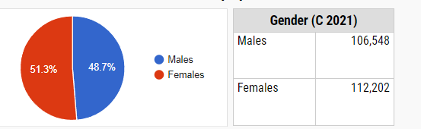
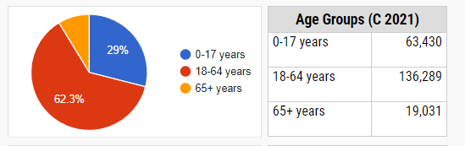
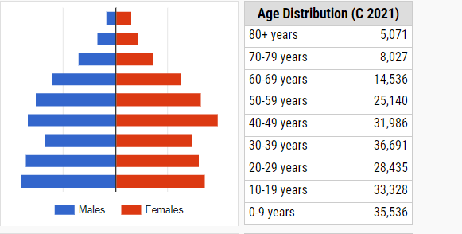
Population
According to the most recent estimates, Barking and Dagenham has a population of roughly 211,998 residents.
This reflects a significant increase over previous decades, with an inflow of young families and different ethnic communities adding to the region's dynamic demographics.
(Census,2021)
2/7/20XX
5
Notes:
5

Slide 6
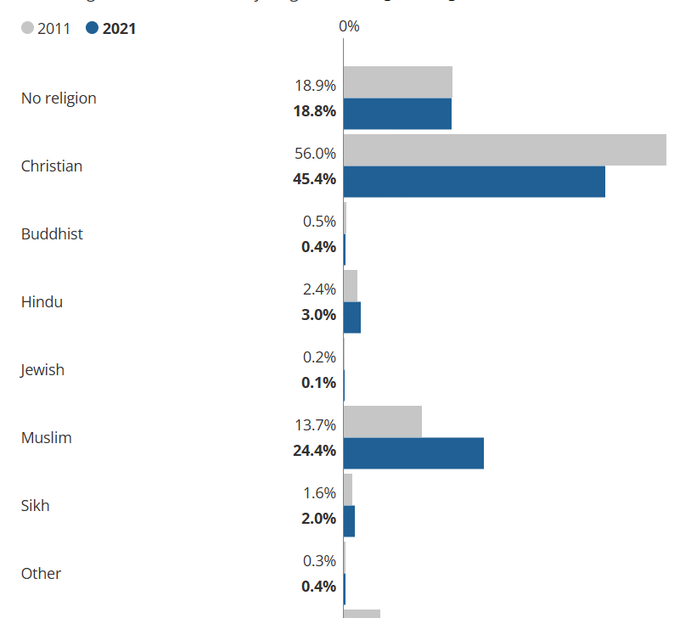
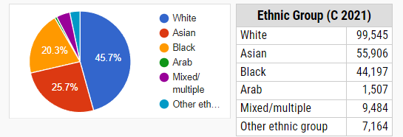
Religion/Ethnicity
According to the 2021 Census, Barking and Dagenham is a multifaith Borough:
Christianity (45.4%)
Muslim (24.4%)
Hinduism (3.0%)
Sikhism (2.0%)
No religion (18.8%)
(ONS, 2021)

Slide 7
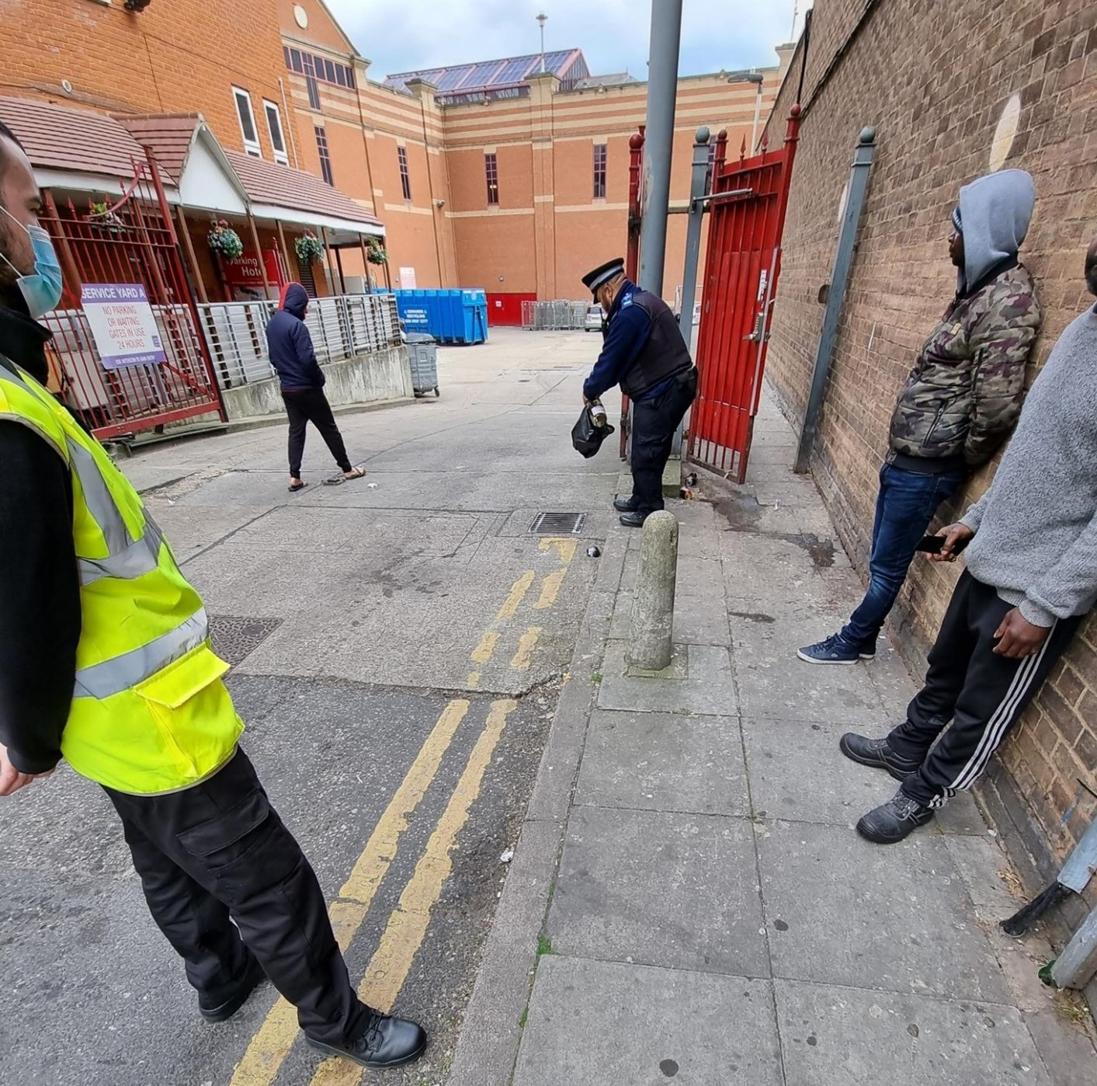
Key Issues
Anti-social behaviour-often includes damage, public disorder, and intimidation, leading to more serious criminal activity.
knife crime and gang-related activities- Burglary and theft are very prevalent in Barking and Dagenham.
Property crimes- Robbery and Theft are very prevalent in B&D Borough
Drug-related- The production, transportation, and consumption of illegal substances not only increase crime rates but also increase health and social issues.
(Metropolitan, 2021)

Slide 8
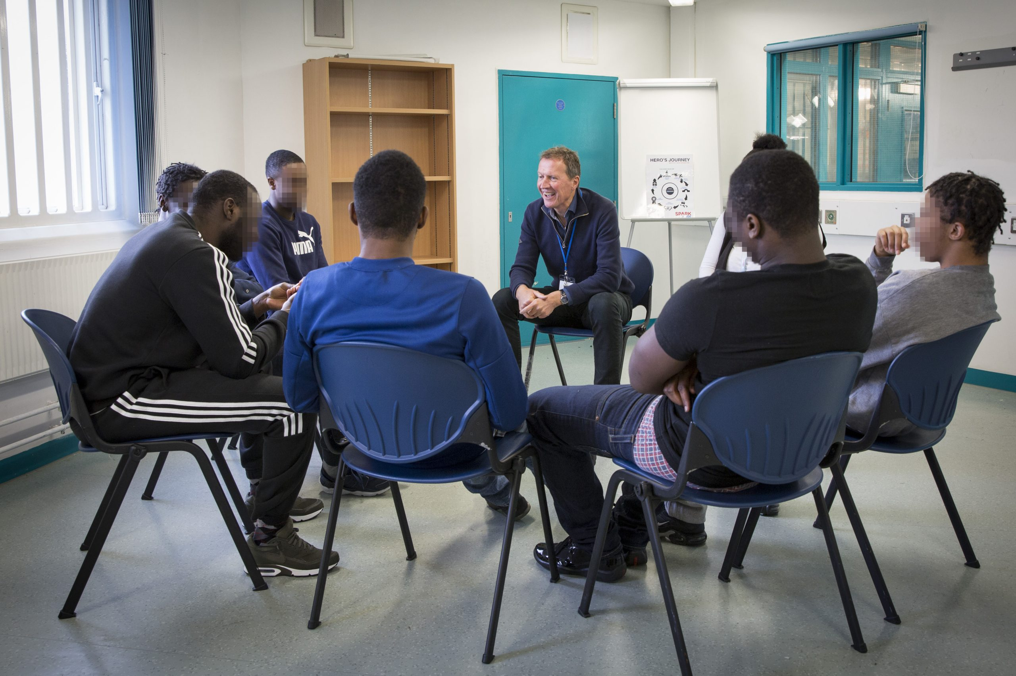
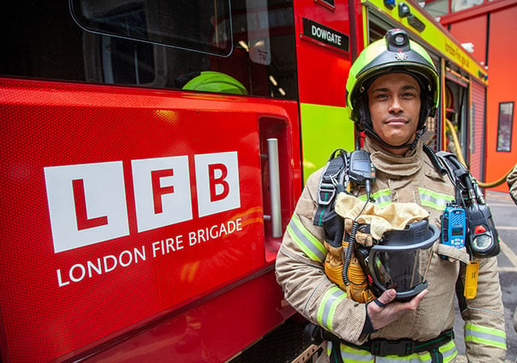

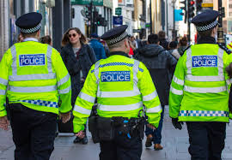
Stakeholders involved in the program
Barking and Dagenham CVS
London Fire Brigade
Metropolitan Police Service
London Community Rehabilitation Company
(Council,2024)
(Admin, 2024)
(Council,2024)
(Povala & Dunning, 2019)
Notes:
The Barking and Dagenham Community Safety Partnership (CSP) is a multi-agency group that works to reduce crime and disorder in the area.
8

Slide 9
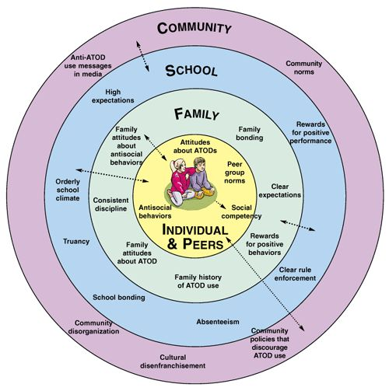
Bronfenbrenner theory
Barking and Dagenham employ Bronfenbrenner's Ecological Systems Theory to tackle crime by involving families, schools, community organizations, local governments, and cultural initiatives at various ecological levels.
(BASS, 2024)

Slide 10

Digital Media
#Barkinganddagenhammoresafe
#Safetyisapriority
#Ourkidssafety
#seeitsayitsortit

Slide 11



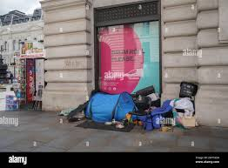
legislation and policy impact the support and growth of a community
Homelessness Reduction Act (2017)
The Academies Act 2010
Economic Act
Equality Act (2010)
Health and Wellbeing Act (2016)
(Courtesy, 2016)
(2024)
(Alamy,2024)
11

Slide 12
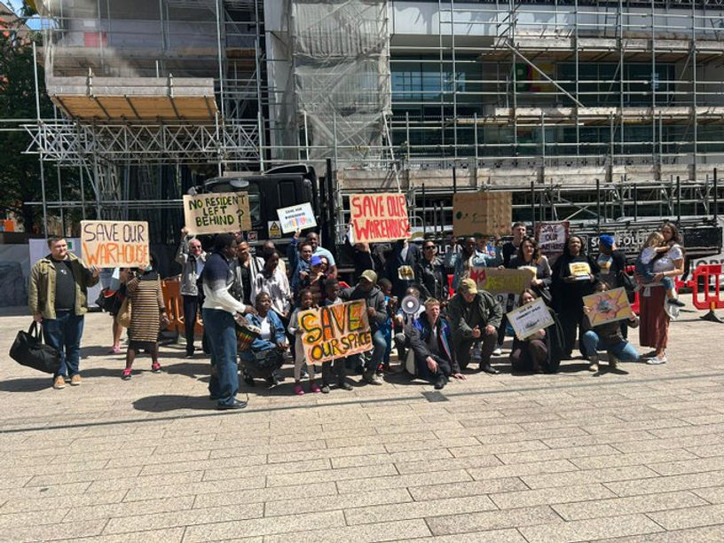
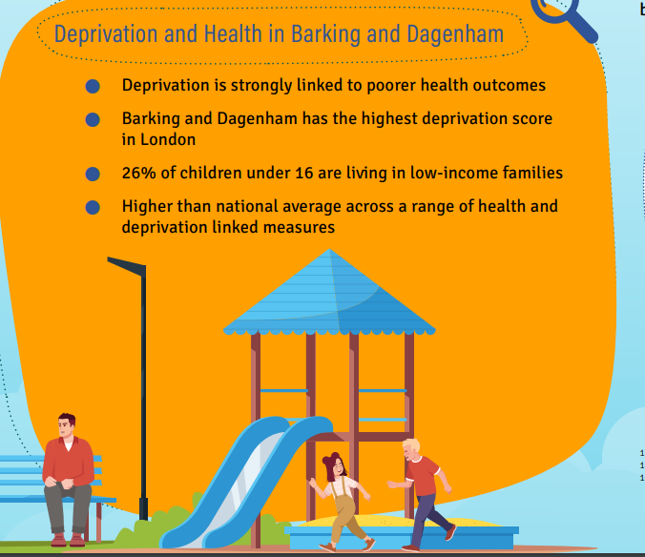
Barriers to community development
Deprivation
Housing
Inequalities
Environment
Government grants
(Municipal Enquiry, 2023)
(Public Health Report, 2020)
2/7/20XX
12

Slide 13

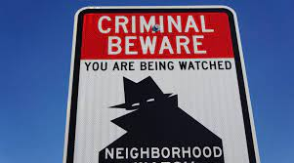
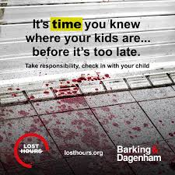
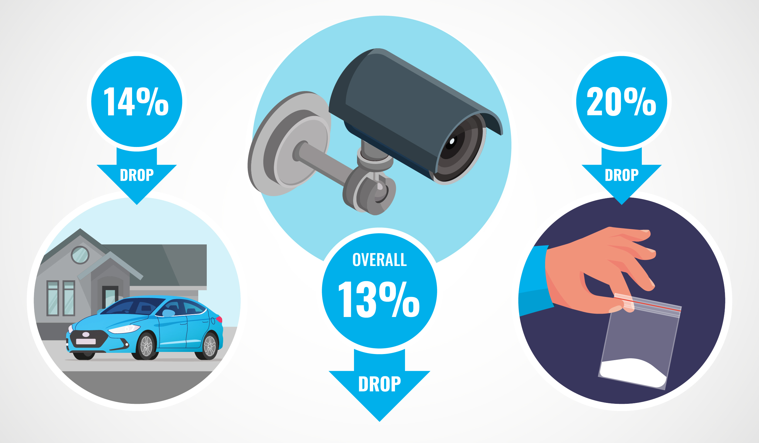
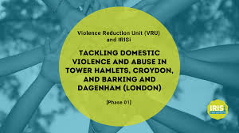
Recommendations
Community Engagement and Trust Building
Youth Intervention Programs
Improved Surveillance and Technology
Substance Abuse Rehabilitation
Economic Development and Employment Opportunities
13

Slide 14
Conclusion
Barking and Dagenham's crime reduction efforts involve collaboration, prevention, and community participation. Targeted measures include increased police presence, youth participation programs, and addressing crime causes like unemployment and educational inequalities. Advanced technology like CCTV and data analytics enhances monitoring and deterrence.
2/7/20XX
14

Slide 15
REFERENCES
Barking and dagenham crime and safety statistics | crimerate (2024) Crime and Safety in Barking and Dagenham. Available at: https://crimerate.co.uk/london/barking-and-dagenham (Accessed: 26 October 2024).
Borough, B. (2023) Barking & dagenham, London Borough of Barking and Dagenham. Available at: https://www.lbbd.gov.uk/council-and-democracy/statistics-and-data/barking-dagenham (Accessed: 29 October 2024).
cfo-admin (2021) What is community development?, Community First Oxfordshire. Available at: https://www.communityfirstoxon.org/signpost/what-is-community-development/ (Accessed: 28 October 2024).
Barking and Dagenham Council and police join forces for day of action (2021) London Borough of Barking and Dagenham. Available at: https://www.lbbd.gov.uk/news/2021/barking-and-dagenham-council-and-police-join-forces-day-action (Accessed: 29 October 2024).
in Psychology, B.A.S.S. (2024) Erikson’s 8 stages of psychosocial development – explained, Communication Theory. Available at: https://www.communicationtheory.org/eriksons-8-stages-of-psychosocial-development-explained/ (Accessed: 31 October 2024).
London borough of barking and dagenham (2024) Wikipedia. Available at: https://en.wikipedia.org/wiki/London_Borough_of_Barking_and_Dagenham. (Accessed: 18 October 2024).
London borough of barking & dagenham council (2024) Barrie Bookkeeping & Payroll Solutions Ltd. Available at: https://barriebookkeeping.co.uk/localcouncil/barking-and-dagenham-council/ (Accessed: 29 October 2024).
Marsh, A. (2024) Pictures reveal murder crime scene after man shot dead, Barking and Dagenham Post. Available at: https://www.barkinganddagenhampost.co.uk/news/24648954.linton-road-barking-shooting-pictures-reveal-murder-scene/ (Accessed: 26 October 2024).
Povala, J. and Dunning, H. (2019) Spending six weeks with the Metropolitan Police Service and their data: Imperial News: Imperial College London, Imperial News. Available at: https://www.imperial.ac.uk/news/189629/spending-weeks-with-metropolitan-police-service/ (Accessed: 31 October 2024).
(2024) London Community Rehabilitation Company. Available at: https://londoncrc.org.uk/author/id/ (Accessed: 31 October 2024).
What makes you you-nique? (2019) London Borough of Barking and Dagenham. Available at: https://www.lbbd.gov.uk/news/2019/what-makes-you-you-nique (Accessed: 28 October 2024).
Wilding, M. (2019) Barking and Dagenham approves 1,100-home 29-storey Retail Park Redevelopment, Barking and Dagenham approves 29-storey housing scheme. Available at: https://www.planningresource.co.uk/article/1586409/barking-dagenham-approves-1100-home-29-storey-retail-park-redevelopment (Accessed: 03 November 2024).
2/7/20XX
15

Slide 16

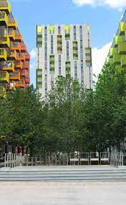
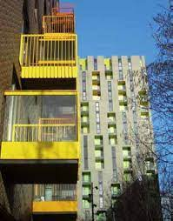

(B&D Borough, 2024)
Sample Footer Text
16

