Slide 1
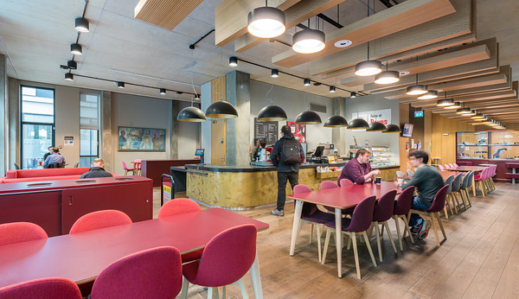

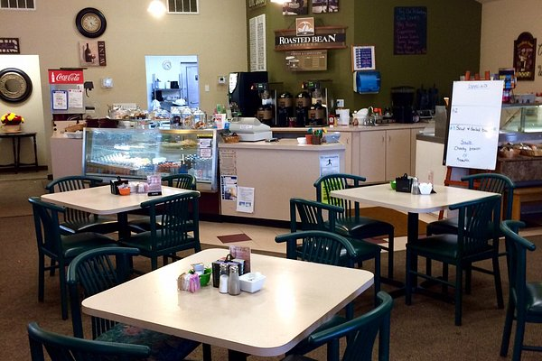
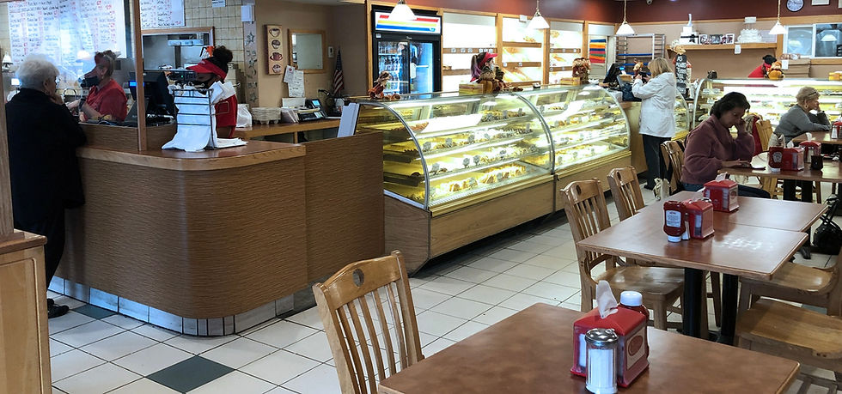
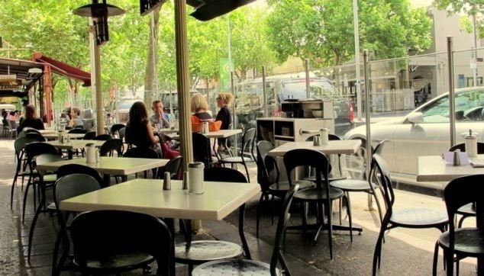
Student Name:Fahad Ali
Student ID:2227918
f
Element 3
Poster
Research methods
The researcher has decided to undergo mixed methods in order to collect and analyse the data and present it effectively. In addition, the researcher has undergone both quantitative and qualitative research, which are suitable (Dawadi et al., 2021). The quantitative data sets would undergo numerical and statistical data in order to attain real time data and enhancing the knowledge based on the provided evidence. The qualitative data has provided theoretical understanding as per interview process of the students who have been part of the University. Numerical and theoretical knowledge has been developed based both quantitative and qualitative data sets.
Methods to collect data
The collection of data is to be done on the basis of interview and survey analysis. 50 students from the University are being considered to undergo the survey through the help of random sampling methods. There would be certain limitations that are to be associated with the data sets which can lead to a barrier in order to engage with the proper method of survey. While collecting the relevant data, GDPR (General Data Protection Rule) is considered, which would be helping to maintain privacy and confidentiality based upon the personal information of the participants and make sure that the data are to be kept safe and secured. (Vlahou et al., 2021). The participant information is not misused and no harm is created to anyone and they have been stored in the personal computer in order to make sure they are to be used for research purpose only and to be deleted once the research is done.
Result and discussion
Primary quantitative analysis
Survey analysis was being conducted on 50 students who have been part of the University and have been visiting the cafe on a regular basis. Through the findings, it can be found that the students are not happy with the approaches that have been undertaken by the cafe owner. They have a lot of complaints which include high prices, long waiting hours, less options of foods. The area is not at all clean and over the course of it one thing which has been found that the type of food which has been available is of low quality in some days. This has been one of the biggest problems within the cafe across the University and the students are finding it quite difficult to handle with the situation and take up with clear actions which are going to be suitable for the betterment of the company in the course of time and making sure that things are being done in a correct manner.
Primary Qualitative analysis
Service quality and staff efficiency is closely related with the overall satisfaction and this has proper influence on the business perceptions. These have been the factors which are being discussed together in order to create a relation and ambiguity in between two of the findings that have been conducted by the researcher in order to conduct the whole process. The qualitative data has increased the theoretical and statistical knowledge and understanding regarding the chosen topic.
Reference List
Dawadi, S., Shrestha, S. and Giri, R.A., (2021). Mixed-methods research: A discussion on its types, challenges, and criticisms. Journal of Practical Studies in Education, 2(2), pp.25-36.
Vlahou, A., Hallinan, D., Apweiler, R., Argiles, A., Beige, J., Benigni, A., Bischoff, R., Black, P.C., Boehm, F., Céraline, J. and Chrousos, G.P., (2021). Data sharing under the General Data Protection Regulation: time to harmonize law and research ethics?. Hypertension, 77(4), pp.1029-1035.

