Slide 1
Gender and criminality
Laura Knight

Slide 2
Learning objectives
By the end of today's session, you should be able to:
- Identify key statistics in relation to gender and criminality
- Identify key vulnerabilities in terms of females as offenders
- Determine whether the needs of women are being met by the justice system
- Examine gender specific interventions that are currently available

Slide 3
"The most significant fact about crime is that it is almost always committed by men" (Newburn and Stanko, 1994).

Slide 4
What is the percentage of women currently held in prison in England and Wales?
How does this compare with men?
Remember to find credible sources to help you answer these questions. If done properly, you should leave this session with a list of credible sources that you may want to address in your second assignment.

Slide 5
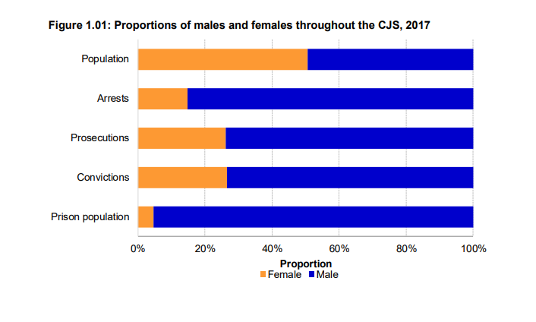
What do the statistics say?
Ministry of Justice (2018)
Notes:
https://assets.publishing.service.gov.uk/government/uploads/system/uploads/attachment_data/file/759770/women-criminal-justice-system-2017..pdf

Slide 6
Recent Figures
As of 2022, 4% of the prison population were female
This number has stayed stable for the last 5 years
As of currently there are 3,259 women in prison
Also, in 2022 17% of females were serving sentences of less than 12 months
A higher proportion of female's offenders were first time offenders
Females have a higher average number of reoffences per reoffender compared to males
Notes:
https://www.gov.uk/government/statistics/women-and-the-criminal-justice-system-2021/women-and-the-criminal-justice-system-2021#:~:text=As%20at%2030%20June%202022,serving%20shorter%20custodial%20sentence%20lengths. (Ministry of Justice)

Slide 7

Vulnerabilities of women
Across the UK, around 12,000 women are imprisoned each year.
Although women are less than 5% of those in prison, they account for over 19% of self harm incidents, an indication of the traumatic impact of imprisonment on many.
Women entering prison are more likely to have been imprisoned for non-violent offences.
Women in prison are highly likely to be victims as well as offenders. Over half the women in prison report having suffered domestic violence
Many of them have dependent children

Slide 8
Other vulnerabilities of Women in prison
52% of women had used heroin or cocaine in the four weeks before custody
29% had an alcohol problem on arrival to prison
About 170 imprisoned women will give birth each year
600 women in prisons in England and Wales receive antenatal care each year
Notes:
https://www.bmj.com/bmj/section-pdf/187724?path=/bmj/346/7891/Analysis.full.pdf (British Medical Journal)

Slide 9
Criminal Justice System in Wales
No prisons in Wales for female offenders
Do not have accommodation when released
Inadequate support leads to women re-offending
Calls for devolution of responsibility to Welsh Government

Slide 10
Research
Which types of offences do men mainly commit and which offences do women mainly commit?
Which mitigating factors are the courts most likely to take into account when sentencing women?

Slide 11
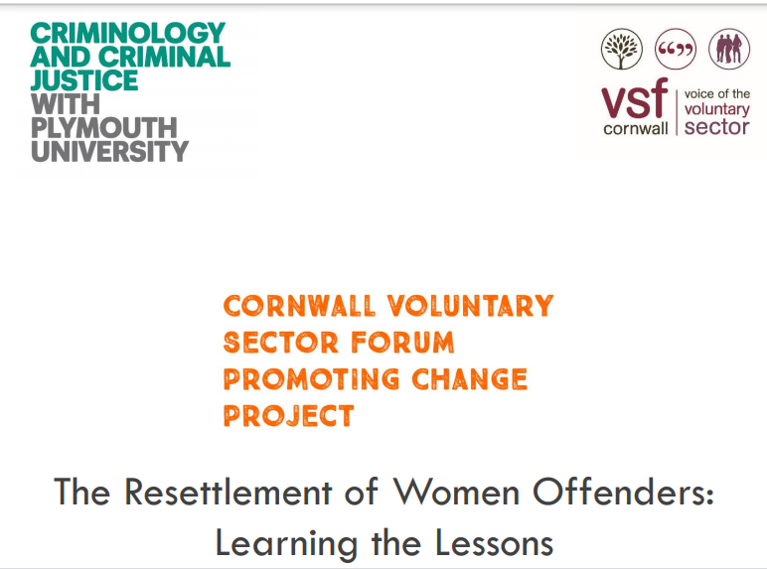
Resettlement of female offenders
A system designed for men made to fit women?
Drugs and alcohol misuse
Short prison sentences
Lack of awareness of Probationary schemes
Money
Education – numeracy and literacy skills
Notes:
Research by the University of Plymouth into the resettlement of female offenders (2017): https://www.plymouth.ac.uk/uploads/production/document/path/8/8608/Women_s_Research_Project_FINAL_REPORT_13_Feb_2017.pdf

Slide 12



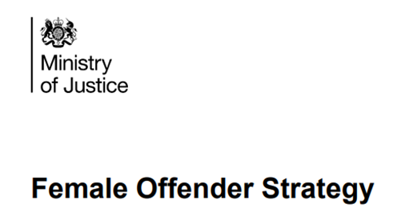
Pollock and Glyn (2018) have stated that ‘women who commit minor crimes need help not prison’.
What evidence can you find in support/against this statement?

Slide 13
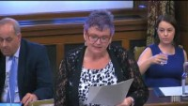
Notes:
Play Video
https://www.youtube.com/watch?v=iDjSq5qmK2k

Slide 14
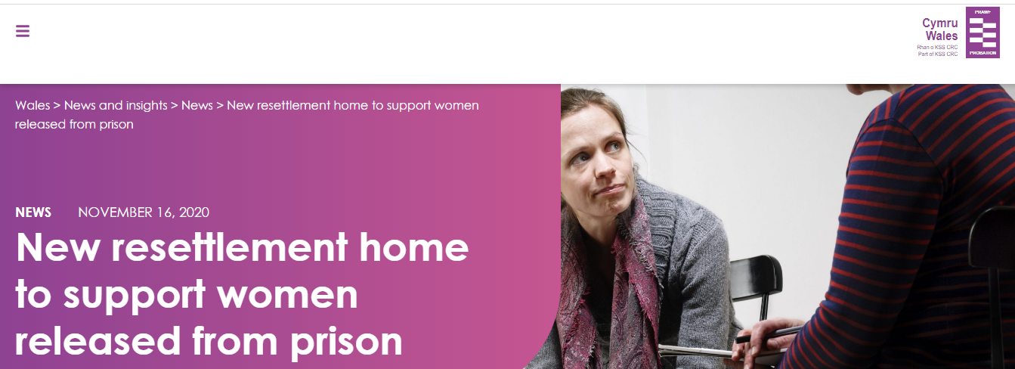
Resettlement homes for female offenders
Notes:
16 November 2020: https://www.wales.probationservices.co.uk/2020/11/16/new-resettlement-home-to-support-women-released-from-prison/

Slide 15

Cockett Residential Centre
Site in Swansea, planned to open in 2024
Local women to be diverted from crime with bespoke support
Meant for 50 offenders who would have been handed a prison sentence of 12 months or less
Female offenders will receive one-to-one mental health therapy, counselling and support to overcome addiction
Not everyone is supportive of the planned development

Slide 16
Iriss
(2018)
1. How effective (in terms of outcomes and costs) are women specific interventions in addressing complex needs?
2. What are the impact of these interventions as preventative strategies in children’s services? (e.g. reducing the likelihood of recurrent child protection interventions)
Notes:
https://www.iriss.org.uk/sites/default/files/2018-06/iriss-esss-evidence-review-impact-women-specific-interventions-2018-06-04.pdf

Slide 17
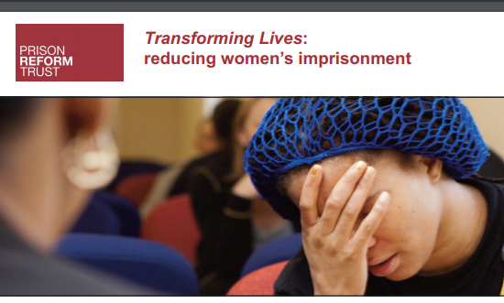
Gender Specific Interventions
Improve
Improve the governance of women’s justice across the UK, which requires dedicated leadership and cross-government co-ordination informed by a robust economic case
Strengthen
Strengthen the pathways into mental health and social care services for vulnerable women caught in the criminal justice system
Increase
Increase awareness of the links between women’s experience of domestic abuse and their offending
Reduce
Reduce the use of custodial remand unless the seriousness of the offence or the protection of the public demands it
Promote
Promote non-custodial options for mothers of dependent children
Reduce
Reduce the number of foreign national and black and ethnic minority women in custody
Work
Work intensively in selected local areas to foster greater use of early intervention and community orders for women
Notes:
https://prisonreformtrust.org.uk/project/women-the-criminal-justice-system/ (Prison Reform Trust)

Slide 18
Recap of learning objectives
In today's session we have looked at:
Key statistics in relation women in prison
The key vulnerabilities of women in prison
Are the needs of women are being met by the justice system
What are the gender specific interventions that are currently available

Slide 19
Further Reading
Abuse, women and the criminal justice system (Crime and Justice)
Women in the criminal justice system: the triumph of inertia (British Society of Criminology)
Improving outcomes for women in the criminal justice system (House of Commons)
Is the criminal justice system failing Welsh women? (Welsh Parliament)
Notes:
https://senedd.wales/senedd-now/news/inadequate-support-leads-to-women-re-offending-senedd-report/ (Welsh Parliament)
https://commissioner.south-wales.police.uk/en/news/location-of-first-ground-breaking-residential-women-s-centre-revealed/ ( South Wales Police and Crime Commissioner)

