Slide 2
ECAD6015: 2026-2027
What am I teaching?
Professional and Pedagogic Studies: Leading the Learning: what, how and why am I teaching?
Beth ydw i'n ei addysgu? Astudiaethau Proffesiynol ac Addysgeg: Arwain y Dysgu: beth, sut a pham ydw i'n addysgu?
ECAD6015C: 2026-2027

Slide 3
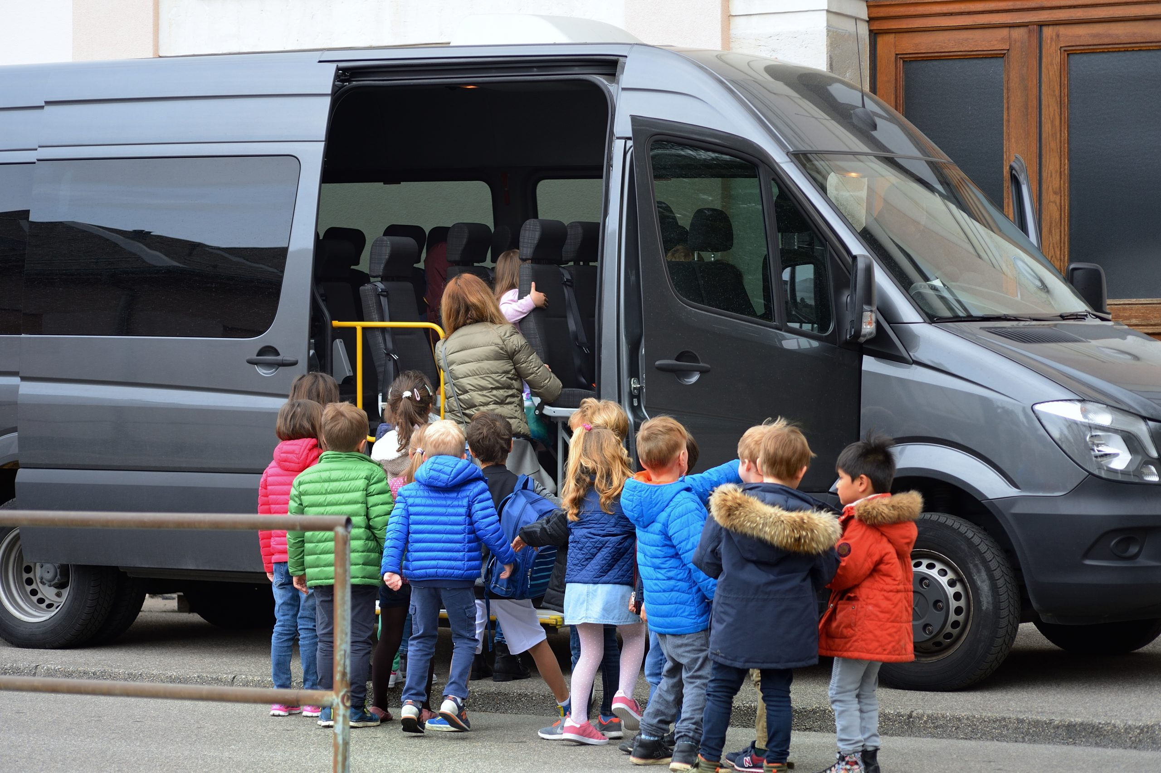

ECAD6015-C
Diwrnod Allan ar Hyd y Lle
Out and About Day

Slide 4

Aims for this session
Nodau ar gyfer y sesiwn hwn
To think about pupils' feelings about educational visits
Meddwl am deimladau disgyblion ynghylch ymweliadau addysgol
To consider why we take pupils on educational visits
Ystyried pam rydym yn mynd â disgyblion ar ymweliadau addysgol
To identify suitable places to visit and explain how these visits link to the Curriculum for Wales
Nodi lleoedd addas i ymweld â nhw ac egluro sut mae'r ymweliadau hyn yn cysylltu â Chwricwlwm i Gymru
To choose a place to visit in your local area, plan and visit the place on Monday, 5th October
I ddewis lle i ymweld ag ef yn eich ardal leol, gwnewch gynllun ac ymwelwch â'r lle Dydd Llun, Hydref 5ed.
To submit a group planning sheet and photographs from your visit
I gyflwyno taflen gynllunio grŵp a ffotograffau o'ch ymweliad.
.

Slide 5

Why we take pupils on educational visits
Pam rydym yn mynd â disgyblion ar ymweliadau addysgol

Slide 6

What some of the literature says
Beth mae rhai llenyddiaeth yn ei ddweud
Students who directly participate during a field experience generate a more positive attitude about the subject. Many researchers have noted knowledge gain and learning that occurred during field trips
Hudak, 2003; Mawdsley, 1999; Michie, 1998; Nadelson & Jordan, 2012; Scribner-MacLean & Kennedy, 2007
The outcome of an experience depends on a person’s interests, motivation, life circumstances at that time, needs, and prior experiences and knowledge (Rennie, 2007). Field trips offer an opportunity to motivate and connect students to appreciate and understand classroom concepts, which increase a student’s knowledge foundation, promoting further learning and higher-level thinking strategies. With understanding comes confidence and intrinsic motivation. A successful and quality field trip requires teacher preparation and interaction. Some factors should be addressed before the trip. The experience needs to be planned.
Behrendt & Franklin, 2014

Slide 7

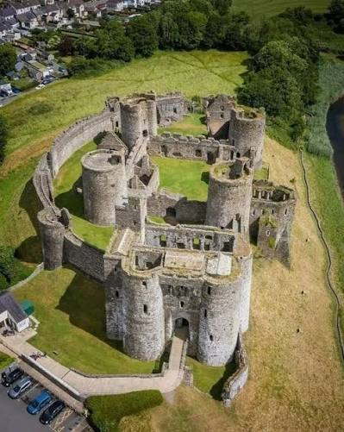
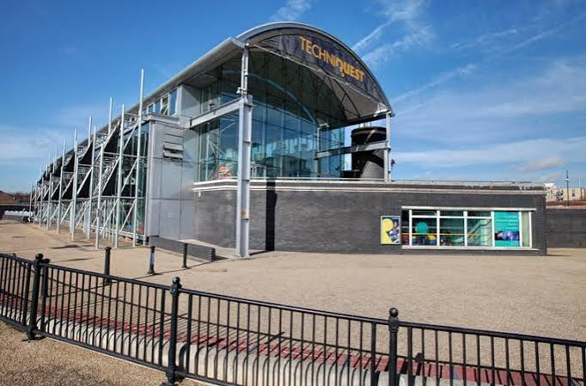

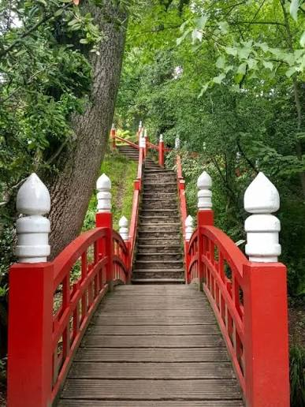
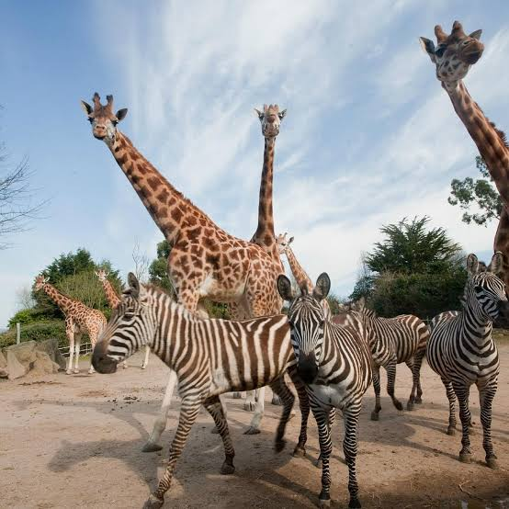
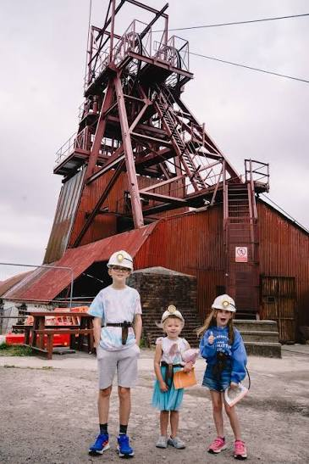
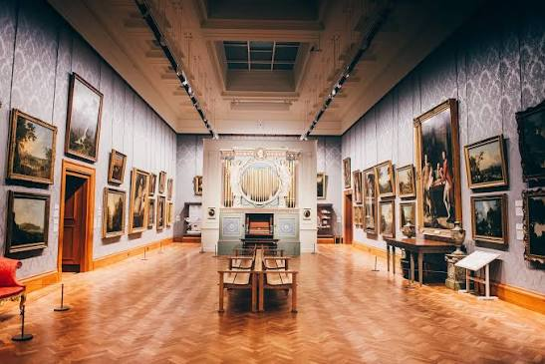
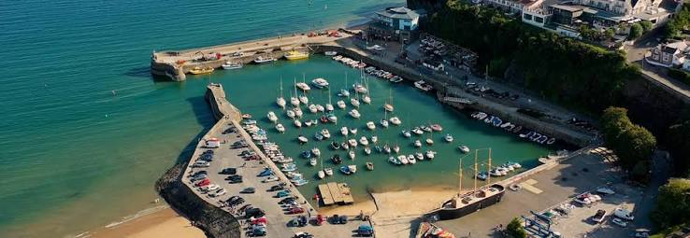
Where shall we go?
Ble awn ni?

Slide 8
Planning a visit
Cynllunio ymweliad

Slide 9
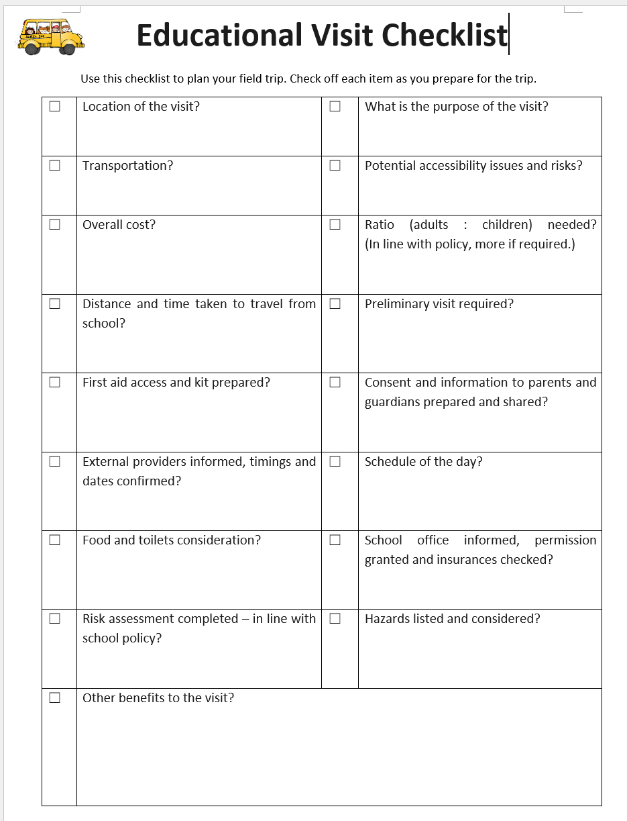
Planning a school visit
Cynllunio ymweliad ysgol
Using Microsoft Word
create a checklist that you could use in the future to help you plan a visit.
Have a look at this template, as an example.
Defnyddiwch Microsoft Word
i greu rhestr wirio y gallwch ei defnyddio yn y dyfodol i’ch helpu i gynllunio ymweliad.
Edrychwch ar y templed hwn fel esiampl.

Slide 10
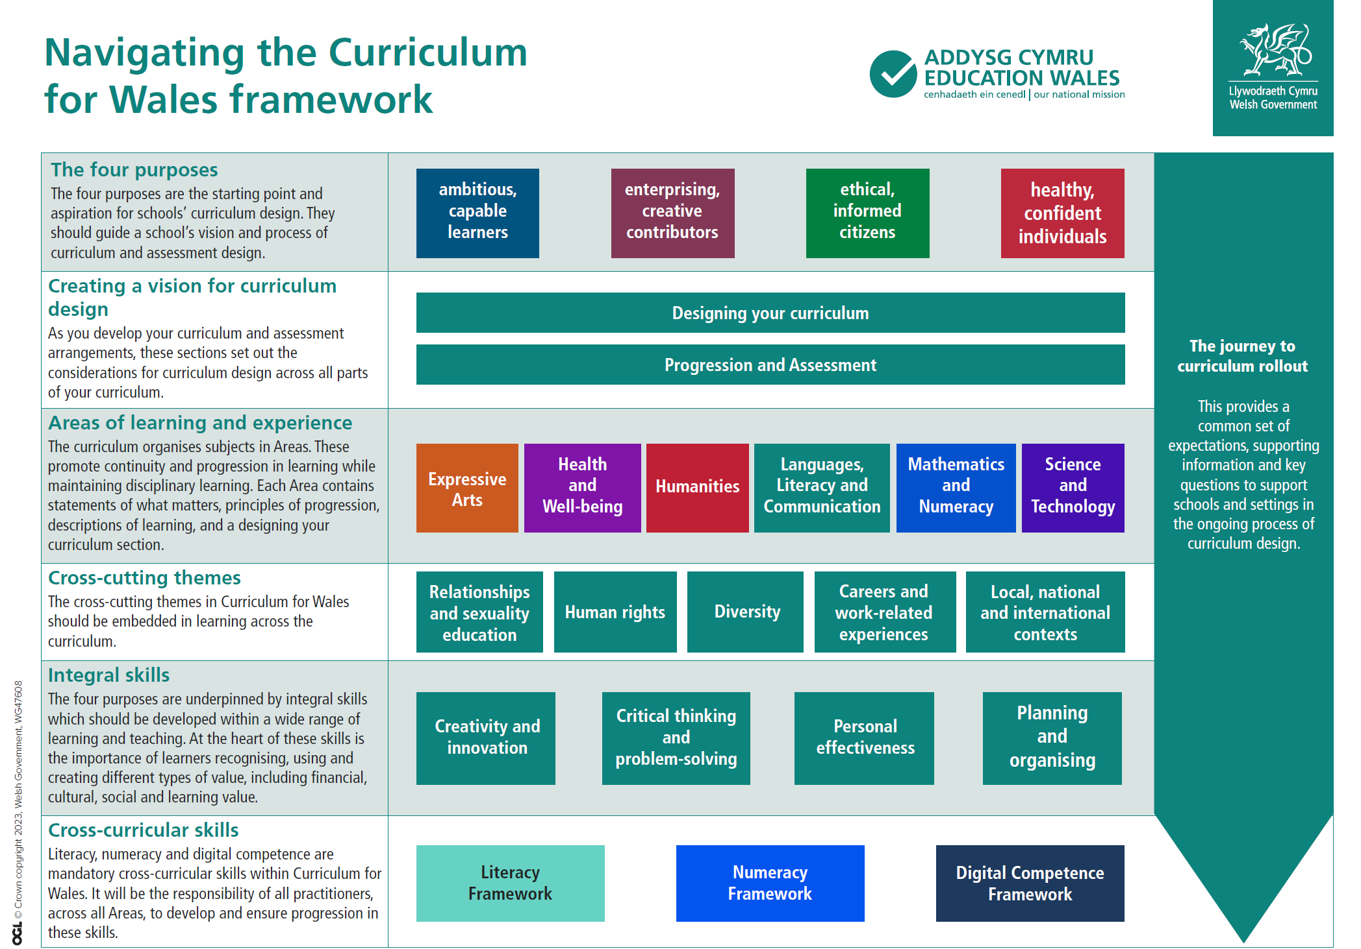

Sut mae’r ymweliad rydych chi wedi’i gynllunio yn cysylltu â’r Cwricwlwm i Gymru?
How does the visit you have planned link to the Curriculum for Wales?

Slide 11
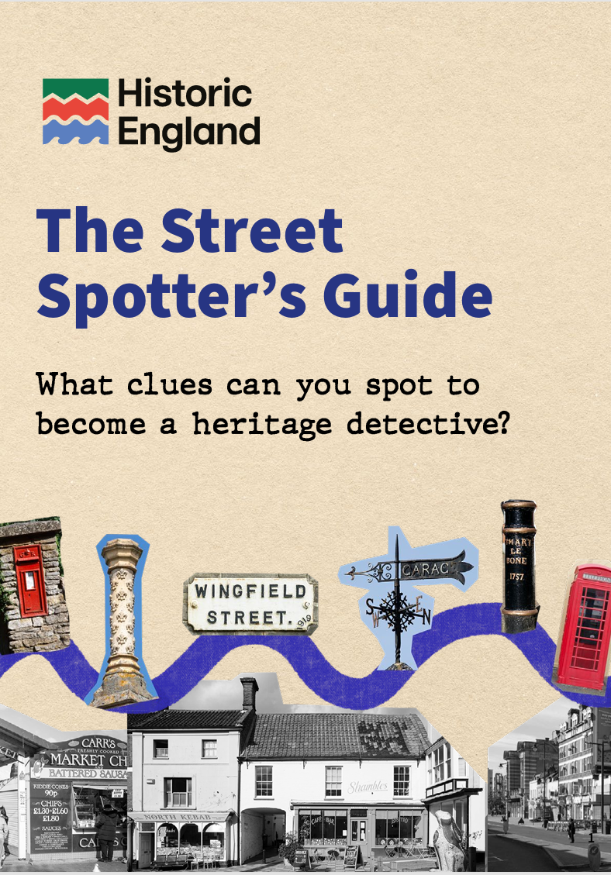
The details
Y manylion
Gweithiwch gyda'ch gilydd sut bynnag yr hoffech chi – o leiaf 2 berson.
Gallwch ddewis mynd i unrhyw le a fynnwch, ond yn ôl pob tebyg, i le yn eich ardal leol.
Ystyriwch eich diogelwch chi, yn ogystal â diogelwch y disgyblion pan fyddant ar ymweliad addysgol.
Nodi lleoedd addas i ymweld â nhw ac egluro sut mae'r ymweliadau hyn yn cysylltu â Chwricwlwm i Gymru.
Dewis lle i ymweld ag ef yn eich ardal leol, ei gynllunio ac ymweld ag ef DYDD LLUN HYDREF 5.
Cyflwyno taflen gynllunio grŵp a ffotograffau o'ch ymweliad erbyn 9yb Dydd Gwener, Hydref 23.
Gallwch gyflwyno eich taflen gynllunio eich hun neu gopi o daflen gynllunio'r grŵp.
Work together however you would like – minimum of 2 people.
You can choose to go wherever you like, but probably somewhere in your local area.
Please consider your safety, as well as considering the safety of pupils when they are on an educational visit.
To identify suitable places to visit and explain how these visits link to the Curriculum for Wales.
To choose a place to visit in your local area, plan and visit the place on MONDAY 5 OCTOBER.
To submit a group planning sheet and photographs from your visit by 9am on Friday, 23 October.
You may submit your own planning sheet or a copy of the group’s planning sheet.

Slide 12
Time to think…
Amser i feddwl…
Ydych chi’n meddwl bod hwn yn gynllun da?
A fyddech chi'n teimlo'n hyderus i gynllunio ymweliad nawr?
Os na, pa gymorth arall fyddai ei angen arnoch chi?
Do you think this is a good plan?
Would you feel confident planning a visit now?
If not, what more support would you need?
Notes:
Any other reflections on the session?

Slide 13
Gwefannau defnyddiol wrth gynllunio ymweliad
Useful websites when planning a visit
https://oeapng.info/about-national-guidance/#1630503498392-52d9bfab-9367
Plan your educational visit
Educational visits and outdoor learning | GOV.WALES
Planning your education visit | Cadw
Learning Beyond - in your local area
https://www.ukschooltrips.co.uk/plan-your-trip.html
https://www.educationalvisitsuk.com/blog/school-trip-guide-planning-a-school-trip-with-educationalvisitsuk-com/
https://www.kingswood.co.uk/post/the-ultimate-guide-to-planning-a-school-trip
Notes:
Allow students time to navigate these pages independently.

Slide 14

References
Cyfeiriadau
Behrendt, M., & Franklin T. (2014). A review of research on school field trips and their value in education. International Journal of Environmental and Science Education, 9(3), 235- 245. doi: 10.12973/ijese.2014.213a
Hudak, P. (2003). Campus field exercises for introductory geoscience courses. Journal of Geography, 102(5), 220-225.
Lyman, F. (1981). The Responsive Classroom Discussion. College Park, MD: University of Maryland College of Education.
Mawdsley. R. D. (1999). Legal issues involving fieldtrips. School Business Affairs, 65(9), 28-31.
Michie, M. (1998). Factors influencing secondary science teachers to organise and conduct field trips. Australian Science Teacher’s Journal, 44, 43–50.
Nadelson, L., & Jordan, J. (2012). Student attitudes toward and recall of outside day: An environmental science field trip. Journal of Educational Research, 105(3), 220-231.
Rennie, L.J. (2007). Learning outside of school. Handbook of Research on Science Education. Mahwah: New Jersey.
Scribner-MacLean, M., & Kennedy, L. (2007). More than just a day away from school: Planning a great science field trip. Science Scope, 30(5), 57-60.

