Slide 1
Lecture Two: Types of research & research design
Jodie Croxall & Kalee Thomas
Wednesday 12th October, 2022
Room AS501

Slide 2

Today’s Session
Lecture:
Research Philosophy
Types of Research
Research Design
Tutorial:
Group activity
Q & A

Slide 3
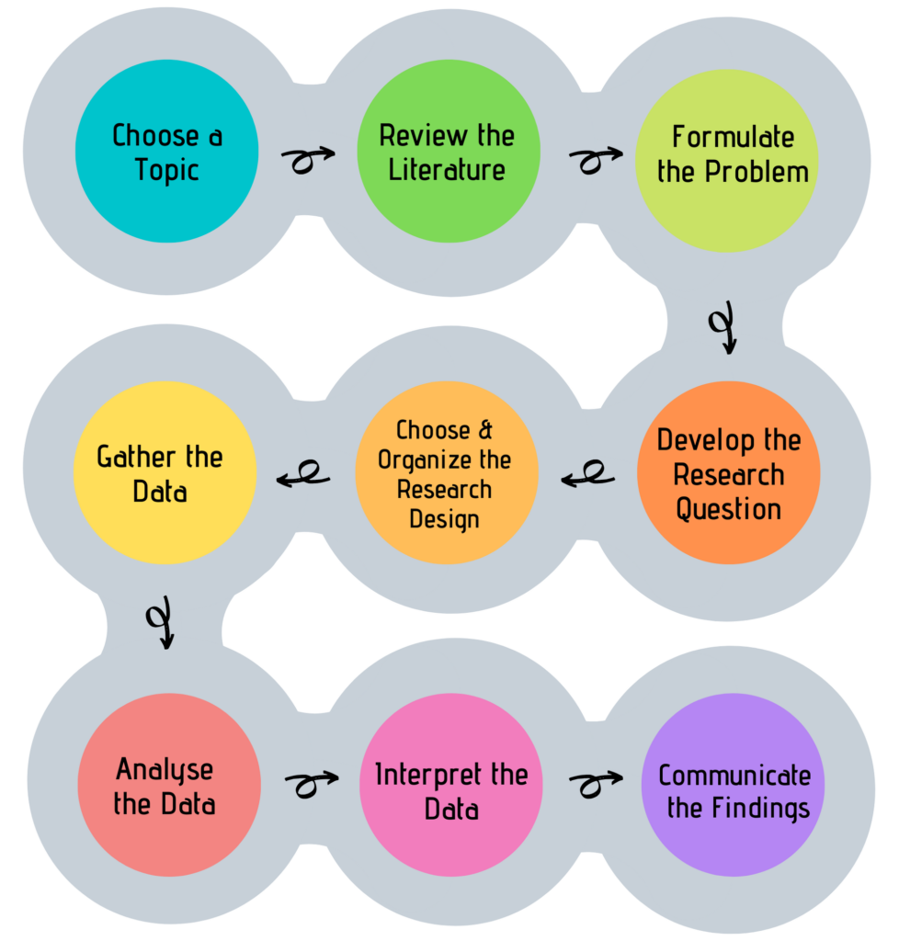
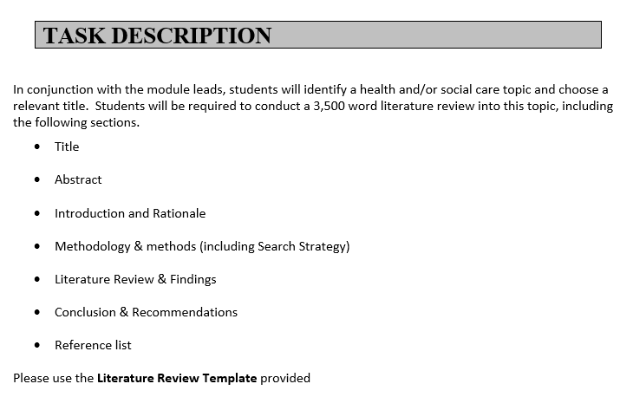
Before we begin…
Key components of the research process

Slide 4
Part One: Research Philosophy

Slide 5

A (reassuring) note on terminology…
There are many complex and often philosophical terms associated with research…
Terms are often debated, understood, and communicated in many diverse ways…

Slide 6

What comes to mind when you think about types of research & research design?
Methods
Methodology
Epistemology
Ontology
Research Paradigm

Slide 7

Why does this matter in the research process?

Slide 8


Because the way we view the world influences how, and what we find out about the world!

Slide 9


Slide 10
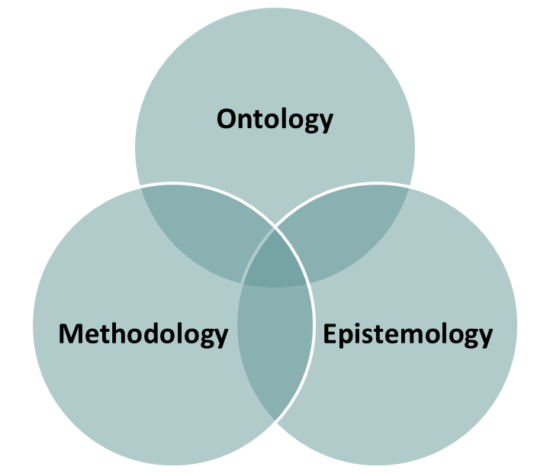
Research paradigms
All research or inquiry is guided by a set of beliefs or worldviews…
Referred to as a paradigm = a way of thinking about the world…
There is no way to prove that one paradigm is more superior than others, this is why they are debated!!! (and debated, and debated…)
“Paradigms are basic belief systems based upon ontological, epistemological and methodological assumptions”
(Guba & Lincoln 1994)
Research Paradigm
Ontological, epistemological and methodological assumptions (whatever they me be) are interrelated…

Slide 11
Research Paradigm

Slide 12

Ontology
The term Ontology originates from two Greek words: on, which means "being," and logos, which means "study, or science of...“
In philosophical terms it refers to the study of our existence, and the fundamental nature of reality or being…
Beliefs about reality therefore determine what can be known about it…
Throughout history, human beings have ascribed to various belief systems as to what constitutes truth and/or reality in their quest to make sense out of the world (Denzin & Lincoln, 2008).
Questions relating to ontology incl.
What is true?
What exists?
What is real?

Slide 13
Two main Ontological stances
Realists believe that reality exists, driven by natural laws, independent from any theories, human beliefs or behaviours, context free. There is "truth” that is objective, static and measurable…. It is
Context-free generalizations
Cause and effect laws
Research that converges the truth
Reductionist and deterministic approaches
Realism
Relativists believe that reality cannot exist without context. There are many constructions of reality which are influenced by experiences, social interactions etc. each person therefore has their own reality that is considered correct…It is
Searching for meaning rather than truth
Meaning in the experiences of individuals
‘Truths’ are subjective, dynamic and contextual
Multiple perceptions or truths may change with time
Relativism
  There are many different versions of realism and relativism - so it’s important not to assume that these terms always mean the same thing

Slide 14
Research Paradigm

Slide 15

Epistemology
The term epistemology also originates from two Greek words: "episteme," meaning "knowledge," and "logos,“ =the "study, or science, of.“
It is used to describe the beliefs about how ‘knowledge’ might be discovered about the world…
It defines the ways in which a researcher’s ontological perspective on reality, are translated into knowledge…
Again, throughout history human beings have developed numerous theories about what it means to know, and subsequently there are many epistemological perspectives…
Questions relating to epistemology incl.
How we come to know what we know?
  How do I know what is true?

Slide 16
How we order knowledge: some distinctions
Other ways we order knowledge?
What is happening?
What does it mean?
What are the causes of it?
Is it a good or a bad thing?
Description
Interpretation
Explanation
Evaluation

Slide 17
Research Paradigm

Slide 18

Methodology
‘the underlying principles and rules of organisation of a philosophical system or inquiry procedure’
(Oxford Dictionaries, 2018)
How we go about discovering and creating knowledge in a systematic way…
The appropriate methodology is driven by ones own ontological and epistemological beliefs…(or the ones imposed upon us!)
Different to method as this refers to the ‘research tools’, the techniques & procedures to collect & analyse data….
Methodology is the justification for using a particular research method - including whether you use qualitative or quantitative methods, or a mixture of both…

Slide 19
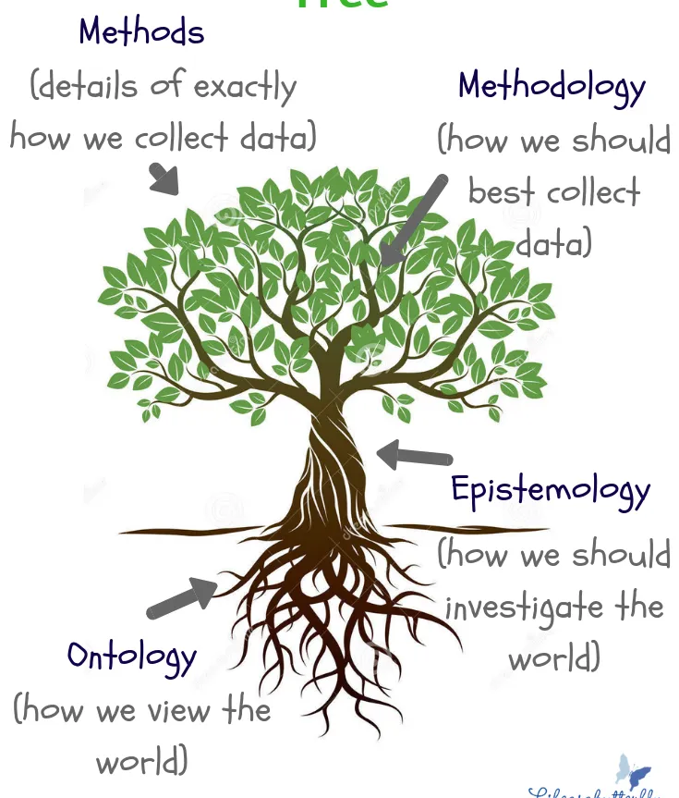

Slide 20

Group Discussion Exercises
Some
thinking points…

Slide 21

Thinking Point 1.
What does it mean to say that ‘beauty is in the eye of the beholder’?
Do you think this is true?
If so, why?
If not, why not?

Slide 22
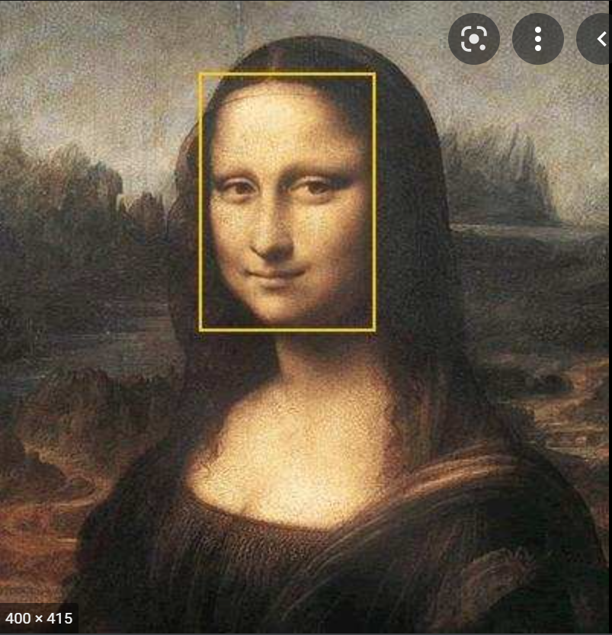
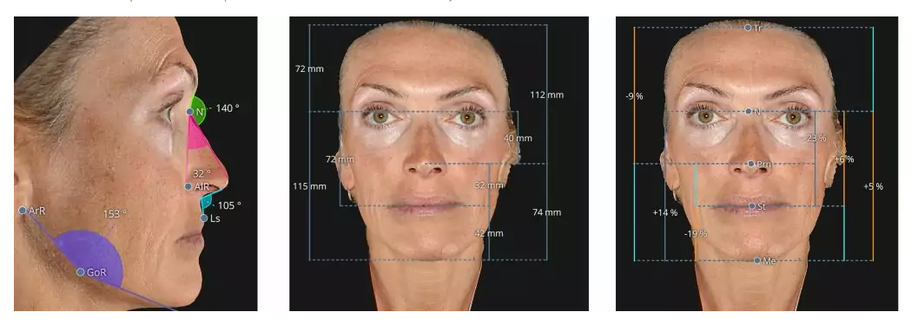
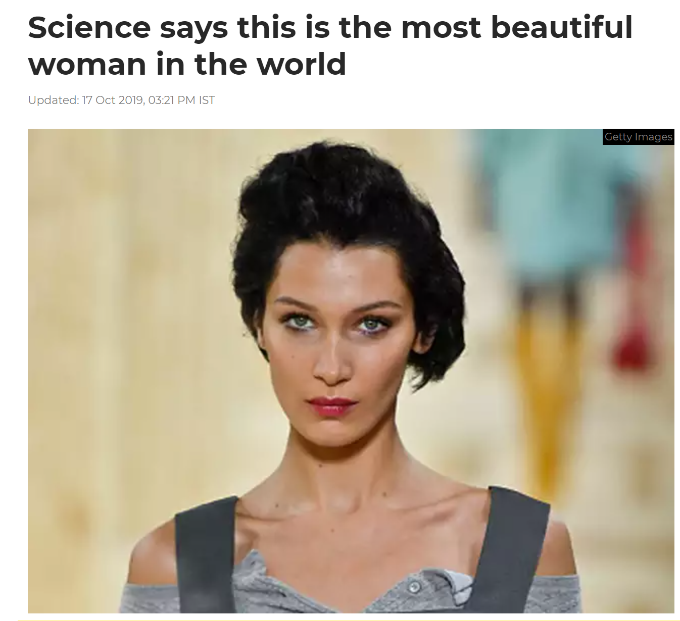
The ‘Golden Ratio’
Devised by Robert Rickets in 1982
Tried to define the ideal of facial beauty
Identified the proportion between two lines of facial measurements
The ‘Golden Ratio of 1.618 (Click HERE to access journal article)

Slide 23

Thinking Point 2.
In 1543, the astronomer Copernicus published his theory that rather than being the centre of the universe, the earth revolves around the sun… His findings revolutionised science
So does this mean that…
In 1542, were people who thought the earth was the center of the universe were wrong?

Slide 24
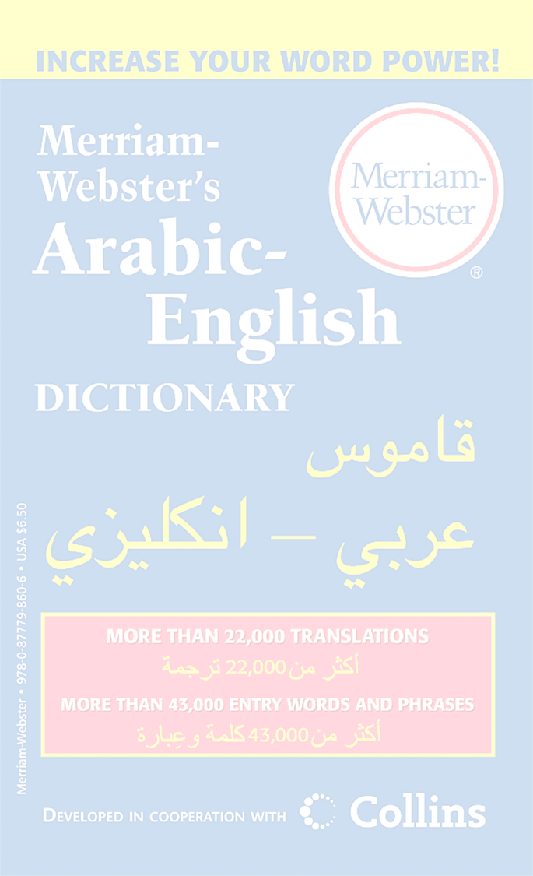

Thinking Point 3.
Some argue that the language we speak influences reality, and that there are thoughts in the heads of people who speak some languages which can’t be translated into others… (e.g. Welsh example Hiraeth)
From this perspective, the world is different in some ways, depending on whether or not we speak Russian or Swahili….and therefore, the way we refer to events, or people, can change the way they are…
Does this sound convincing to you?
If so, why?
If not, why not?

Slide 25
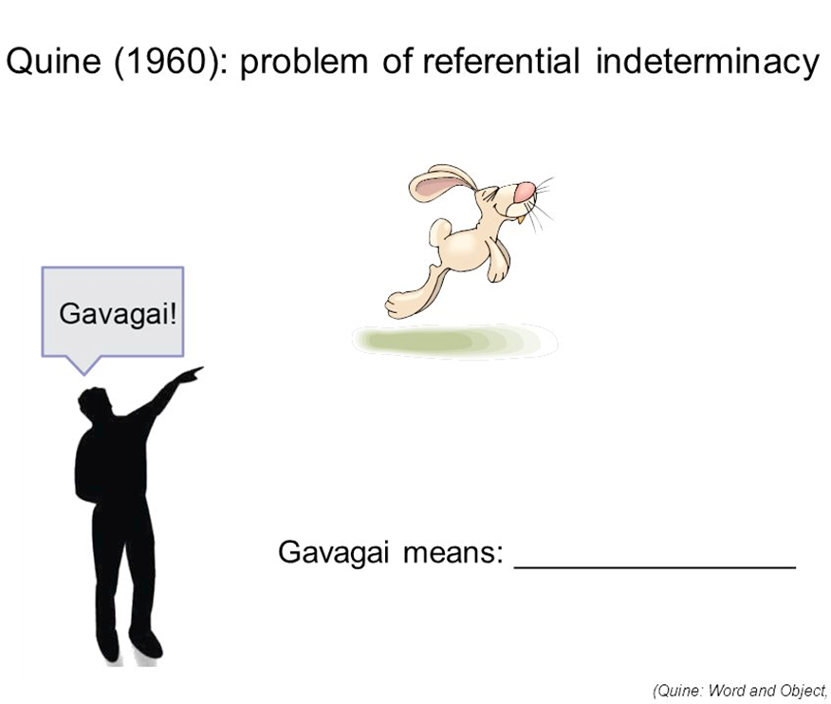

Quine (1960) refers to the interpretation of words or phrases in isolation and argues that no unique interpretation is possible because the interpreter has no way of telling which of the many possible meanings the speaker has in mind…
Example of the word “Gavagai” as spoken by a native speaker of the unknown language Arunta upon seeing a rabbit…A speaker of English could do what seems natural and translate this as ‘Look, a rabbit’
BUT, other translations would be equally compatible with all the evidence the translator has…for example ‘Look, food’; ‘Lets go hunting’ or ‘there will be a storm tonight’…
Quine argues that the situation is made worse when more abstract words are used, not directly attached to public observation…
Quine is not arguing that translation is impossible, but that it is multiply possible…

Slide 26
Thinking Point 4.
Can I know that the colour ‘blue’ is the same for you as it is for me?
Do you think colour is an objective reality?
Or do you think colour is somehow subjective?

Slide 27

Thinking Point 5.
What is the message of this advert?
Is the final perspective accurate?
Notes:
https://youtu.be/_SsccRkLLzU

Slide 28

Thinking Points
Is what an object is like to do with the object, or the person perceiving it, or a bit of both?
What counts as truth, and why do we count some things as ‘reliable’ knowledge, and others as more questionable?
How much do the words we use, our upbringing or cultural background shape how we view the world ?
Can I know that you perceive things like I do?
Can we distinguish between the way things appear, and the way things really are – and can we ever have a ‘complete’ description of reality?
What was the point of those thinking points?
…To help us to raise a huge range of questions…
Each helps us focus in on specific aspects of the ontology/epistemology relationship…

Slide 29
Research Paradigm
Ontology
Epistemology
Methodology
Methods
What is true?
What exists?
What is real?
what kinds of knowledge are possible? and legitimate?
How knowledge is systematically discovered and created
The tools and procedures can use to acquire knowledge

Slide 30
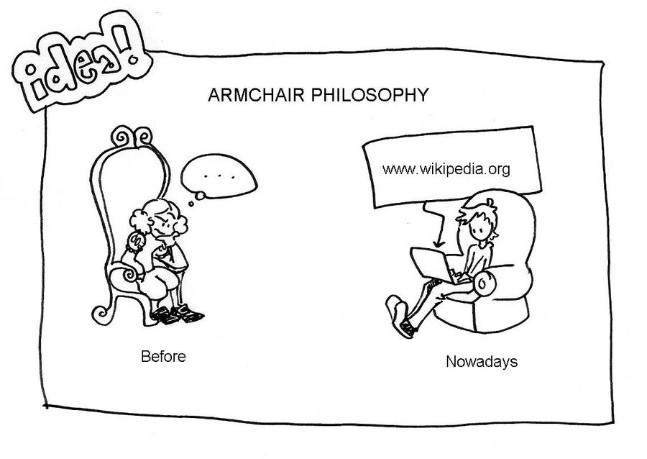
These may seem like just ‘armchair’ philosophy questions – just abstract puzzles.
But in fact, they reflect issues and challenges which come up whenever we try to gather knowledge, and compare different descriptions of anything.
Reflecting on knowledge, its limits, and how it relates to ontology is a crucial part of any kind of research….

Slide 31
Part Two: Types of Research & Design

Slide 32

Many different ways to categorise different types of research
In general, research designs are shaped by:
The type of knowledge the research aims to contribute
The type of data to be collected and analysed
The sampling methods, timescale and location of the research

Slide 33
Types of research aims
Type of research | What’s the difference? | What to consider
Basic vs Applied | Basic research aims to develop knowledge, theories, and predictions, Applied research aims to develop techniques, products, and procedures | Do you want to expand scientific understanding or solve a practical problem?
Exploratory vs Explanatory | Exploratory research aims to explore the main aspects of an under-researched problem, Explanatory research aims to explain the causes and consequences of a well-defined problem. | How much is already known about your research problem? Are you conducting initial research on a newly-identified issue Or seeking precise conclusions about an established issue?
Inductive vs Deductive | Inductive research aims to develop a theory Deductive research aims to test a theory. | Do you want to propose new theories based on your findings? Or is there already some theory on your research problem that you can use to develop hypotheses?

Slide 34
Types of research data
Type of research | What’s the difference? | What to consider
Primary vs Secondary | Primary data is collected directly by the researcher (e.g., interviews or experiments) Secondary data has already been collected by someone else (e.g., in surveys or scientific publications) | How much data is already available on your topic? Do you want to collect original data or analyse existing data (e.g., through a literature review)?
Qualitative vs Quantitative | Qualitative research methods focus on words and meanings Quantitative research methods focus on numbers and statistics. | Is your research more concerned with interpreting something Or concerned with measuring something?
Descriptive vs Experimental | Descriptive research gathers data without controlling any variables, Experimental research manipulates and controls variables to determine cause and effect. | Do you want to identify characteristics, patterns, and correlations Or test causal relationships between variables?

Slide 35

Types of sampling
Type of research | What’s the difference? | What to consider
Probability vs non-probability sampling | Probability sampling allows you to generalise your findings to a broader population. Sample based on random methods, mainly used in Quantitative research. Allows you to make strong statistical inferences about the population Non-probability sampling allows you to draw conclusions only about the specific subjects of the research. Sample selected in a non-random way. Can be used in both qualitative and quantitative research. Easier to achieve but greater risk of bias. | Do you want to produce generalisable knowledge that applies to many contexts? Or do you want to produce detailed knowledge about a specific context (e.g., in a case study)?

Slide 36
Timescale & location of research
Type of research | What’s the difference? | What to consider
Cross-sectional vs Longitudinal | Cross-sectional studies gather data at a single point in time Longitudinal studies gather data at several points in time. | Is your research question focused on understanding the current situation? or tracking changes over time?
Field vs Laboratory | Field research takes place in a natural or real-world setting Laboratory research takes place in a controlled and constructed setting. | Do you want to find out how something occurs in the real world? Or draw firm conclusions about cause and effect?
Fixed vs Flexible | In a fixed research design the subjects, timescale and location are set before data collection begins In a flexible design these aspects may develop through the data collection process. | Do you want to test hypotheses and establish generalisable facts? or explore concepts and develop understanding?

Slide 37

Choosing among all of these different research types is part of the process of creating your research design
It determines how the research will be conducted…
The next step is to make concrete decisions about the methods and other details of the study….

Slide 38

Research design
The general plan of how you will answer the research question
It represents the overall structure of the research
It is a systematic plan for conducting a study
A step by step procedure that will be used in conducting the research

Slide 39
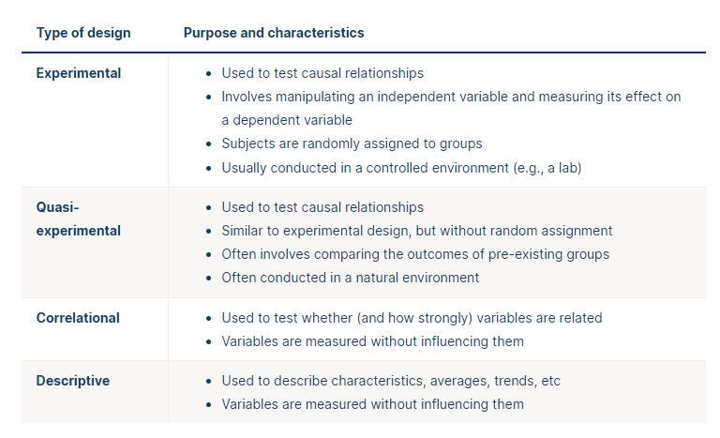
Types of quantitative research designs

Slide 40
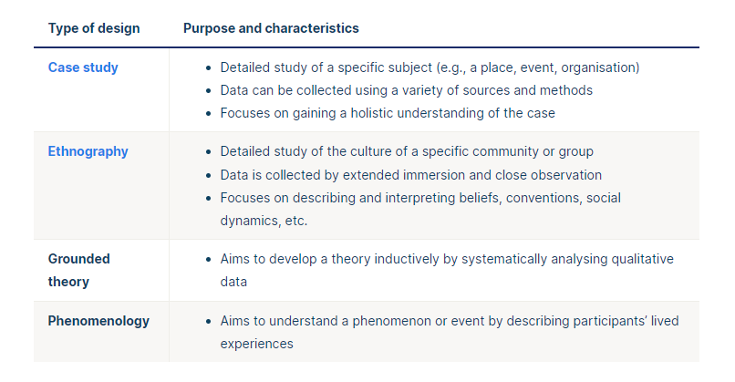
Types of qualitative research designs

Slide 41
Components of a research project

Slide 42
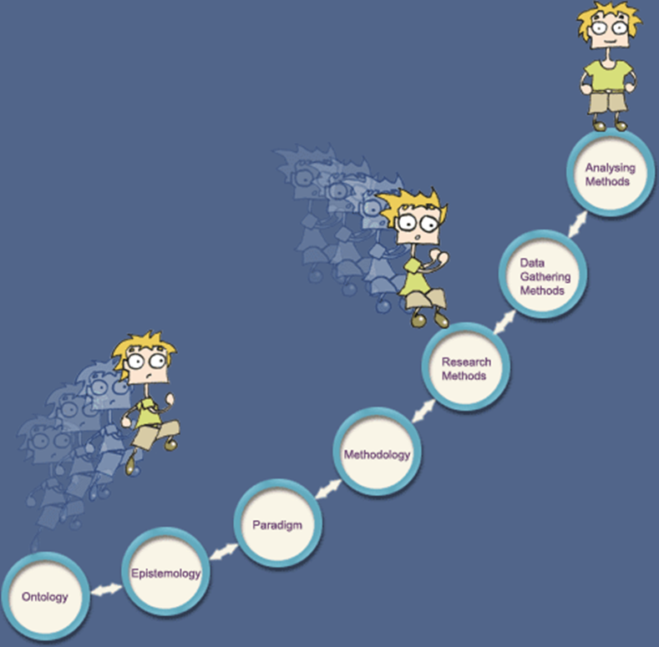
In summary…

