Slide 1

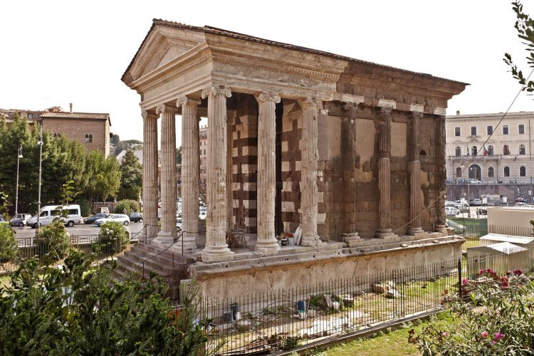
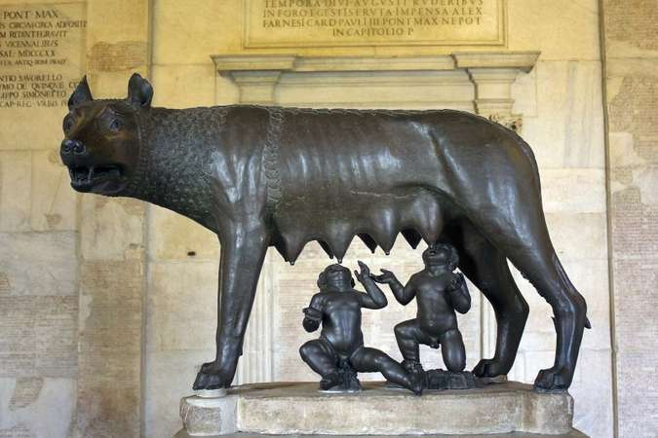
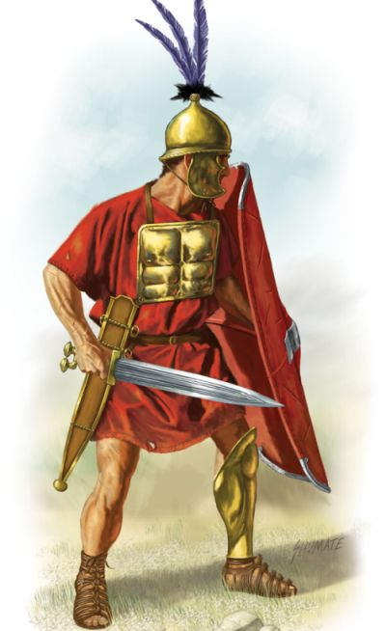
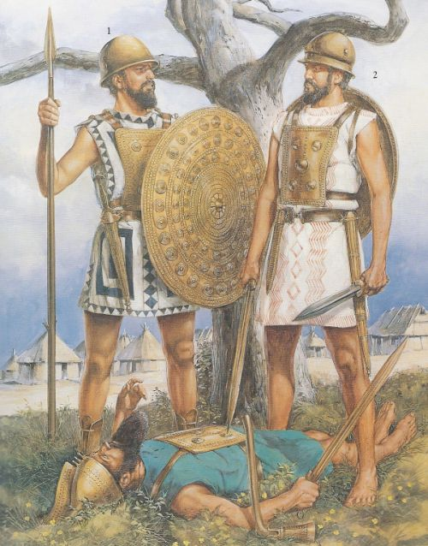
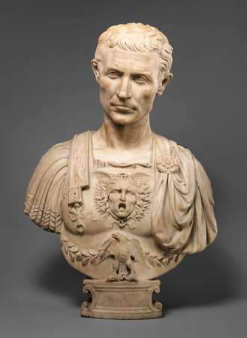
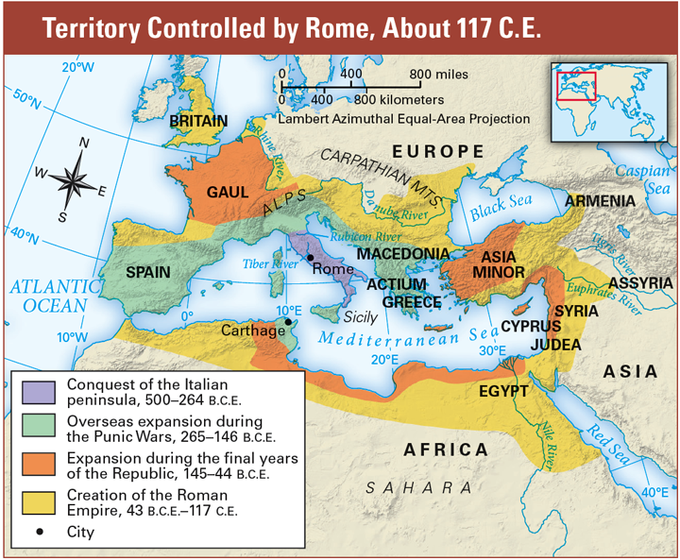
Timeline For Development of Roman Culture.
753 BCE – Legends say that on the 21st of April, Romulus and Remus founded the city of Rome.
509 BCE – After the end of the 7 kings. Rome becomes a republic in which it is ruled by senators and contains a constitution.
501 BCE – Potential Sabine invasion, the Senate passed a ‘senatus consultum’. Allowing the consuls to appoint a dictator during national emergencies.
494 BCE – First ‘secession plebis’. Commoners wanted more rights and say in issues of government.
471 BCE – Plebeian council reorganized.
396 BCE – Roman Soldiers started earning a salary.
390 BCE – Batlle of the Allia, Roman force routed.
351 BCE – First Plebian Dictator/censor
340 BCE – Latin War, Latin League.
297 BCE – Battle of Tifernum, A Roman Legion defeated a superior Samnite force.
241 to 201 BCE – Rome fights in many different wars, winning a majority and the conditions of peace are enforced on Carthage.
107 BCE – Gaius Marius Elected as consul. Reforms the military, established a standing army and recruited non-land owners.
91 BCE – Social War. Marsi, the Paeligni, Vestini, Marrucini, Picentes, Frentani, Hipini, Lapyges, Pompeii, Venosa, Lucania and Samnium rebelled against the roman capital.
60 BCE - Gnaeus Pompey joined the First Tiumvirate, with Julius Caesar and Licinius Crassus.
59 BCE – Julius Caesar becomes a Consul.
15th March 44 BCE – Julius Caesar assassinated in the Pompeian Theatre. He was killed by his own senators.
31 BCE – Batttle of Actium, Augustus Loyalists defeat Antony and Cleopatra, in a naval battle.
19th August 14 CE - Augustus the First Emperor, dies.
80 CE – The Colosseum was Completed.
338 BCE – Rome beats Latin League Armies
293 BCE – Battle of Aquilonia, Roman Army destroyed large portion of Samnite forces.
291/90 BCE – Rome took Samnite city of Venosa / Samnite Wars over.
280 BCE – Phyrrhic War: Greek King Pyrrhus. Lands in Taranto
272 BCE – Taranto Surrenders to Rome.
242 BCE – praetor qui inter peregrinos ius dicit, a Praetor with authority over foreigners formed.
328 BCE – Rome Declares war on Samnites after their subjects raid Fregellae.
287 BCE – Lex Hortensia passed, decisions of the Plebian Council was now binding on all romans. (officially only to commoners).
197 BCE – Quaestor limit increased to twelve, Praestors increased to six.
192 CE – Commondus is killed, this is often considered to be the end of the Roman Golden Age.
23 August 476 – General Odoacer, controlled Germanic foederati, renounced West-Roman Empire. Became King of Italy. This is commonly seen as the End of the western part of roman empire.
2 - Romulus and Remus, with their wolf foster mother, 500-480 BCE.
1 - Temple of Portunus (Temple of Fortuna Virilis), Rome, 3rd-4th century BCE / Wikimedia Commons
Bibliography:
https://www.historic-uk.com/HistoryUK/HistoryofBritain/Timeline-of-Roman-Britain/
https://study.com/academy/lesson/roman-civilization-timeline-facts-contributions.html
https://www.historyextra.com/period/roman/key-romans-dates-timeline-fall-rome-empire-when-founded-romulus-remus/
https://www.knowtheromans.co.uk/Timeline/
https://www.totallytimelines.com/ancient-rome-753-bce-476-ce/
3 - Early Roman soldiers, circa 7th century BCE (Left) - Roman Hastati, circa 3rd century BCE (right)
4 - ‘Julius Caesar’, marble sculpture by: Andrea di Pietro di Marco Ferrucci, CE. 1512/14
References:
1 - Dr. Diana E.E. Kleiner , Technology and Revolution in Roman Architecture, 2017, https://brewminate.com/technology-and-revolution-in-roman-architecture/ . Access date: 25/10/19
2 - Brittany Garcia, Romulus and Remus, 2018, https://www.ancient.eu/Romulus_and_Remus/. Online. Access date: 25/10/19
3 - dattatreya Mandal Visually Reconstructed Evolution Of The Ancient Roman Soldier From 8th Century BC To 3rd Century AD, Online. 2017 https://www.realmofhistory.com/2017/07/13/evolution-ancient-roman-soldier/ . Access date: 25/10/19
4 – Arnold Joseph Toynbee, Julius Caesar ROMAN RULER, 2019.online https://www.britannica.com/biography/Julius-Caesar-Roman-ruler . Access date: 25/10/19
5 – Ancient Rome, U.S. and World History, 2019. ONLINE. http://sharpsocialstudies.weebly.com/ancient-rome1.html . Access date: 25/10/19
Background image : Wikipedia Contributors (2019). SPQR Online. Wikipedia. Available at: https://en.wikipedia.org/wiki/SPQR [Accessed 25 Oct. 2019
5 - This map illustrates the expansionism of Rome, and how it went from a small Italian Peninsula to a Empire than spanned the Mediterranean and beyond. The culture of Rome had spread and received influence from many foreign interactions.

