Slide 1
Nerys Defis
19/02/2018
Nerys.Defis@pcydds.ac.uk

Slide 2
Sut wyt ti’n teimlo?
How are you feeling?
Ar raddfa o 1 i 10, beth yw dy ymateb i’r gosodiadau sy’n dilyn?
1 = mwyaf negyddol
10 = mwyaf cadarnhaol
On a scale of 1 to 10, what’s your response to the following statements?
1 = most negative
10 = most postitive

Slide 3
1 2 3 4 5 6 7 8 9 10
Pa mor egniol wyt ti heddiw?
How energetic are you today?

Slide 4
1 2 3 4 5 6 7 8 9 10
Pa mor gyfforddus yw gwres yr ystafell hon i ti?
How comfortable are you with the warmth of this room?

Slide 5
1 2 3 4 5 6 7 8 9 10
Wrth feddwl yn ôl i dy amser yn yr ysgol gynradd, sut wyt ti’n teimlo – negyddol (1) neu cadarnhaol (10)?
Thinking back to your time at primary school, how do you feel – negative (1) or positive (10)?

Slide 6
1 2 3 4 5 6 7 8 9 10
Mae’r sesiwn hon am fathemateg, sut wyt ti’n teimlo am hyn – negyddol neu cadarnhaol?
The session today is about maths, how do you feel about it – positive or negative?

Slide 7
Meddwl - Paru - Rhannu
Think - Pair - Share
O fewn cyd-destun addysg, pam mae cwestiynau fel hyn yn bwysig?
In the context of education why are such questions important?

Slide 8
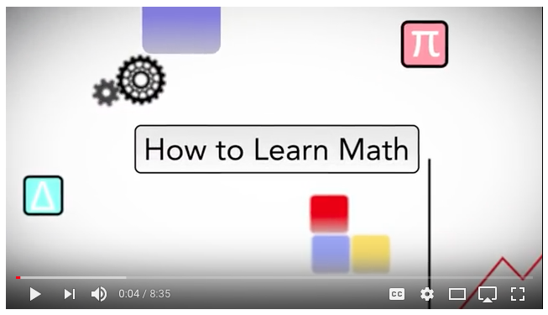
Agweddau at Fathemateg
Attitudes towards Mathematics
https://www.youtube.com/watch?v=bxrPy1fjVU4
Deunydd darllen posib / Possible reading material: Jo Boaler / Carol Dweck

Slide 9
Amcanion y sesiwn
Session Objectives
Rhoi amlinelliad o ddatblygiadau diweddar yn ymwneud gydag addysgu mathemateg yn yr ysgol gynradd
Ystyried rhai prif nodweddion o addysgeg effeithiol mewn mathemateg yn yr ysgol gynradd
Give an outline of recent developments in relation to mathematics teaching in the primary school
Consider some key features of effective pedagogy in mathematics in the primary school

Slide 10
Rhifedd neu fathemateg?
Numeracy or mathematics?
Beth yw’ch syniadau?
Lluniwch frawddeg i esbonio.
What are your ideas?
Form a sentence to explain.

Slide 11
Rhifedd neu fathemateg?
Numeracy or mathematics?
Mae rhifedd yn wahanol i’r pwnc mathemateg oherwydd mae’n golygu cymhwyso’r sgiliau a ddysgwyd mewn mathemateg mewn ffordd drawsgwricwlaidd, byd go iawn, nid dim ond y sgiliau eu hunain.
Numeracy is different to the mathematics subject in that it is the application of the skills learned in mathematics in a cross-curricular, real-world way, and not purely about the skills themselves.
(Ll.C., 2013: 20) ar gael o:
http://learning.gov.wales/docs/learningwales/publications/130415-lnf-guidance-cy.pdf
(W.G., 2013: 20) available from:
http://learning.gov.wales/docs/learningwales/publications/130415-lnf-guidance-en.pdf

Slide 12
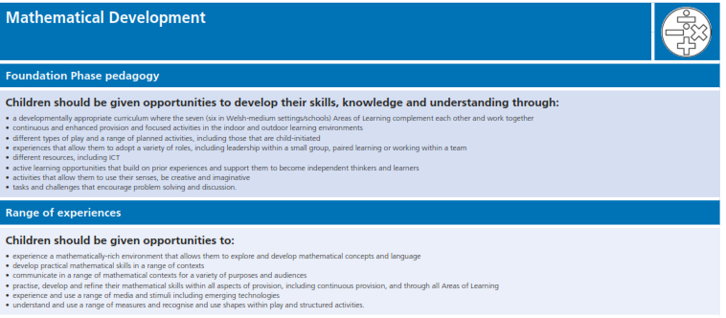
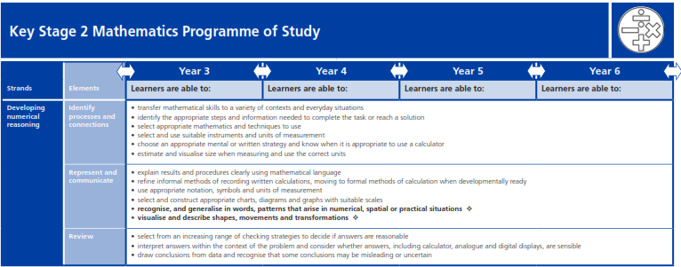
Dogfennau cwricwlaidd cyfredol
Current curricular documents
Cwricwlwm Mathemateg – Fframwaith Rhifedd
Beth sy’n debyg? Beth sy’n wahanol?
Mathematics Curriculum – Numeracy Framework
What’s the same? What’s different?
Notes:
Revised Areas of Learning were introduced in schools from September 2015
Video explaining those changes:
http://learning.gov.wales/resources/browse-all/revised-areas-of-learning-and-programmes-of-study-introductory-video/?lang=en
Current documents are:
Foundation Phase
Key Stage 2 Programme of Study
Numeracy elements of the LNF is incorporated within both of these.

Slide 13
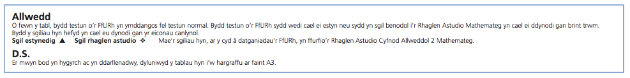
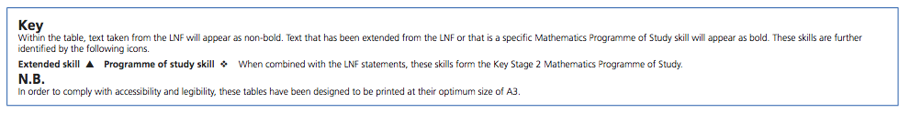
Ff.Ll.Rh. – print normal
Sgil penodol Rhaglen Astudio Mathemateg – print trwm
L.N.F. – non-bold print
Specific Mathematics Programme of Study skills - bold print

Slide 14
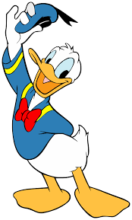

Newidiadau ar y gweill…
Forthcoming changes…
Changes as a result of the ‘Successful Futures’ report (2015), available at:
http://gov.wales/docs/dcells/publications/150225-successful-futures-en.pdf
Newidiadau yn sgil adroddiad ‘Dyfodol Llwyddiannus’ (2015) ar gael o:
http://gov.wales/docs/dcells/publications/150225-successful-futures-cy.pdf
Notes:
Pedwar diben a nodir ar gyfer y cwricwlwm:
Dysgwyr uchelgeisiol, galluog
Cyfranwyr mentrus, creadigol
Unigolion iach, hyderus
Dinasyddiol egwyddorol, gwybodus
(Donaldson, 2015: 29-31)
Chwe maes dysgu a phrofiad er mwyn annog addysgu creadigol a chysylltiedig sef:
Six areas of Learning and Experience:
Celfyddydau mynegiannol - Expressive Arts
Iechyd a lles - Health and Wellbeing
Dyniaethau - Humanities
Ieithoedd, llythrennedd a chyfathrebu - Literacy, Languages and Communication
Mathemateg a rhifedd - Mathematics and Numeracy
Gwyddoniaeth a thechnoleg - Science and Technology
(Donaldson, 2015: 39)
Tri cyfrifoldeb trawsgwricwlaidd sef Llythrennedd, Rhifedd a Chymhwysedd Digidol (Donaldson, 2015: 40-42).

Slide 15
Rhifedd a mathemateg
Numeracy and mathematics
Cross-curricular numeracy
t./p. 40-41
Mathematics and numeracy
t./p. 49-50
Notes:
A new curriculum is being developed for settings and schools in Wales. The curriculum will be available by April 2019 for feedback. A final version will be available in January 2020, and will be used throughout Wales by 2022.
This will include 6 AoLE’s
Info and video clip available at:
http://gov.wales/topics/educationandskills/schoolshome/curriculuminwales/curriculum-for-wales-curriculum-for-life/?skip=1&lang=en

Slide 16
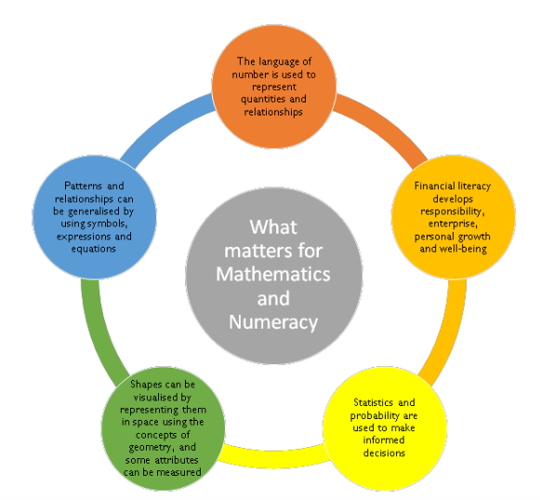
Datblygiadau Diweddaraf
Latest Developments
http://gov.wales/topics/educationandskills/schoolshome/curriculuminwales/curriculum-for-wales-curriculum-for-life/?skip=1&lang=en
Notes:
At present there are 6 strands within the KS2 Programme of Study. The suggestion in the latest report from the Mathematics and Numeracy AoLE group is that these 5 key elements will shape the new curriculum.

Slide 17
Mathemateg trawsgwricwlaidd
Cross-curricular mathematics
Ystyried:
Cyd-destun pwrpasol
Defnyddio sgiliau mathemategol
Cysylltiadau nifer o feysydd cwricwlaidd eraill
Consider:
Purposeful context
Application of mathematical skills
Connections with other curricular areas
Haylock a Thangta (2007)
Notes:
Theory – Policy – Practice
We’ve looked at policy development in Wales, let’s consider the theory behind it…
Mae Haylock a Thangta (2007) yn amlinellu tair ffordd wahanol o ystyried mathemateg traws-gwricwlaidd:
Gall agweddau eraill o’r cwricwlwm roi cyfle a chyd-destun pwrpasol ar gyfer dysgu mathemateg
Gall agweddau eraill o’r cwricwlwm roi cyfle a chyd-destun pwrpasol i ymarfer sgiliau mathemategol
Wrth wneud prosiect ymestynnol (sydd ddim yn gysylltiedig â unrhyw bwnc penodol) gellir datblygu amrywiaeth o feysydd cwricwlwaidd - gan gynnwys mathemateg
Syniadau o Haylock and Thangta (2007) Key Concepts in Primary Mathematics London: SAGE – (copi ar Moodle)

Slide 18
Mathemateg trawsgwricwlaidd
Cross-curricular mathematics
Children learn mathematical (and other) skills best at the time when they need to use them in meaningful, relevant and real contexts.
Pound and Lee (2010: 96)

Slide 19
Tasg / Task
Dewisiwch UN Elfen o’r dogfennau cwricwlaidd cyfredol. Mapiwch eich syniadau ar gyfer ei addysgu’n drawsgwricwlaidd.
Ystyriwch gyd-destunau go-iawn a phwrpasol.
Chose ONE Element from the current curricular documents. Map out all possible cross-curricular links.
Consider real and meaningful contexts.
http://learning.gov.wales/docs/learningwales/publications/150803-fp-framework-cy.pdf
http://learning.gov.wales/docs/learningwales/publications/150803-fp-framework-en.pdf
http://learning.gov.wales/docs/learningwales/publications/150717-nc-maths-cy-v2.pdf
http://learning.gov.wales/docs/learningwales/publications/150717-nc-maths-en-v2.pdf
Notes:
Fframwiath Cyfnod Sylfaen / Foundation Phase Framework http://learning.gov.wales/resources/collections/foundation-phase?lang=en
Rhaglen Astudio CA2 / KS2 Programme of Study http://learning.gov.wales/resources/browse-all/mathsnc/?skip=1&lang=en
Llinynnau / Strands
Datblygu ymresymu rhifyddol Developing numerical reasoning
Defnyddio sgiliau rhif Using number skills
Defnyddio sgiliau mesur Using measuring skills
Defnyddio sgiliau geometreg Using geometry skills
Defnyddio sgiliau algebra Using algebra skills
Defnyddio sgiliau data Using data skills

Slide 20
Addysgu effeithiol
Effective teaching
Mae’r syniad o wneud cysylltiadau yn greiddiol i addysgu effeithiol mewn mathemateg:
Piaget (schemas)
Vygotsky
Bruner
Liebeck
Haylock & Cockburn
The notion of making connections is an integral part of effective mathemtaics teaching:
Piaget (schemas)
Vygotsky
Bruner
Liebeck
Haylock & Cockburn
Notes:
“Piaget, for example, described the development of understanding in terms of the learner relating new experiences to their existing cognitive structures, by assimilation and accommodation, to develop what he called ‘schemas’ (Piaget, 1953)” Haylock and Cockburn (2007)
Vygotsky – ZPD, learning from each other
Link to Bruner (iconic, enactive, symbolic).
Liebeck (1990) proposes that children’s understanding involves building up con- nections between these four components through sequential experi- ence, starting with concrete experiences, then adding in the appropriate language, and then pictures and finally the mathematical symbols.

Slide 21
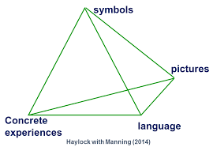
Y Model Cysylltiol
The Connective Model
symbolau
lluniau
Profiadau diriaethol
iaith
Haylock with Thangata (2007) , Key Concepts in Teaching Primary Mathematics, SAGE Publications Ltd. Available at: http://studysites.uk.sagepub.com/haylock/Making%20Connections.pdf

Slide 22
Addysgu effeithiol
Effective teaching
Pa agweddau o’r model cysylltiol sydd i’w gweld ar waith?
What elements of the connections model can you see at work?
https://www.ncetm.org.uk/resources/40533

Slide 23
Eich tasg asesu
Your assessment task
Creu pecyn adnoddau (cyfwerth â 1500 o eiriau)
Ystyriwch:
Adeiladu ar brofiadau ’go-iawn’
Iaith fathemategol
Posibiliadau trawsgwricwlaidd (cynnwys T.G.Ch.)
Cysylltiadau gyda theori a pholisi
Create a resource pack (equivalent to 1500 words)
Consider:
Building on concrete experiences
Mathematical language
Cross-curricular possibilities (including ICT)
Links to theory and policy
Notes:
Things to consider if you want to include mathematics / numeracy into your resource pack…

Slide 24
Syniadau posib…
Possible ideas…
Bondiau rhif i 10
Map (safle a chyfeiriad)
Siapiau
Gwaith wedi ei selio ar stori
Number bonds to 10
Map (position and direction)
Shapes
Work based on a story

Slide 26




Tasg / Task
Dewisiwch un o’r llyfrau sydd ar gael.
Casglwch syniadau am bethau gallech eu cynnwys mewn pecyn adnoddau wedi’i selio ar y llyfr.
Chose one of the available books.
Collect ideas about what could be included in a resource pack based on the book.

Slide 27
Tasg / Task
Yn y farchnad!
‘Gwerthwch’ eich pecyn adnoddau i grŵp arall.
Marketplace!
‘Sell’ your resource pack idea to another group.

Slide 28

Cyfuno llythrennedd a rhifedd
Combining literacy and numeracy
Rhaglen ddwyieithog sy'n cefnogi llythrennedd a rhifedd plant Derbyn
Adnoddau i'w defnyddio yn yr ystafell ddosbarth a gartref
A bilingual programme to support Reception children with literacy and numeracy
Resources to use at home and at school
http://poridrwystori.booktrust.org.uk
Notes:
http://poridrwystori.booktrust.org.uk/cy/
https://www.youtube.com/watch?v=COBCAQAyl_o&index=2&list=PLE5MZB5pedUOHd259SOrfA7OFxb7Yd6YH
Ymgyrch arall gan Llywodraeth Cymru ar Facebook a Trydar:
http://gov.wales/topics/educationandskills/schoolshome/parents/education-begins-at-home/?skip=1&lang=cy
Another campaign by Welsh Government on Twitter and Facebook:
http://gov.wales/topics/educationandskills/schoolshome/parents/education-begins-at-home/?skip=1&lang=en

Slide 29
Her ‘Post-it’…
Post-it challenge…
Heddiw rwyf wedi dysgu…
Rydw i eisiau gwybod mwy am…
Today I have learnt…
I would like to know more about…

Slide 30
Cyfeiriadau / References
Donaldson, G. (2015). Caerdydd: Llywodraeth Cymru. Dyfodol Llwyddiannus – Adolygiad Annibynnol o’r Cwricwlwm yng Ngymru. Caerdydd: Llywodraeth Cymru.
Donaldson, G. (2015). Successful Futures - Independent Review of Curriculum and Assessment Arrangements in Wales. Cardiff: Welsh Government.
Haylock, D. and Thangta, F. (2007). Key Concepts in Primary Mathematics. London: SAGE
Llywodraeth Cymru (2013). Fframwaith Llythrennedd a Rhifedd Cenedlaethol: Cynorthwyo ysgolion i gyflwyno’r Fframwaith Llythrennedd a Rhifedd Cenedlaethol. Caerdydd: Llywodraeth Cymru.
Pound, L. and Lee, T. (2010) Teaching Mathematics Creatively. Oxon: Routledge.
Welsh Government (2013). National Literacy and Numeracy Framework: To support schools in introducing the National Literacy and Numeracy Framework. Cardiff: Welsh Government.

