Slide 1
Digital Skills and Research Methods
Student name: | GABRIELA ROXANA UNGUREANU COSMINA LEMNARIU ANA-MARIA LEMNARIU CIANELLE ANDERSON | Student ID number: | 2118376 2119068 2120848 2117476
Programme: | Certificate of Higher Education Skills for the Workplace
Module: | Digital Skills and Research Methods
Module code: | BMSW4003 | Contribution to Overall Module Assessment (%): | 50
Lecturer: | NGOZI IBEJI | Internal Verifier: | Yohan Mendis
Assignment Title: | Group Presentation – Research proposal How do we use technology to collaborate at UWTSD? | Word count (or equivalent): | Presentation 5 mins per person

Slide 2

Introduction
A highly collaborative workplace could foster creativity and improve productivity only with the application of the right technology. Digital tools used for collaboration leverages technology to enhance the workplace collaboration and effective communication.
Research Question
Which digital tool is most commonly used for collaboration at UWTSD?
Notes:
This slide will be presented by : GABRIELA ROXANA UNGUREANU
The tools used for collaboration are being used for purpose like documents management, flow of information and content management. It vital for institution to understand how to collaborate and effectively use tools so that productive collaboration could be fostered. Collaboration technology is vital for people to provide their opinion and allows other to comment (Kramer et al., 2020). In terms of collaboration technology, it entails a communication medium that will developed with the application of technology and will be designed in the way that it supports collaboration. Since it becomes challenge for the management of education sector to meet needs of the students. Hence the management of university prepares programme and develop technology that will support collaboration and fulfil the needs of the needs. Integration of technology with the operation. Further with the effective if proper technology the communication improved and it sets proper guideline or interaction. This research proposal will shed light on how the digital tool is most commonly used for collaboration at University of Wales trinity Saint David ( UWTSD ).

Slide 3

Rationale
The rationale behind conducting research is to understand how the staffs and students use technology for collaboration purposes.
Further this research will also help to understand the digital tools that are being used by UWTSD for their collaboration purpose
Notes:
This slide will be presented by : GABRIELA ROXANA UNGUREANU
Rationale
Collaborative technology refers to the system that is designed to facilitate work and enhance productivity. Use of digital technology will not only enhance communication but also improve teamwork. Since technology always enhance the ways workforce work and how they communicated among each other. Hence it is vital to explore the application of technology and the benefits it brings to the UWTSD.

Slide 4

Review of existing literature
Overview of the digital tools for collaboration
Factors affecting collaboration
Theoretical underpinning
Significance of Online collaboration in regards to application of digital tools
Digital skills that facilitate collaboration
Notes:
This slide will be presented by : GABRIELA ROXANA UNGUREANU
Overview of the digital tools for collaboration
Technology plays a crucial role in allowing the institution to create an environment that will assist goals of the employees or the students as well as harness the collective creativity. The next generation of the employee productivity involves richer communication, document sharing and co-creation that has significant role in the business dynamic. The adoption of the digital collaboration requirement will have to be initiated from the top. Use of technology within university will lead to openness that correlates engagement. As per current study undertaken Deloitte 17% of the employees are more satisfied with the workplace culture that has access to the digital collaboration tool (deloitte, 2022). The study shows employee engagement to be improved via the collaborations and it is one the relatively simpler ways to enhance the business performance.
Usage of the digital tools are vital way to bring the best out of the organisational talent. As opined by Kramer et al., (2020) within the education arena collaboration encourages the faculty to think beyond their narrow border of the classroom. Management of the educational institution incorporates technological advancement and making the teaching more diversified and communication with peer more effectively (Kramer et al., 2020).. In regard to university virtual collaboration takes places through e-mail, virtual learning communities, only factually forum and other form technology that aids communications.
Factors affecting collaboration
Application of technology facilitating collaboration is associate with focus factors namely social connectivity, digital tools, mental and physical health. Social connection has outsized impact of the productivity and it turn out to facilitates collaborative practice. Students or employees who gave good social connection will more likely maintain and improve their productivity (Emmanuel et al., 2018). Engaging participants with the help of digital events is more likely to make the social connection stronger and they star valuing their connections. The next factor is usage of the digital tools that employees or the students have at their disposal. Students who access to the digital tools has able to enhance their productivity and the make collaboration stronger. The communication gets improve with different application of the digital tools. Individual who are able to maintain their physical and mental health are like wise to work more collaboratively (Sensuse et al., 2021).
During the application of technology for collaboration the physical and mental health of the employees needs to take into considerations. Participants attending events online needs to take breaks so that they are not spending too much time in front of the screen. Designing online events with the help of digital tools will have to inclusive so that students who are with disability could take part.

Slide 5
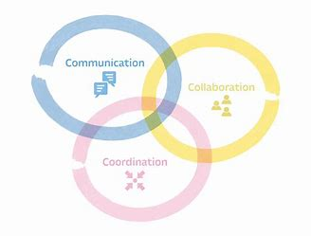
The 3 C's Framework
Notes:
This slide will be presented by : GABRIELA ROXANA UNGUREANU
Coordination is regarded as taking into account the independent elements together as the ay to identify and exploit a certain pattern. Followed by this is cooperation which build upon coordination (Park et al., 2019). Cooperates is referred to as the way of working where individual make their own contributions that becomes something meaningful and significant when combined together. True collaboration is situation at the top of the 3C pyramid and is where two or more people develops something via adding medium and eliminating a shared pool of content. Attending conferencing, digital events, and online workshops are some instances of collaboration.
Significance of Online collaboration in regards to application of digital tools
Online collaboration provides students with number of benefits that assist students with enhancing the creative thinking and increasing the productivity level of the students along with management. The performance of individual enhances with the usage of online collaboration and it allows better knowledge sharing as well as retention. In terms of students, they are able learn the concepts better and enhance their grades (Strauß and Rummel, 2021). Furthermore, its facilities active learning and more engage in the learning process. With the application of online collaboration, the knowledge sharing gets increased. Both employees and the students in interdependent on the environment created for collaboration and they are more likely to open to exchange of knowledge. Additionally, the social interactions get improved with the help of online collaboration. The tools actually help on motivating people to make conversating even though they are not physically present. Online collaboration also helps in creating a supportive and positive environment among peer (Brolpito, 2018). Not only better learnings being provided but also promotes the spirit of brotherhood among them. This encourages the employees to build relationship that may extend beyond the boundaries of the workplace.

Slide 6
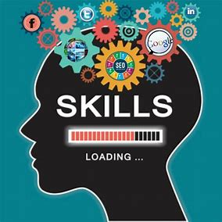
Digital skills that facilitate collaboration
Communication
Humility
Grace
Netiquette
Notes:
This slide will be presented by : GABRIELA ROXANA UNGUREANU
There are number of feel that still feel the immediacy of face-to-face collaboration which they consider to be the basic standard in order to complete any project. In the digital era with the application of right technology digital collaboration does achieve positive results. In order to facilities collaboration each individual will be needing some digital collaboration skills. Communication is the first digital skill that is the primary requirement of online collaboration environment responding in emails or any other platforms is necessary in order to continue the task. Humility that is associated with the above skills and it is mainly concern with declaring one’s elf in the dark. For instance, it is very common fora person to not have knowledge about some concepts. During online collaboration it will better to clearly state the lack of information and in this way, communication will improve (van Laar et al.,2020).
In the same manner having grace is also vital. Online collaboration will be requiring enormous patience and deep-seated sense of quality. Other skills that is also of great significance is Netiquette that becomes the decorum for good online collaborations. Since every individual could have different setting, time zone and work environment during online collaboration, it is essential to take in consideration all these (Brolpito, 2018). Some vital points like trying to acknowledging other person perspective, not publishing personal details during online collaboration, keeping in mind different time zones and so on.

Slide 7

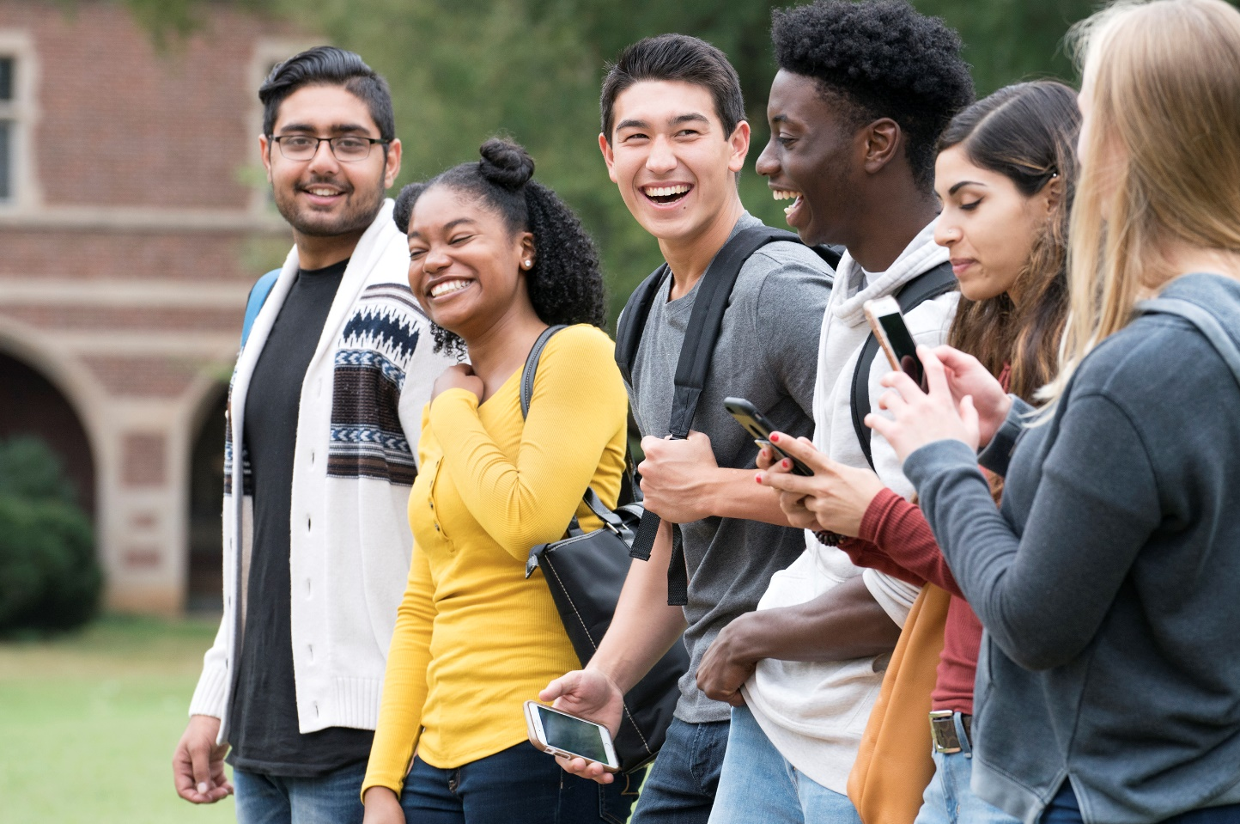

Proposed method Who?
Students
Teachers
Administrative staff
Notes:
This slide will be presented by : COSMINA LEMNARIU

Slide 8


Proposed method How?
Online questions
MS - forms
Notes:
This slide will be presented by : COSMINA LEMNARIU

Slide 9


Proposed method - What?
Are you happy to complete my survey?
Yes
No
When collaborating with peers do you use one digital tool more than others?
Yes
No
Do you MS Teams more than other digital tools to work with your peers or colleagues?
Yes
No
Do you use the OneDrive more than other digital tools to collaborate with peers or colleagues?
Yes
No
Rank these applications in order according to how frequently you use them to collaborate with others. (Most frequent at the top)
MS Team
OneDrive
MS Word
WhatsApp
Module
Notes:
This slide will be presented by : COSMINA LEMNARIU

Slide 10

Ethical considerations
Ethical considerations
The researcher will be accountable to perform the research in ethical manner so that there are not negative implications.
Further the who research will be done by following the guidelines of Data Protection Act 2018 (legislation.gov.uk, 2022)
Notes:
This slide will be presented by : ANA-MARIA LEMNARIU
The researcher will be accountable to perform the research in ethical manner so that there are not negative implications. Prior to collecting of data consent will be taken from the participants and they could opt out from the survey whenever they wish. Further the who research will be done by following the guidelines of Data Protection Act 2018 (legislation.gov.uk, 2022) All the data collected will used solely by the researcher and no third-party entity will have access to it

Slide 11
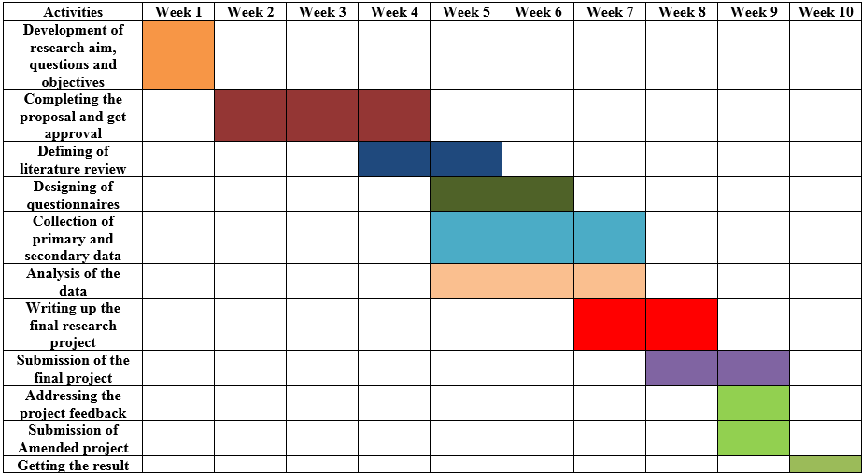
Research timeline
Notes:
This slide will be presented by : ANA-MARIA LEMNARIU

Slide 12
Hypothesis
Our hypothesis are :
RH­­₀: If the management of UWTSD use the digital collaboration tools then the learning procedure will be enhanced?
RH­­₁: If the management of UWTSD will not use the digital collaboration tools then the learning procedure will not be enhanced?
Notes:
This slide will be presented by : CIANELLE ANDERSON

Slide 13
Anticipated Outcome
It can be anticipated from the above discussion that the use of different told for collaboration dopes provide many benefits to individual and institution associated with it.
Notes:
This slide will be presented by : CIANELLE ANDERSON
The research proposal has been designed to understand the digital tools used for collaboration in UWTSD. Review of previous literature associated with application of technology in collaboration has been discussed. Additionally, asset of methodology has been provided in the study which will help the researcher to undertaken the study.

Slide 14
Reference List
Basias, N. and Pollalis, Y., 2018. Quantitative and qualitative research in business & technology: Justifying a suitable research methodology. Review of Integrative Business and Economics Research, 7, pp.91-105.
Brolpito, A., 2018. Digital Skills and Competence, and Digital and Online Learning. European Training Foundation.
Deloitte, 2022. deloitte-digital-collaboration [Online] Available at: https://www2.deloitte.com/content/dam/Deloitte/se/Documents/technology-media-telecommunications/deloitte-digital-collaboration.pdf [Accessed 21 February 2022]
legislation.gov.uk, 2022. Data Protection Act 2018. [Online] Available at: https://www.legislation.gov.uk/ukpga/2018/12/contents/enacted [Accessed 21 February 2022]
Mazhar, S.A., Anjum, R., Anwar, A.I. and Khan, A.A., 2021. Methods of data collection: A fundamental tool of research. Journal of Integrated Community Health (ISSN 2319-9113), 10(1), pp.6-10.
Park, H., Cho, I.H., Park, S. and Shin, G.C., 2019. Application of Whiteheadian creativity to corporate creativity: A five Cs creativity model.
Sensuse, D.I., Lestari, P.I. and Al Hakim, S., 2021. Exploring Factors Influencing Knowledge Sharing Mechanisms and Technology to Support the Collaboration Ecosystem: A Review. DESIDOC Journal of Library & Information Technology, 41(3).
Sheard, J., 2018. Quantitative data analysis. In Research Methods: Information, Systems, and Contexts, Second Edition (pp. 429-452). Elsevier.
Strauß, S. and Rummel, N., 2021. Promoting regulation of equal participation in online collaboration by combining a group awareness tool and adaptive prompts. But does it even matter?. International Journal of Computer-Supported Collaborative Learning, 16(1), pp.67-104.
van Laar, E., van Deursen, A.J., van Dijk, J.A. and de Haan, J., 2020. Determinants of 21st-century skills and 21st-century digital skills for workers: A systematic literature review. Sage Open, 10(1), p.2158244019900176.
Notes:
This slide will be presented by :

