Slide 1

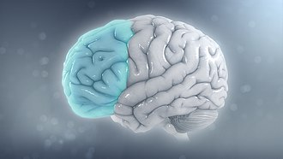
Student name: Carla Cardoso
Student number:1818222
Lecturer: Bianca Sanfilippo
Poster Due: 27th March 2026 14:00 (2PM)
BMHP6029
Psychopathological Classifications and Provisions Component
ADHD
Acknowledgement of the use of AI tools
I confirm that I have not used AI tools in preparing this work and that it contains no AI-generated material, and I have retained all drafts and sources in case they are requested.

Slide 2
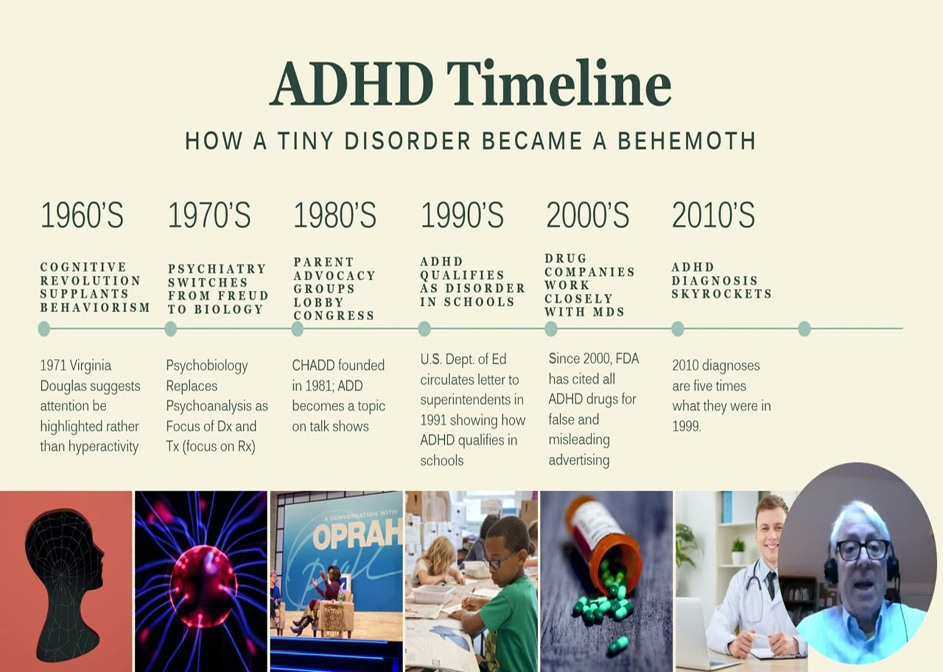
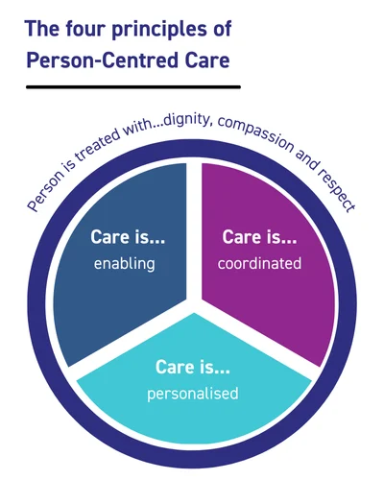
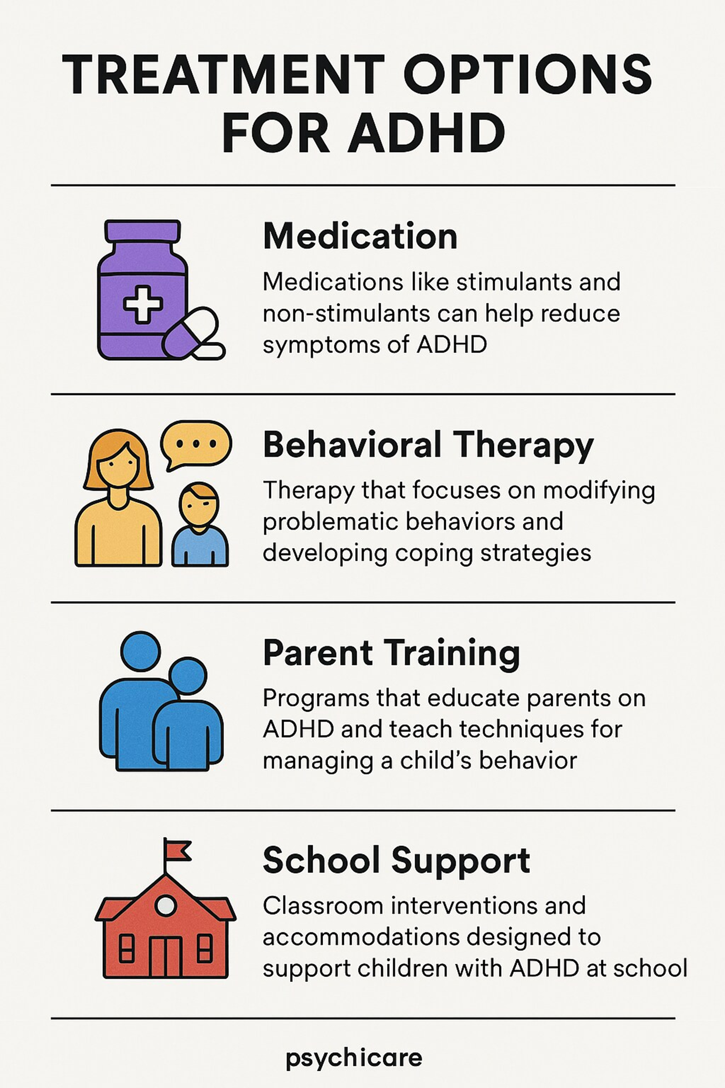

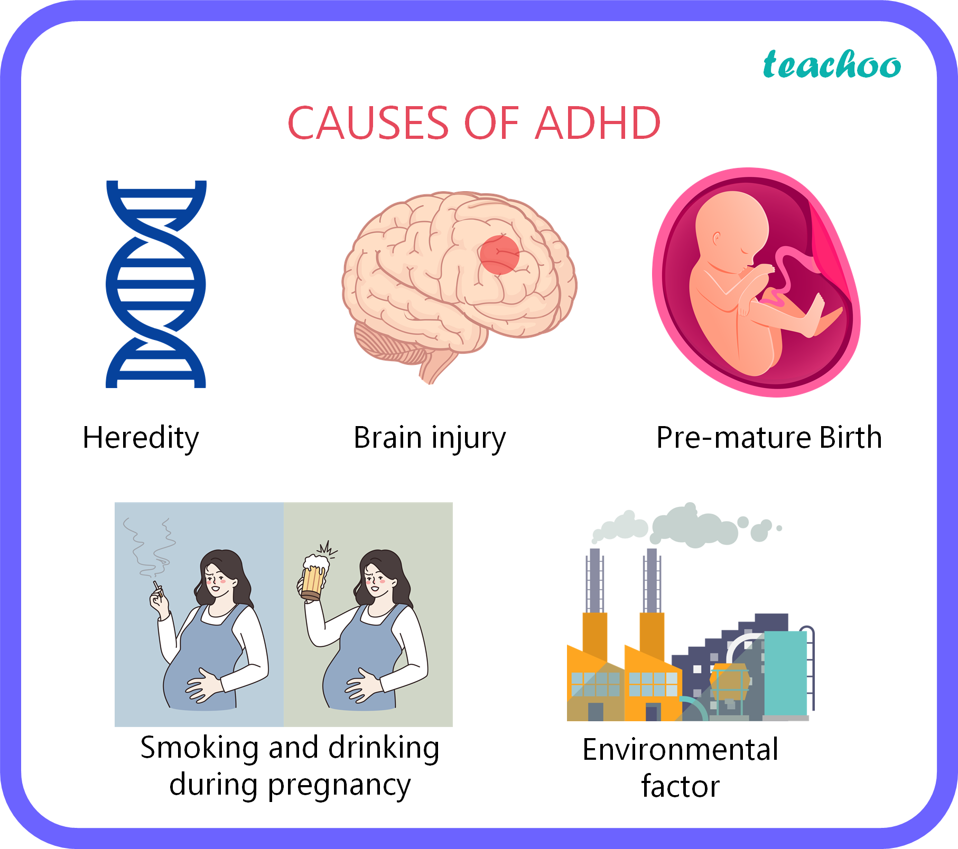
Attention- Deficit/ Hyperactivity Disorder ADHD
Attention- Deficit/ Hyperactivity Disorder ADHD 6A05
Introduction
Historical perspectives and treatments
Current services and treatments
Recommendations
Broad Category
Neurodevelopmental Disorder
Included in ICD-11 (Chapter 06: Mental, Behavioural and Neurodevelopmental Disorders) (World Health Organization, 2019)
Classification
Attention-Deficit / Hyperactivity Disorder (ADHD) ICD-11 Code: 6A05
Tips of ADHD
6A05.0 ADHD, predominantly inattentive
6A05.1 ADHD, predominantly hyperactive-impulsive
6A05.2 ADHD, combined
Definition
ADHD is a condition that affects how the brain works, particularly in relation to attention, activity levels and impulse control. It can significantly impact daily functioning.
How Common Is ADHD in UK?
Around 5% of children and young people are affected
Around 3-4% of adults have ADHD
More commonly diagnosed in boys than girls
Many cases in girls may go unnoticed due to masking behaviours (Young et al., 2020)
This equates to approximately 2.5 to 3 million people in UK (ADHD UK, 2023)
Affects around 4–5% of the global population(NICE, 2018; NHS, 2023)
Medical Treatment
Stimulant medication (e.g., methylphenidate) (NICE, 2018)
Non-stimulant medication (for some individuals)
Regular medical monitoring
Individual response varies(NHS, 2023)
Psychological Therapies
Cognitive Behavioural Therapy (CBT)
Behavioural interventions
Emotional regulation support
Coaching for executive functioning skills
Educational Support
Individual Education Plans (IEPs)
Classroom adjustments
Extra time in exams
Structured learning environments
SEN (Special Educational Needs) services
Workplace Adjustments
Flexible working arrangements
Clear task structuring
Reduced distractions
Occupational health support
Person-Centred Approach
Care tailored to the individual’s needs
Recognition of strengths as well as challenges
Collaboration between professional, family and individual
Respect for autonomy and dignity(NICE, 2018)
Early Identification & Multi-Agency Support
Early screening in schools
Collaboration between education, healthcare and families
Clear referral pathways
Reduced delay in diagnosis (Public Health England, 2017)
Evidence-Based Psychological Interventions
Cognitive Behavioural Therapy (CBT)
Emotional regulation programmes
Executive functioning coaching
Parent training programmes
Mindfulness-Based Interventions (Contemporary Evidence)
Emerging research supports mindfulness
May improve attention regulation
Supports emotional control (NHS, 2023)
Complementary to medical treatment
Promote Neurodiversity Awareness
Shift from deficit to strength-based perspective
Anti-stigma education
Inclusive school and workplace policies
Public awareness campaigns
Mini Critical Reflection
Access to services remains unequal
Gender bias still present
Cultural stigma may limit disclosure
How were people viewed in the past?
Often labelled as “difficult”, “lazy” or “badly behaved”
Behaviour misunderstood as moral failure
Limited scientific understanding
Strong stigma and social exclusion
In some cases, institutionalisation
How did medical professionals view the disorder?
Early theories focused on “minimal brain dysfunction”
Strong deficit-based model
Emphasis on controlling behaviour
Limited psychological support
Contemporary Perspective (Today)
Recognised as a neurodevelopmental condition
Evidence-based treatments available
Person-centred approach
Legal protections (Human Rights Act 1998, Equality Act 2010)
Inclusion in education and employment
Anti-stigma campaigns
Causes
Strong genetic component (family patterns commonly observed) (NICE, 2018)
Neurobiological differences in brain development and regulation
Differences in dopamine pathways linked to attention and impulse control
Environmental risk factors (e.g., prenatal exposure, early adversity) (Public Health England, 2017)
Social context may influence how symptoms are recognised

Slide 3
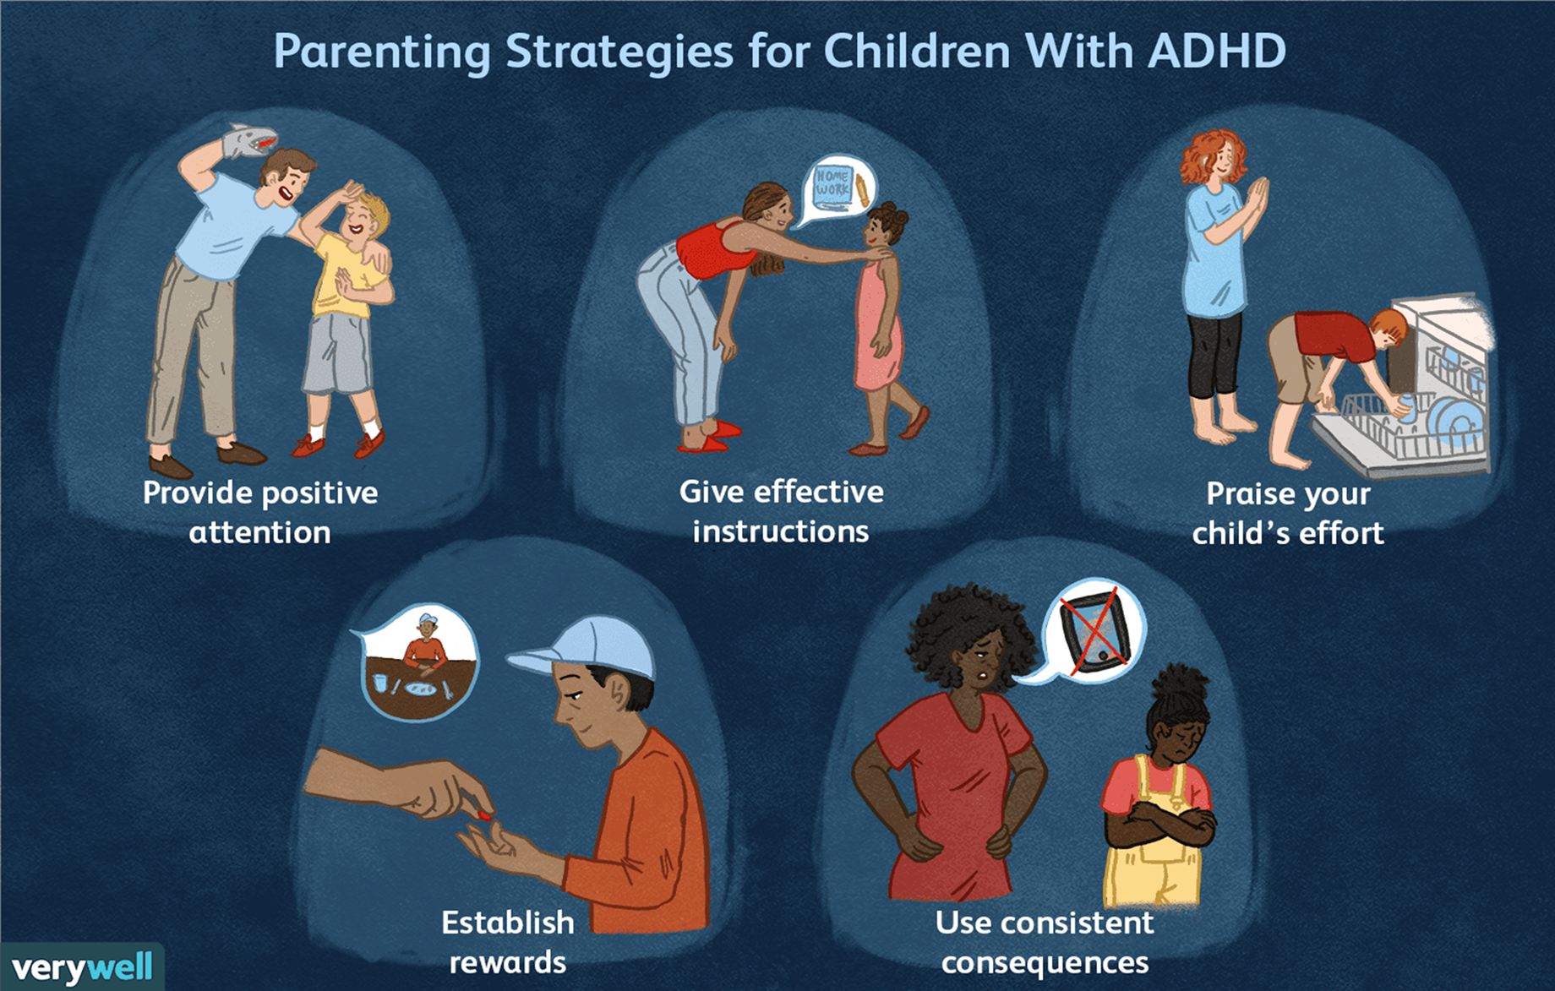
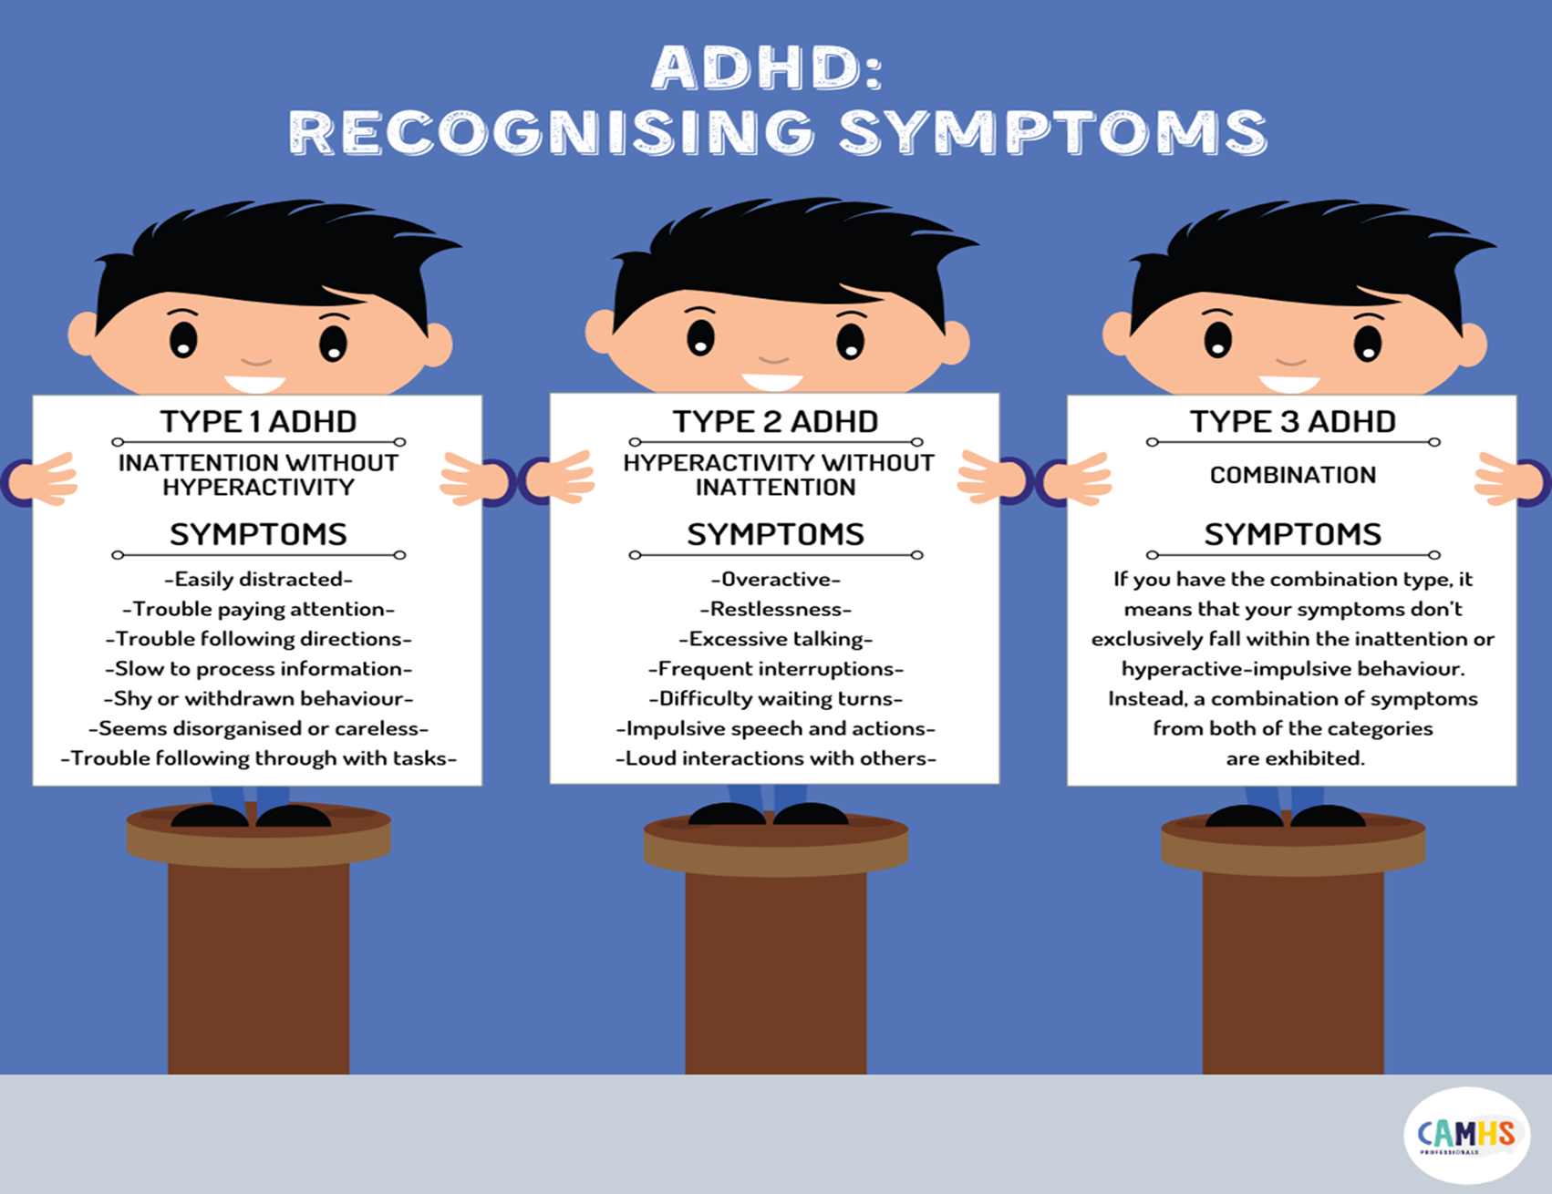

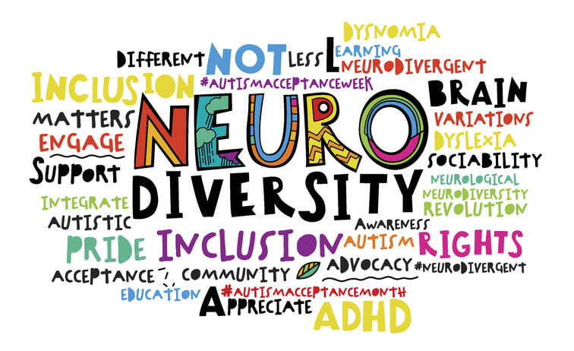
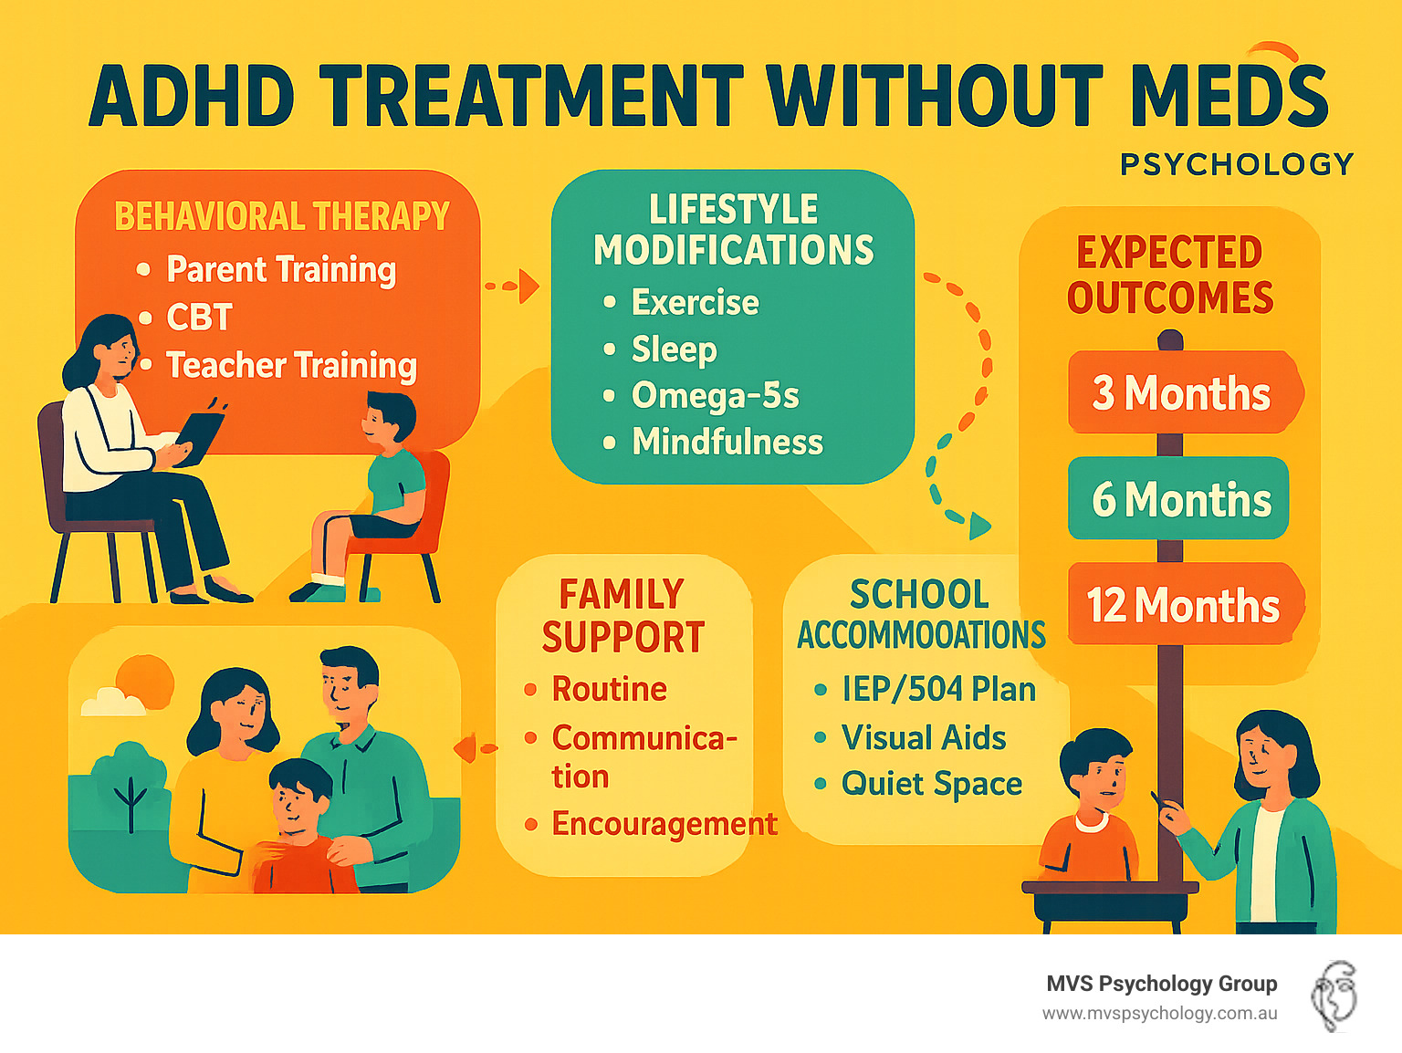
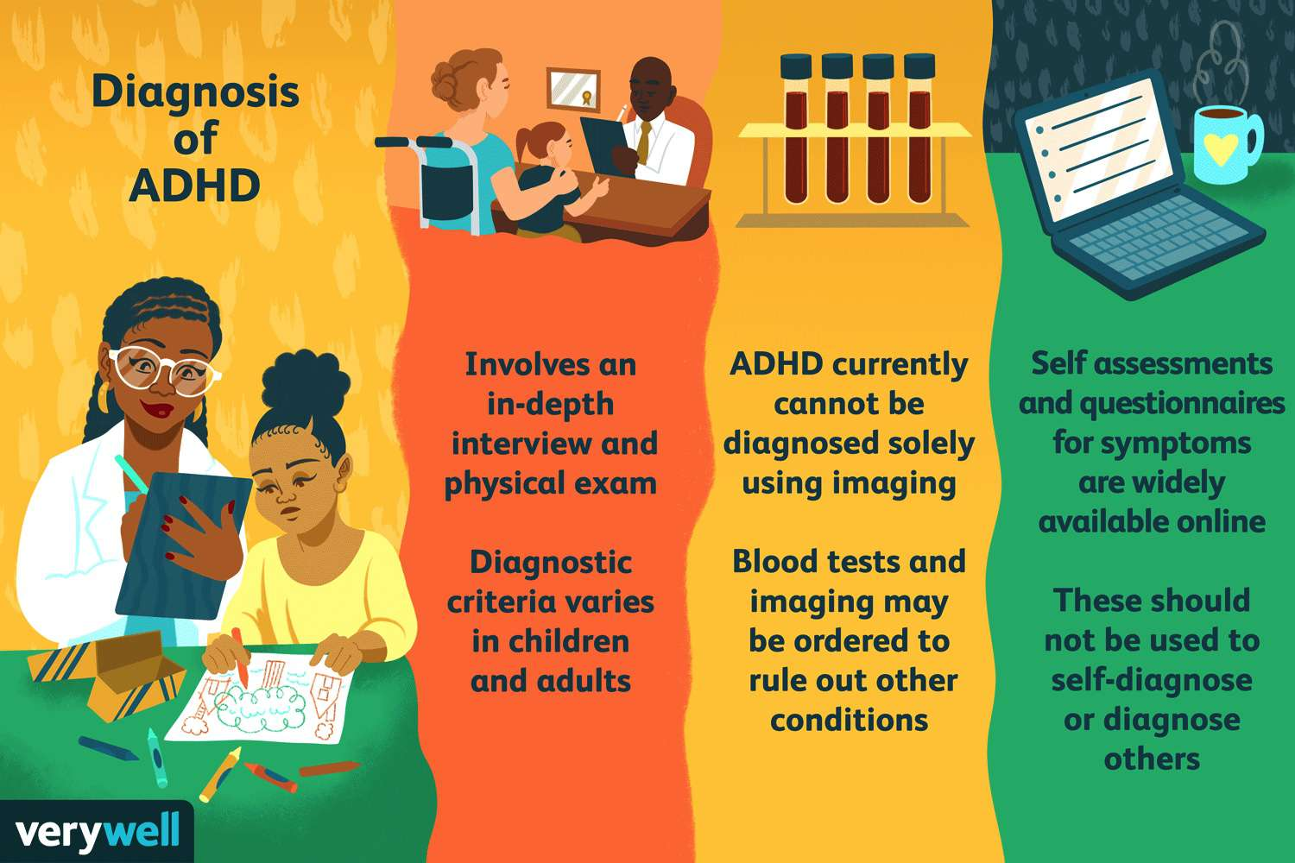
Attention- Deficit/ Hyperactivity Disorder ADHD
Attention- Deficit/ Hyperactivity Disorder ADHD 6A05
Symptoms
Historical perspectives and treatments cont.
Current services and treatments cont.
Conclusions
Persistent difficulties with sustained attention
Distractibility and difficulty completing tasks
Hyperactivity or internal restlessness
Impulsivity (difficulty delaying responses)
Emotional dysregulation
Organisational and executive functioning challenges
Symptom presentation may differ by gender and age.
Symptoms must be persistent and present in more than one setting (e.g., home, school, work)(NHS, 2023; NICE, 2018)
Past Present
Stigma Awareness
Punishment Support
Deficit model Strength-based approach
Institutionalisation Inclusion
Silence “It’s okay not to be okay”
(Department of Health and Social Care, 2011)
(Royal College of Psychiatrists, 2021)
NEURODIVERSITY
Neurodiversity Movement
Recognises brain differences as natural variation
Moves away from purely deficit-based thinking
Emphasises strengths as well as challenges
Advocates for inclusion and acceptance
Important balance:
Diagnosis still necessary for access to support
Family & Parent Support
Parent training programmes
Psychoeducation
Family therapy
Support groups
Complementary & Emerging Approaches
Mindfulness-based interventions
Physical activity programmes
Digital support tools
Coaching models
Critical Reflection
Access to services can vary by region
Long NHS waiting lists
Late diagnosis in adults
Gender and cultural inequalities
Ultimately, current treatment approaches reflect a broader shift from controlling behaviour to promoting wellbeing, autonomy and quality of life. (NICE, 2018)
ADHD is a neurodevelopmental condition
It affects attention, impulse control and emotional regulation
It can impact education, work and relationships
It presents differently in each individual
Understanding has changed over time
In the past, behaviour was misunderstood and stigmatised
Today, ADHD is recognised as a legitimate clinical condition
There is greater awareness and legal protection
Neurodiversity has reshaped perspectives
Brain differences are increasingly seen as natural variation
Strengths such as creativity are recognised
However, diagnosis remains important for access to support
Support must be individualised
Person-centred care is essential
Early intervention improves outcomes
Multi-agency collaboration is necessary
Ongoing challenges remain
Gender bias in diagnosis
Cultural stigma
Unequal access to services (NICE, 2018; NHS, 2023)
Although there have been improvements in understanding and treatment, inequalities in access to diagnosis and support still remain a concern, showing the need for more inclusive and accessible care.”
https://youtu.be/YeamHE6Kank?feature=shared
Diagnosis
Diagnosis based on ICD-11 (6A05) criteria Symptoms must: (World Health Organization, 2019)
Be persistent over time
Be present in more than one setting
Significantly impair functioning
Multi-informant assessment (family, school, workplace reports) (NICE, 2018)
Screening tools used as part of broader assessment
Physical conditions (e.g., thyroid dysfunction) must be excluded
Diagnosis made by specialist clinicians (NHS, 2023)
Diagnostic challenges:
Gender bias
Cultural stigma
Late diagnosis in adults

Slide 4
REFERENCES
ADHD UK (2023) ADHD prevalence in the UK. Available at: https://adhduk.co.uk/adhd-incidence/ (Accessed: 19 March 2026).
Asherson, P., Buitelaar, J., Faraone, S.V. and Rohde, L.A. (2016)‘Adult attention-deficit hyperactivity disorder: key conceptual issues’, The Lancet Psychiatry 3(6), pp. 568–578.
Department of Health and Social Care (2011) No health without mental health: A cross-government mental health outcomes strategy for people of all ages. London: DHSC. Available at: https://assets.publishing.service.gov.uk/media/5a7c348ae5274a25a914129d/dh_124058.pdf (Accessed: 3 March 2026).
National Collaborating Centre for Mental Health (NCCMH) (2009) Attention deficit hyperactivity disorder: diagnosis and management of ADHD in children, young people and adults London: British Psychological Society.
National Institute for Health and Care Excellence (NICE) (2018) Attention deficit hyperactivity disorder: diagnosis and management (NG87). London: NICE.
NHS (2023) Attention deficit hyperactivity disorder (ADHD). Available at: https://www.nhs.uk/conditions/attention-deficit-hyperactivity-disorder-adhd/ (Accessed: 3 March 2026).
Office for National Statistics (ONS) (2022) Prevalence of mental health conditions in children and young people in England. London: ONS.
Public Health England (2017) Better mental health: JSNA toolkit. London: PHE.
Royal College of Psychiatrists (2021) Attention deficit hyperactivity disorder (ADHD) in adults. London: RCPsych.
UK Government (1998) Human Rights Act 1998. London: The Stationery Office.
UK Government (2010) Equality Act 2010. London: The Stationery Office.
World Health Organization (2019) International classification of diseases 11th revision (ICD-11). Geneva: WHO.
Young, S., Asherson, P., Lloyd, T. and Absoud, M. (2020) ‘Failure of healthcare provision for attention-deficit/hyperactivity disorder in the United Kingdom’, BJPsych Bulletin, 44(2), pp. 70–76.

