Slide 1

Mastering Metrics
Unit 2 Chris Thomas

Slide 2
Learning Outcomes
Know the relevant measures of marketing performance
Apply marketing metrics to establish the effectiveness of the marketing activities

Slide 3
Assessment
Assignment
  Useful to have the assessment in mind as we work through the lectures…

Slide 4
Assessment
CIM give an audio detailed assignment brief:
https://vimeo.com/213079231/684a71d387

Slide 5
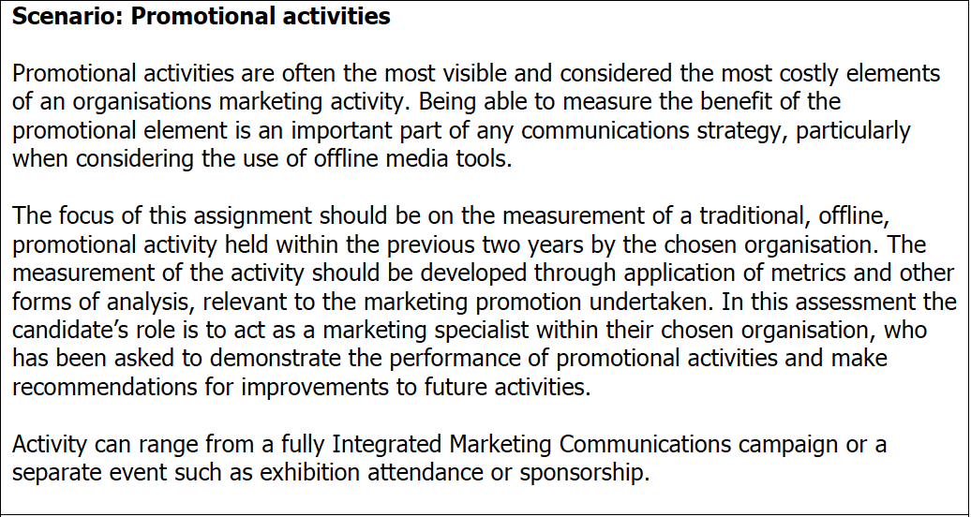
Assessment

Slide 6
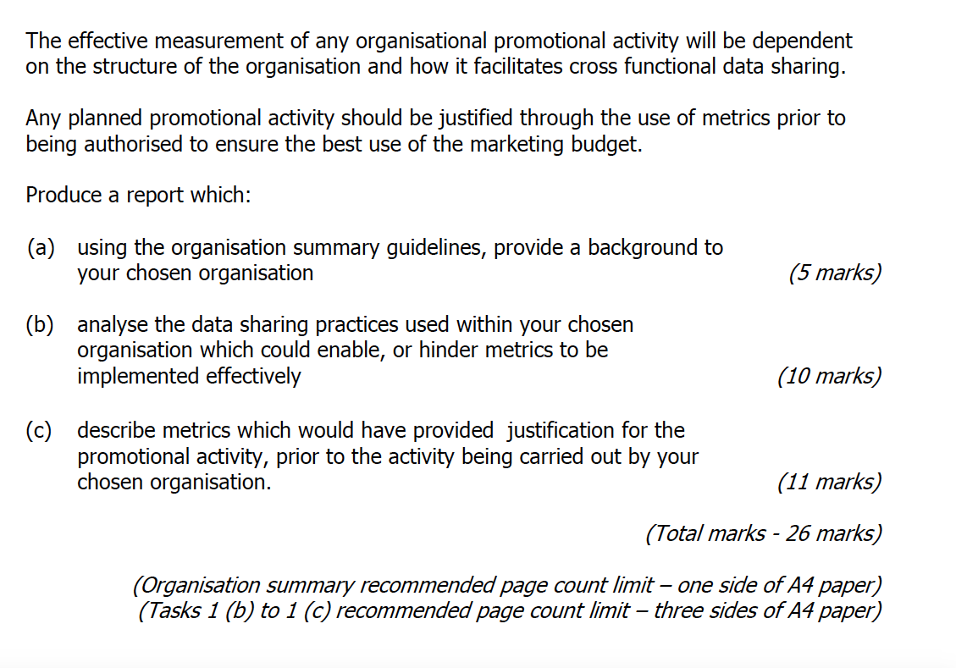
Task 1

Slide 7
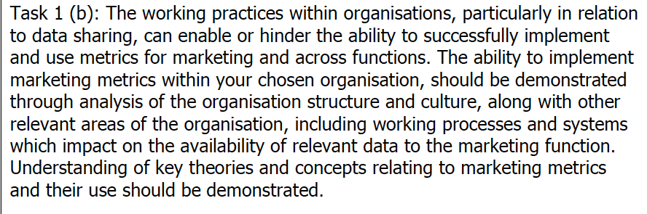

Slide 8
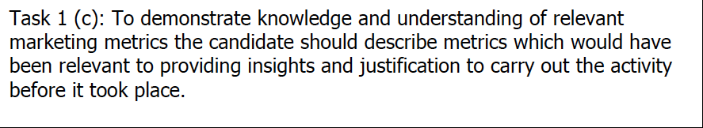
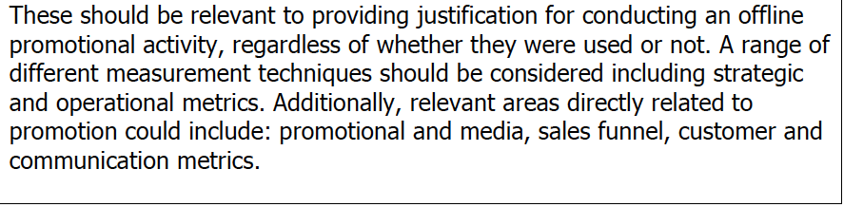

Slide 9
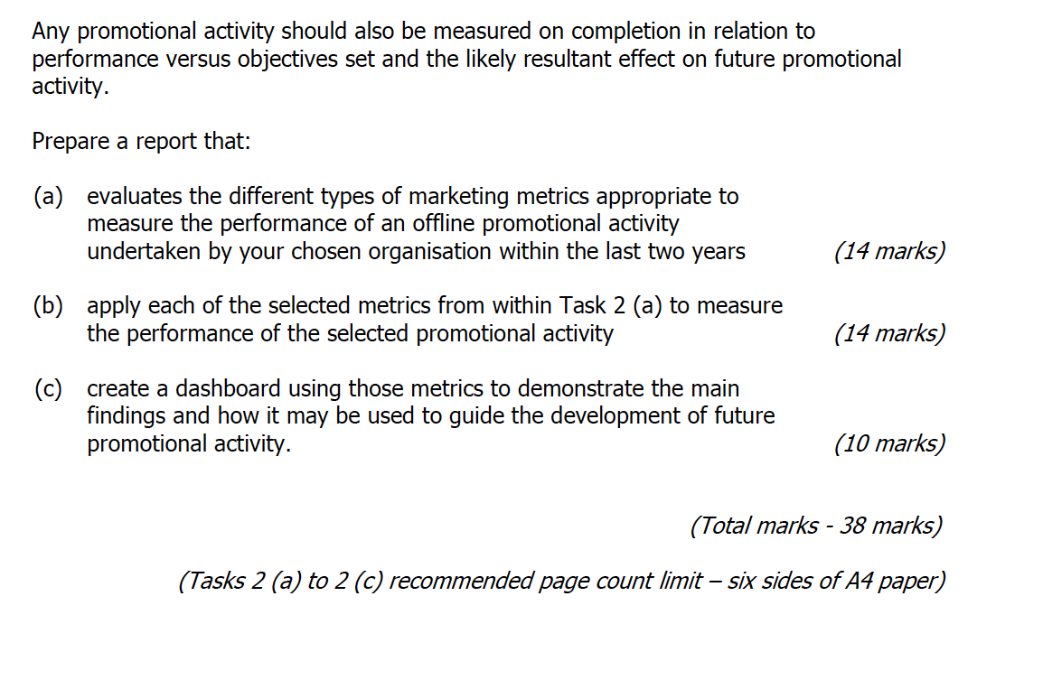
Task 2

Slide 10
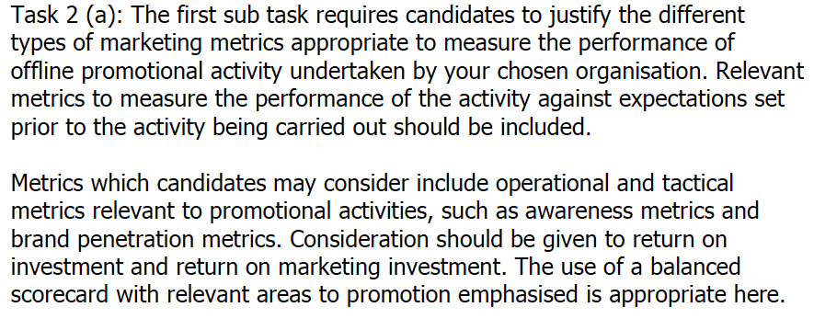

Slide 11
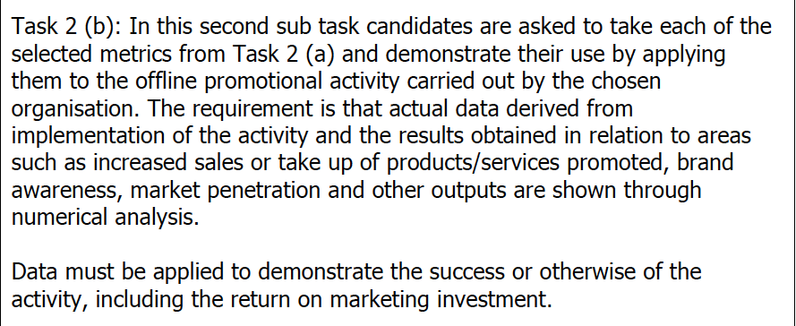

Slide 12
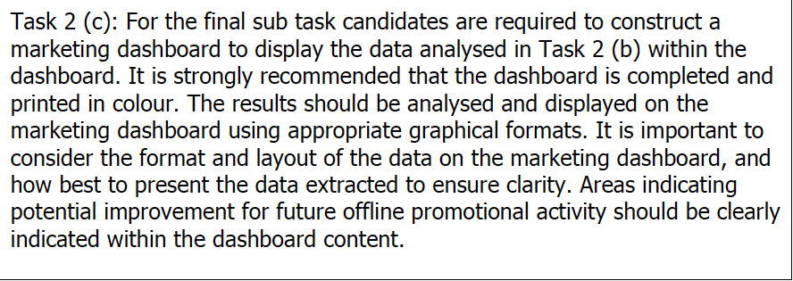

Slide 13
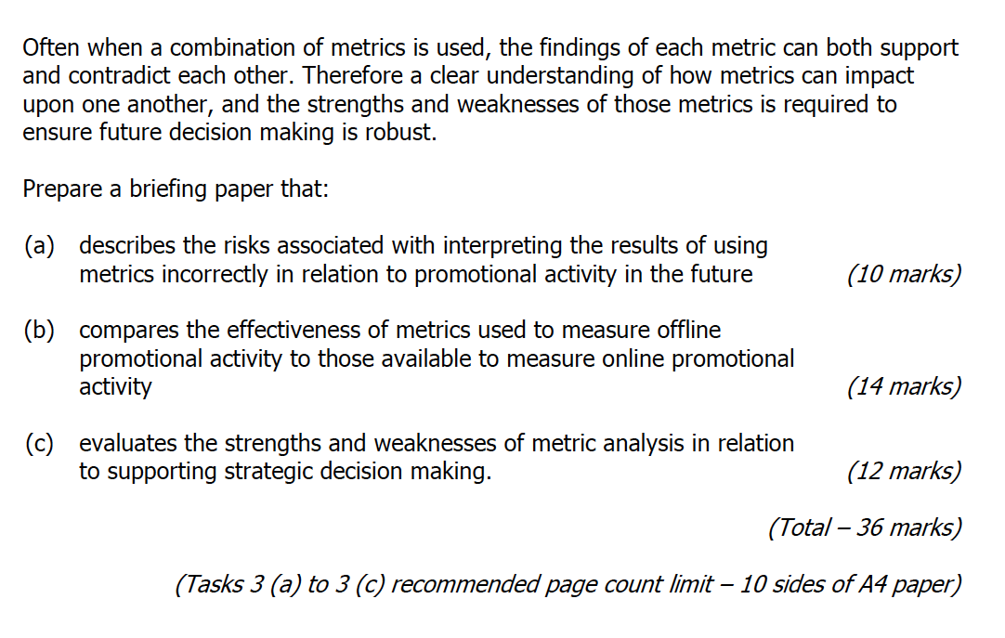
Task 3

Slide 14
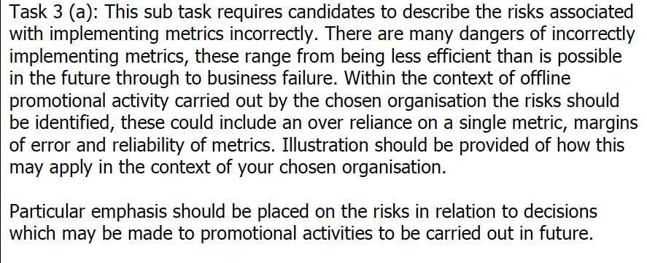
x

Slide 15
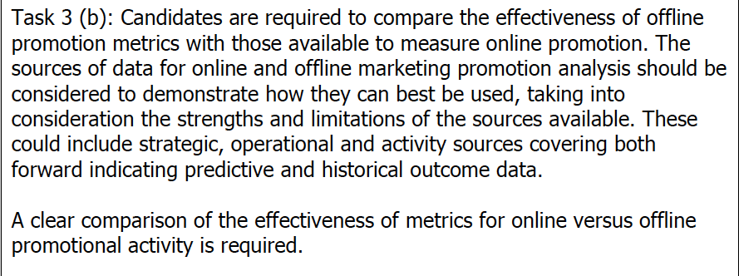

Slide 16
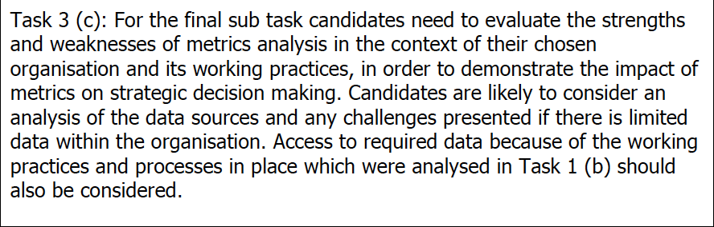

Slide 17
Key Dates
Study Sessions
28th & 29th April
12th & 13th May
2nd & 3rd June
16th June
Assessment Booking Deadline
9th June 2017
Assignment Deadline
30th June 2017

Slide 18
What is strategy?
What also is the problem with setting a strategy?
  Rapidly changing external environment
  Strategies need to be flexible

Slide 19
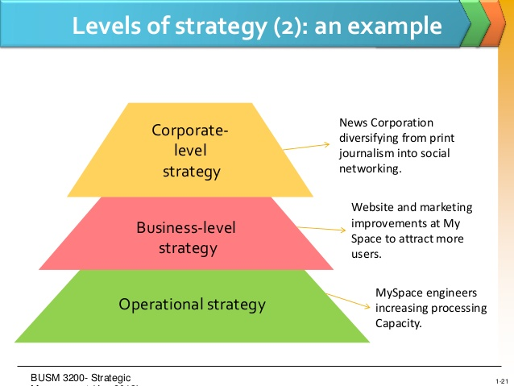

Slide 20
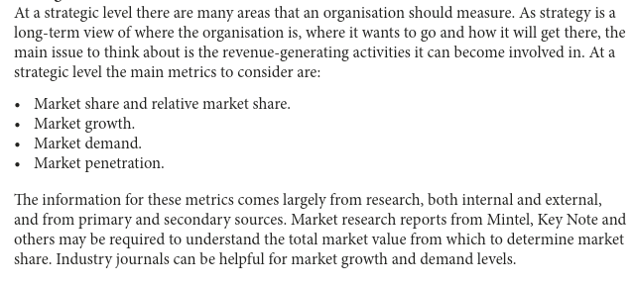
Strategic Level Metrics

Slide 21
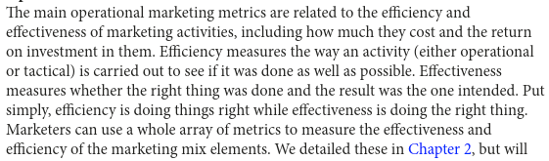
Operational Metrics

Slide 22
Operational Metrics
Basically 'doing the right thing' means acting in the way that you think is right at the time. However doing things right basically means 'doing the thing you are doing already, correctly'. In other words, doing the right thing refers to the decision of what you do, and doing things right refers to what you do within that context.
Give an example of how this would apply ot marketing metrics?

Slide 23
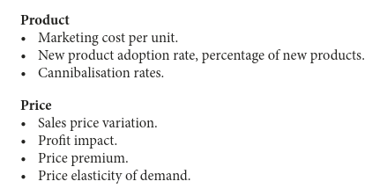
Operational metrics

Slide 24
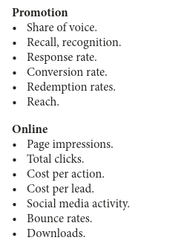
Operational metrics

Slide 25
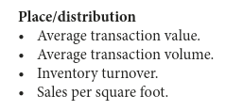
Operational metrics

Slide 26
Activity metrics
Aggregates and reporting
  Number of leads at a trade show
  Number of visitors to a website
RARELY DEMONSTRATE THE CONTRIBUTION MARKETING MAKES TO BUSINESS OUTCOMES
Think of some further examples

Slide 27
Outcome based metrics
**LINK MARKETING METRICS to ORG STRATEGY
  Market share
  Customer value
  New product adoption
(Depending on the organisations strategy)

Slide 28
Discussion
Consider how your organisation/department measures its marketing activity. How do they relate to your strategic objectives?

Slide 29
AN ORGANISATION’S STRATEGIC PLAN
http://www.uwtsd.ac.uk/media/uwtsd-website/content-assets/documents/strategies-policies/uwtsd-strategic-plan.pdf

Slide 30
Leading indicators
Measures of potential future activity
  If looking to increase your share of customer then Customer Lifetime Value (CLV) could serve as an indicator.

Slide 31
Metrics Brand, Sales and Business results
What is a brand?
What is brand equity/value?
  Financial value of the brand
  How it attracts and retains customers

Slide 32
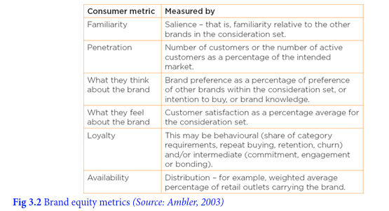
How do we measure it?

Slide 33
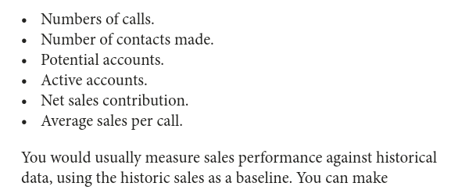
Sales force Metrics

Slide 34
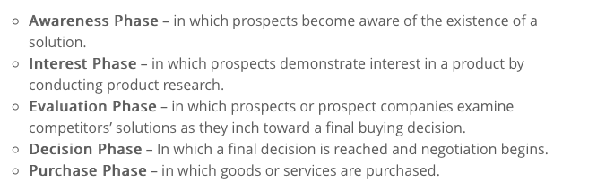
Sales Funnel
Sales process customer is taken through. Channel and company dependent
Salesforce example:

Slide 35
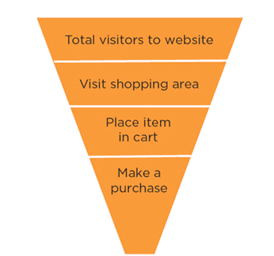
Sales Funnel
Website example:

Slide 36
Sales Funnel Metrics
Numbers and percentages can be shown for each stage
Sourcing and engagement: where customers come from and how people are engaged (usually web analytics software). Understanding this can help increase flow to top of funnel.
https://support.google.com/analytics/answer/6367342?hl=en

Slide 37
Sales Funnel metrics (Digital focus)
Conversion rate: ratio of deals that are closed that enter the funnel
Funnel value: This represents the potential value of prospective customers in the funnel. If the ‘normal’ funnel conversion rates are understood , you can use this to estimate future income.
Time spent at each stage: Important measure because it builds understanding of future potential, and allows you to speed up the process.
Average sales value: the average spend of customers in that channel, particularly if related to the costs involved in attracting and converting them. It can be a critical measure.

Slide 38
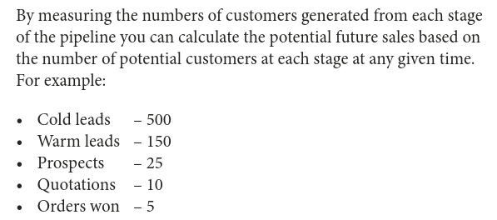
Sales Funnel Metrics
(offline emphasis)

Slide 39
CIM Sales Funnel Metrics
http://www.cimmarketingexpert.co.uk/page/9475/sales-funnel-metrics

Slide 40
Marketing ROI
Compare different types of expenditure actual or proposed by looking at the cash profit return after deducting the cost of the activity i.e. Return minus investment.
More generally ROI measures tends to be calculated as return divided by investment expressed as a percentage.
Problem is actually calculating the profit and the actual expenditure.

Slide 41
Return on Investment (ROI)
Marketing ROI measure is most useful for comparing different potential uses of the marketing budget – you can forecast the activity which is likely to yield the highest returns. Use it post implementation for future planning.
http://www.cimmarketingexpert.co.uk/page/2974/return-on-investment-roi-

Slide 42
Brand Metrics
Brand awareness
Brand value
Brand positioning
Impact on brand metrics by various campaigns
Use ones most relevant to your objectives

Slide 43
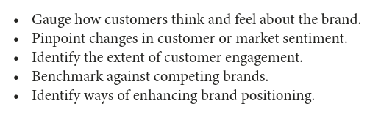
Brand Objectives

Slide 44
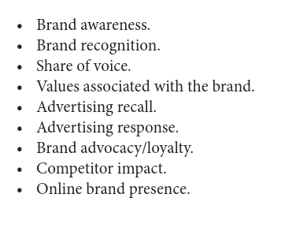
Key Brand Metrics

Slide 45
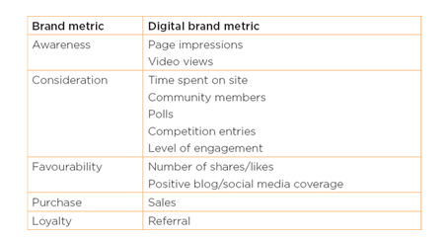

Slide 46
Promotional Media Metrics
For potential impact and effectiveness of a promotional or media campaign.
Beneficial to set metrics before and after a campaign to identify and measure the impact.

Slide 47
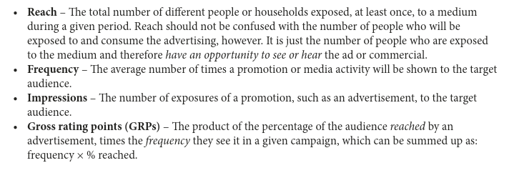
Key promotional metrics

Slide 48
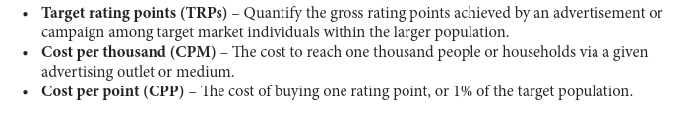
Key promotional metrics

Slide 49
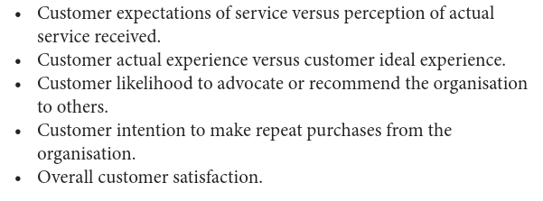
Service and satisfaction metrics
Traditionally not a strong area for marketers in demonstrating strategic impact.
Key metrics for real insight:

Slide 50
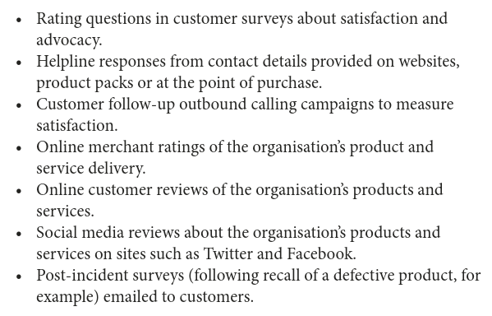
Measurement tools to assess impact of customer activity

Slide 51
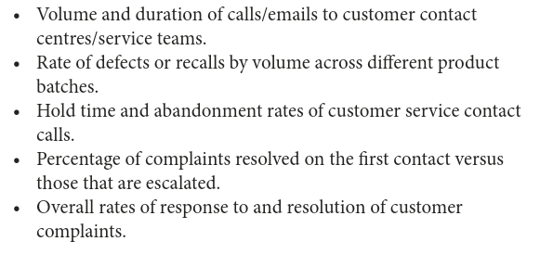
Measurement tools to test internal responsiveness to customer queries and complaints

Slide 52
Customer loyalty and Customer Lifetime Value (CLV) are more strategic measures than customer satisfaction alone.
Combining them can give both short-term satisfaction measures and longer-term relational building activities. E.g….

Slide 53
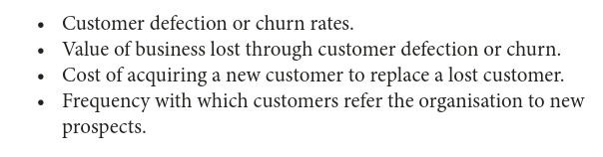

Slide 54
***Customer Lifetime Value (CLV)***
A forward-looking indicator that forecasts the value of the relationship between an organisation and a customer and ho much profit the organisation will make out of that customer.
How much that customer is worth to that organisation as a lump sump in current money terms.
It helps organisations decide which customers are worth the most not just based on past spend but potential future spend.

Slide 55
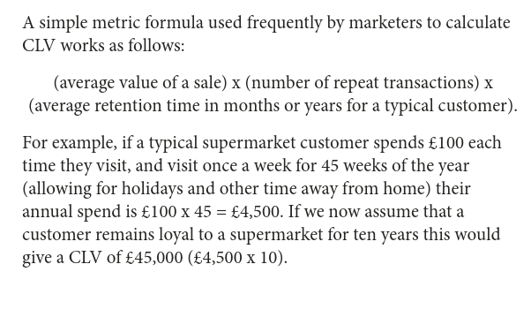

Slide 56
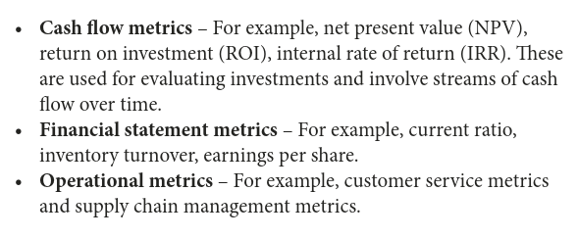
Financial and Operational Metrics

Slide 57
Marketers should integrate operational and financial metrics in order to gain a strategic view of the impact of metrics on the others.
E.g. operational metrics such as delivery quality, purchase cost and supply chain process efficiency should be measured in conjunction with product costs, customer satisfaction rates and rates of return. As it could show a deteriorating supply chain.

Slide 58
Measures of Marketing Performance

Slide 59
Choosing Appropriate measures
Use a wide variety of metrics initially, and study the results and decide which provide the most salient data to inform the setting and monitoring of KPIs

Slide 60
MKIS?
A Marketing Information System (MKIS) should integrate the data from all of the organisations customer data sources to allow informed business decisions.
Better customer insights, higher conversion rates, improved retention rates and better customer service.

Slide 61
MOST IMPORTANT
Metric must link with strategies
CIM will want you to JUSTIFY your choice of metrics
BIG DATA many sources of data available which can complement ‘traditional’ sources but beware of too much analysis and too little decision making.

Slide 62
The Balanced Scorecard
A framework for setting and monitoring business performance.
Translates organisational strategies into objectives and then providing metrics to monitor the execution of the strategy.
It translates vision and strategy into objectives

Slide 63
Why?
In part due to fact that previous over relying on financial metrics such as turnover and profitability meant retrospective measures.

Slide 64
Four area of the BSC
Customer
  e.g. time, quality, service and cost
Internal Business Processes
  e.g. number of activities per function; cycle time, productivity
Financial Measures:
  e.g. Cash flow, ROI, ROCE, profitability
Learning and growth e.g. (innovation and staff development)
  e.g. % rev from new services; employee turnover, job satisfaction

Slide 65
Balanced Scorecard example
  https://www.slideshare.net/Jasminekaurnagpal12345/sample-balanced-scorecard

Slide 66
Implication for Marketers
Balance their focus of marketing objectives with the overall goals of the organisation.

Slide 67
Reporting
Frequency
Metric hierarchies
  Top down decide strategic metric - operational and then tactical
  Bottom up – metric of each individual area that can be measured, tactical and operational and group these together to develop the next level of measure to be applied

Slide 68
Interaction of factors
  E.g. price reduction results in no increased sales
  Is it the amount of the price reduction
  Or way the price reduction was promoted?

Slide 69
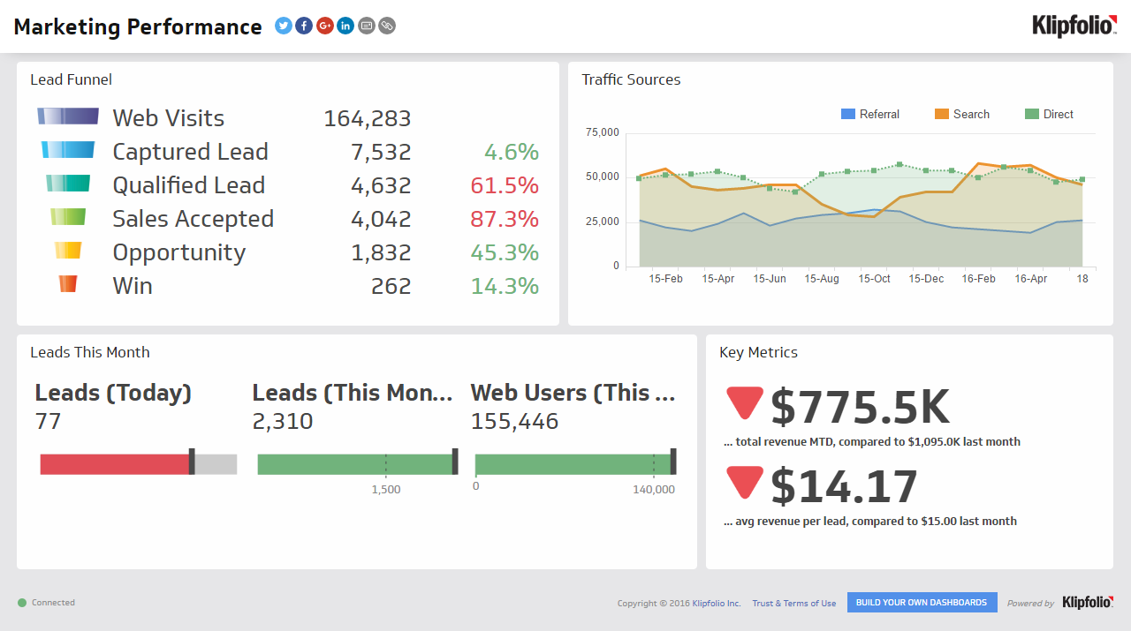
Marketing Dashboards

Slide 70
Marketing Dashboards
What are they?
Why have them?
How do we create them?

Slide 71
What are they?
Graphical description of data and information for to inform managers for decision making
Visually intuitive, easy to understand
Rich in graphs and tables
Financial and non financial metrics
Demonstrates progress towards achieving objectives
Contain the vital information needed to present the current situation and inform progress
  Strategically, operationally and tactically

Slide 72
Why have them?
Can be quickly and easily interpreted
Can be shared easily
Negative trends can be easily seen and investigated
Some trends can be drilled down for further analysis
Facilitate more informed decision making
Less time consuming than running off multiple reports
Give a holistic view from multiple metrics in one place
Increases employee engagement
Competitive advantage

Slide 73
Creating dashboards
Present only relevant data that can be used for making effective decisions
Include comparisons or targets to give context
  This year versus last year
  Performance against budget
Free and paid software to create dashboards
  Try www.clicdata.com
    free for one user plus details tutorials on youtube.

Slide 74
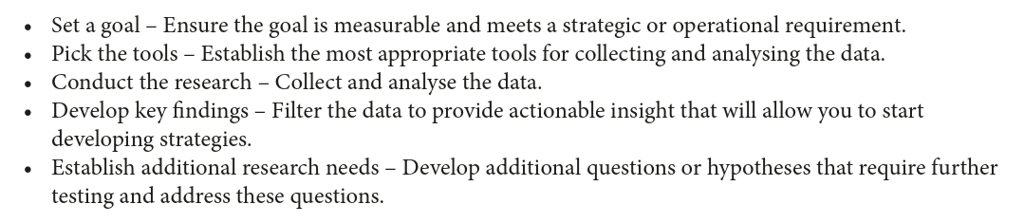
Creating Dashboards
5 step process Hemann and Burbary (2013)

Slide 75
Note of caution
Dashboard present only part of the picture

Slide 76
Summary
Marketing Metrics are important as they:
  justify your job
  justify any project you want to drive forward
  enable better business decisions
  Therefore ultimately increase profitability/value of company

Slide 77
Summary
Some metrics are better than others (to inform business decisions:
  Some are just ‘vanity metrics’/totals: they tell of quantity not quality
  Better metrics should give an idea of costs for comparison i.e. ROI
  Any task undertaken should be linked to the overall business strategy so some metrics should be strategic
  Some really useful metrics are predictive: trends, sales funnel, CLV
  Some metrics may be strategic and/or predictive but not relevant to the task you are considering. I you cant justify it as a measure of your promotional activity for your assignment – don’t use it.
  Balanced scorecard

