Slide 1

Importance of employee engagement in the hotel industry
STUDENT NAME: FERDOUS RAHMAN
STUDENT ID: 2120267
MODULE CODE: BMIH4006
MODULE TITLE: OPERATING HOTEL FACILITIES
PLACEMENT TUTOR: FFION CUMBERPATCH

Slide 2

Employee engagement can be clarified as the aids that may derive from a commercial that sets the strength in and copes to occupy with its team. It is hard and needs pretty much effort to jump and pledge but it is important to a business and can be substantial (PARiM, 2021).
Introduction to Employee Engagement

Slide 3

Important of employee engagement:
There is an impact of employee engagement on administrative victory.
Companies are attentive to the significance of holding and making pleasure at work and are preliminary to make an interior involvement for their staff.
When staffs are cheerier at jobs, they incline to play the proprietorship of their company.
Staffs are extra attentive to people and the worth that they can enhance to the merchandise intended, shaped, and transported by them.
All these efforts in the interior biosphere are nourishing better customer familiarity as the eminence values are being paid greater (Da Costa & Loureiro, 2019).

Slide 4
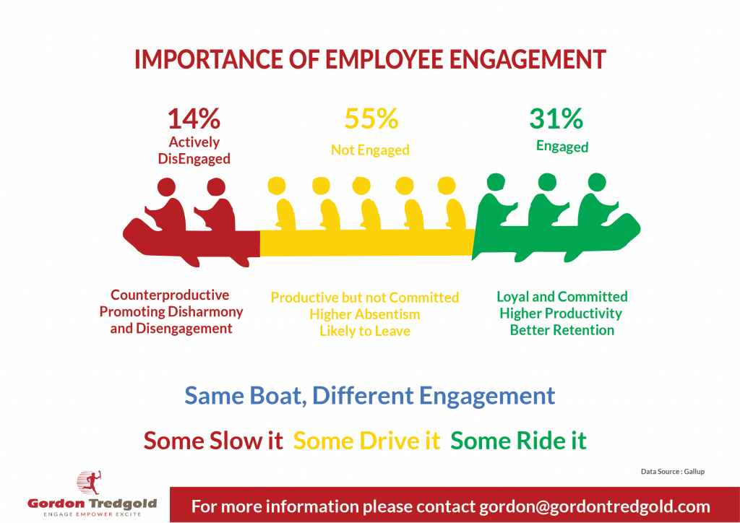
Importance of employee engagement:
Graphical presentation of the dissemination of engaged, disengaged, and actively disengaged workforce as persons paddling a yacht (Tredgold, 2022).

Slide 5
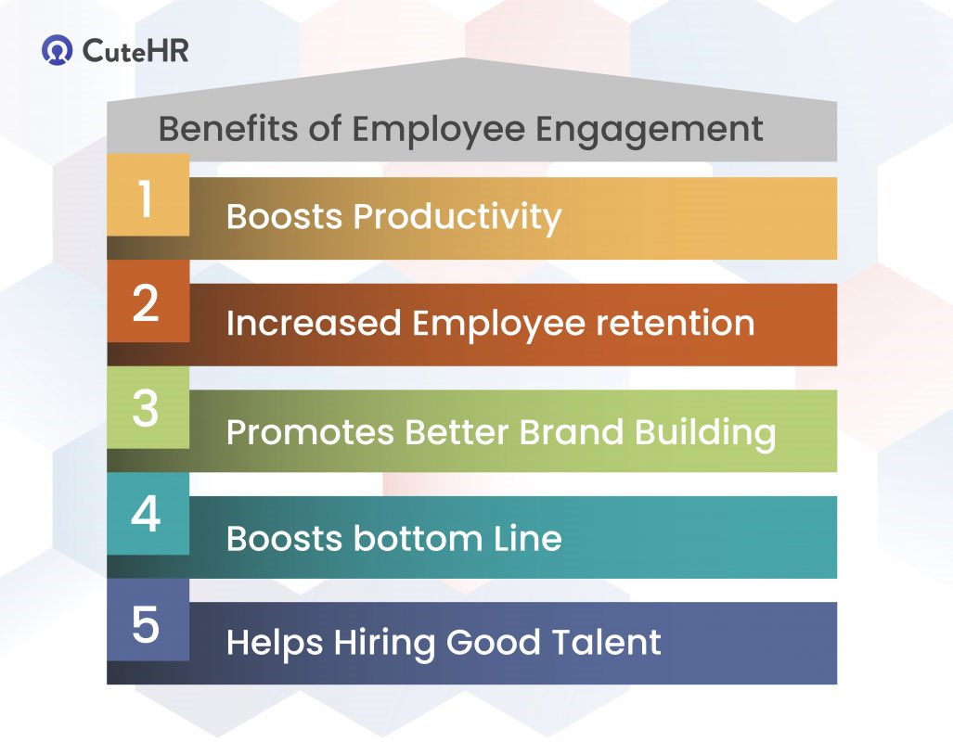
Benefit of employee engagement:
An engaged worker emphasizes continually refining his talents and aims at advanced stages of influence at every stage. Such a worker is enthusiastically involved in providing consequences and hence adds to amplified production.
Sound worker engagement creativities indorse a joyful and vigorous place of work (Kapoor, 2022).

Slide 6
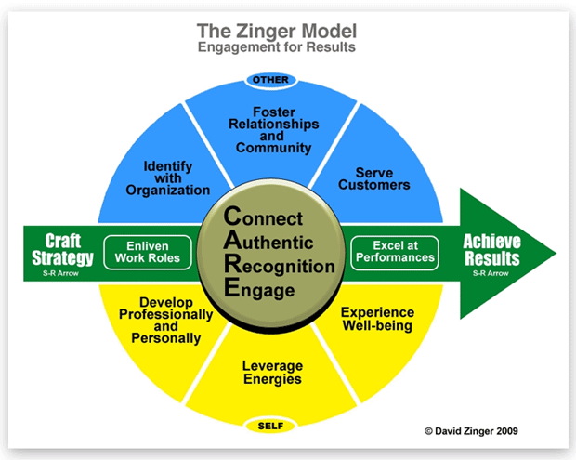
Employee engagement theories and models:
An employee engagement model is a plan for how to create a worker’s sense of appreciation, authorization, and creativity in their work. It is the strength of a business’s philosophy. The most common employee engagement frameworks are discussed below (Thompson, 2021).
Zinger Model of Employee Engagement
A workable model that tosses bright on numerous features of employee participation, devotion, and commitment. This model offers administrations with 12 bases that a supervisor needs to trail to attain noteworthy outcomes (Juneja, 2022).

Slide 7
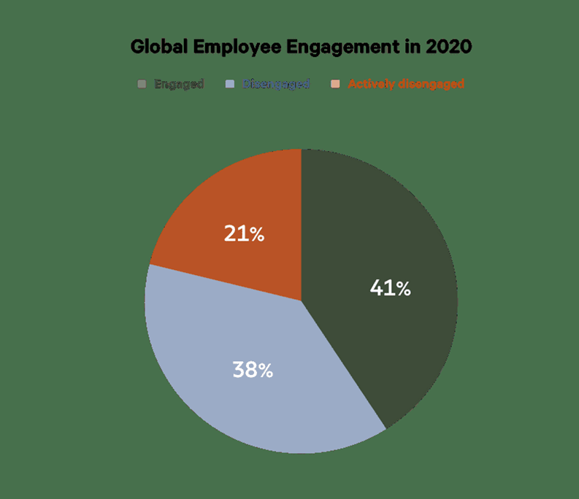
Employee engagement Statistics
Engaged employee is gifted to attach their role and are very loyal. They can hold jobs since they want to, and as they trust their additional energy will profit their company.
Disengaged employees may be labeled as “submissive” and won’t spread over flexible exertion in the office. Keenly disengaged staff signify workers that are meaningfully displeased and less prolific at their job.
As of January 2020, 41% of staff worldwide are engaged. 38% of workers are disengaged, and 21% of workforce are vigorously disconnected (Heartbeat, 2022).

Slide 8
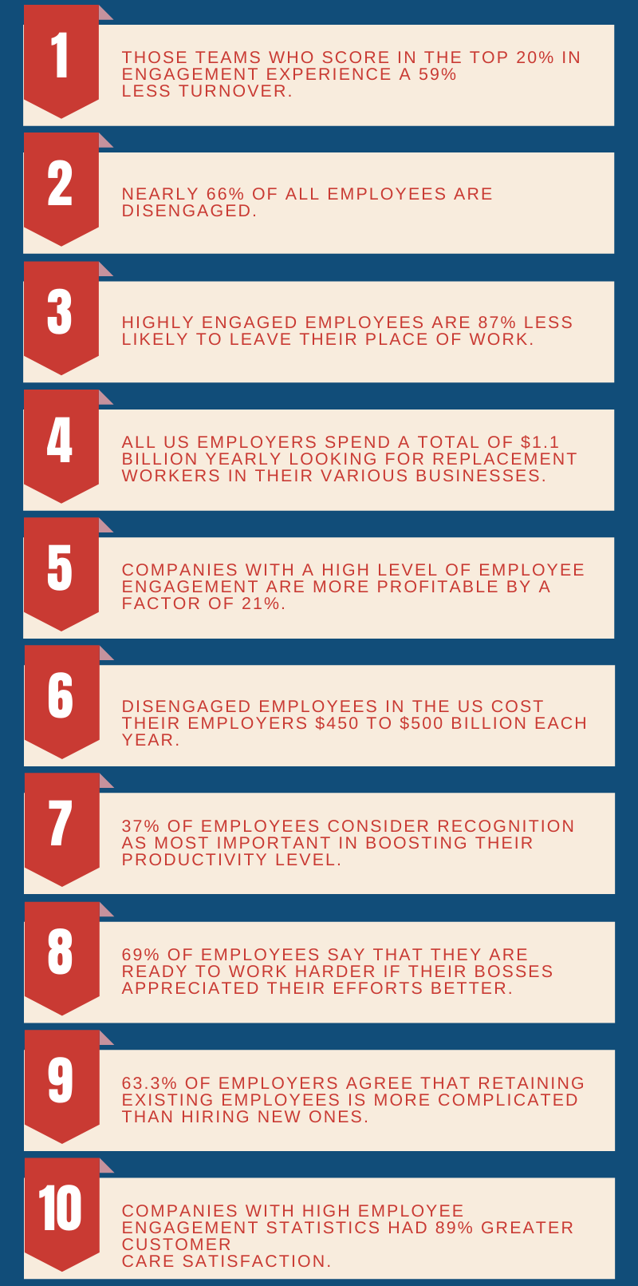
Employee Engagement Statistics 2020
This shows that employee engagement is a reason for alarm that wants to be talked about by associations around the world now, in order to decrease the degree of erosion. In any case, good staffs are a strength to any business, and assuming the increasing race for gifted workers, businesses now need to confirm that the staffs are pleased (IGITALthoughts, 2020).

Slide 9
Example of Employee Engagement
Tesla, Inc. (TSLA), startled by the great amount of damage at its Fremont car assembly plant, used further clear communication as a work commitment policy to recover security. For this, the electronic car creator’s co-founder and CEO Elon Musk said to the staff that he required all damage informed to him, lacking exclusion, so he could comprehend what was desired to stop alike coincidences from happening in the upcoming.
Musk even executes a similar job on the manufacturing line with workforces who have been wounded to see anywhere security developments can be prepared. As an outcome of this worker commitment to inventiveness, the number of occurrences that injured staff abridged by further than 50% in 2019 was associated with 2018, rendering to a business weblog post (Smith, 2022).

Slide 10
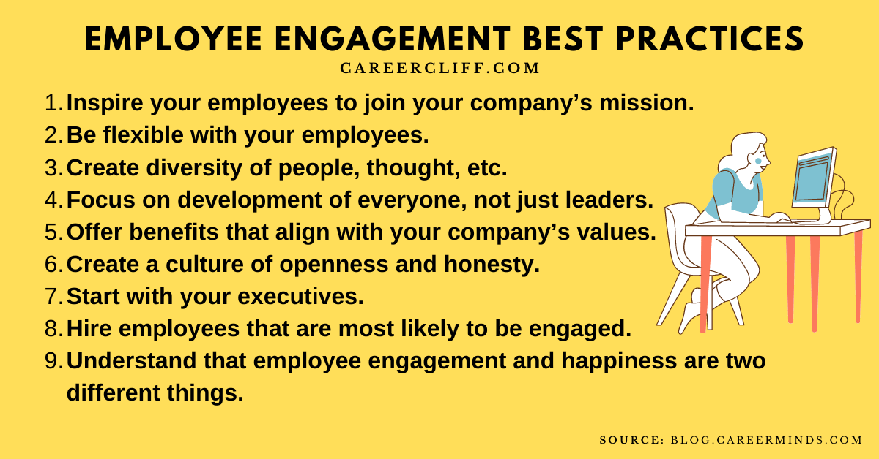
Best Practices For Employee Engagement
Employee Engagement Greatest Practices provides the business with various assistance. Consequently, boundless, or successful to be countless corporations constantly pay attention to employee engagement best practices (Ansary, 2020).

Slide 11
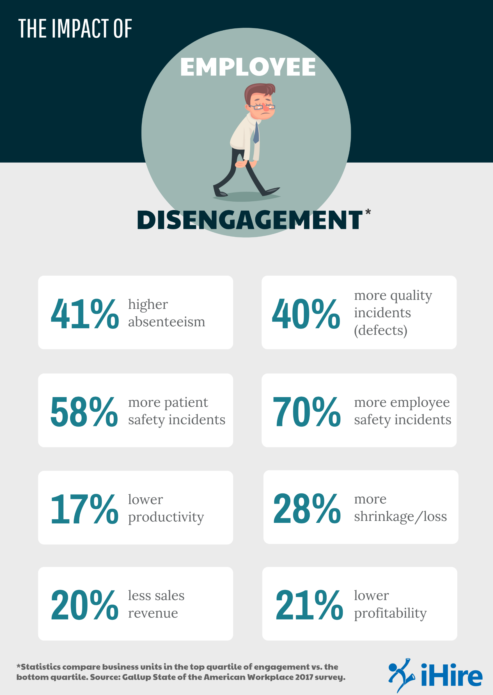
Results of Poor Employee Engagement
Low employee drive tips to extra coincidences, greater fault degrees, and abridged effectiveness. It’s an issue that influences minor trades and Wealth 500 companies, and it’s extensive throughout the US staff.
When Gallup inspected the highest and lowest 25% of businesses in relation to worker engagement, they exposed the correct degree of how little worker drive disturbs an association (Rohner, 2017).

Slide 12
conclusion
From the worldwide worker engagement information, employee assignation grips crucial to the positive implementation of commercial policies. Though it creates a group added attention to the point that not all staff attach to the concept and task the equal mode, it also bounces their gears and visions to create their personnel extra associated (Gupta, 2022).
Engaged staff’s effort is tougher as they like anything they do and trust in their worth to the corporation. When staffs are glad and occupied, they’re further probable to attention to clientele and go beyond and beyond to confirm clients and customers have a boundless involvement.
Extremely engaged administrations see a typical 20% upper trades than individuals that are disconnected (EveryoneSocial, 2022).

Slide 13
REFERENCE LIST
Ansary, A.S. (2020) 40 employee engagement best practices from Great Companies, Career Cliff. Available at: https://www.careercliff.com/employee-engagement-best-practices/ (Accessed: December 5, 2022).
Da Costa, L.R. and Loureiro, S.M. (2019) The importance of employees’ engagement on the organizational success ..., tandfonline.com. Available at: https://www.tandfonline.com/doi/full/10.1080/10496491.2019.1557811 (Accessed: December 2, 2022).
EveryoneSocial (2022) Employee engagement: Why it matters for your company. Available at: https://everyonesocial.com/employee-engagement/#:~:text=Why%20is%20employee%20engagement%20so,relationships%2C%20and%20impact%20company%20profits. (Accessed: December 3, 2022).
Gupta, V. (2022) 50+ employee engagement statistics &amp; trends for 2022, 5MinutesSEO. Available at: https://5minutesseo.com/statistics/employee-engagement-statistics/ (Accessed: December 2, 2022).

Slide 14
Heartbeat (2022) Employee Engagement Benchmark Statistics for 2020 | Heartbeat by Workday. Available at: https://heartbeat.peakon.com/data/employee-engagement/ (Accessed: December 4, 2022).
IGITALthoughts (2020) Infographics Blog on Employee Engagement Statistics 2020. blog.thedigitalgroup.com. Available at: https://blog.thedigitalgroup.com/infographics-blog-on-employee-engagement-statistics-2020 (Accessed: December 1, 2022).
Juneja, P. (2022) Zinger model of employee engagement, managementstudyguide. Available at: https://www.managementstudyguide.com/zinger-model-employee-engagement.htm (Accessed: December 2, 2022).
Kapoor, J. (2022) A complete guide to employee engagement for 2022, CuteHR. Available at: https://www.cutehr.io/employee-engagement-guide/ (Accessed: December 3, 2022).
PARiM (2021) 11 ideas to jump start staff engagement. Employee Management Software |&nbsp; Staff Management Software. Available at: https://parim.co/blog/11-ideas-to-jump-start-staff-engagement (Accessed: December 3, 2022).
Rohner, F. (2017) Cost of employee disengagement - hr advice, iHire. Available at https://www.ihire.com/resourcecenter/employer/pages/employee-disengagement (Accessed: December 4, 2022).

Slide 15
Smith, T. (2022) What is employee engagement? definition, strategies, and example, Investopedia. Investopedia. Available at: https://www.investopedia.com/terms/e/employee-engagement.asp (Accessed: December 1, 2022).
Thompson, M. (2021) Employee engagement models and theories, WeThrive. Available at: https://wethrive.net/employee-engagement/employee-engagement-models-and-theories/ (Accessed: December 3, 2022).
Tredgold, G. (2022) This is why employee engagement is important, Gordontredgold. Available at: https://gordontredgold.com/this-is-why-employee-engagement-is-important/ (Accessed: December 1, 2022).

