Slide 1
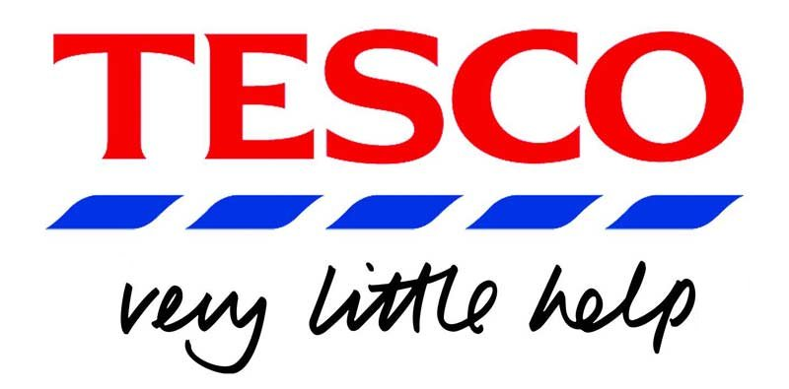
UNIVERSITY OF WALES TRINITY SAINT DAVID
Understanding and Engaging in Customer Experience (BMSW5103_SWAN)
Lecturer: Maria Heffernan
Presentation on Quality in CRM on TESCO
14/03/2022
Student: Cyrille Rene Tounoudjou (1914188)
This Photo by Unknown Author is licensed under CC BY-NC-ND

Slide 2
WHAT IS QUALITY IN CRM
Effective ways of acquiring, storing, and curating data for customer relationship management (CRM) are a must-have requirement. The cost of preserving your CRM data is based on the quality of the data itself.. This is due to the fact that the price of data rises as it gets older, larger, and more complex. The quality of the data you save in CRM determines the usefulness of the information you track in CRM (Aljawarneh et al.,2020).

Slide 3
QUALITY MODEL
As well as how these characteristics are to be determined, a quality model specifies which
attributes of a product are relevant (like usability, performance, and visibility).
such as QMS is used.
To meet the needs of its customers, Tesco believes in expanding by acquiring new stores,
enhancing retail services, and listening to customers. It is essential to Tesco's business
strategy to give top-notch customer service to all of the company's clients, not just those in
the UK (Symon et al.,2019). It is Tesco's business model that acquires, moves, and sells all
of its many products and services to its customers so that the company may learn and
improve its performance with each transaction.

Slide 4
TWO DIFFERENT MODELS OF QUALITY
QMS and Six Sigma are the two models that are used. One of the benefits of owning stock in Tesco is that the corporation has no limit on the amount of money it can raise through public offerings. To be sure, there are advantages to being a Public Limited Company, such as not having to publicly disclose your company’s financial data, but there are also cons. Public firms are subject to strict regulations than private corporations in many jurisdictions. An increase in the amount of equity capital required (Symon et al.,2019). A higher level of openness (for example, in the required form of accounting) For publicly traded companies, having their shares listed on a recognised stock market serves as an indirect endorsement.

Slide 5
SWOT ANALYSIS OF TESCO
Strengths. Tesco is The largest retailer in the UK. Stores are growing day by day. Diversified market and product range. Geographically diversified.
Weaknesses. Financial mistakes. Accounting scandal. Low cost Strategy.
Opportunities. Expanding Jacks business, Online shopping. Emerging markets.
Threats. Brexit referendum. Large competitions with other supermarkets. Economies crises.

Slide 6
REFERENCES
Aljawarneh, N. M., Sokiyna, M., Obeidat, A. M., Alomari, K. A. K., Alradaideh, A. T., & Alomari, Z. S. (2020). The Role of CRM Fog Computing on Innovation and Customer Service Quality: an Empirical Study. Marketing and Management of Innovations, 2, 286–297. https://doi.org/10.21272/MMI.2020.2-21
Symon, A., McFadden, A., White, M., Fraser, K., & Cummins, A. (2019). Using the Quality Maternal and Newborn Care Framework to evaluate women's experiences of different models of care: A qualitative study. Midwifery, 73, 26-34.
Demirel, D. (2022). The effect of service quality on customer satisfaction in digital age: customer satisfaction based examination of digital CRM. Journal of Business Economics and Management, 1-25.
Soegoto, F. A. (2021). Product Development using SWOT Analysis. International Journal of Entrepreneurship & Technopreneur (INJETECH), 1, 1-10.
Alam, M. M., Awawdeh, A. E., & Muhamad, A. I. B. (2021). Using e-wallet for business process development: challenges and prospects in Malaysia. Business Process Management Journal.

