Slide 1
Access Control Lists (ACL)

Slide 2
Objectives
4.1 Standard ACL Operation and Configuration
  Configure standard IPv4 ACLs.
4.2 Extended IPv4 ACLs
  Configure extended IPv4 ACLs.
4.3 IPv6 ACLs
  Configure IPv6 ACLs.
4.4 Troubleshoot ACLs
  Troubleshoot ACLs.
Notes:
2

Slide 3
4.1 Standard ACL Operation and Configuration Review

Slide 4
ACLs and the Wildcard Mask
An ACL is a sequential list of permit or deny statements, known as access control entries (ACEs).
As network traffic passes through an interface configured with an ACL, the router compares the information within the packet against each ACE.
An IPv4 ACE includes the use of a wildcard mask to filter IPv4 addresses.

Slide 5
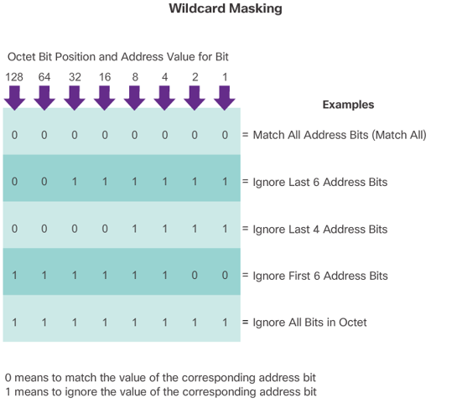
ACLs and the Wildcard Mask cont…

Slide 6
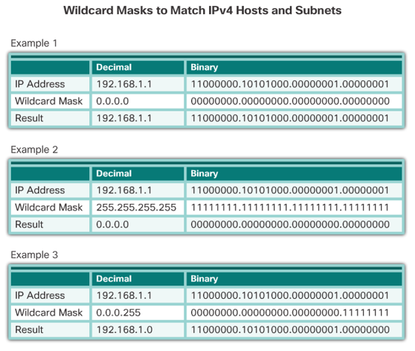
ACLs and the Wildcard Mask cont…

Slide 7
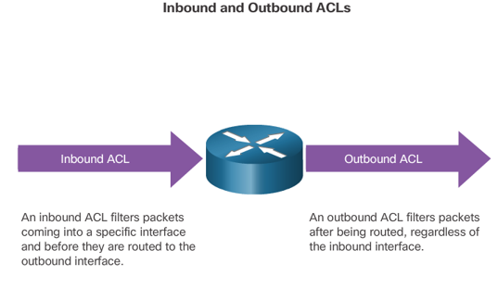
Applying ACLs to an Interface

Slide 8
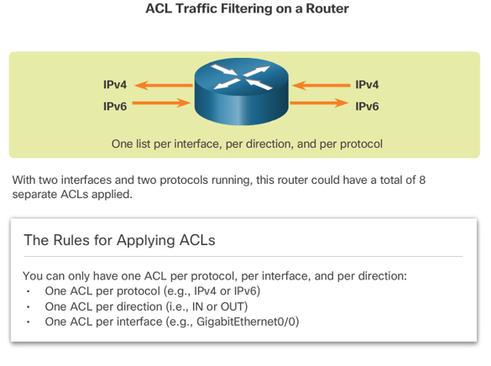
Applying ACLs to an Interface cont…

Slide 9
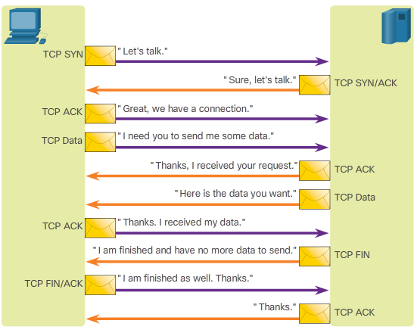
A TCP Conversation
TCP segments are marked with flags that denote their purpose:
a SYN starts (synchronizes) the session
an ACK is an acknowledgment that an expected segment was received
a FIN finishes the session.

Slide 10
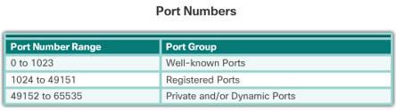
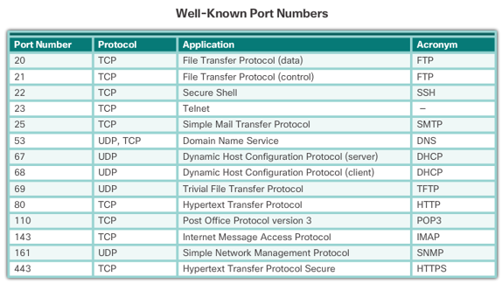
A TCP Conversation cont…
The TCP data segment also identifies the port which matches the requested service.

Slide 11
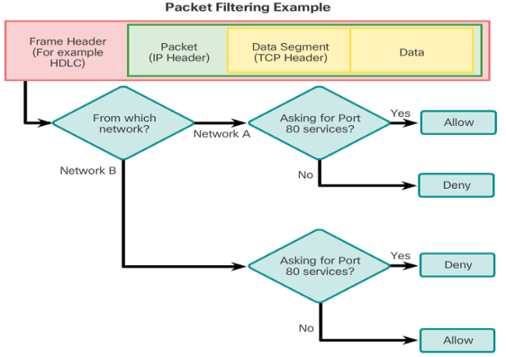
ACL Packet Filtering
Packet filtering controls access to a network by analyzing the incoming and outgoing packets and forwarding them or discarding them based on given criteria.

Slide 12
Standard and Extended IPv4 ACLs
Two types of Cisco IPv4 ACLS:
  Standard
    Standard ACLs can be used to permit or deny traffic only from source IPv4 addresses. The destination of the packet and the ports involved are not evaluated
  Extended
    Extended ACLs filter IPv4 packets based on several attributes:
      Protocol type
      Source IPv4 address
      Destination IPv4 address
      Source TCP or UDP ports
      Destination TCP or UDP ports
      Optional protocol type information for finer control

Slide 13
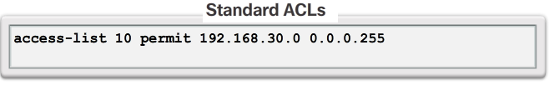
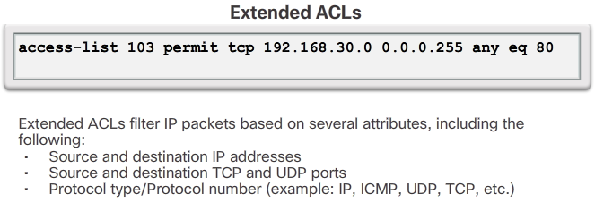
Standard and Extended IPv4 ACLs cont…

Slide 14
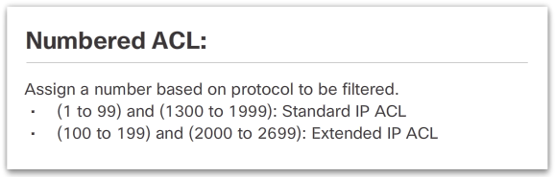
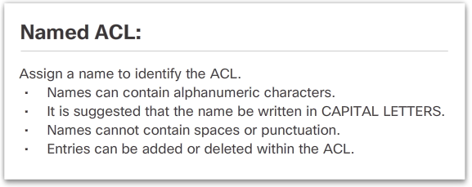
Numbered and Named ACLs
Standard and extended ACLs can be created using either a number or a name to identify the ACL.

Slide 15
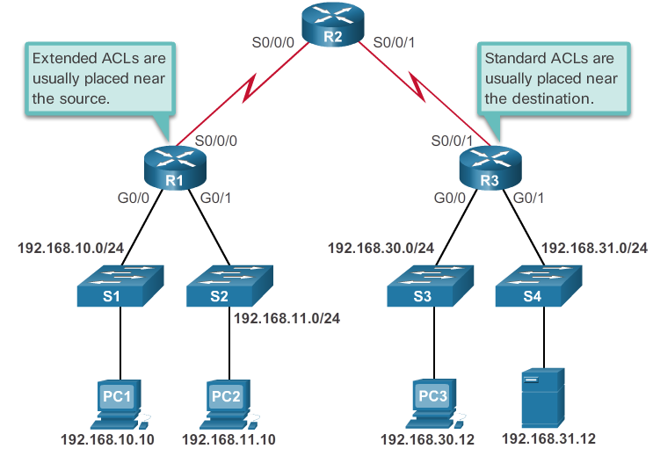
Where to Place ACLs

Slide 16
Where to Place ACLs cont…
Every ACL should be placed where it has the greatest impact on efficiency. The basic rules are:
  Extended ACLs - Locate extended ACLs as close as possible to the source of the traffic to be filtered.
  Standard ACLs - Because standard ACLs do not specify destination addresses, place them as close to the destination as possible.
  Placement of the ACL, and therefore the type of ACL used, may also depend on: the extent of the network administrator’s control, bandwidth of the networks involved, and ease of configuration.

Slide 17
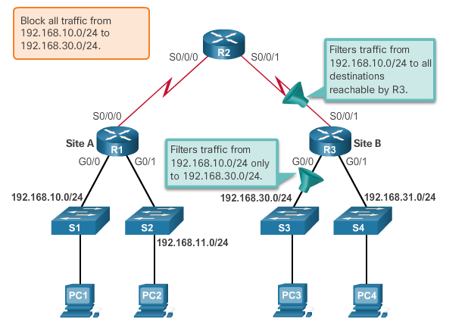
Standard ACL Placement Example
The administrator wants to prevent traffic originating in the 192.168.10.0/24 network from reaching the 192.168.30.0/24 network.

Slide 18
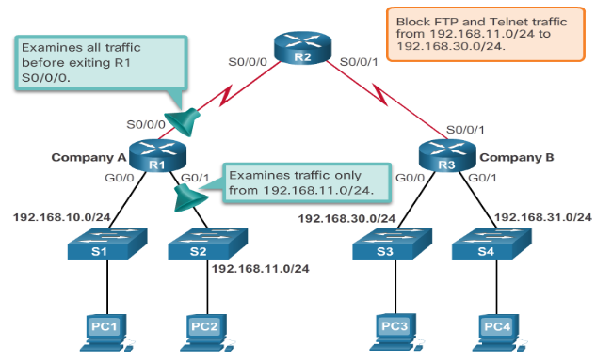
Extended ACL Placement Example
The administrator wants to deny Telnet and FTP traffic from the 192.168.11.0/24 network to Company B’s 192.168.30.0/24 network. All other traffic from the .11 network must be permitted to leave Company A without restriction.

Slide 19
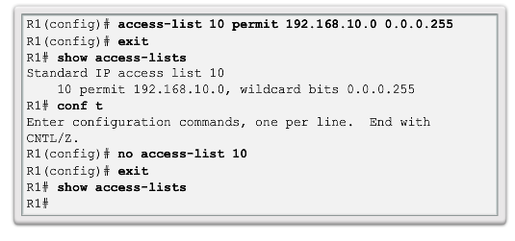
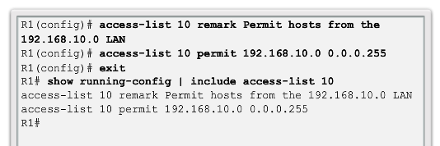
Configure a Standard IPv4 ACL
Router(config)# access-list access-list-number { deny | permit | remark } source [ source-wildcard ] [ log ]

Slide 20
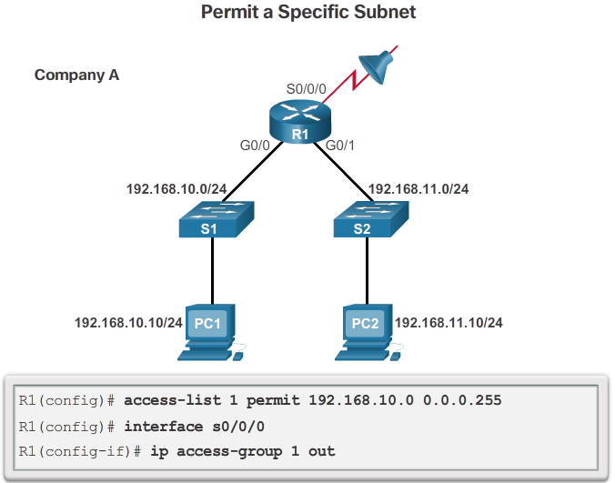
Apply a Standard IPv4 ACL

Slide 21
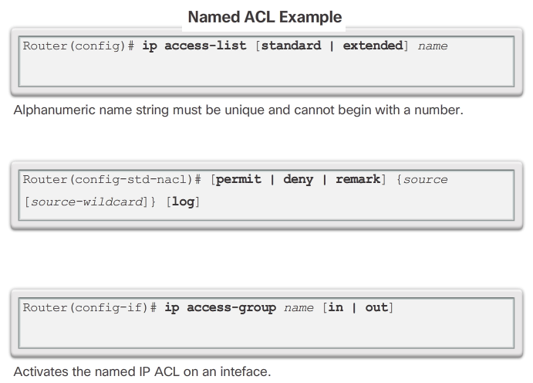
Named Standard IPv4 ACLs

Slide 22
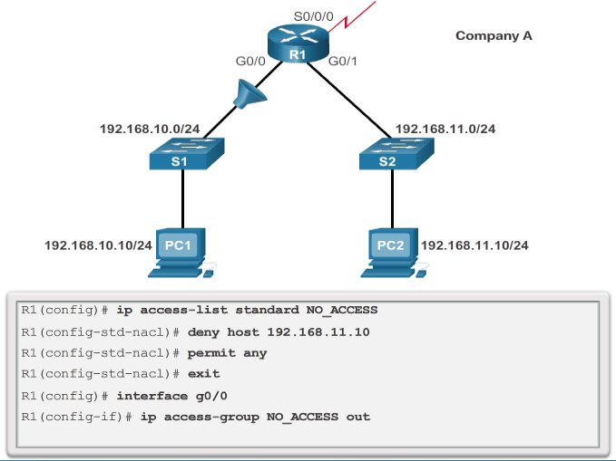
Named Standard IPv4 ACLs cont…

Slide 23
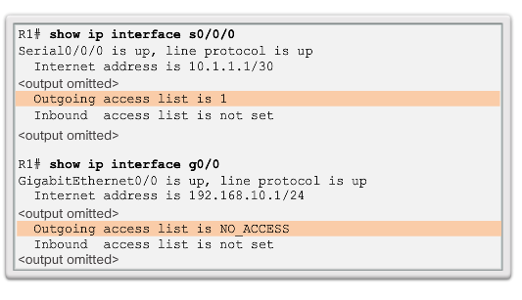
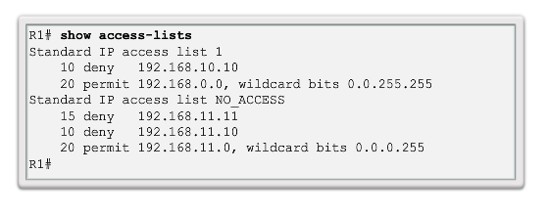
Verify ACLs

Slide 24
4.2 Extended IPv4 ACLs

Slide 25
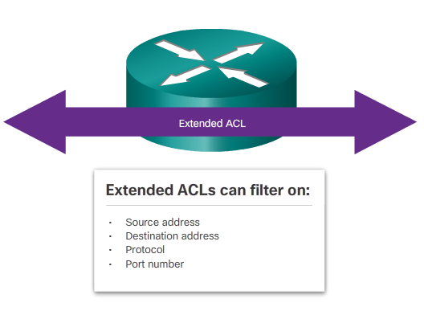
Extended ACLs
Extended ACLs are used more often than standard ACLs because they provide a greater degree of control.

Slide 26
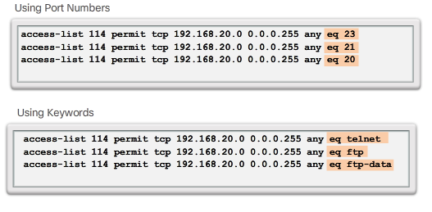
Filtering Ports and Services
The ability to filter on protocol and port number allows network administrators to build very specific extended ACLs.
An application can be specified by configuring either the port number or the name of a well-known port.

Slide 27
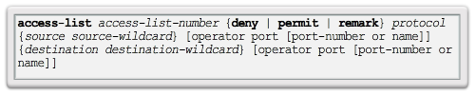
Configuring Extended ACLs
The procedural steps for configuring extended ACLs are the same as for standard ACLs. The extended ACL is first configured, and then it is activated on an interface. However, the command syntax and parameters are more complex to support the additional features provided by extended ACLs.

Slide 28
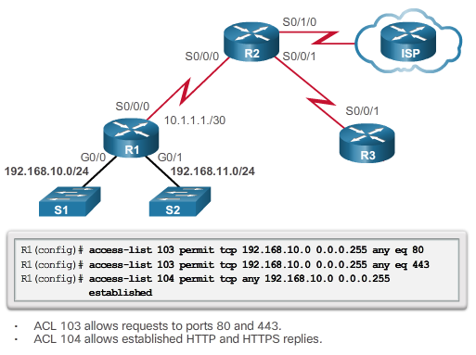
Configuring Extended ACLs cont…

Slide 29
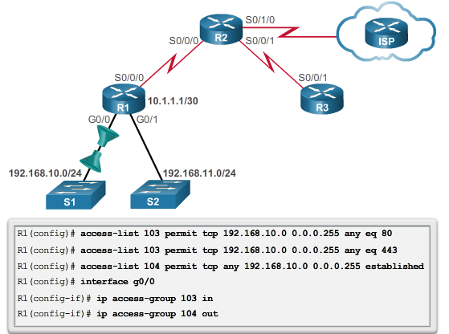
Applying Extended ACLs to Interfaces

Slide 30
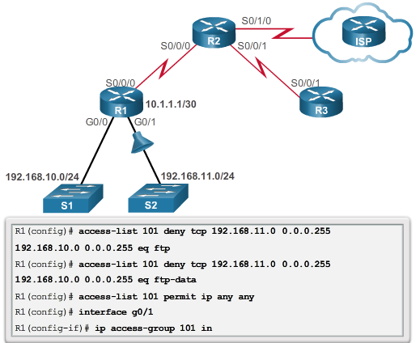
Filtering Traffic with Extended ACLs

Slide 31
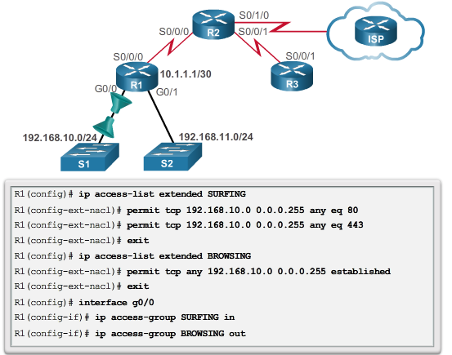
Creating Named Extended ACLs

Slide 32
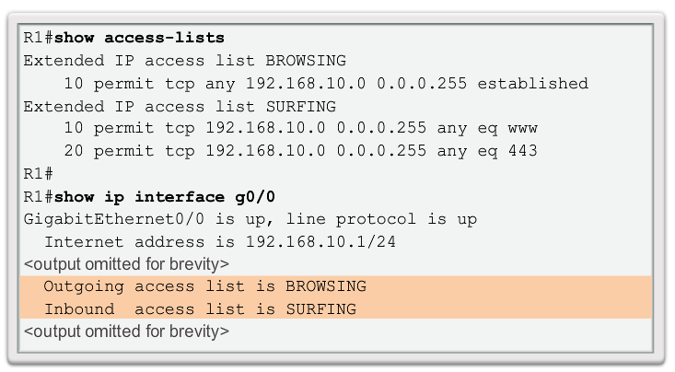
Verifying Extended ACLs

Slide 33
Editing Extended ACLs
Editing an extended ACL can be accomplished using the same process as editing a standard. An extended ACL can be modified using:
  Method 1 - Text editor
    The ACL is copied and pasted into the text editor where the changes are made. The current access list is removed using the no access-list command. The modified ACL is then pasted back into the configuration.
  Method 2 – Sequence numbers
    Sequence numbers can be used to delete or insert an ACL statement.

Slide 34
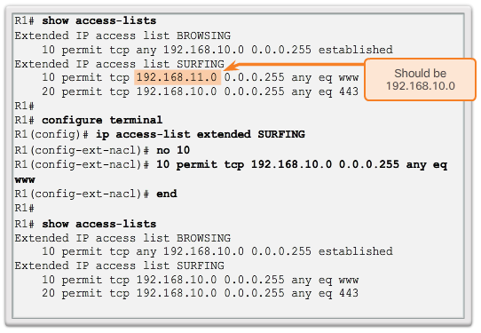
Editing Extended ACLs cont…
Editing an extended ACL via Sequence Numbers:

Slide 35
4.3 IPv6 ACLs

Slide 36
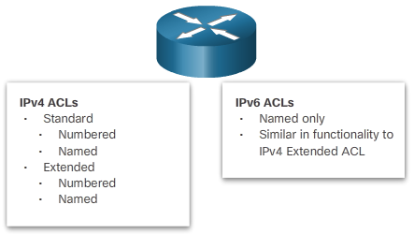
Types of IPv6 ACLs

Slide 37
Comparing IPv4 and IPv6 ACLs
Although IPv4 and IPv6 ACLs are very similar, there are three significant differences between them.
Applying an IPv6 ACL
  IPv6 uses the ipv6 traffic-filter command to perform the same function for IPv6 interfaces.
No Wildcard Masks
  The prefix-length is used to indicate how much of an IPv6 source or destination address should be matched.
Additional Default Statements
  permit icmp any any nd-na
  permit icmp any any nd-ns

Slide 38
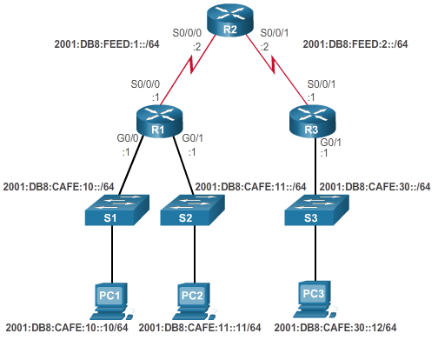
Configuring IPv6 Topology

Slide 39
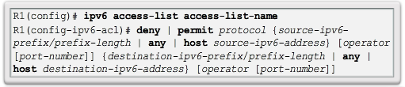
Configuring IPv6 ACLs
There are three basic steps to configure an IPv6 ACL:
From global configuration mode, use the ipv6 access-list name command to create an IPv6 ACL.
From the named ACL configuration mode, use permit or deny statements to specify one or more conditions to determine if a packet is forwarded or dropped.
Return to privileged EXEC mode

Slide 40
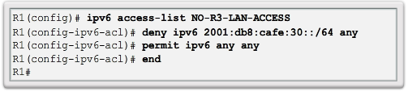
Configuring IPv6 ACLs cont…
This IPv6 ACL does the following:
  The first statement names the IPv6 access list NO-R3-LAN-ACCESS.
  The second statement denies all IPv6 packets from the 2001:DB8:CAFE:30::/64 destined for any IPv6 network.
  The third statement allows all other IPv6 packets.

Slide 41
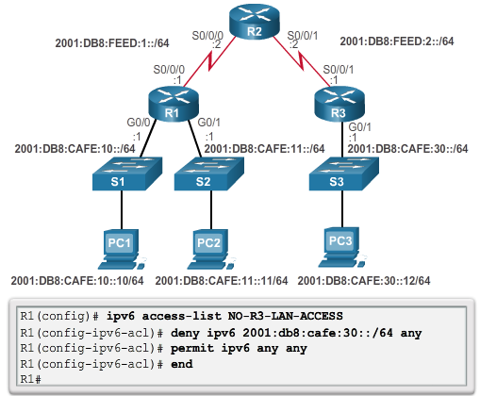
Configuring IPv6 ACLs cont…

Slide 42
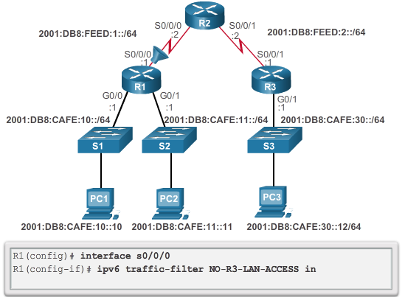
Applying an IPv6 ACL to an Interface

Slide 43
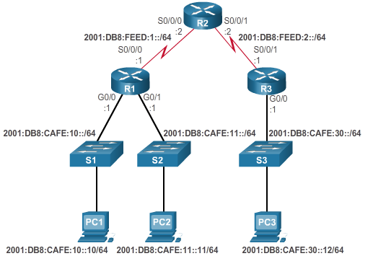
IPv6 ACL Examples

Slide 44
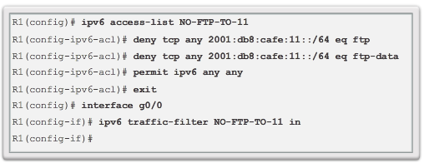
IPv6 ACL Examples cont…
Router R1 is configured with an IPv6 access list to deny FTP traffic to 2001:DB8:CAFE:11::/64. Ports for both FTP data (port 20) and FTP control (port 21) need to be blocked.
Because the filter is applied inbound on the G0/0 interface on R1, only traffic from the 2001:DB8:CAFE:10::/64 network will be denied.

Slide 45
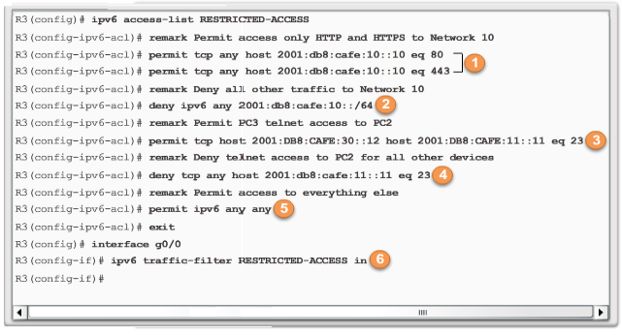
IPv6 ACL Examples cont…
  1. The first two permit statements allow access from any device to the web server at 2001:DB8:CAFE:10::10.
  2. All other devices are denied access to network 2001:DB8:CAFE:10::/64.
  3. PC3 at 2001:DB8:CAFE:30::12 is permitted Telnet access to PC2 which has the IPv6 address 2001:DB8:CAFE:11::11.

Slide 46

IPv6 ACL Examples cont…
  4. All other devices are denied Telnet access to PC2.
  5. All other IPv6 traffic is permitted to all other destinations.
  6. The IPv6 access list is applied to interface G0/0 in the inbound direction, so only the 2001:DB8:CAFE:30::/64 network is affected.

Slide 47
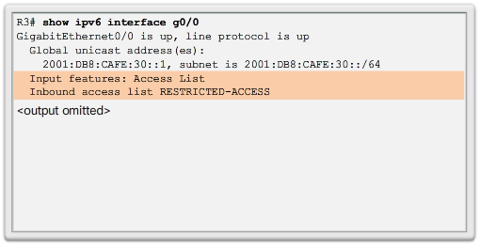
Verifying IPv6 ACLs

Slide 48
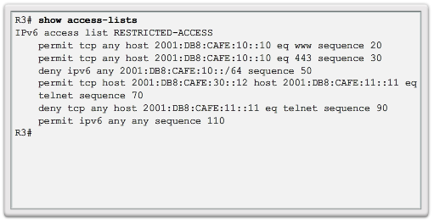
Verifying IPv6 ACLs cont…

Slide 49
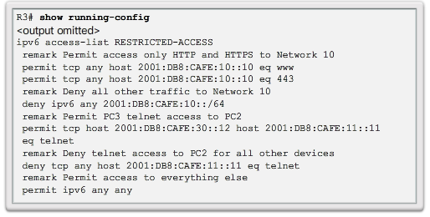
Verifying IPv6 ACLs cont…

Slide 50
4.4 Troubleshoot ACLs

Slide 51
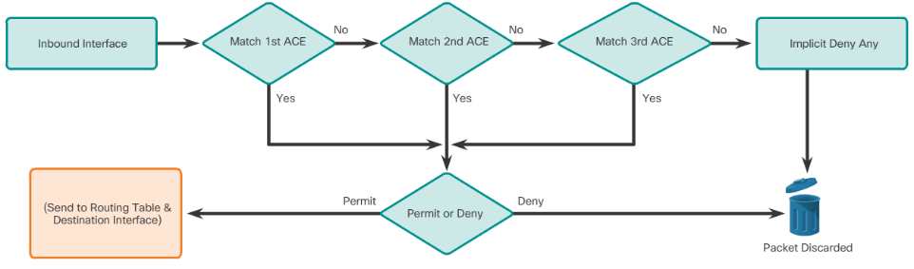
Inbound and Outbound ACL Logic

Slide 52
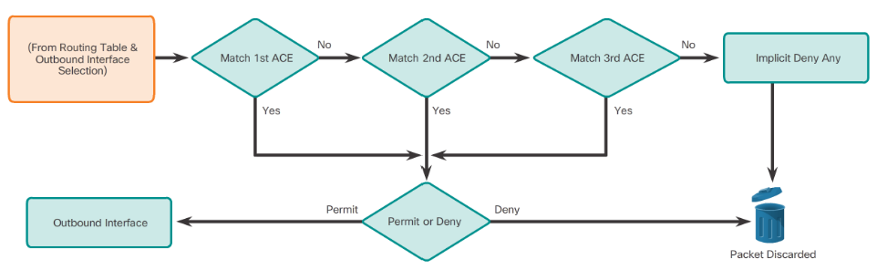
Inbound and Outbound ACL Logic

Slide 53
ACL Logic Operations
As a frame enters an interface, the router checks to see whether the destination Layer 2 address matches its interface Layer 2 address, or whether the frame is a broadcast frame.
If the frame address is accepted, the frame information is stripped off and the router checks for an ACL on the inbound interface.
If an ACL exists, the packet is tested against the statements in the list.
If the packet matches a statement, the packet is either permitted or denied.
If the packet is accepted, it is then checked against routing table entries to determine the destination interface.
If a routing table entry exists for the destination, the packet is then switched to the outgoing interface, otherwise the packet is dropped.
Next, the router checks whether the outgoing interface has an ACL. If an ACL exists, the packet is tested against the statements in the list. If the packet matches a statement, it is either permitted or denied.
If there is no ACL or the packet is permitted, the packet is encapsulated in the new Layer 2 protocol and forwarded out the interface to the next device.

Slide 54
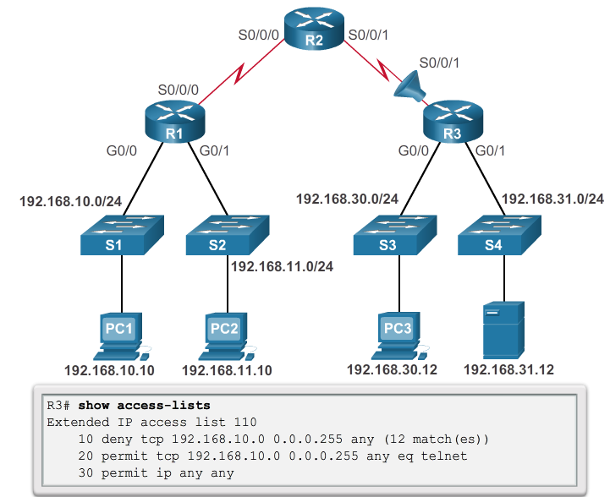
Troubleshooting IPv4 ACLs- Example 1
Host 192.168.10.10 has no Telnet connectivity with 192.168.30.12.

Slide 55
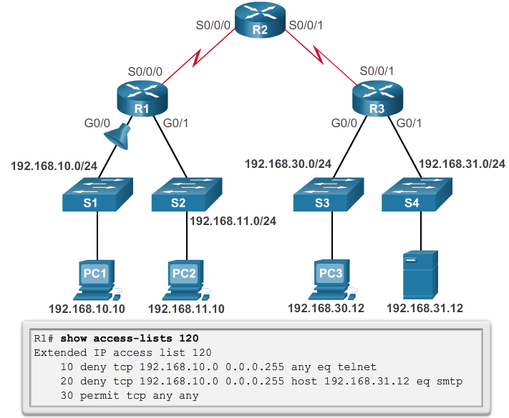
Troubleshooting IPv4 ACLs- Example 2
The 192.168.10.0/24 network cannot use TFTP to connect to the 192.168.30.0/24 network.

Slide 56
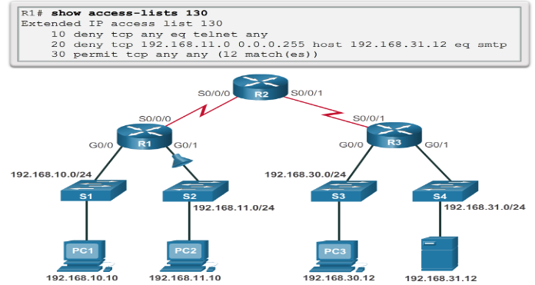
Troubleshooting IPv4 ACLs- Example 3
The 192.168.11.0/24 network can use Telnet to connect to 192.168.30.0/24, but this connection should not be allowed.

Slide 57
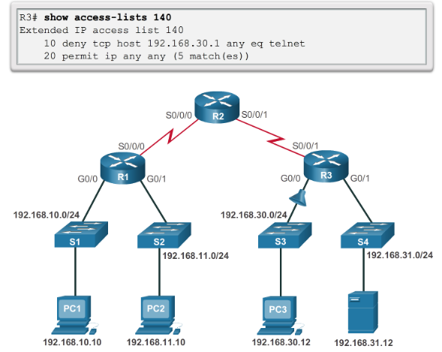
Troubleshooting IPv4 ACLs- Example 4
Host 192.168.30.12 is able to Telnet to connect to 192.168.31.12, but this connection should not be allowed.

Slide 58
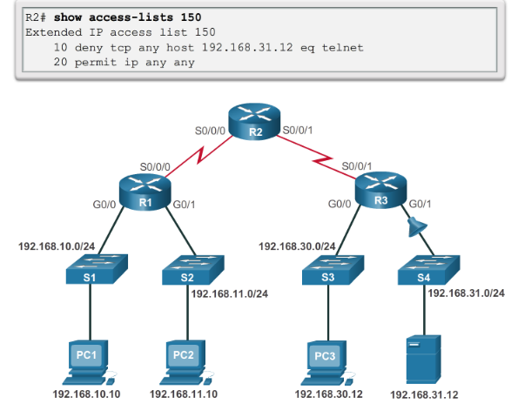
Troubleshooting IPv4 ACLs- Example 5
Host 192.168.30.12 can use Telnet to connect to 192.168.31.12, but this connection should not be allowed.

Slide 59

Troubleshooting IPv6 ACLs- Example 1
R1 is configured with an IPv6 ACL to deny FTP access from the :10 network to the :11 network, but PC1 is still able to connect to the FTP server running on PC2.

Slide 60

Troubleshooting IPv6 ACLs-
Example 1 cont…

Slide 61

Troubleshooting IPv6 ACLs-
Example 1 cont…

Slide 62

Troubleshooting IPv6 ACLs- Example 2
R3 is configured with IPv6 ACL RESTRICTED-ACCESS that should enforce the following policy for the R3 LAN:
However, after configuring the ACL, PC3 cannot reach the 10 network or the 11 network, and it cannot SSH into the host at 2001:DB8:CAFE:11::11.

Slide 63

Troubleshooting IPv6 ACLs-
Example 2 cont…

Slide 64

Troubleshooting IPv6 ACLs-
Example 2 cont…

Slide 65

Troubleshooting IPv6 ACLs-
Example 2 cont…

Slide 66

Troubleshooting IPv6 ACLs-
Example 3
R1 is configured with IPv6 ACL DENY-ACCESS that should enforce the following policy for the R3 LAN:
However, after applying the ACL to the interface the :10 network is still reachable from the :30 network.

Slide 67

Troubleshooting IPv6 ACLs-
Example 3 cont…

Slide 68

Troubleshooting IPv6 ACLs-
Example 3 cont…

Slide 69
Summary & Questions

