Slide 1
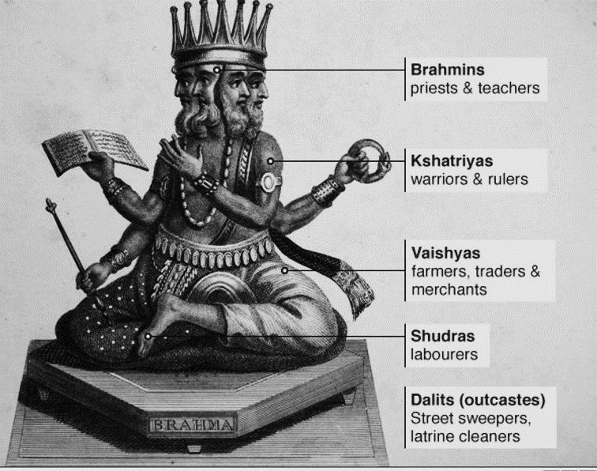
HPHP4010 Reframing the World
.
"To understand history," Chacko said, "we have to go inside and listen to what they're saying. And look at the books and the pictures on the wall. And smell the smells.“
(The God of Small Things)
Brahma & the origins of caste

Slide 2
LEARNING OUTCOMES
We need history, but not the way a spoiled loafer in the garden of knowledge needs it.
Nietzsche, ‘Of the Use and Abuse of History’
Upon the successful completion of this module, the student should be able to:
• Demonstrate a competent and critical understanding of different approaches to global history.
• Demonstrate a comprehension of the different way that academics have engaged with the concept of globalisation and glocalisation. In particular, to be able to respond critically or creatively to various archaeological and historical debates and contributions from the world of literature.

Slide 3
Literature & history: Theoretical /historical contexts
Enlightenment – reason/ self determination (geography primarily that of class)
Modes of writing: the novel as enlightenment form;
  Narratives of individual development and success from dependency to independency
Nation state – colonial system
Orientalism (Edward Said): the de-rationalising of colonial subjects & their histories
‘English’ literature
a) Denigration of culture in India – Lord Macaulay
b) ‘Lack of any culture in Caribbean’ – James Froude
Language
use of English - playing with different spellings / imports from Malayaman
Issues
The postcolonial novel must challenge its assumption of the nation state to allow deviant readings including perspectives marginalised within them
Use of English: Cultural appropriation or cultural oppression?

Slide 4
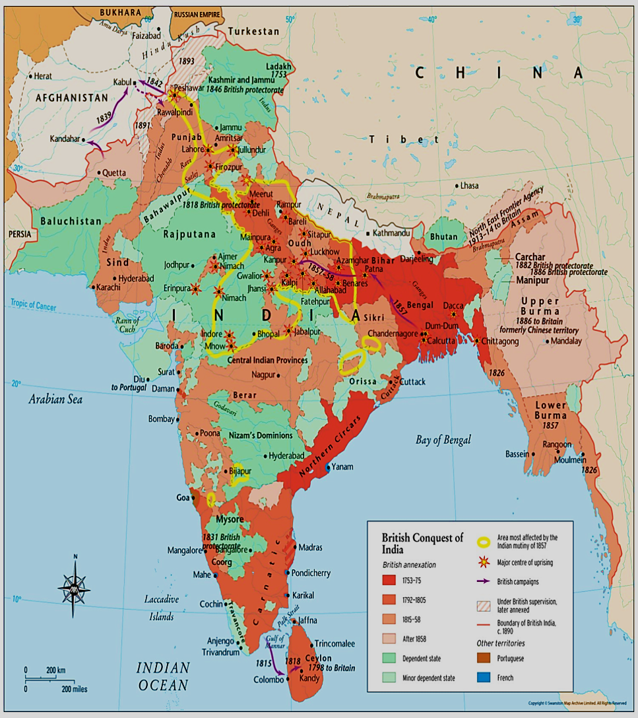
‘Core-periphery’ in History
Rise of Great Britain:
Expansion of British Empire e.g. west Africa and India
Colonisation of periphery by core
Linked to Industrialisation
‘Pax- Britannica’ in 19thc and ‘Scramble for Africa =
New threats and competitors - Germany, Japan

Slide 5
Colonialism hardly ever exploits the whole of a country. It contents itself with bringing to light the natural resources, which it extracts, and exports to meet the needs of the mother country's industries, thereby allowing certain sectors of the colony to become relatively rich. But the rest of the colony follows its path of under-development and poverty, or at all events sinks into it more deeply.
The settler makes history and is conscious of making it. And because he constantly refers to the history of his mother country, he clearly indicates that he himself is the extension of that mother-country. Thus the history which he writes is not the history of the country which he plunders but the history of his own nation in regard to all that she skims off, all that she violates and starves.
Jean-Paul Sartre, ‘Preface’, The Wretched of the Earth (2nd edn 1963)

Slide 6
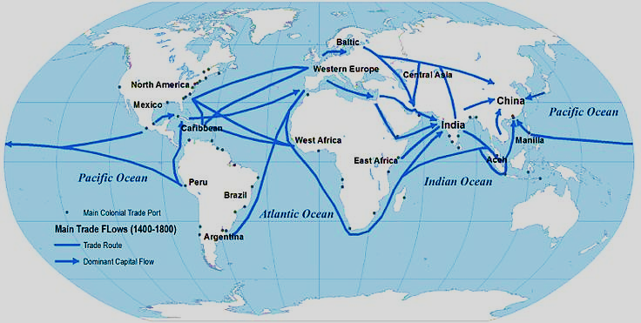
World Systems
Capitalist world-based economy = unique
First to expand around the planet, leading to interconnection between economies and states

Slide 7
NARRATIVES & SELVES AS HISTORICAL CONSTRUCTS
Psychology of colonialism (Franz Fanon)
Orientalism (Edward Said )
Postcolonialism (Homi Bhabha; Gayatri Chakrovorty Spivak)
Chinua Achebe (Nigeria)
Ngũgĩ wa Thiong’o (Kenya)
Derek Walcott (Caribbean)
Jean Rhys (Caribbean)
Arundhati Roy (India)
Chimamanda Ngozi Achidie (Nigeria)
Writers include:

Slide 8

Black Skin, White Masks (1952)
For Fanon, being colonized by a language has larger implications for one’s consciousness: “To speak … means above all to assume a culture, to support the weight of a civilization” (17-18). Speaking French means that one accepts, or is coerced into accepting, the collective consciousness of the French, which identifies blackness with evil and sin.
In an attempt to escape the association of blackness with evil,,
the black man dons a white maskor thinks of himself as a universal subject equally participating in a society that advocates an equality supposedly abstracted from personal appearance. Cultural values are internalized, or “epidermalized” into consciousness, creating a fundamental disjuncture between the black man’s consciousness and his body. Under these conditions, the black man is necessarily alienated from himself
(PROBLEMS WITH WOMEN)

Slide 9

A DYING COLONIALISM (1959)
In 1953, Fanon became head of the psychiatry department at the Blida-Joinville Hospital in Algeria, where he instituted reform in patient care and desegregated the wards. During his tenure in Blida, the war for Algerian independence broke out, and Fanon was horrified by the stories of torture his patients — both French torturers and Algerian torture victims — told him. …His letter of resignation encapsulates his theory of the psychology of colonial domination, and pronounces the colonial mission incompatible with ethical psychiatric practice:
“If psychiatry is the medical technique that aims to enable man no longer to be a stranger to his environment, I owe it to myself to affirm that the Arab, permanently an alien in his own country, lives in a state of absolute depersonalization … The events in Algeria are the logical consequence of an abortive attempt to decerebralize a people”

Slide 10
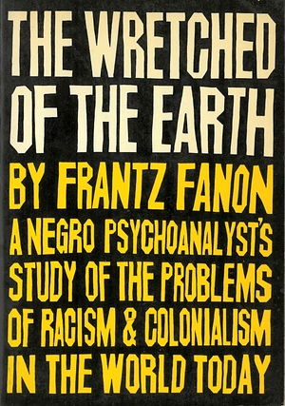
The Wretched of the Earth (1963)
In The Wretched of the Earth, Fanon develops the Manichean perspective implicit in BSWM. To overcome the binary system in which black is bad and white is good, Fanon argues that an entirely new world must come into being. This utopian desire, to be absolutely free of the past, requires total revolution, “absolute violence” (37). Violence purifies, destroying not only the category of white, but that of black too. According to Fanon, true revolution in Africa can only come from the peasants, or “fellaheen.” …this emphasis on the rural underclass highlights Fanon’s disgust with the greed and politicking of the comprador bourgeoisie in new African nations The brand of nationalism espoused by these classes, and even by the urban proletariat, is insufficient for total revolution because
such classes benefit from the economic structures of imperialism. Fanon claims that non-agrarian revolutions end when urban classes consolidate their own power, without remaking the entire system. In his faith in the African peasantry as well as his emphasis on language, Fanon anticipates the work of Ngũgĩ wa Thiong’o, who finds revolutionary artistic power among the peasants.

Slide 11
…the native intellectuals, since they could not stand wonderstruck before the history of today's barbarity, decided to back further and to delve deeper down; and, let us make no mistake, it was with the greatest delight that they discovered that there was nothing to be ashamed of in the past, but rather dignity, glory, and solemnity. The claim to a national culture in the past does not only rehabilitate that nation and serve as a justification for the hope of a future national culture. In the sphere of psycho-affective equilibrium it is responsible for an important change in the native. Perhaps we have not sufficiently demonstrated that colonialism is not simply content to impose its rule upon the present and the future of a dominated country. Colonialism is not satisfied merely with holding a people in its grip and emptying the native's brain of all form and content. By a kind of perverted logic, it turns to the past of the oppressed people, and distorts, disfigures, and destroys it. This work of devaluing pre-colonial history takes on a dialectical significance today.
When we consider the efforts made to carry out the cultural estrangement so characteristic of the colonial epoch, we realize that nothing has been left to chance and that the total result looked for by colonial domination was indeed to convince the natives that colonialism // came to lighten their darkness. The effect consciously sought by colonialism was to drive into the natives' heads the idea that if the settlers were to leave, they would at once fall back into barbarism, degradation, and bestiality.
Frantz Fanon, The Wretched of the Earth 1961

Slide 12
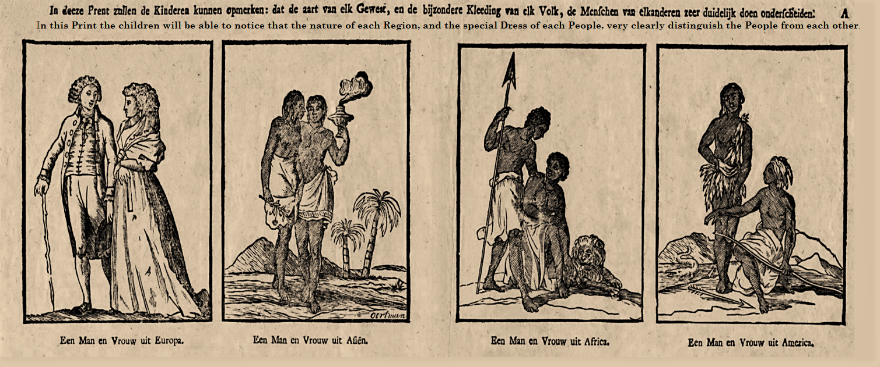
Imaging the world: colonisers & colonised; culture & nature
Europe Egypt Africa America

Slide 13
I come to the third meaning of Orientalism, which is something more historically and materially defined than either of the other two. Taking the late eighteenth century as a very roughly defined starting point Orientalism can be discussed and analyzed as the corporate institution for dealing with the Orient-dealing with it by making statements about it. authorizing views of it. describing ./ it, by teaching it, settling it, ruling over it: in short, Orientalism is a Western style for dominating, restructuring, and having authority over the Orient. I have found it useful here to employ Michel Foucault's notion of a discourse, as described by him in The Archaeology of Knowledge and in Discipline and Punish, to identify Orientalism. My contention is that without examining Orientalism as a discourse one cannot possibly understand the enormously systematic discipline by which European culture was able to manage-and even produce-the Orient politically, sociologically, militarily, ideologically. scientifically. and imaginatively during the post-Enlightenment period. Moreover, so authoritative a position did Orientalism have that I believe no one writing, thinking. or acting on the Orient could do so without taking account of the limitations on thought and action imposed by Orientalism. In brief, because of Orientalism the Orient was not (and is not) a ' free subject of thought or action. This is not to say that Orientalism unilaterally determines what can be said about the Orient, but that it is the whole network of interests inevitably brought to bear on (and therefore always involved in) any occasion when that peculiar entity "the Orient" is in question.
Edward Said, Orientalism, 1979 p.3.

Slide 14
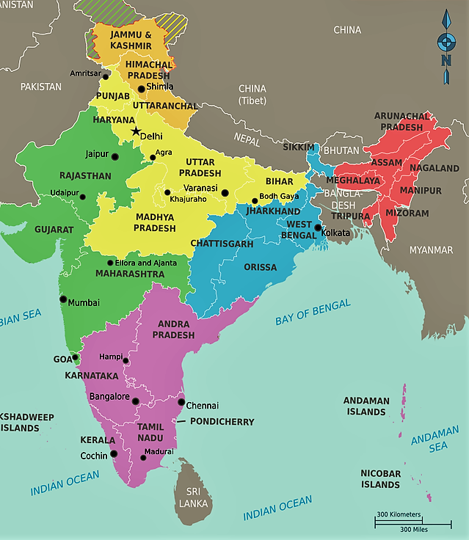
Kashmir (strong local identity; caste less significant)
Bihar (caste warfare/ no sense of local identity
Kerala (identity in total flux: The God of Small Things)

Slide 15
Questions of identity/categories: small things relate to big things
Two egg twins – problem of self and other
Christian or Hindu or Communist
The question of caste: what is it? How can you have a Paravan Marxist, or a Brahman Christian;
What is it to be middle class Indian watching The Sound of Music and dressing like Elvis
What is it to be Indian in Britain (Chacko) – both love and hate
The police work to establish and sustain boundaries (including the love laws)
Influence shifts from British to American (gardening to TV quiz shows: controlling land to controlling media)
History house moves from a site of oriental ‘going native’ (ref Heart of Darkness); to a site of punishment for crossing caste boundaries;
Other problems of categorisation (banana jam; Pappachi’s moth)
The figure of the Kathakali dancer – the enacter of sacred performances dramatizing cosmic struggles - reduced
  To an exotic image to guarantee authenticity in the brand identity of Paradise pickles
  from 6 hour epic performances to 20 minute entertainments for tourists with limited attention spans

Slide 16
Which history? which story?
In a purely practical sense it would probably be correct to say that it all began when Sophie Mol came to Aymenem. Perhaps it's true that things can change in a day. That a few dozen hours can affect the outcome of whole lifetimes. And that when they do, those few dozen hours like the salvaged remains of a burned house - the charred clock, the singed photograph, the scorched furniture - must be resurrected from the ruins and examined. Preserved. Accounted for.
Little events ordinary things, smashed and reconstituted. Imbued with new meaning. Suddenly they become the bleached bones of a story.
Still, to say that it all began when Sophie Mol came to Aymenem is only one way of looking at it.
Equally, it could be argued that it actually began thousands of years ago. Long before the Marxists came. Before the British took Malabar, before the Dutch Ascendancy, before Vasco da Gama arrived, before the Zamorin’s conquest of Calicut. Before three purple-robed Syrian Bishops murdered by the Portuguese were found floating in the sea, with coiled sea serpents riding on their chests and oysters knotted in their tangled beards. It could be argued that it began long before Christianity arrived in a boat UN seeped into Kerala like tea from a tea bag.
That it really began in the days when the Love Laws were made. The laws that lay down who should be loved, and how.
And how much. (pp.32-33)

Slide 17
[a] nostalgic vision of narrative commonality cannot be sustained in The God of Small Things. Indeed, Roy undermines a sense of celebratory nativism in the ‘‘Kochu Thomban’’ chapter by associating the mythical source of the kathakali with the ‘‘love laws’’ (delineated in texts such as the Manusmriti or The Laws of Manu) which proscribe Ammu’s affair with Velutha. As the night-long drama in the temple unfolds, Roy points up the routine oppressions of the play-world, indicating that, when Dushasana tries publicly to undress Draupadi, the Pandava’s wife, after she has been staked in a game of dice …The patriarchal violence which informs idealized figures such as Draupadi is registered again in the sudden jolting bathos at the close of the drama, when dawn arrives, and the kathakali men take off ‘‘their make-up’’ and go ‘‘home to beat their wives’’.
As Roy suggests early in the text, whilst extrapolating possible beginnings for the events in her narrative, the origins of kathakali ‘‘lovelaws’’ demand a longer sense of history than most post-colonial readings allow. Velutha’s death may be the result of an unexpected power-alliance between a local Marxist demagogue and Ayemenem’s Christian police chief, but it is also presaged in the social and religious structures which existed before early Christianity incorporated the Malabar coast into its own history: … in this history of successive encounter, Roy recognizes the deeply cosmopolitan, syncretized nature of South India’s past, yet also maintains the rhetorical importance of (always-already compromised) authentic cultural times and spaces, as locations from which ‘‘equally viable’’ modes of postcolonial self-fashioning can occur.
Alex Tickell,‘The God of Small Things: Arundhati Roy’s Postcolonial Cosmopolitanism’ Journal of Commonwealth Literature

Slide 18
The History house
They were a whole family of Anglophiles. Pointed in the wrong direction, trapped outside their own history and unable to retrace their steps because their footprints had been swept away. He explained that history was like an old house at night. With all the lamps lit. And ancestors whispering inside.
And when we look in through the windows, all we see are shadows. And when we try and listen, all we hear is a whispering. And we cannot understand the whispering, because our minds have been invaded by a war. A war that we have both won and lost. The very worst sort of war. A war that captures dreams and re-dreams them. A war that has made us adore our conquerors and despise ourselves.
Estha and Rahel had no doubt that the house Chacko meant was the house on the other side of the river…Kari Saipu’s house. The black Sahib. The Englishman who had “gone native.” Who spoke Malayalam and wore mundus. Ayemenem’s own Kurtz. Ayemenem his private Heart of Darkness”

Slide 19
The problem of speaking in the postcolonial text
The search of subaltern studies for hidden pasts calls up textual criticism, fragmentary testimonies, and lost moments “to restore the integrity of indigenous histories that appear naturally in non-linear, oral, symbolic, vernacular, and dramatic forms” (Ludden 2002, p. 20).
… the subaltern focus, which is to look for “a history in which the subaltern was the maker of his own destiny” brings into focus “the question of the relationship between texts and power” (Chakrabarty 2003, p. 198). Arundhati Roy’s novel, The God of Small Things, is a worthy example to examine the colonial discourse and Western style of thinking about and studying the subaltern, and how the colonizer and the colonized evolved within an unequal power relationship. In The God of Small Things, three groups of subaltern can be defined: Firstly, all of the inhabitants of Ayemenem—whether touchable or untouchable—are the subaltern since they are all victims of colonization. Though they have been liberated from the colonialism in the sense of land occupation, they are still culturally and linguistically colonized. Secondly, the Untouchables—Pelaya, Pulaya, Paravan— who are at the bottom of the caste system in India are subalterns. Though theoretically and legally, the caste system was abolished, in practice, it still dominates the social life ideologically. Lastly, the women, whether upper class or lower class, are one of the subaltern groups since they are the other of the phallocentric Other.
Şule Okuroğlu Özün* Ayşe Iren, ‘Subalternity In Arundhati Roy’s The God Of Small Things,’ DEU Journal of GSSS, Vol: 22, Issue: 2

Slide 20
‘Inglish’ in the god of small things
Roy’s first novel can be set in the wider tradition of what is often called Indo-Anglian writing, …. This tradition spread first after its establishment as the language of the Indian Civil Service and thus of the administration and maintenance of Empire. The rise of the Indian novel in English…is linked particularly to the generation of authors writing in the 1930s which included Raja Rao and R.K Narayan. Decades later, it would be followed by writers as various as V.S. Naipaul, Amitav Ghosh, Anita Desai, Salman Rushdie and Vikram Chandra among others. Today Indo-Anglian fiction is largely a transnational, diasporic phenomenon that reveals that India itself is a hybrid creation, a conglomeration of what was brought in from outside, absorbed and reworked. Taken to the level of language, hybridity must be understood, according to Mikhail Bakhtin, as “a mixture of two social languages within the limits of a single utterance, an encounter, within the arena of an utterance, between two different linguistic consciousness, separated from one another by an epoch, by social differentiation or by some other factor” (cited in Young 1995: 20). The use of language is in this way a crucial factor not only in determining identity and how speakers see themselves but also in creating thoughts and a concept of the world. Roy’s portrayal of Rahel and Estha’s use of Inglish throughout the novel reveals on the one hand the development of a hybrid conscience, and on the other, the author’s reappropriation of the imperial English to release it from the ideology and the political loadness of the old colonial discourse. As Homi Bhabha puts it, hybridity here is symbolized by “the moment in which the discourse of colonial authority loses its univocal grip on meaning and finds itself open to the trace of language of the other, enabling the critic to trace complex movements of disarming alterity of the colonial text” (1990: 22).
Agustín Reyes Torres ‘Roy’s Inglish in The God of Small Things:’,’Odisea, nº 12,, 2011, 195-204

Slide 21
Discussion: postcolonial literature
& history

Slide 22
‘I actually started writing with a single image in my head: the sky blue Plymouth [car] with two twins inside it, a Marxist procession surrounding it. . . . [The story] just developed from there’’. …this ‘‘single image’’ is divided across the second chapter of the novel, forming the centre-piece of a larger episode which recounts a family outing to Cochin in the southern Indian state of Kerala, during which Roy’s protagonists, middle-class Syrian Christians who run a failing pickle-factory, find their car surrounded by a trade-union demonstration at a rural level-crossing.
…. the scene offers itself very readily as a metaphor for some important literary-theoretical issues which inform contemporary South Asian writing – the family group confined in the foreign, socially contained space of the sky-blue Plymouth could be seen as a fitting analogy for the creative situation of the postcolonial author, as s/he relates the transcultural preoccupations of an anglicized, often elite Indian middle-class, and couches these within the appropriated form of the novel. Moreover, like many of the more commercially successful South Asian novels published in recent years, the vehicle in Roy’s work is conspicuously hybrid in its construction. On the Plymouth roof-rack, we are told, there is ‘‘a four-sided, tin-lined plywood billboard’’ advertising the family pickle business (Paradise Pickles & Preserves), complete with painted pickle-jars and a picture of a kathakali dancer to give the products, as Uncle Chacko states, a ‘‘Regional Flavour’’.
Alex Tickell,‘The God of Small Things: Arundhati Roy’s Postcolonial Cosmopolitanism’

Slide 23
The history of time: linear or cyclical, fragmentary or continuous, solar or lunar
Ever since human beings have existed, we’ve measured time by observing the natural world: the flux of seasons, the dance of heavenly bodies across the sky. More than 30,000 years ago, men and women in what’s now central Europe tracked the moon and stars by carving notches into mammoth tusks. From Stonehenge to the ancient Chinese observatory at Shanxi, many Neolithic structures were originally built to mark the midwinter solstice and celebrate the start of a new year. Some 4,000 years ago, it was the summer flooding of the Nile that signaled to ancient Egyptians that another year had passed. …
Yet time isn’t as natural or as objective as it seems. Indeed, our sense of time has everything to do with how we relate to one another and understand our place in the universe. Judeo-Christian societies learned to perceive historical time as linear and unidirectional because of a particular story they told themselves about the fate of humankind. The Inca and the Mayans drew different cosmologies from different tales, cyclical and continuous. Time, in other words, has always been a product of the human imagination—and a source of tremendous political power. Julius Caesar knew this when he reshuffled the Roman calendar in 46 B.C.E. to insulate it from the priesthood. Joseph Stalin thought the weekend was a bourgeois luxury; he abolished it in 1929 in a bid to transform ordinary Russians into good Communists.
Ian P. Beacock ‘A Brief History of (Modern) Time: Our global system of timekeeping didn’t just emerge—it had to be imposed.’ Atlantic, 22 December, 2015

Slide 24
…Ogle frames time reform chiefly as a story about globalization. Built impressively on archival research conducted in eight countries and multiple languages, her book reveals that worldwide integration has always been uneven and contested. She reminds us that transnational networks and flows are never neutral and that globalization is an ideological process. Like Sven Beckert’s sensational Empire of Cotton, Ogle’s formidable work contributes to a new history of political economy which takes seriously the ideas, values, and acts of violence behind the emergence of global capitalism.
….
What we learn from Ogle’s genealogy of time zones is that technology changes the world not by its own Promethean logic but rather according to ours. Telegraphs and steamships and railways generated the future they did only because they were harnessed to a particular political vision: a liberal world order under European auspices. High-minded concepts like uniformity, efficiency, and progress were as ideological as they were scientific. Taking Western superiority for granted, they reflected European convictions about human reason and the remaking of the world.
Time reform was modernity defined in Western terms, developed to suit the interests and assumptions of the world’s wealthiest and most powerful citizens. Synchronization made it easier for European elites to project their influence and sell their goods. … In Natal, for instance, indigenous populations lost the right to mark time for themselves after missionaries deemed Zulu calendars wasteful and backwards. …Opponents of time reform were astute enough to recognize that the future they were being straitjacketed into was neither necessary nor equal nor democratic. It was designed to benefit some more than others.

Slide 25
From colonial to neocolonial: big things rendered small
Recently , after enduring more than half a century of relentless, pernickity attention, the ornamental garden had been abandoned. Left to its own devices, it had grown knotted and wild, like a circus whose animals had forgotten their tricks. ...
The reason for this sudden , unceremonious dumping was a new love. Baby Kochamma had installed a dish antenna on the roof of the Ayemenem house. She presided over the World in her drawing room on satellite TV. The impossible excitement that this engendered in Baby Kochamma wasn't hard to understand. It wasn't something that happened gradually. It happened overnight. Blondes, wars, famines, football, sex, music, coup d’état - they all arrived on the same train. They unpacked together. They stayed at the same hotel . And in Ayemenem, where once the loudest sound had been a musical bus horn, now whole wars, famines, picturesque massacres and Bill Clinton could be summoned up like servants (p.27)

Slide 26
toy history for tourists: History and Literature enlisted by commerce
The house had been renovated and painted . It had become the centerpiece of an elaborate complex, crisscrossed with artificial canals and connecting bridges. . . . The old colonial bungalow with its deep verandah and Doric columns, was surrounded by smaller, older, wooden houses - ancestral homes - that the hotel chain had bought from old families and transplanted in the Heart of Darkness. Toy Histories for rich tourists to play in. ... "Heritage," the hotel was called.
. . . The furniture and knick-knacks that came with the house were on display. A reed umbrella, a wicker couch. A wooden dowry box. They were labeled with edifying placards that said Traditional Kerala Umbrella and Traditional Bridal Dowry-box.
So there it was then, History and Literature enlisted by commerce.
(p. 120)

Slide 27
Frozen time: history amputated by commercial colonization
This new commercial "Heritage" cuts culture and history into truncated forms to be packaged and sold as bits of "authentic" culture. The History House even offers its guests, for "Regional Flavor," drastically shortened performances by kathakali danc- ers, "so ancient stories were collapsed and amputated. Six-hour classics were slashed to twenty-minute cameos" (121). The new resort unsettles and indeed traumatizes history (stories are "amputated"), forming a perverse temporal hybridity, where various times, and indeed various traditions, are pushed together and abbreviated. It is a commercial colonization, built alongside - and intertwined with - a political one. […] the new History House also literally covers over and erases the twin's personal history, as it is outside its doors where they witnessed the beating of Velutha. Buried in the ground remains, however, Rahel's plastic wristwatch, where time is frozen at ten to two, reflecting the still present trauma that lies beneath. Time here is pictured almost as disrupted archaeological layers, the "Toy Histories" in the hotel piled on top of the individual and collective traumas represented by Rahel's watch and the hotel’s very location.
  Elizabeth Outka, ‘Trauma and Temporal Hybridity in Arundhati Roy's "The God Of Small Things“’ Contemporary Literature , Spring 2011, Vol. 52, No. 1: 21-53

Slide 28
Writing histories of ambivalence
The link to Conrad in the history house is also part of a larger set of references to British and American authors and movies , all of which serve simultaneously to highlight Roy's own articulation of the Indian voices left outside of these cultural texts and to emphasise how damaging this exclusion remains, especially for the Twins. Chacko, Rahel, and Estha frequently use British and American texts to narrate or to form their lives: Chacko quotes The Great Gatsby, Estha cites A Tale of Two Cities, the twins know both The Jungle Book and parts of The Tempest by heart, and the whole family is captivated by The Sound of Music. All of these texts reflect a cultural and a temporal past that haunts and indeed disrupts the present moment for the characters, at the same time that they reflect Roy's own rewriting of these past texts. The Sound of Music in particular disturbs Estha, as it is during the movie when he is molested by the Orangedrink Lemondrink Man; his feelings of shame from the sexual trauma blend with his larger sense that as an Indian child, he lies outside of what he views as the "clean white children" from the movie
Elizabeth Outka, ‘Trauma and Temporal Hybridity’

Slide 29
history: the caste system ancient and immutable or reframed for administrative purposes?
2 arguments: caste defined pre and colonial rule
Until the 18th Century, the formal distinctions of caste were of limited importance to Indians, social identities were much more flexible and people could move easily from one caste to another.
Prof. Mridu Rai argues that Caste makes no sense outside of locality
British changed the arena by making it an identity recorded in successive censuses where identity had to be defined to engage with state /colonial administative systems that fixed caste and a rigid and inherited social feature
This simplified the system, enabling the creation of a single society that could be easily governed with a common law
By the late 19th the relation of caste and locality was broken. Earlier versions of caste relations always involved reciprocity; what happened was an extreme fragmentation of communities
Northern India a particular case in point: Bihar has no clear regional identity and is wracked by caste violence all attempts to create a regional identity founder on the problem of caste. In fact it is a system of caste warfare and the upper caste have private armies that terrorise the local populations.
In Kashmir, by contrast, regional identity overcomes religion and caste

Slide 30
history’s henchmen. Sent to square the books and collect the dues from those who broke its laws
They heard the thud of wood on flesh. Boot on bone. On teeth. The muffled grunt when a stomach is kicked in The muted crunch of skull on cement. The gurgle of blood on a man's breath when his lung is torn by the jagged end of a broken rib.
Blue-lipped and dinner-plate-eyed, they watched, mesmerized by something that they sensed but didn't understand: the absence of caprice in what the policemen did. The abyss where anger should have been. The sober, steady brutality, the economy of it all.
They were opening a bottle.
Or shutting a tap.
Cracking an egg to make an omelette.
The twins were too young to know that these were only history’s henchmen. Sent to square the books and collect the dues from those who broke its laws. Impelled by feelings that were primal yet paradoxically wholly impersonal. Feelings of contempt born of inchoate, unacknowledged fear — civilization’s fear of nature, men’s fear of women, power’s fear of powerlessness.

Slide 31
human history masquerading as God’s Purpose,
What Esthappen and Rahel witnessed that morning, though they didn’t know it then, was a clinical demonstration in controlled conditions (this was not war after all, or genocide) of human nature’s pursuit of ascendancy. Structure. Order Complete monopoly. It was human history, masquerading as God’s Purpose, revealing herself to an under-age audience.
There was nothing accidental about what happened that morning. Nothing incidental. It was no stray mugging or personal settling of scores. This was an era imprinting itself on those who lived in it.
History in live performance.

Slide 32
Final discussion

