Slide 1
The writing process: planning for criticality
critical reading and self-critical writing

Slide 2
A structured approach to developing criticality
Underpinned by two main ideas:
As a critical reader, one evaluates the attempts of others to communicate with and convince their target audience by means of developing a sufficiently strong argument
As a self-critical writer, one develops one’s own argument, making it as strong and as clear as possible, so as to communicate with and convince one’s target audience.
Wallace & Wray (2011)

Slide 3

Are you a critical reader?
Read the advert on the next slide and think about how you would respond to it.
What critical questions might you ask about the text? Why?
You have 10 mins for this task in your breakout rooms.
We will discuss this as a group after.

Slide 4

WHY DO IT THE HARD WAY when you can be RICH NOW!!!
It took me five years to make my first million. I made my second million in six weeks. Now I just can’t stop making money. I own four luxury villas on three continents, five top-of-the-range sports cars and my own helicopter. Most important of all, the financial security of my family is ensured.
Now I want to share my good fortune with you. By following my simple instructions, you too can be a millionaire within just a few months. There is no risk, and it just can’t fail. I have already helped hundreds of people attain their dream of a new life. They are so grateful to me – no longer do they worry about domestic bills, healthcare or their children’s education. Their future is certain. And yours can be too.
Just call me on the number below, and I will send you my introductory pack free of charge. It will explain to you how my failsafe method can bring you guaranteed wealth and happiness. Call now, and let your life change forever for the better!
+44 011 123 456 789
Adapted from: Wallace & Wray (2011)

Slide 5
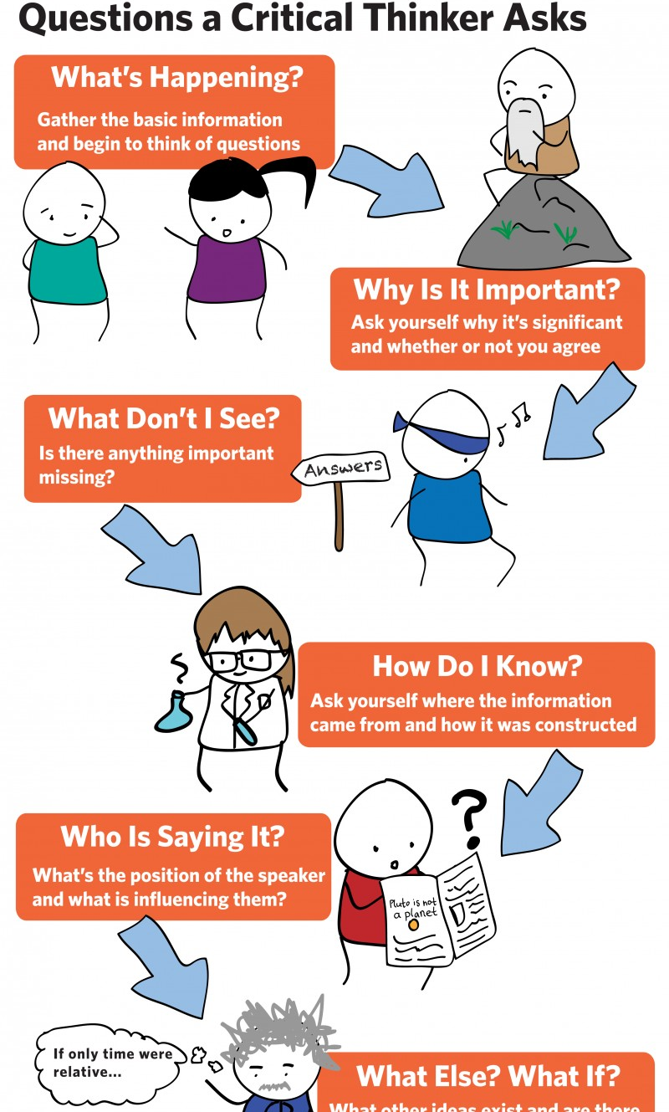
Possible questions to ask
Are you as rich as you claim?
Why do you want to help people you have never met?
Is your method legal and ethical?
Is there really no risk?
Would I just end up making you richer, at my own expense?
If your method is so wonderful, why have I never heard of it before?
What will you do with my personal details once I give them to you?
How much will the phone call cost?’
These are all critical questions.

Slide 6

Being critical in academic enquiry
Adopt a critical frame of mind and friendly scepticism towards what authors say.
Reasonable scepticism means being open-minded and willing to be convinced, but only if authors can adequately back their claims.
It entails striking a balance between what one expects and what one accepts.
To practise, consider the extract from a study on the next slide.
What critical questions might you ask?
The account refers to a study where some children were taught to read using the phonics method (sounding out words on the basis of the component letters) and others were taught using the whole word method (learning to recognise and pronounce complete words).
The account has been taken from and adapted for our purposes from Wallace & Wray (2011).

Slide 7
Reading Critically: browning (2005)
In the reading test, the five children who were taught to read using phonics performed better overall than the five children taught using the whole word method. This shows that the phonics method is a better choice for schools.
Adapted from: Wallace & Wray (2011)

Slide 8
Your questions might include:
Is a study of just ten children sufficient to draw such a strong conclusion?
What does ‘performed better overall’ signify? Did some children taught using the whole word method perform better than some children taught using phonics?
If so, what does this mean for the results?
Were the differences between the two groups sufficiently great for us to be satisfied that they would occur in a re-run of the experiment with different subjects?
How were the two teaching programmes administered, and might there have been ‘leakage’ of whole word teaching into the phonics teaching and vice versa?
What was the reading test actually testing, and might it have been unintentionally biased to favour the children taught using phonics?
What care was taken to check how parental involvement at home might have influenced what and how the children learned?
Were the two sets of five children matched for intelligence, age, gender or other factors?
Is it reasonable to infer that what works well in a small experimental study will work well in school environments?
How does Browning envisage phonics being used in schools? Would there still be a place for the whole word method?

Slide 9
Now put these observations in writing
Write a paragraph critiquing Browning's study. You have 5 mins for this task.
In your breakout rooms, share and discuss your paragraphs for 5 mins.
Choose a group speaker who will present your ideas.
Browning (2005: 89) found that children taught to read using phonics did better in a reading test than children taught using the whole word method. However, the study was small, the test rather limited, and the subjects were not tightly matched either for age or gender. An examination of Browning’s test scores reveals that, although the mean score of the phonics group was higher, two of the highest scorers in the test were whole word learners. Since this indicates that the whole word method is effective for some learners at least, Browning is perhaps too quick to propose that “the phonics method is a better choice for schools”.

Slide 10
Benefits of critical reading for self-critical writing
Your critical reading of others’ work will usually be in preparation for producing your own written text.
One person’s writing is another person’s reading.
First, you will develop a sense of what is and is not a robust piece of research – essential when you come to plan your own empirical investigation (for your thesis).
Second, you will identify where the existing research has left a gap that your investigation can fill.
Third, the attention you pay to different authors’ texts will naturally affect the quality of your own writing.

Slide 11

Are you ready?
Access the MS Word document on Teams (Session 7 folder) and spend 5 mins thinking about the elements of critical reading and writing you already use and complete the table – tick as appropriate.
Look back at any items that you have not ticked.
Consider how you might incorporate these elements of critical reading and self-critical writing into your usual approach to study.
Discuss your ideas in your breakout rooms for 10 mins.

Slide 12

Five Critical Synopsis Questions
1. Why am I reading this?
2. What are the authors trying to do in writing this?
3. What are the authors saying that is relevant to what I want to find out?
4. How convincing is what the authors are saying?
5. In conclusion, what use can I make of this?

Slide 13
STRUCTURE FOR A CRITICAL SUMMARY OF AN ARTICLE OR CHAPTER REPORTING RESEARCH (500 WORDS)
Full bibliographical details (title, authors, year, etc.)
Introducing the text (50–100 words) (Critical Synopsis Question: A Why am I reading this?)
Reporting the content (100–200 words) (Critical Synopsis Questions: B What are the authors trying to do in writing this? and C What are the authors saying that’s relevant to what I want to find out?)
Evaluating the content (100–200 words) (Critical Synopsis Question: D How convincing is what the authors are saying?)
Drawing your conclusion (100–150 words) (Critical Synopsis Question: E In conclusion, what use can I make of this?)

Slide 14
Structuring an account to develop a convincing argument
The basic structure for a Critical Summary is flexible, but there are limits.
Your target readers need to know what the text is about before reading your critical assessment.
They also need to know how the Critical Summary contributes to what you are trying to achieve in your account, and they must be able to see that your conclusion is well backed by adequate warranting.
The combination of these components is necessary for rendering a Critical Summary convincing to critical readers.
You can also use the Critical Summary to compare two articles.

Slide 15
Making progress as a critical reader and self-critical writer
You can enhance your own learning by noticing good and bad practice in what you read and understanding how to model your own writing on what you find most effective in the writing of others.
You can organise your approach to critical reading and writing for postgraduate study by knowing how to choose what texts to read, identifying your purpose in reading them and making succinct, orderly notes (possibly using critiquing tools) that can be drawn upon for writing your critical account of the literature.
You can easily compare across texts, knowing that your approach to reading has highlighted the key points that you need for an effective comparison.
Your expectation of finding adequate warranting for every conclusion in what you read will transfer into your own writing, so that you expect of yourself, as a self-critical writer, a justification for any claim you make.
As a result, you will be equipped to present your assessors with what they are looking for: robust arguments that reflect how your own interpretation of a range of evidence leads you to a well-warranted conclusion.

Slide 16
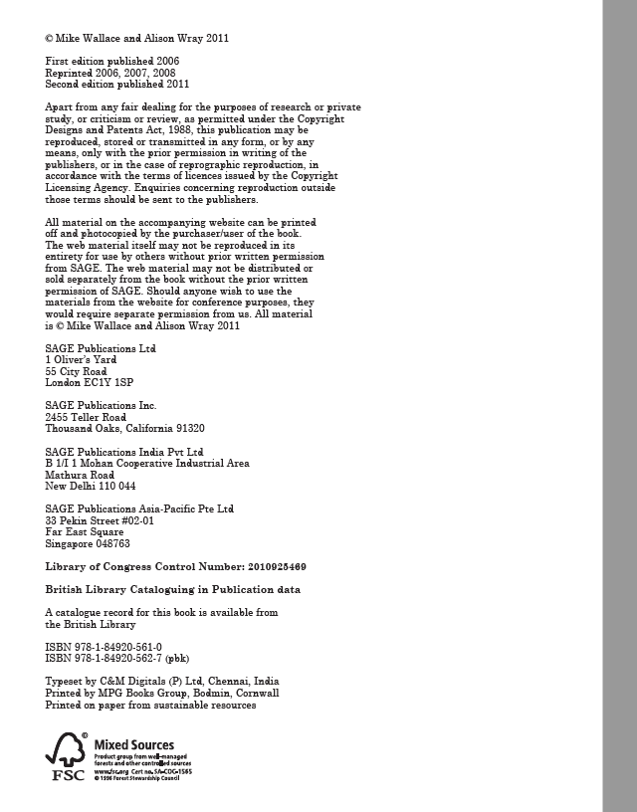
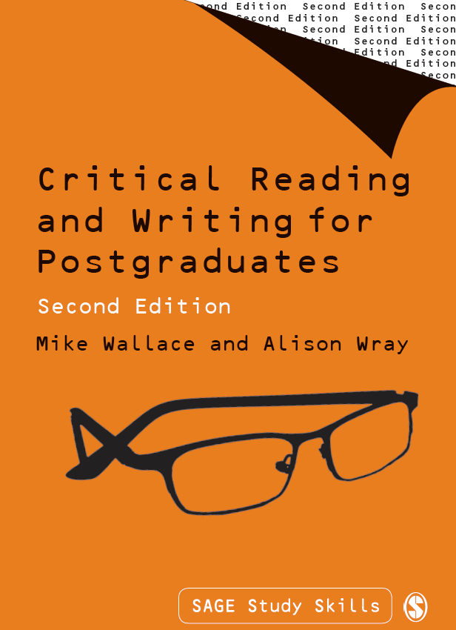
Today materials are sourced from Wallace and Wray (2011)

