Slide 1
DEBATE PRESENTED BY:
ANTHONIA AKPAN: 2026998
SOCORRO ALAM : 2029042
MODULE : Living with Care: The Older Person
MODULE CODE : BMHP6009
LECTURER : Joanne Davies
ASSIGNMENT TITTLE: Component 1 - Debate

Slide 2


INTRODUCTION
END OF LIFE, EUTHANASIA AND ASSISTED SUICIDE

Slide 3
DEFINITION OF EUTHANASIA AND ASSISTED SUICIDE
Euthanasia is an act of intentionally ending a person's life to relieve their suffering.
It derive from greek "EU" meaning Good and "thanatos" means death. ( Annadurai,K. Et.al. 2014).
Assisted Suicide is the act of helping a person end their own life and is done by consent of individual's who wishes to die.
Euthanasia is the process of deliberately ending one's life to lighten the person's pain or agony
This can be achieved through a poisonous or deadly injection conducted by a doctor ( Brody, 1993 ).

Slide 4
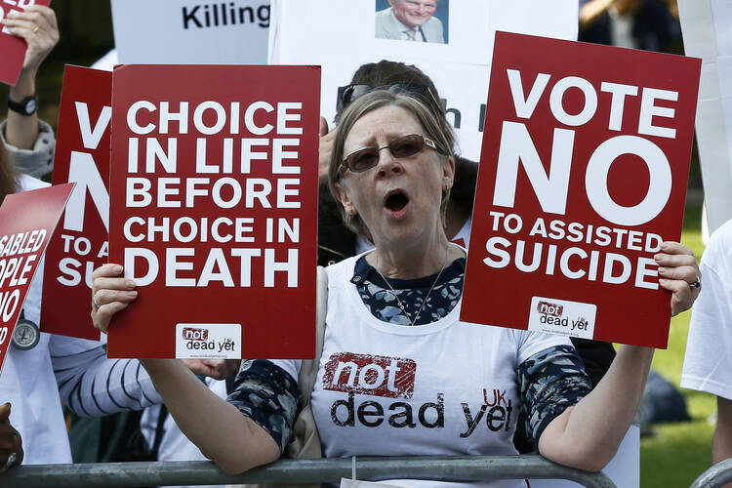
LAW GOVERNING EUTHANASIA AND ASSISTED SUICIDE IN THE UK AS COMPARE WITH OTHER COUNTRIES:
It is an offence in the UK under the 1961 suicide Act and the coroners and Justice Act 2009.
It is seen as manslaughter, and lead to life
Imprisonment ( Burkhardt,et al.2006).
However, there were ongoing debates on this issues for the need to reassess the law.
Law’s & regulations are subjected to change in refer to other countries who legalised Euthanasia & Assisted suicide. (BBC News.2021).
Notes:
Assisted dying laws differ in many countries. Some countries permitting Euthanasia and assisted suicide under specific guidelines. Countries permitting are as follows: Netherlands, Belgium, Switzerland,Canada, and some parts of the United States. ( BBC News. 2021).

Slide 5

END OF LIFE AND PALLIATIVE CARE AS WELL AS HOW AND WHEN THIS IS DELIVERED
New Brunswick, N.J. – August 1, 2018
Hospital
Hospice
Care Homes
At Home
Notes:
HOSPITAL: Offers specialized Palliative care teams that work with other medical professionals & provide comprehensive care. ( Center to advance palliative care. 2019).
HOSPICE CARE: Is widely recognize for end-of-lie & Palliative care. Hospice care teams consist of Healthcare professional, such as Doctors, Nurses, Social worker, Chaplain & volunteers, to meet the physical ,emotional & spiritual needs of patients and families. ( National Hospice & Palliative care Organization. 2021).
HOME BASE CARE: It provides palliative care in their own familiar surounding. A home visit by healthcare professionals to manage pains, symptoms, emotional and social needs.( Kehl. 2016).

Slide 6

THE GAP BETWEEN NEED AND AVAILABILITY OF END-OF- LIFE CARE
Resources Limitation
Funding Issues
Geographical Disparities
Lack of public Awareness and Understanding
Eligibility to Health Care
Notes:
To address the gap between need & availability of end-of-life care a strategy must be implemented. ( World Health Organization. 2007).
Increase in fundings
Educational Awareness
Integration & Healthcare systems
Collaboration & Partnership.

Slide 7
LEGISLATION, POLICY AND THEORIES OF AGEING, WHICH ARE RELEVANT TO OLDER PEOLE APPROACHING THE END OF LIVES
Patient self-determination Act (1990)
National Hospice & Palliative Care Organization (NHPCO). (2010)
“Aging process is influence by biological, Psychological, and Social factors”, Dr. George Engel (1977).
The Care Act ( 2014)
The Equality Act (2010)
The HR Act

Slide 8
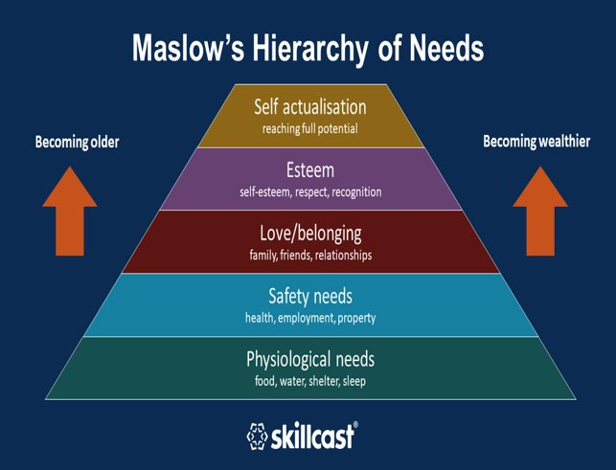
The Activity Theory: ( Havighurst,R.J. 1963).
OLDER ADULTS STRIVE TO REMAIN ACTIVE & ENGAGE.
SHOULD CONTINUE PARTICIPATING IN ACTIVITIES WHICH THEY ENJOY MOST.
HIGH LEVEL OF ACTIVITIES LEADS TO BETTER PHYSICAL & MENTAL HEALTH OUTCOMES.
Disengagement Theory:
Disabilities to interact
Loses interest to socialized
Hobbies

Slide 9

PLANNING FOR END OF LIFE
Patients make advance treatment decisions
Aids the clinicians provide care compatible with their care.
It involves communication ( Sudore, and Fried, 2010).
LIVING WILL:
DNR:

Slide 10

CONCLUSION AND RECOMMENDATION
Need for discussion in both academic fields and daily life.
Legally accepted.
It should be the last resort.
Respect and preserved at all cost.
Taking part in what is finally accepted and agreed.
Legislation and policies to promote healthy living
Proponents of legalization.
Advocate for improved Palliative care

Slide 11
REFERENCES
American Bar Association commission on Law & Aging. (no date). Advance care planning & healthcare directives & Living wills. https://www.amaercanbar.org/groups/law-aging resources/health_care_decision_making/healthcaredirectives/
American Heart Association. (2015). Do not attempt resuscitation (DNAR) orders. https://www.ahajournals.org./doi/10.1161/cir.0000000000000240
Annadurai,K., Danasekaran,R., & Mani,G. (2014)‘Euthanasia’: Right to die with dignity: Journal of the family medicine & primary care.
Asiamah, N.( 2017) Social Engagement and Physical Activity: Commentary on why the activity and disengagement theories of ageing may both be valid. Cogent Medicine, 4(1), p.1289664.
Baum, E.E.( 2009) Advance Care Planning: Beyond the Living Will. Cleveland Clinic journal of medicine, 76(5), p.277.
BBC News.(2021). Assisted dyingLaws around the world. Retrieved from https://www.bbc.com/news/world-33009579
Brody, H. (1993) Causing, Intending, and Assisting Death. The Journal of clinical ethics, 4(2), pp.112-117.Assessed at journals. Uchicago.edu.
Burkhardt, S. La Harpe, R. Harding, T.W. and Sobel, J.( 2006) Euthanasia and Assisted Suicide: Comparison of Legal Aspects in Switzerland and other Countries. Medicine, science and the law, 46(4), pp.287-294. Assessed at journals. Sagepub.co.
Center to Advance Palliative care. (2019). What is palliative care? Retrieved from https://www.capc.org/about/palliative-care/
Cherniack, E.( 2002 ) Increasing Use of DNR Orders in the Elderly Worldwide: Whose Choice is it?. Journal of medical ethics, 28(5), pp.303-307. Assessed at escholarship.org.
Dwerkin,R.(1993). Life’s dominion: An argument about abortion,Euthanasia and individual freedom. Vintage.
Engel,G.L.(1977) The need for new medical model. A challenge for biomedicine science, 196(4286), 129-136
Engel,G.L.(1977) The need for new medical model. A challenge for biomedicine science, 196(4286), 129-136
Fontalis, A., Prousali, E. and Kulkarni, K.(2018) Euthanasia and Assisted Dying: what is the current position and what are the key arguments informing the debate?. Journal of the Royal Society of Medicine, 111(11) 407. Assessed at journals. Sagepub.com.

Slide 12
REFERENCES
Fontalis, A., Prousali, E. and Kulkarni, K.(2018) Euthanasia and Assisted Dying: what is the current position and what are the key arguments informing the debate?. Journal of the Royal Society of Medicine, 111(11) 407. Assessed at journals. Sagepub.com.
Glendinning, C.(2003) Breaking down Barriers: Integrating Health and Care Services for Older People in England. Health policy, 65(2), pp.139 Assessed at sciencedirect.com.
Glendinning, C.(2003) Breaking down Barriers: Integrating Health and Care Services for Older People in England. Health policy, 65(2), pp.139 Assessed at sciencedirect.com.
Havighurst,R.J.(1963) Successful Aging. The Gerontologist, 3(1), 13-17
Hui,D., Mori,M., Watanabe,S.M., Caraceni,A., Strasser,F.,Saarro,T., & Glare,P.(2018) Referral criteria for outpatient speciality. Palliative cancer care: an International consensus. The Lancet oncology, 19(12), e659-e676
Kehl,K.(2016). Moving towards peace: An analysis of home- based Palliative Nursing, 18(4), 269-276
Lewis,M., Lichtenthal,W.E., Holland,J.C., & Breitbart,W.S.(2020). The gap between the need & availability of psychological support services for relatives of patients dying from cancer. Journal of pain & symptom management, 59(2), 217-222
Lockwood, G., Henderson, C. and Thornicroft, G.(2012) The Equality Act 2010 and Mental Health. The British Journal of Psychiatry, 200(3), pp.182-183. Assessed at cambridge.org.
Lync,S.(2013) Hospiced and Palliative Care access Issues in Rural areas. American journal of Hospice and Palliative Medicine. 30(2), pp172-177.
Mabry, J.B. and Bengtson,V.L.(2005) Disengagement theory. Encyclopedia of ageism, pp.11e3-117
Mathes,E.W.(1981) Maslow’s Hierachy of Needs as a guide for Living. Journal of HumanisticPsychology,21(4), pp.69-72.
National Hospice & Palliative Care Organization.(2010) NHPCO’s Standards of practice programs. Retrieve from https://www.nhpco.org/wp-content/uploading/nhpco-standards-book-web.pdf
National Hospice & Palliative Care Organization.(2021) Hospice FAQ’s. retrieved from https://www.nhpcd.org/patients-and -caregivers;/hospice-care-faqs/

Slide 13
REFERENCES
National Institute for Health and Care Excellence.(2019) End-of-life care for adults. https://www.nice.org.uk/guidance/ng 142
Sudore,R.L. and Fried,T.(2010) Redefining the “Planning” in Advance care Planning: Preparing for the End-of-lifeDecision Making. Annals of internal Medicine, 153(4),pp256-261.
U.S. Congress.(1990) Patient self-determination Act. Pub.L. no. 101-508,104 stat.1388
Ventegodt,S., Merrick,J. and Andersen,N.J. (2003) Quality of Life Theory 111 TheIQQl theory: An Integrated Theory of the GlobalQuality of life Concept.The scientific world journal,3,pp.1030-1040.
World Health Organization.(2014). Definition of Palliative Care. https://www. Who. Int/cancer/palliativde/definition/en/
World Health Organization.(2019) Strengthening Palliative Care throughout the life course. https://www.who.int/news-room/fact-sheets/detail/palliative-care.

