Slide 1
Critical factors that lead start-ups to succeed beyond three years

Slide 2
Introduction
In the present growing and competitive business world, a great idea alone is insufficient for a start-up to attain success.
To succeed in the current market saturated with various products and services, start-ups must stand out by utilising different strategies and tools.
This presentation discusses the critical factors that lead start-ups to succeed beyond three years.

Slide 3

Definition and characteristics of start-up
• The term "start-up" refers to any enterprise in its early stages of operation.
Common characteristics typically associated with start-ups.
• Innovation: A start-up is typically founded based on a new idea or innovation, a new product, service, or business model.
• Growth: Start-ups typically focus on rapid expansion to quickly expand their customer base and market share.
• Risk: Start-ups usually affiliated with risk often operate in new and untested markets and may not have a clear path to profitability (Barringer, 2019).

Slide 4

Importance of long-term success
• Around 20% of start-ups fail in their first year worldwide, and 50% do not survive during their first five years, according to Luisa Zhou's research in 2022.
Long-term success is vital for start-ups for many reasons, including:
• Financial stability is critical to investing in growth, paying employees, and surviving economic downturns.
• Employee satisfaction: provide employees with job security and a sense of future, increasing motivation.
• Customer loyalty: Customers are more likely to be loyal to successful start-ups for reliable products and services.
• Brand reputation: Strong brand reputation attracting customers and investors.

Slide 5

UK Market analysis and identification
• According to Beauhurst, in 2023, the UK is one of the top countries in the world for nurturing over 50 successful unicorn start-ups (reaching a valuation of $1 billion).
• Due to strong economic growth, government support, favourable regulations, a highly skilled workforce, and a robust tech ecosystem, the UK start-up market is expected to grow by 20% in 2023 and to be worth £100 billion by 2025.
• For example, Revolut, since 2018, has achieved long-run success by offering digital banking solutions where their valuation, as per current analysis, reached over 1.2 billion dollars.
Source: (O’Hear, 2018)

Slide 6

Unique value proposition
• Crafting a strong, unique value proposition UVP is an essential tool for any start-up; entrepreneurs must invest time and effort in developing it for enterprise success.
• According to Omniconvert (2023), a unique value proposition (UVP) is a statement that explains why a particular business or product is unique and why customers should choose you over your competitors.
• A Unique Value Proposition (UVP) should be concise, transparent, credible, differentiating, and benefit-driven. An effective UVP can attract customers, differentiate from competitors, boost sales, and build brand awareness.

Slide 7
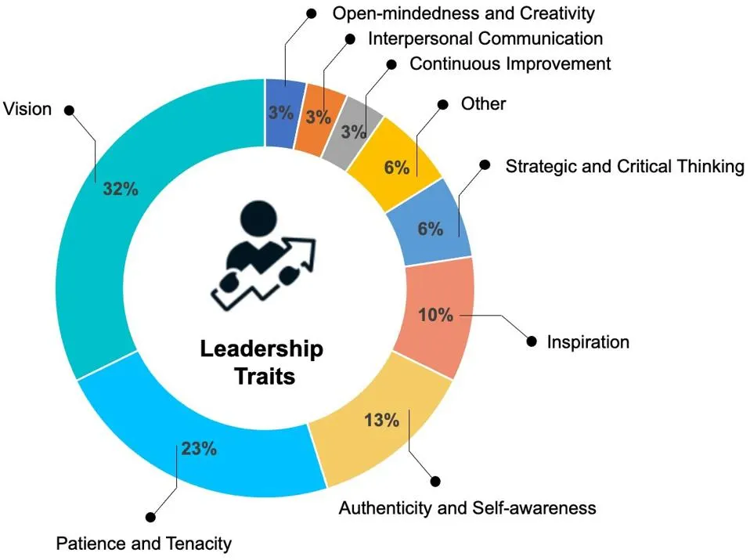
Strong leadership and team
• According to Harvard Business Review (2021), effective leadership is essential for business success in the fast-paced and rapidly changing world of start-ups.
• Every start-up needs efficient leaders who can set clear vision and strategy and communicate effectively with their team’s short-term and long-term vision.
• According to Forbes (2022), a survey was conducted among 30 CEOs of innovative start-ups at the World Economic Forum. The study identified as essential - the strong leadership traits, critical practices, and habits crucial in business's growth, where vision takes - 32%, patience and tenacity take - 23%, and authenticity and self-awareness - 13%.
Source :(Forbes 2022)

Slide 8

Partnering with established businesses
• One of the effective strategies for start-ups is to form partnerships or collaborate with established enterprises.
• Partnering with established enterprises can provide start-ups access to new customers, increase their brand awareness and credibility, share resources, and provide joint marketing and sales opportunities.

Slide 9
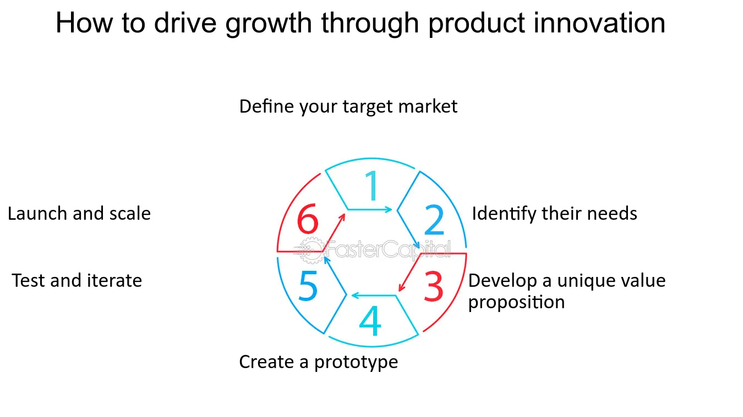
Financial planning and management
Effective financial management and planning are crucial for a start-up to succeed and remain operational.
For start-ups, effective cost management is essential.
Each start-up must set spending priorities, pinpoint areas for cost-cutting, and bargain with suppliers for advantageous terms.
As per Ecotech Solutions (2023), by developing a thorough budget and financial forecast, Ecotech Solutions, a start-up focused on eco-friendly products, can ensure long-term viability.
Source : (Fastercapital 2023)
Notes:
For keeping finances stable, every start-up must manage its cash flow. Accounts payable and receivable for EcoTech Solutions must be closely monitored. A healthy cash flow can be obtained by requesting longer payment terms from suppliers and receiving prompt payments from customers (Ecotech Solutions 2023). EcoTech Solutions can set itself up for three years of success and continuity by putting these strategies into practice.

Slide 10

Innovation and adaptability
Innovation and adaptability are essential for a start-up to succeed over three years.
As per URBACT (2023), a UK-based start-up called "TechRevolution" can guarantee long-term viability by encouraging a culture of constant innovation.
They should conduct market research to find new trends and customer needs so they can modify their goods and services accordingly.
They can react quickly to changes in the market by adopting an agile approach.
Source : (TechRevolution.com. 2022)
Notes:
Building scalable infrastructure, working with industry leaders, and placing a priority on customer-centricity is essential. Success is influenced by proactive risk management, hiring talent, lifelong learning, and data-driven decision-making. TechRevolution can set itself up for three years of long-term success by embracing innovation and adaptability.

Slide 11
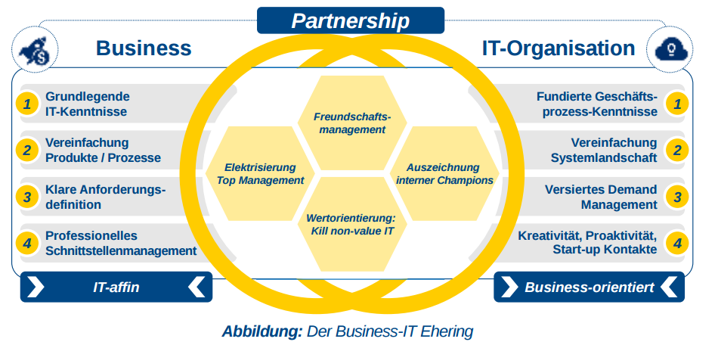
IT partnerships and collaborations
Over three years, IT alliances and partnerships can significantly boost the success of start-ups.
As an illustration, DataTech can deliver cutting-edge and scalable solutions to its clients by partnering with technology providers and accessing advanced tools, software, and infrastructure.
Source: (adlittle.com 2023)
Notes:
DataTech can join forces with well-known IT firms to benefit from their experience, resources, and customer base (Datatech 2023). By working together, we can expand our efforts to acquire customers and accelerate product development. Engaging with IT-specific start-up incubators and accelerators can offer DataTech mentorship, networking opportunities, and potential investments to support their growth and market penetration.

Slide 12
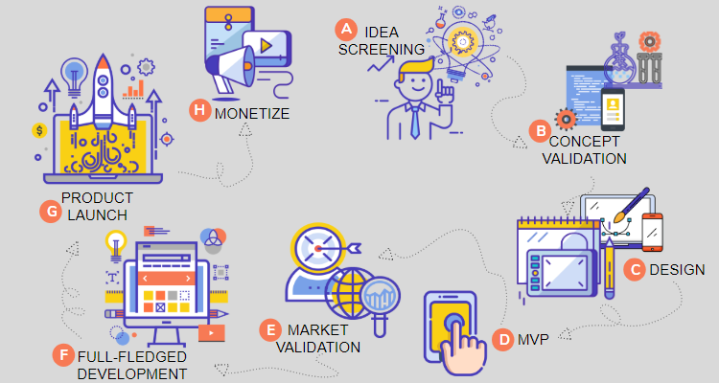
Product development and improvement
A start-up's growth and success depend on creating and improving its products.
Start-ups can iterate and improve their products continuously by adopting an agile methodology.
Ongoing analysis of competitor strategies and market trends helps start-ups stay ahead of the curve and modify their products to satisfy shifting consumer demands.
Source: (BinaryFolks 2023)
Notes:
To learn about customer needs, pain points, and new trends, startups must conduct extensive market research. Effective product development is built on the findings of this research. Startups can respond to user insights and improve their offerings by iteratively developing their products and soliciting frequent feedback. By putting these tactics into practice, startups can develop cutting-edge, customer-focused products and maintain market competition, which will ultimately fuel their growth and success.

Slide 13
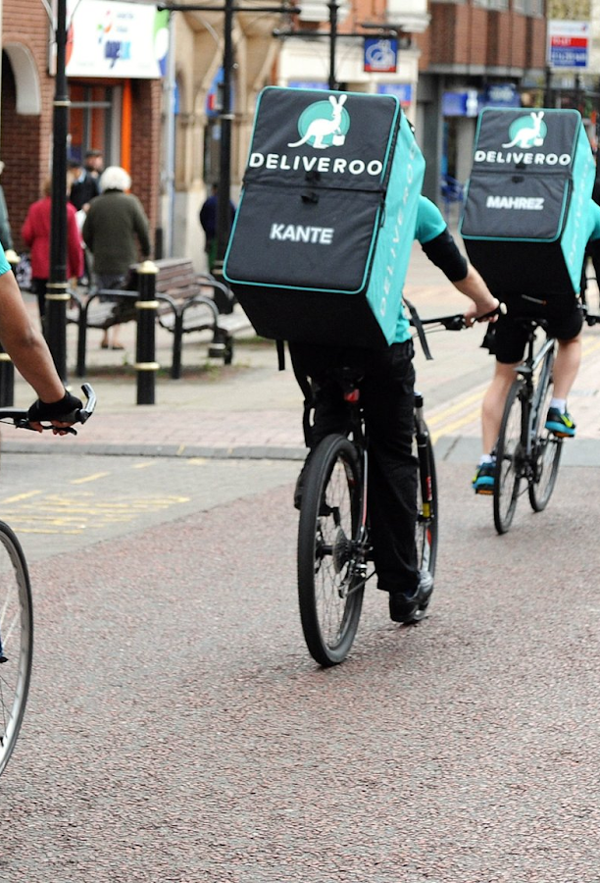
Effective marketing and branding
Effective marketing and branding are essential for start-ups to succeed over three years.
As per Business Insider (2018), Deliveroo, a start-up with roots in the UK and impressive success in the food delivery sector, is an example.
The marketing and branding strategies that Deliveroo uses to great success.
Source :(Inc42 Media 2018)
Notes:
Deliveroo has concentrated on developing a compelling brand identity that is connected with its target market and positioned itself as a dependable and practical food delivery service (Business Insider 2018). Deliveroo successfully reached its audience through targeted digital marketing campaigns, utilizing online advertising, social media, and search engine optimization to increase brand recognition and draw in customers.

Slide 14
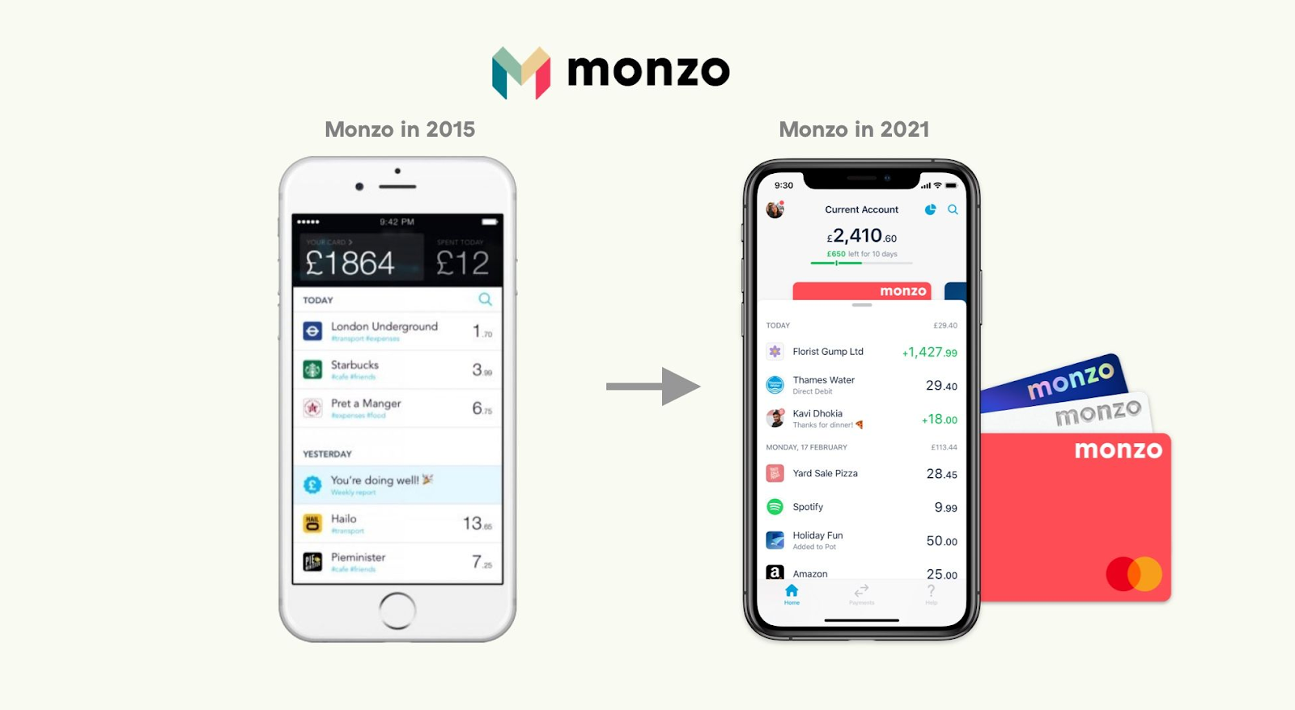
Legal consideration and regulatory compliance
Over three years, a start-up's success depends on legal considerations and regulatory compliance.
Regarding business registration, permits, and licenses, start-ups must abide by all applicable laws and regulations.
Monzo, a fintech start-up headquartered in the UK, is a good example.
As per FF News 2022), Focusing on legal compliance and regulatory requirements has been a critical factor in Monzo's success.
Source: (Y Combinator 2023)
Notes:
For Monzo to function as a digital bank, regulatory organizations like the Financial Conduct Authority (FCA) granted them the necessary licenses (FF News 2022). The General Data Protection Regulation (GDPR) compliance and implementation of strong security measures were top priorities for Monzo. By putting legal concerns and regulatory compliance first, Monzo was able to successfully navigate the complex regulatory environment, win over customers, and establish itself as a successful startup.

Slide 15

Consumer feedback and support
For a start-up to succeed over a three-year period, customer feedback and support are essential.
As an example of a business that has used customer feedback and support for success over three years, consider Depop, a UK-based start-up in the fashion resale industry.
As per Staite (2023), Depop actively promotes user feedback through various channels, such as in-app ratings, reviews, and social media interactions.
Source: (Staite, 2023)
Notes:
Depop has improved its platform continuously, added new features, and adjusted to changing user needs by appreciating and implementing customer feedback (Staite, 2023). Through this strategy, they have been able to build a devoted user base, increase user interaction, and enjoy three years of sustained success in the fashion resale market.

Slide 16

Continuous learning and adaption
For a start-up to succeed over a three-year period, constant learning and adaptation are essential.
The UK-based start-up in the healthcare technology industry Babylon Health is a good example.
Continuous learning and adaptation are highly valued at Babylon Health.
Source: (Victoria News 2023)
Notes:
Babylon has been discovered to be actively investing in research and development, keeping up with scientific and technological advances (Victoria News 2023). Babylon Health has experienced significant growth as a result of staying on the cutting edge of healthcare technology and customizing its solutions accordingly. This has solidified their position as a leading startup in the UK's healthcare industry.

Slide 17

Networking and industrial involvement
A start-up’s success over three years depends on networking and industrial involvement.
A prime example is the artificial intelligence start-up DeepMind, based in the UK.
Through partnerships with universities, business leaders, and other start-ups, DeepMind actively participates in networking and industry involvement.
Source: (Financial Times 2023)
Notes:
According to Financial Times (2023), DeepMind can form useful connections, have access to cutting-edge research, and acquire expertise through collaborations and conference participation for the desired level of success. As per Financial Times (2023), DeepMind has established itself as a leader in the field of artificial intelligence by developing a solid network and being actively involved in the industry. DeepMind has also increased its knowledge base, attracted strategic partnerships, and gained credibility.

Slide 18

Measuring Success and Overcoming Challenges
Over three years, start-up growth depends on measuring success and overcoming obstacles.
TransferWise, a fintech start-up headquartered in the UK, is a great example.
As per Rawson Rob (2023), Key performance indicators (KPIs) used by TransferWise to gauge success include transaction volume, user satisfaction, and customer acquisition.
They regularly analyse data to assess their progress and reach data-driven decisions.
Source: (RawsonRob 2023)
Notes:
For illustration, TransferWise has achieved remarkable growth and disrupted the financial sector by continuously tracking success metrics and adjusting to challenges, solidifying their position as a successful fintech startup in the UK and internationally.

Slide 19

Building strong organisational culture within the Start-up
For a start-up to grow a cohesive and motivated team, it is essential to establish a solid organisational culture.
Start-ups can achieve success over three years by fostering a sense of purpose and values among their team members.
The UK-based fintech start-up Revolut prioritises an innovative, open, and cooperative culture.
They promote creative thinking, idea sharing, and ownership of the work among staff members.
Notes:
Employee engagement, loyalty, and productivity are all fostered by an effective organizational culture. By encouraging a positive work environment, luring top talent, and supporting the startup's growth trajectory, it unites the team around shared values and goals.

Slide 20

Conclusion
In conclusion, many vital factors affect a start-up's success beyond the first three years.
These include market analysis and identification.
By comprehending and implementing these factors, start-ups can improve their chances of achieving sustainability and long-term success in the competitive business environment.

Slide 21

Conclusion
A start up summary business plan includes the description of your products and services, the structure of your business, your target market, marketing strategy, funding requirements, financial projections, and licensing requirements, among others. It serves as a roadmap for your business.

Slide 22
References
• Barringer. (2019). Entrepreneurship: successfully launching new ventures (Ireland, Ed.; Sixth edition, global edition., p. 1 online resource (617 pages) :). Pearson.
Omniconvert (2023) What is a UVP (unique value proposition)?, Omniconvert. Available at: https://www.omniconvert.com/what-is/uvp-unique-value-proposition/ (Accessed: 13 July 2023).
• Pereira, D. (2023) Scalable business models, Business Model Analyst. Available at: https://businessmodelanalyst.com/scalable-business-models/ (Accessed: 13 July 2023).
Notes:
Hosseini, E., Tajpour, M., Salamzadeh, A., Demiryurek, K. and Kawamorita, H., 2021. Resilience and knowledge-based firms performance: the mediating role of entrepreneurial thinking. Journal of Entrepreneurship and Business Resilience, 4(2), pp.7-29.https://jebr.fimek.edu.rs/index.php/jebr/article/view/19
Pearson, R.J., Costley, A.E., Phaal, R. and Nuttall, W.J., 2020. Technology Roadmapping for mission-led agile hardware development: a case study of a commercial fusion energy start-up. Technological Forecasting and Social Change, 158, p.120064.
Karitu, B., Wangondu, W. and Muathe, S., 2022. A theoretical route towards conceptualization of start-ups in emerging markets: A Kenyan perspective. International Journal of Research in Business and Social Science (2147-4478), 11(4), pp.448-457.
Luisa Zhou (2022) Startup Failure Statistics: What Percentage of Startups Fail? [2023], Luisa Zhou. Available at: https://www.luisazhou.com/blog/startup-failure-statistics/ (Accessed: 13 July 2023).
O’Hear, S. (2020) Caura, an app to take the hassle out of car ownership, launches from Echo co-founder Sai Lakshmi, TechCrunch. Available at: https://techcrunch.com/2020/09/22/caura/ (Accessed: 13 July 2023).
KARAARSLAN, M.H. and SOYLU, N., 2023. Risk Factors in Start-Ups: An Evaluation. Selçuk Üniversitesi Sosyal Bilimler Meslek Yüksekokulu Dergisi, 26(1), pp.241-258.
Beauhurst (2023) Unicorn companies: Britain’s $1B+ businesses: 2022, Beauhurst. Available at: https://www.beauhurst.com/research/unicorn-companies/ (Accessed: 13 July 2023).
O’Hear, S. (2018) Digital banking startup Revolut raises $250m at a valuation of $1.7b, TechCrunch. Available at: https://techcrunch.com/2018/04/25/revolunicorn/ (Accessed: 13 July 2023).
Caura (2023) Everything car. all in one place., Caura. Available at: https://caura.com/ (Accessed: 13 July 2023).
FourWeekMBA (2023) What is a scalable business model? scalable business model in Nutshell, FourWeekMBA. Available at: https://fourweekmba.com/scalable-business-model/#:~:text=Key%20takeaways%3A-,A%20scalable%20business%20model%20is%20one%20where%20the%20business%20can,and%20outsourcing%20tasks%20where%20necessary. (Accessed: 13 July 2023).
Anastasia (2023) Internal and external business model scalability, NEXEA. Available at: https://www.nexea.co/internal-and-external-business-model-scalability/ (Accessed: 13 July 2023).
Harvard Business Review (2021) An agile approach to change management, Harvard Business Review. Available at: https://hbr.org/2021/01/an-agile-approach-to-change-management (Accessed: 13 July 2023).
Harvard Business Review (2019) 5 ways to help your team be open to change, Harvard Business Review. Available at: https://hbr.org/2019/04/5-ways-to-help-your-team-be-open-to-change (Accessed: 13 July 2023).
Techhub (2023) Techhub, techhub. Available at: https://tech-hub.tech/ (Accessed: 13 July 2023).
Ecotech Solutions (2023) Ecotech Solutions - manufacturer of heat pump & Tray Dryer from Ahmedabad, https://www.ecotechheatpump.com/. Available at: https://www.ecotechheatpump.com/ (Accessed: 13 July 2023).
URBACT (2023) URBACT. Available at: https://urbact.eu/networks/tech-revolution (Accessed: 13 July 2023).
Datatech (2023) Data Centres, secure hosting & Telecoms, Datatech UK - Complete Solutions. Available at: https://www.datatechuk.com/ (Accessed: 13 July 2023).
Business Insider (2018) Deliveroo is having a rough start to its IPO. here’s how the food-delivery firm grew from being a hungry banker’s idea to a publicly listed company., Business Insider. Available at: https://www.businessinsider.com/deliveroo-history-and-timeline-2018-9 (Accessed: 13 July 2023).
FF News (2022) Monzo, Fintech Finance. Available at: https://ffnews.com/companies/monzo/ (Accessed: 13 July 2023).
Y Combinator (2023) Monzo makes money work for everyone, Y Combinator. Available at: https://www.ycombinator.com/blog/monzo-makes-money-work-for-everyone (Accessed: 13 July 2023).
Staite, T. (2023) How to start a successful Depop store in 2023..., Medium. Available at: https://medium.com/@tomstaite1/how-to-start-a-successful-depop-store-in-2023-d5c9222b7266 (Accessed: 13 July 2023).
Victoria News (2023) Thousands turn to virtual doctor clinic that is babylon health app, Victoria News. Available at: https://www.vicnews.com/news/thousands-turn-to-virtual-doctor-clinic-that-is-babylon-health-app/ (Accessed: 13 July 2023).
Financial Times (2023) Alphabet merges DeepMind and Google Brain Ai Research units, Subscribe to read | Financial Times. Available at: https://www.ft.com/content/db162a4e-4ff2-45b7-ad36-5db05ac57de4 (Accessed: 13 July 2023).
RawsonRob (2023) How to transfer money using WISE (formerly TransferWise), Time Doctor Blog. Available at: https://www.timedoctor.com/blog/transferring-money-transferwise/ (Accessed: 13 July 2023).
Inc42 Media (2018) UK based Food Delivery Giant Deliveroo to set up India operations, Inc42 Media. Available at: https://inc42.com/buzz/deliveroo-food-delivery-india/ (Accessed: 13 July 2023).
BinaryFolks (2023) A complete guide for startup product development, BinaryFolks. Available at: https://www.binaryfolks.com/blog/startup-product-development (Accessed: 13 July 2023).
adlittle.com (2023) Business-IT-partnership: It’s complicated: Arthur D. Little, Linking people, technology and strategy. Available at: https://www.adlittle.com/en/insights/viewpoints/business-it-partnership-it%E2%80%99s-complicated-0 (Accessed: 13 July 2023).
Fastercapital (2023) Drive Growth Through Product Innovation as a startup, Fastercapital.com. Available at: https://fastercapital.com/content/Drive-Growth-Through-Product-Innovation-as-a-Startup.html (Accessed: 13 July 2023).

Slide 23
References
World Economic Forum (2022). What Makes A Great Startup Leader? Forbes. [online] 7 Feb. Available at: https://www.forbes.com/sites/worldeconomicforum/2022/02/04/what-makes-a-great-startup-leader/?sh=675ec831422a [Accessed 7 Aug. 2023].
Zhou, L. (2022). The Percentage of Businesses That Fail (Statistics & Failure Rates). [online] Luisa Zhou. Available at: https://www.luisazhou.com/blog/businesses-that-fail/ [Accessed 7 Aug. 2023].
‌
Notes:
Hosseini, E., Tajpour, M., Salamzadeh, A., Demiryurek, K. and Kawamorita, H., 2021. Resilience and knowledge-based firms performance: the mediating role of entrepreneurial thinking. Journal of Entrepreneurship and Business Resilience, 4(2), pp.7-29.https://jebr.fimek.edu.rs/index.php/jebr/article/view/19
Pearson, R.J., Costley, A.E., Phaal, R. and Nuttall, W.J., 2020. Technology Roadmapping for mission-led agile hardware development: a case study of a commercial fusion energy start-up. Technological Forecasting and Social Change, 158, p.120064.
Karitu, B., Wangondu, W. and Muathe, S., 2022. A theoretical route towards conceptualization of start-ups in emerging markets: A Kenyan perspective. International Journal of Research in Business and Social Science (2147-4478), 11(4), pp.448-457.
Luisa Zhou (2022) Startup Failure Statistics: What Percentage of Startups Fail? [2023], Luisa Zhou. Available at: https://www.luisazhou.com/blog/startup-failure-statistics/ (Accessed: 13 July 2023).
O’Hear, S. (2020) Caura, an app to take the hassle out of car ownership, launches from Echo co-founder Sai Lakshmi, TechCrunch. Available at: https://techcrunch.com/2020/09/22/caura/ (Accessed: 13 July 2023).
KARAARSLAN, M.H. and SOYLU, N., 2023. Risk Factors in Start-Ups: An Evaluation. Selçuk Üniversitesi Sosyal Bilimler Meslek Yüksekokulu Dergisi, 26(1), pp.241-258.
Beauhurst (2023) Unicorn companies: Britain’s $1B+ businesses: 2022, Beauhurst. Available at: https://www.beauhurst.com/research/unicorn-companies/ (Accessed: 13 July 2023).
O’Hear, S. (2018) Digital banking startup Revolut raises $250m at a valuation of $1.7b, TechCrunch. Available at: https://techcrunch.com/2018/04/25/revolunicorn/ (Accessed: 13 July 2023).
Caura (2023) Everything car. all in one place., Caura. Available at: https://caura.com/ (Accessed: 13 July 2023).
FourWeekMBA (2023) What is a scalable business model? scalable business model in Nutshell, FourWeekMBA. Available at: https://fourweekmba.com/scalable-business-model/#:~:text=Key%20takeaways%3A-,A%20scalable%20business%20model%20is%20one%20where%20the%20business%20can,and%20outsourcing%20tasks%20where%20necessary. (Accessed: 13 July 2023).
Anastasia (2023) Internal and external business model scalability, NEXEA. Available at: https://www.nexea.co/internal-and-external-business-model-scalability/ (Accessed: 13 July 2023).
Harvard Business Review (2021) An agile approach to change management, Harvard Business Review. Available at: https://hbr.org/2021/01/an-agile-approach-to-change-management (Accessed: 13 July 2023).
Harvard Business Review (2019) 5 ways to help your team be open to change, Harvard Business Review. Available at: https://hbr.org/2019/04/5-ways-to-help-your-team-be-open-to-change (Accessed: 13 July 2023).
Techhub (2023) Techhub, techhub. Available at: https://tech-hub.tech/ (Accessed: 13 July 2023).
Ecotech Solutions (2023) Ecotech Solutions - manufacturer of heat pump & Tray Dryer from Ahmedabad, https://www.ecotechheatpump.com/. Available at: https://www.ecotechheatpump.com/ (Accessed: 13 July 2023).
URBACT (2023) URBACT. Available at: https://urbact.eu/networks/tech-revolution (Accessed: 13 July 2023).
Datatech (2023) Data Centres, secure hosting & Telecoms, Datatech UK - Complete Solutions. Available at: https://www.datatechuk.com/ (Accessed: 13 July 2023).
Business Insider (2018) Deliveroo is having a rough start to its IPO. here’s how the food-delivery firm grew from being a hungry banker’s idea to a publicly listed company., Business Insider. Available at: https://www.businessinsider.com/deliveroo-history-and-timeline-2018-9 (Accessed: 13 July 2023).
FF News (2022) Monzo, Fintech Finance. Available at: https://ffnews.com/companies/monzo/ (Accessed: 13 July 2023).
Y Combinator (2023) Monzo makes money work for everyone, Y Combinator. Available at: https://www.ycombinator.com/blog/monzo-makes-money-work-for-everyone (Accessed: 13 July 2023).
Staite, T. (2023) How to start a successful Depop store in 2023..., Medium. Available at: https://medium.com/@tomstaite1/how-to-start-a-successful-depop-store-in-2023-d5c9222b7266 (Accessed: 13 July 2023).
Victoria News (2023) Thousands turn to virtual doctor clinic that is babylon health app, Victoria News. Available at: https://www.vicnews.com/news/thousands-turn-to-virtual-doctor-clinic-that-is-babylon-health-app/ (Accessed: 13 July 2023).
Financial Times (2023) Alphabet merges DeepMind and Google Brain Ai Research units, Subscribe to read | Financial Times. Available at: https://www.ft.com/content/db162a4e-4ff2-45b7-ad36-5db05ac57de4 (Accessed: 13 July 2023).
RawsonRob (2023) How to transfer money using WISE (formerly TransferWise), Time Doctor Blog. Available at: https://www.timedoctor.com/blog/transferring-money-transferwise/ (Accessed: 13 July 2023).
Inc42 Media (2018) UK based Food Delivery Giant Deliveroo to set up India operations, Inc42 Media. Available at: https://inc42.com/buzz/deliveroo-food-delivery-india/ (Accessed: 13 July 2023).
BinaryFolks (2023) A complete guide for startup product development, BinaryFolks. Available at: https://www.binaryfolks.com/blog/startup-product-development (Accessed: 13 July 2023).
adlittle.com (2023) Business-IT-partnership: It’s complicated: Arthur D. Little, Linking people, technology and strategy. Available at: https://www.adlittle.com/en/insights/viewpoints/business-it-partnership-it%E2%80%99s-complicated-0 (Accessed: 13 July 2023).
Fastercapital (2023) Drive Growth Through Product Innovation as a startup, Fastercapital.com. Available at: https://fastercapital.com/content/Drive-Growth-Through-Product-Innovation-as-a-Startup.html (Accessed: 13 July 2023).

Slide 24


