Slide 1
Research methods
ACFA7004
Dr Kim Dearing

Slide 2

Week 3: Study skills
Policy analysis
Critical analysis skills
Critiquing academic text

Slide 3
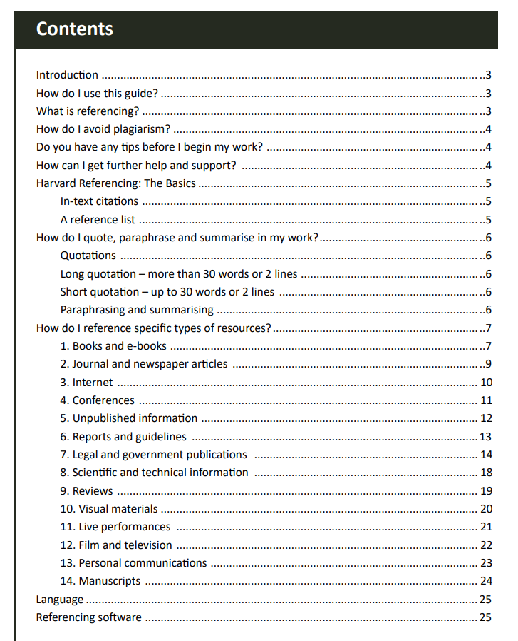

Check the referencing system expected in each Programme Handbook
https://www.uwtsd.ac.uk/library/student-essentials/referencing-handbooks/

Slide 4

Policy analysis
Dependent on what the need is:
As part of a literature review?
As part of a report?
As part of secondary data analysis in a research project?

Slide 5
Policy analysis: some considerations
Common methodologies of policy analysis:
Programme evaluation
Cost benefit and cost analysis
Needs assessment
Single subject or case studies
Surveys (research project)
Secondary data analysis
Outcome studies

Slide 6

As part of a research project:
Verify, define, and detail the problem
Objectives aren’t always clear
Locate the problem
Likely that if you are looking to conduct this for an assessment, then work in the area will already have been conducted
What have others said? What lens are they exploring through?

Slide 7
Establish a criteria:
Consider the cost and net benefit?
Economic benefit?
Effectiveness?
Efficiency?
Administrative ease?
Legal and political acceptability?
Has the policy caused harm or impacted on one group or particular groups of people more than others?

Slide 8

Identify alternative policies:
Logical order (complete the previous steps first)
In order to generate new alternatives, there needs to be a clear understanding of the problem and how it is/has been tackled
Consider the ‘do nothing’ approach
Combine alternatives?
Concept mapping

Slide 9
Evaluate alternatives
How would the alternative/s match up with the criteria established?
Include additional data? (dependent on the nature of the analysis)
Consider the levels of influence (economic, political, social dimensions)
Modify and recycle?
Several alternatives more efficient and effective than a single detailed one? All using one approach?

Slide 10
Display and distinguish between alternatives:
Numerical? Don’t speak for themselves but helpful in reaching for a solution
Comparison? Summarising and distinguishing between options
Qualitative methods or qualitative analysis?
Explore the economic, politic, legal and administration ramifications of each – this is a major factor in decision making and appropriate choices

Slide 11
Monitoring and implementation policy
How will you know if an alternative will have impact?
How can this be measured?
Criteria for continue, modify or stop?

Slide 12
Introduction to policy analysis:
Professor Leckrone (US) – useful is this may form a significant part of your research project:
https://www.youtube.com/watch?v=MjAH7YqKOSI

Slide 13
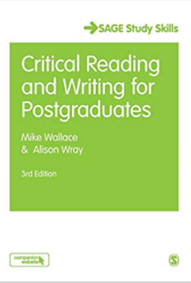
Critiquing academic text and developing critical analysis skills
Wallace, M. and Wray, A. (2016) Critical Reading and Writing for Postgraduates. 3rd edition. London: Sage.

Slide 14
Critical analysis skills:
What does it mean to be critical?

Slide 15
Thoughts?
“Let me share my good fortune with you… I am a multi millionaire and I can’t stop making money…. Can I share my good fortune with you? In six short weeks, you too, could have a luxury villa and your own helicopter… there is no risk and this will not fail… call me on the number below for a free introductory trial pack that will explain how you can have wealth guaranteed….change your life for the better”.
Will you call?
Notes:
Are you as rich as you claim? Why would you help? Legal? Ethical? Make you richer at my expense? How much will it call to cost? – all critical questions – hidden agenda? More to it than what is presented? Being tricked?

Slide 16
Academic enquiry
- key skills
Capacity to evaluate what you read
Capacity to relate what you read to other information

Slide 17

Unpacking critical thinking
What is knowledge?
Notes:
A set of facts? Taken at face value?

Slide 18
Knowledge
Facts?
Or, to gain knowledge is only partly about facts, it is also then about the interpretation of these facts, to then potentially make predictions about future facts?
Opinion
Hypothesis
Argument
Evidence
Notes:
Diversity of facts and interpretation – assessing the facts – sufficient evidence?

Slide 19

Critical reading – reflections:
What evidence is provided
Is the authors reasoning logical?
Can this be cross-referenced with other author claims?
Can this be cross-referenced with the readers own claims, evidence or knowledge?

Slide 20

Critical choices:
How do you decide what to read?
How do you go from a long list to a short one?
Notes:
Recommended reading list? Internet search? Library search? Particular journals? Abstract database?
Textbooks are a useful place to begin, but limited to an overview about research without seeing the original research.
Internet can be hit and miss

Slide 21
Tip: vary your reading strategy:
Scanning – looking for keywords, specific sections
1
Skimming – quick reading for a content overview
2
Intensive reading – from beginning to end
3

Slide 22

Abstracts
Abstract summarises the paper
Offers an idea of the topic
The approach
The claims made
Hidden value – it is short
Use the abstract as a resource

Slide 23
Template for critical synopsis:
Why am I reading this?
What are the author/s trying to achieve?
What is being claimed that is relevant to my work?
Are the claims convincing?
What use can I make of it?
Notes:
Once you think the text is relevant, this could be a template of sorts to use systematically

Slide 24
Mixed literature: many texts give unequal emphasis to more than one kind of knowledge
Theoretical – emphasises theoretical knowledge
System of related concepts that are applied in order to understand
Sometimes suggesting improvement (policy and/or practice)
Research – emphasises research knowledge
Outcomes of an investigation
Sometimes suggesting improvement (policy and/or practice)
Notes:
p. 112
Does it include key concepts, are they compatible, logical assumptions, impartial? Values?
2. rigorous? Design method? detail? Generalised? Contradicting others? Over claiming?

Slide 25
What kind of material are you reading?
Practice – emphasises practice knowledge
Professionals, trainers, practitioner led
Based on experience or the evaluation of others
Policy – emphasises practice knowledge
Vision for improved practice
Ways to achieve this
Notes:
Factors to improve capacity ignored, unjustified? Generalised? Narrow?
assumptions, based on values or political ideology? Under informed by research? Contradicting research?

Slide 26
Critical analysis of a text
It takes a lot of effort
You need to be familiar the text you are reading
Some kind of evaluation (from the critical skills discussed) will have already taken place

Slide 27
Template for critical synopsis:
Why am I reading this?
What are the author/s trying to achieve?
What is being claimed that is relevant to my work?
Are the claims convincing?
What use can I make of it?
Notes:
Once you think the text is relevant, this could be a template of sorts to use systematically

Slide 28
Critically analysis a journal article:
Be clear: what am I try to find out? What is my central question? Why have I selected this text? How does it fit with my central focus?
What type of literature is this? – does it link with other key literature?
What does this text suggest are the key features
Is it impartial? (of sorts) assumptions?
What was undertaken? What is wrong?
What is being claimed that is relevant for me?
How clear are the authors claims?

Slide 29
Critically analysis a journal article:
Does the argument fit together?
How certain/generalised are the claims?
How adequate is the backing of these claims?
How robust is the evidence?
Is there sufficient backing for the claims?
How effective is the framework?
What are the assumptions? (explicit and implicit)
Are the key concepts consistent, compatible?

Slide 30

Critically analysis a journal article:
Are the claims supporting or challenging the work of others?
How robust is the interpretation of wider research?
To what extent are the claims consistent with your experience?
How could the authors have provided a stronger backing?
What is your summary evaluation of the text in relation to your own question?

Slide 31
Developing your argument
Drive the analysis according to your own question
1
Be familiar with how the authors try to convince the audience
2
Evaluate the claims to knowledge
3
Draw a strong conclusion that contributes to answering your own question
4

Slide 32
Indicative plan from 25th November
4 weeks focused on introducing qualitative research methods
Week 1: principles and approaches; standards of reliability and validity; the research process
Week 2: field work: case studies; interviews; focus groups; ethnography
Week 3: analysis and interpretation within an interpretive paradigm and the social/cultural context of research
Week 4: Ethics. Formulating a research question; developing a research proposal; project planning

