Slide 1
BMIH4003: Hospitality & Guest Services
Presentation on
The role and importance of quality service, hospitality, and guest services within the hotel Industry
Student ID : 2210210
Module Leader : Lisa-Marie Bassler

Slide 2

Introdcution
Today, the hospitality and tourist sectors are the most dynamic and rapidly expanding.
The wide diversity of careers is one of the fascinating features of this industry.
The hotel sector is unique, yet certain substantial, universal aspects still help accommodations go above and beyond for guests (Olimovich, 2020).
Notes:
Today, the hospitality and tourist sectors are the most dynamic and rapidly expanding. The wide diversity of careers is one of the fascinating features of this industry. The hotel sector is unique, yet certain substantial, universal aspects still help accommodations go above and beyond for guests (Olimovich, 2020). The development and distribution of remarkable goods and services is one driving force. A vital goal of the hospitality industry is to improve the quality of its clients' lives. This presentations use "Hilton Worldwide" as their basis. The Hilton Worldwide clientele and support staff, will be involved. Guests' expectations of hotels and how they should be met or exceeded will also be addressed.

Slide 3
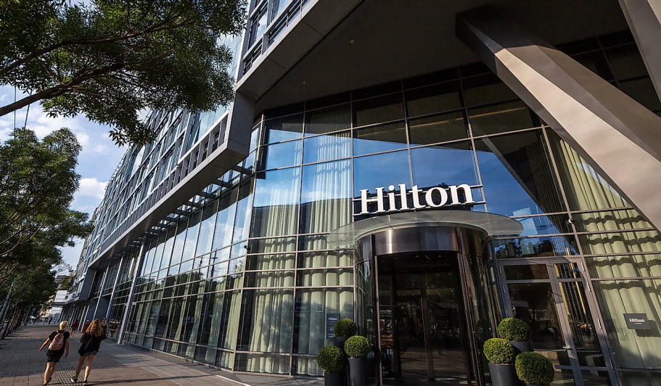
Overview of Hilton Worldwide
Conrad Hilton established the foundation for what is now Hilton Worldwide Holdings Inc. when he opened his first hotel in 1919.
In that year, Conrad Hilton purchased his first hotel, the 40-room Mobley Hotel in Cisco, Texas.
He subsequently added many more hotels to his Texas property (Olimovich, 2022).
Notes:
Conrad Hilton established the foundation for what is now Hilton Worldwide Holdings Inc. when he opened his first hotel in 1919. In that year, Conrad Hilton purchased his first hotel, the 40-room Mobley Hotel in Cisco, Texas. He subsequently added many more hotels to his Texas property (Olimovich, 2022). By 2021, Hilton Worldwide will have over 5,000 properties in the United States alone. The most well-known of the 18 hotel chains that Hilton Worldwide owns is Hampton. Embassy Suites, Waldorf Astoria, and DoubleTree are among more brands in the industry. The company's rapid expansion in recent years has made it a formidable competitor in the global hotel industry.

Slide 4
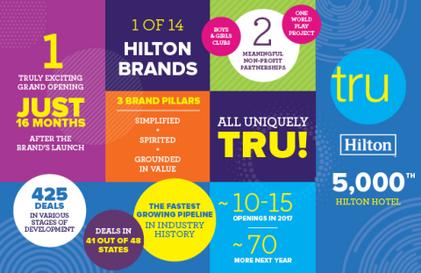
Hilton Worldwide's main consumers
Business and vacation visitors make up the bulk of Hilton Worldwide's clientele. Guests are searching for a low-cost yet pleasant place to stay.
Hampton Inn by Hilton and Embassy Suites are just two of the chain's many hotels that focus on serving business travelers (Freitas, 2019).
The area has many other entertainment choices, including the DoubleTree and Homewood Suites by Hilton. Rooms in both hotel categories are sizable and equipped with luxuries like flat-screen TVs and coffee makers (Pius, 2020).
Notes:
Business and vacation visitors make up the bulk of Hilton Worldwide clientele. Guests are searching for a low-cost yet pleasant place to stay. Hampton Inn by Hilton and Embassy Suites are just two of the chain's many hotels that focus on serving business travellers (Freitas, 2019). The area has many other entertainment choices, including the DoubleTree and Homewood Suites by Hilton. Rooms in both hotel categories are sizable and equipped with luxuries like flat-screen TVs and coffee makers (Pius, 2020). Also, each morning, a complimentary breakfast is served to all guests. The hotels also have commercial amenities, including meeting spaces and a business centre for local use. They may also arrange meetings outside of the office via their partners. Hotels often provide a wide range of amenities and services to cater to their clientele. Some services they could set up for travellers include dry cleaning, room service, and transportation. Concierge services are also offered to assist visitors in planning their trips and other activities (Wirtz, 2021). As a bonus, the hotels are conveniently located and simple to reach. The majority of them live in the country's main urban centres. So, getting there from the airport or anywhere else in the city is not hard. A variety of great places to eat and have fun can also be found nearby.

Slide 5
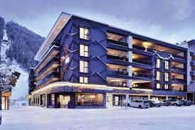
The nature, scope, and role of the guest services and facilities of Hilton Worldwide
Nature of the services
Customer service
Concierge services
Laundry & dry-cleaning services
Notes:
Nature of the services
Customer service: From the moment visitors first contact us until they leave, they want their experience to be as smooth and pleasant as possible (Jang, 2019).
Concierge services: With extensive local knowledge, their concierge team can advise them on anything from where to dine to what to do during a particular holiday or event.
Laundry & dry-cleaning services: Customers may drop off their clothes and have it immediately returned thanks to their on-site laundry and dry-cleaning facilities. In the working week, Hilton provides rush and same-day service for an extra fee (Olimovich, 2022).

Slide 6
The nature, scope, and role of the guest services and facilities of Hilton Worldwide
Role of Services
By supplying effective and innovative services that supplement the customer journey, the company may build exceptional experiences for its clientele.
Make sure workers have access to everything they need to do their jobs well, and they'll likely see an improvement in morale and satisfaction (Freitas, 2019).
Notes:
Role of Services
By supplying effective and innovative services that supplement the customer journey, the company may build exceptional experiences for its clientele.
Make sure workers have access to everything they need to do their jobs well, and they'll likely see an improvement in morale and satisfaction (Freitas, 2019).
Use careful management of resources and careful optimization of the customer journey to boost firm performance by observable amounts (Tien, 2019).

Slide 7

The nature, scope, and role of the guest services and facilities of Hilton Worldwide
Scope of services
Airline Tickets: With their assistance, people may book flights with any of the airlines Hilton works with, and we'll ensure they receive the best deal possible (Freitas, 2019).
Hotel Reservations: Hilton can assist travelers in making a hotel reservation at any of their numerous hotels worldwide after agreeing on a specific time frame and location (Olimovich, 2022).
Notes:
Scope of services
Airline Tickets: With their assistance, people may book flights with any of the airlines Hilton works with, and we'll ensure they receive the best deal possible (Freitas, 2019). All tickets booked via one of their partnered agencies get a discount, including free upgrades to First Class on some airlines.
Travel Insurance: For their peace of mind, Hilton collaborates with Allianz Global Assistance to provide travel insurance to cover any unexpected circumstances that may arise during their trip.
Hotel Reservations: Hilton can assist travelers in making a hotel reservation at any of their numerous hotels worldwide after agreeing on a specific time frame and location (Olimovich, 2022). Their hotels and other global venues provide enough room for business gatherings and social events, and we'd be happy to help them book them if necessary.

Slide 8

The role and function of guest services in general hotel industries
The quality of a hotel's guest services may make or break the stay for the client. In addition to standard services like Wi-Fi and concierge assistance, personalized attention from guest services makes a hotel stay memorable for customers (Olimovich, 2020).
Similarly to hotel maids, housekeepers are in charge of maintaining a spotless environment across a building. A few housekeepers even make final touches to the room before the visitor arrives. They could also pitch in with general hotel cleaning duties (Olimovich, 2022).
Notes:
The role and function of hospitality customer care in the hotel industry as a whole:
The quality of a hotel's guest services may make or break the stay for the client. In addition to standard services like Wi-Fi and concierge assistance, personalized attention from guest services makes a hotel stay memorable for customers (Olimovich, 2020).
Similarly to hotel maids, housekeepers are in charge of maintaining a spotless environment across a building. A few housekeepers even make final touches to the room before the visitor arrives. They could also pitch in with general hotel cleaning duties (Olimovich, 2022).
The front desk personnel handles the registration of new visitors. Since they are travelers' initial point of contact, they provide services, including helping with check-ins and check-outs. In addition, they handle requests for ancillary services like valet parking and room service.
Concierge services facilitate the vacationing experience by reserving tables at local eateries and introducing visitors to the area's best sights and sounds.
The hotel's security staff protects visitors to the hotel. Security guards are often employed to keep an eye on the premises, including the front and back doors, parking lot, elevators, and other high-traffic areas (Adzoyi, 2021).
A guest relations representative's duties include keeping tabs on guests' lengths of stay and future visit preferences. In addition, they maintain the guest loyalty program by keeping track of the points gained.

Slide 9
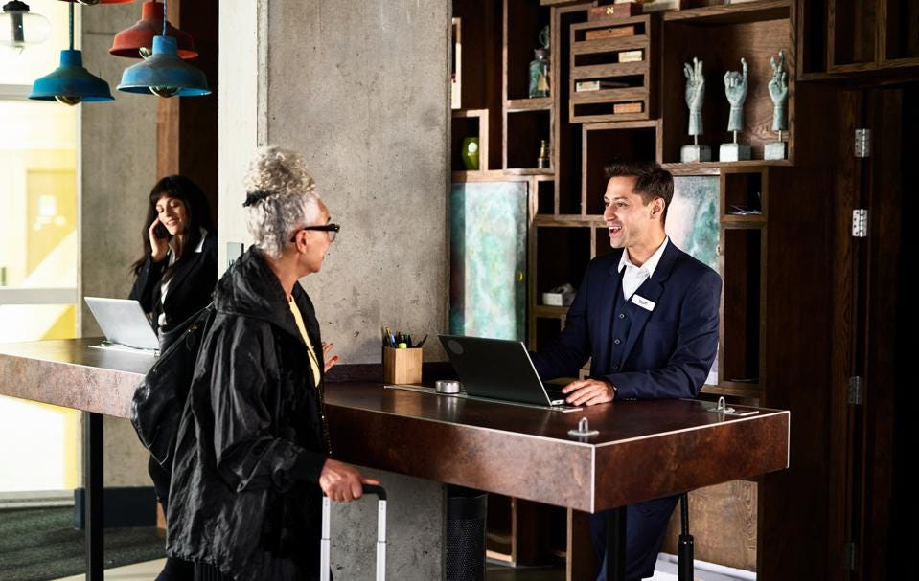
The importance of hospitality and hotels' meet/exceed guest expectations
It is in the best interest of any hotel that its customers have a good time while there.
Guests should feel at home and have everything they need throughout their stay (Jang, 2019).
It's crucial to have realistic expectations for the trip. Five strategies are provided below to guarantee that guests enjoy their stay.
Before engaging in conversation with guests, it is essential to learn about them. Ask them questions to get a feel for what they like and don't like (Tien, 2019).
Notes:
It is in the best interest of any hotel that its customers have a good time while there. Guests should feel at home and have everything they need throughout their stay (Jang, 2019). It's crucial to have realistic expectations for the trip. Five strategies are provided below to guarantee that guests enjoy their stay.
Acknowledge their visitors. Before engaging in conversation with guests, it is essential to learn about them. Ask them questions to get a feel for what they like and don't like (Tien, 2019). Find out what they like doing in their spare time and what they would want to do if they were visiting. Be sure to ask their visitors about any allergies or health concerns when meeting with them. Learn as much as they can about the hotel's incoming visitors.
People should try to make their stay as comfortable as possible. If they own a hotel, they want their visitors to have a relaxing and enjoyable stay, so they do all their power to make that happen (Verevka, 2019). Offering them several comforts is a beautiful method of doing so. In addition, there are many other possible activities to engage in. The variety of activities ensures that all guests will have a good day.
Keep on performing at a high level. Providing excellent service increases the likelihood that customers will return (Wirtz, 2021). In addition, it will inspire people to spread the word about their excellent experiences, which might lead to additional people visiting their website or referring them to business. The goal of every business should be to give excellent customer service.

Slide 10

Conclusion
With the conclusion of Hilton Worldwide's guest services, Hilton would like to express our gratitude to their loyal guests.
Hilton hopes people will succeed further in their tourist careers with Hilton Worldwide and its other great businesses.
Not only does it reflect the company's values and dedication to overall quality, but it also creates a memorable experience for its consumers.
Notes:
With the conclusion of Hilton Worldwide guest services, Hilton would like to express our gratitude to their loyal guests. Hilton hopes people will succeed further in their tourist careers with Hilton Worldwide and its other great businesses. Not only does it reflect the company's values and dedication to overall quality, but it also creates a memorable experience for its consumers.

Slide 11
Reference List
Adzoyi, P.N., Blomme, R.J. and Honyenuga, B.Q., 2021. Hotel Customer Retention: A Study of Customers’ Perspectives in an Emerging Market. In Advances in Hospitality and Leisure (Vol. 17, pp. 21-36). Emerald Publishing Limited.
Freitas, B.D.A. and Correia, P., 2019. Attractiveness of cultural events organized by hotels. International Journal of Culture, Tourism and Hospitality Research, 13(1), pp.113-127.
Jang, S. and Moutinho, L., 2019. Do price promotions drive consumer spending on luxury hotel services? The moderating roles of room price and user-generated content. International Journal of Hospitality Management, 78, pp.27-35.
Olimovich, D.I., Bakhtiyorovich, T.M. and Salimovna, N.G., 2020. Improving of personnel training in hotel bussines. Academy, (2 (53)), pp.18-19.
Olorunsola, V.O., Saydam, M.B., Arasli, H. and Sulu, D., 2022. Guest service experience in eco-centric hotels: a content analysis. International Hospitality Review, (ahead-of-print).
Pius, A., Alharahsheh, H.H., Nwaogbe, O. and Dariescu, M., 2020. Contemporary Quality Management Approaches and Practices Within the Hospitality Industry. In Contemporary Management Approaches to the Global Hospitality and Tourism Industry (pp. 1-34). IGI Global.
Notes:
Adzoyi, P.N., Blomme, R.J. and Honyenuga, B.Q., 2021. Hotel Customer Retention: A Study of Customers’ Perspectives in an Emerging Market. In Advances in Hospitality and Leisure (Vol. 17, pp. 21-36). Emerald Publishing Limited.
Freitas, B.D.A. and Correia, P., 2019. Attractiveness of cultural events organized by hotels. International Journal of Culture, Tourism and Hospitality Research, 13(1), pp.113-127.
Jang, S. and Moutinho, L., 2019. Do price promotions drive consumer spending on luxury hotel services? The moderating roles of room price and user-generated content. International Journal of Hospitality Management, 78, pp.27-35.
Olimovich, D.I., Bakhtiyorovich, T.M. and Salimovna, N.G., 2020. Improving of personnel training in hotel bussines. Academy, (2 (53)), pp.18-19.
Olorunsola, V.O., Saydam, M.B., Arasli, H. and Sulu, D., 2022. Guest service experience in eco-centric hotels: a content analysis. International Hospitality Review, (ahead-of-print).
Pius, A., Alharahsheh, H.H., Nwaogbe, O. and Dariescu, M., 2020. Contemporary Quality Management Approaches and Practices Within the Hospitality Industry. In Contemporary Management Approaches to the Global Hospitality and Tourism Industry (pp. 1-34). IGI Global.
Tien, L., 2019. Improving customer service within Asian culture at Hilton hotel.
Verevka, T.V., 2019. Development of industry 4.0 in the hotel and restaurant business. IBIMA business review, 324071.
Wirtz, J., Kunz, W. and Paluch, S., 2021. The service revolution, intelligent automation and service robots. European Business Review, 29(5), p.909.

