Slide 1





BA (Hons) Business Management
Entrepreneurship LCBB5001
STUDENT: FARIDA AHMED
STUDENT ID:2123556
LECTURER DR SAID USMAN AMER KAREEM
Business Plan: ‘Nursery Business’
CARE for Special and Mainstreams

Slide 2

Introduction
  The business idea includes an inclusive nursery called CARE for Special and Mainstreams
  Through innovative learning, aim to support both challenged and mainstream kids
  Addresses the growing need for SEND nursery places in the United Kingdom (Clarke, 2024)
Notes:
SN: This business plan proposes a nursery school that will cater for disabled children and other children of the society to provide the children with equal chances in life. The service strongly focuses on the children’s multiple sensory learning experiences, and social interactions and teaches everyday skills. According to Clarke, (2024), nursery spaces are scarce for children who have special needs which call for the implementation of our proposed model.

Slide 3


Overview of Business Idea
  CARE for Special and Mainstreams advocates an equitable education for both SEND and mainstream pupils
  Multisensory educational and recreational activities are key services for promoting social integration
  An increasing need for SEND nursery rooms contributes to the business's growth potential (Clarke, 2024)
Notes:
SN: The business idea, “CARE for Special and Mainstreams,” seeks to fill the gap in Education for both SEND and Mainstream students. Using multisensory teaching and learning techniques, the children are provided with various interesting activities and learning solutions that help meet all their needs for social-emotional and cognitive development (Clarke, 2024). The business leverages the growing market need for niche market state childcare facilities. In addressing this area, the nursery fosters community diversity and contributes to the delivery of such a government policy as the EHC plan as parents expect to see it.

Slide 4
Legal Format and Ownership
01
The business will be a partnership so that, customer relations, production, profits, and other business liabilities will be split (Kopp, 2024)
02
Some of the key stakeholders may comprise the co-founders, investors, and outside legal consultants on those laws
03
Registration with the HMRC and Companies House makes legal and tax requirements to be fulfilled (GOV.UK, 2021).
04
This comprises employment regulations, data privacy and licences that may be required to operate the business
Notes:
SN: For legal structure, the nursery business will embrace the partnership legal structure which shares responsibilities and risks as well as facilitates decision-making (Kopp, 2024). Major stakeholders are co-founders actively handling the firm’s operations while other parties ensure compliance with laws. Registration with HMRC and Companies House helps do business taxes such as National insurance and income tax on trading profits (GOV.UK, 2021). The business will adhere to employment laws and data regulations in terms of the staff and clients. Further, licences for learning equipment will be obtained as per the requirement of the corresponding learning specialisation.

Slide 5



Management and Team Structure
  The owner is responsible for strategy, cash flow, as well as regulatory compliance to ensure operational success (Settembre-Blundo et al., 2021)
  Teachers strive to provide inclusive education along with multisensory learning experiences
  Carers assist children's everyday needs while providing a nurturing and safe atmosphere (Merrick et al., 2020)
  External experts provide specialised advice on SEND care and legal obligations
Notes:
SN: The management system of CARE for Special and Mainstreams focuses on leadership in the management structure of the centres. The owner is responsible for most of the strategic decisions such as regulatory issues and the company’s finances (Settembre-Blundo et al., 2021). The teachers employed at this school are qualified in teaching and act appropriately in the classroom to ensure both the SEND and mainstream students learn. Others provide support through childcare services in managing young ones’ physical and emotional aspects in that they provide them with a safe atmosphere (Merrick et al., 2020). Moreover, talking to outside professionals like therapists and consultants gives more understanding of the care strategies for SEND and updating rules and regulations for service improvement. Together this qualified team guarantees a comprehensive handling of childcare management responsibilities.

Slide 6







SWOT Analysis
Strength
Weakness
Opportunity
Threats
The inclusive strategy provides a unique learning environment for all children (Grantham and Somji, 2022)
There is a growing demand for specialised care for children with SEND (Clarke, 2024)
It includes prospective rivalry from existing nurseries, as well as legislative changes.
A significant initial expenditure is required for facility setup and staff employment
Notes:
SN: The main strength of the business is that it has adopted an inclusive model. However, high start-up costs mean that some initial funding problems have to be dealt with. A growing trend in SEND provision offers business opportunities for schools (Clarke, 2024). However, threats from competitors, especially the well-rooted ones and continually changing regulatory systems may affect the performance of the nursery.

Slide 7
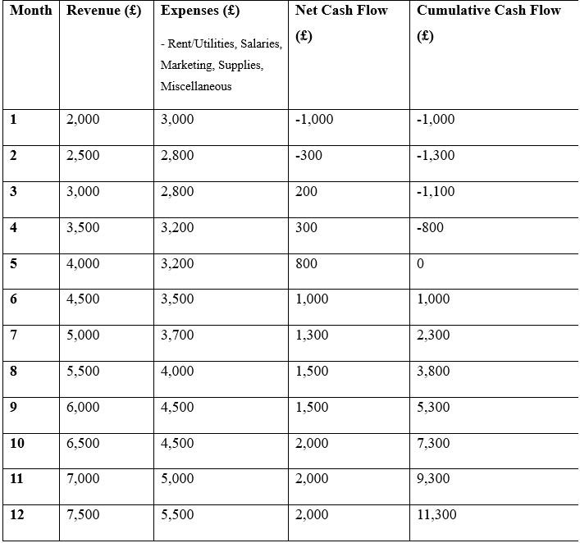
Financial Overview and Cash Flow
  The expected monthly revenue slowly rises from £2,000 to £7,500
  Monthly expenses range from £2,800 to £5,500 due to operational charges
  Net cash flow grows from -£1,000 in month one to £2,000 in month twelve
  The total cash flow exceeds £11,300 by the conclusion of the first year
Notes:
SN: The cash flow forecast proves that there’s a healthy flow of revenues and that helps prove the business model presented in the plan (Ball and Nikolaev, 2022). The breakeven is unlikely before its first few months of operation due to higher startup costs like rents, wages and advertising, than the income the business earns during this period. However, the business turns viable from month 5 onwards thus meeting the £25,000 funding constraints as required. The income profile has also been projected to be sustainable for funding the operational costs since the funding will be strictly for the start-up costs.

Slide 8
Reference List
Ball, R. and Nikolaev, V.V., 2022. On earnings and cash flows as predictors of future cash flows. Journal of Accounting and Economics, 73(1), p.101430. https://papers.ssrn.com/sol3/Delivery.cfm?abstractid=3842963
Clarke, V. (2024). Family moves 180 miles for special-needs nursery space. www.bbc.com. [online] 25 Jan. Available at: https://www.bbc.com/news/education-68017998 [Accessed 13 Nov. 2024].
GOV.UK (2021). HMRC compliance checks: help and support. [online] GOV.UK. Available at: https://www.gov.uk/guidance/hmrc-compliance-checks-help-and-support [Accessed 13 Nov. 2024].
Grantham, K. and Somji, A., 2022. Childcare solutions for women Micro and small enterprises. Research Paper. Donor Committee for Enterprise Development. Women’s Economic Empowerment Working Group. https://www.unicef.org/jordan/media/15426/file/Childcare-Solutions-for-Women-Micro-and-Small-Enterprises-MAY-22.pdf
Kopp, C. (2024). Partnerships: What You Should Know. [online] Investopedia. Available at: https://www.investopedia.com/terms/p/partnership.asp [Accessed 13 Nov. 2024].
Merrick, M.T., Ports, K.A., Guinn, A.S. and Ford, D.C., 2020. Safe, stable, nurturing environments for children. In Adverse childhood experiences (pp. 329-347). Academic Press. https://www.sciencedirect.com/science/article/pii/B9780128160657000161
Settembre-Blundo, D., González-Sánchez, R., Medina-Salgado, S. and García-Muiña, F.E., 2021. Flexibility and resilience in corporate decision making: a new sustainability-based risk management system in uncertain times. Global Journal of Flexible Systems Management, 22(Suppl 2), pp.107-132. https://link.springer.com/content/pdf/10.1007/s40171-021-00277-7.pdf

Slide 9
Thank You!

