Slide 1
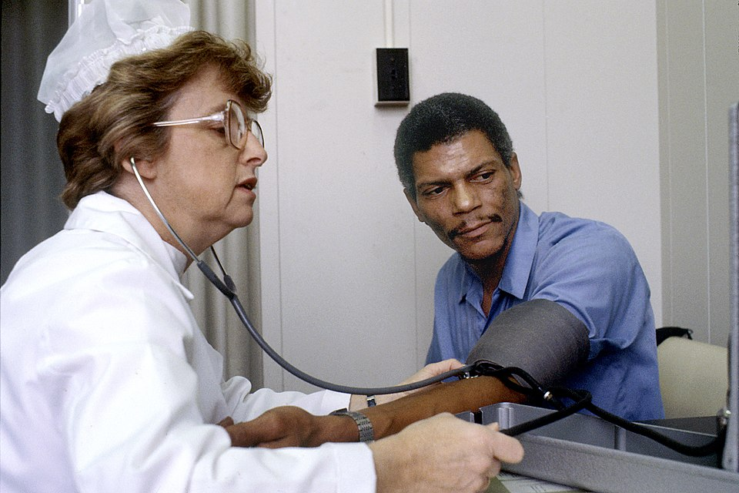
LCHS4009 · Professional Development in Health and Social Care
Communication
in Health and Social Care
Self-Awareness Presentation · Component 1
Elizabeth Nuworkpor | Student ID: 2508597
Lecturer: Hajra Mustasim

Slide 2
Introduction
What This Presentation Will Cover
Why I Chose Communication
Defined communication as a key professional skill in health and social care.
Explained why communication is critical to safe, effective practice.
Introduce the SBAR model - a structured communication tool used in the NHS.
Apply SBAR to a practical scenario in a health and social care role.
Reflect on communication as a personal professional development priority.
Communication underpins every interaction in health and social care between professionals, patients, families, and agencies.
NHS England (2021) identifies communication failure as one of the most frequently reported factors in patient safety incidents.
Effective communication enables person-centred care, informed consent, and coordinated multi-agency support.
It is a skill I must continuously develop to practise safely and professionally in any H&SC role.

Slide 3
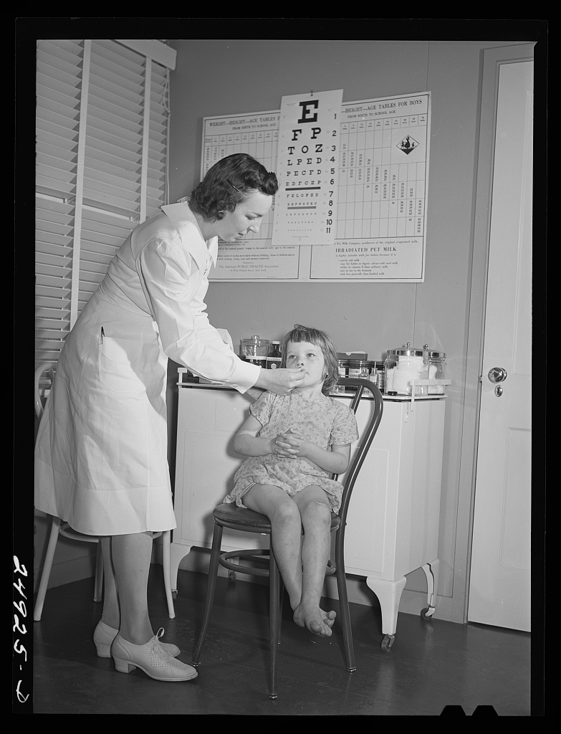
Understanding Communication in Health and Social Care
Communication is the foundation of safe, effective, person-centred health and social care practice.
"Communication is the process by which information, ideas, and feelings are conveyed, encompassing verbal, non-verbal, written, and digital forms." (McCabe and Timmins, 2023)
Verbal Communication
V
Spoken words, tone of voice, pace, and clarity. In H&SC, clear verbal communication ensures accurate information transfer during assessments, handovers, and patient interactions.
Non-Verbal Communication
NV
Body language, facial expressions, eye contact, and proximity. Non-verbal cues significantly shape how messages are received and whether service users feel heard and respected.
Written and Digital
W
Care plans, clinical records, emails, and referral letters. Accurate written communication is a legal obligation and professional duty in every health and social care setting.
Key elements:
Active Listening
Clarity
Empathy
Cultural Sensitivity
Confidentiality
(McCabe and Timmins, 2023)

Slide 4
Why Communication Matters in Health and Social Care
Effective communication is not just professional courtesy, it is a patient safety imperative.
70% of serious patient safety incidents involve a communication failure (NHS England, 2021)
01
Patient Safety
02
Therapeutic Relationships
Clear, structured communication prevents medication errors, missed diagnoses, and unsafe handovers. It is central to the NHS's duty of care to every patient. (NHS England, 2021)
Communication builds trust between professionals and service users. McCabe and Timmins (2023) identify empathic communication as the foundation of person-centred care. (McCabe and Timmins, 2023)
03
Multi-Disciplinary Teamwork
04
Legal and Ethical Duty
Effective communication enables nurses, social workers, GPs, and therapists to coordinate safe, holistic support plans and conduct effective clinical handovers. (NHS England, 2021)
Accurate documentation, informed consent, and confidentiality are underpinned by clear communication. Failures can result in regulatory action or harm to service users. (NMC, 2018; Burnard and Gill, 2014)

Slide 5
The SBAR Communication Model
Developed by the US Navy and adopted by NHS England as a structured tool for safe clinical communication and escalation.
SBAR stands for Situation · Background · Assessment · Recommendation, providing a structured framework for clear, safe professional communication (NHS England, 2021)
S
Situation
B
Background
A
Assessment
R
Recommendation
What is happening NOW?
What is the CONTEXT?
What do you THINK?
What do you NEED?
Identify yourself and your role
State the patient's name and location
Describe the immediate concern clearly and concisely
Reason for admission or referral to the service
Relevant medical, social, or developmental history
Any recent changes noted in the person's condition
Your professional judgement about what is happening
What you believe the underlying issue or risk may be
Key observations, measurements, or concerns noted
The specific action you are requesting from the recipient
Indicate the level of urgency clearly
Any immediate steps already taken or care plan changes needed
(NHS England, 2021; McCabe and Timmins, 2023)

Slide 6
Practical Application of SBAR
Scenario: Healthcare Assistant (HCA) in an NHS medical ward, escalating a concern about a deteriorating patient.
S
Situation
"I am Elizabeth, Healthcare Assistant on Ward 4. Mr. Ahmed in Bed 7 has become increasingly confused and his blood pressure has dropped significantly in the last hour."
B
Background
"He was admitted 48 hours ago for a routine knee replacement. He has no prior cardiac or neurological history and there have been no complications until now."
The Scenario
A
Assessment
Role: Healthcare Assistant, NHS Medical Ward
Patient: Mr. Ahmed, Bed 7 — admitted 48hrs ago for routine knee replacement
Concern: He has become confused; blood pressure has dropped from 128/82 to 90/60 in the last hour
Action: Escalate immediately to the senior nurse using SBAR
"I am concerned he may be developing a post-operative complication. His observations are outside normal parameters and his mental state is deteriorating."
R
Recommendation
"I am requesting an urgent clinical review. Could you please come to assess Mr. Ahmed immediately? I have already increased his observation frequency."
Outcome: Structured communication → faster clinical response → improved patient safety

Slide 7
Conclusion
Overall Judgement
Communication is one of the most fundamental skills in health and social care, not merely a 'soft skill' but a patient safety tool with direct consequences for patient outcomes. The SBAR model demonstrates that even in high-pressure situations, structured communication reduces errors and enables faster clinical responses. As a trainee professional, developing strong communication skills across verbal, non-verbal, and written channels is essential to safe, ethical, and effective practice in every health and social care context.
Personal Reflection and Professional Development
Reflecting on my practice, I recognise strengths in written and analytical communication from my professional experience, but identify active listening across cultural and clinical contexts as a development priority. My action plan includes: practising SBAR in simulated handover scenarios, completing the NHS online communication training module, and actively seeking feedback from supervisors during placement. Communication is not static, it demands continuous reflection and development throughout a career in health and social care.

Slide 8
References
1
Arnold, E.C. and Boggs, K.U. (2019) Interpersonal Relationships: Professional Communication Skills for Nurses. 8th edn. St. Louis: Elsevier.
2
Bramhall, E. (2014) 'Effective communication skills in nursing practice', Nursing Standard, 29(14), pp. 53-59.
3
Burnard, P. and Gill, P. (2014) Culture, Communication and Nursing. Harlow: Pearson Education.
4
McCabe, C. and Timmins, F. (2023) Communication Skills for Nursing Practice. 3rd edn. London: Macmillan International Higher Education.
5
NHS England (2021) SBAR Communication Tool: Situation, Background, Assessment, Recommendation. Available at: https://www.england.nhs.uk/patient-safety/ [Accessed: 1 June 2026].
Nursing and Midwifery Council (2018) The Code: Professional Standards of Practice and Behaviour for Nurses, Midwives and Nursing Associates. London: NMC. Available at: https://www.nmc.org.uk/standards/code/ [Accessed: 1 June 2026].
6

