Slide 1

Contemporary management approaches
Katy Brenchley
BMSP4013
Notes:
Play I'll be talking about Amazon

Slide 2

An introduction to Amazon
Amazon is currently the largest internet based company in the world to date, Jeff Bezos started the company in 1994 from his home, he chose to sell books as they were easy to source, package and distribute, his business concept was to grow big and fast and was based on a model of delivering online orders directly to customers anywhere in the world.
Amazons was originally called cadabra, but after feedback from various people Jeff chose Amazon after coming upon it whilst looking through the dictionary for inspiration, Jeff’s original plan was always to sell more than books, his vision was to be a one stop shop and for the business to one day be a tech company all of which he achieved by the mid 2000’s.
Amazon joined with other companies, where they used their platform to advertise his merchandise, he paid them a commission for every item sold, this win win system expanded Amazon’s associates by 350,000 in 3 years and increased revenue to more than 600 million.
I recent years amazon has become the second ever 1 trillion pound company in history and continues to expand and change with the times, recently adopting a more automated solution to increase efficiency , such as robots programmed to to find and retrieve item for customers.

Slide 3
Organizational function of Amazon
Amazon comes under a hierarchical system where it has different levels of authority within a chain of command that connects many levels of management within the organisation, typically decision making flows from the top down to each level of management this promotes clear boundaries of control and responsibility and allows complete control of global operations resulting in increased market share.
This system allows for clear lines of authority, good understanding of roles and responsibilities and accountability for decisions and actions at different management levels,
In addition to this clear career paths are available through this method and opportunities to specialise in certain areas can be obtained due to close supervision and close management control.
Amazon states they have experienced loyalty towards teams, departments and their organisation as a whole through using the hierarchical structure

Slide 4
Organisational function - structure
Amazon consists of 3 CEO’s and 3 senior vice presidents who work alongside Jeff Bezos, they call themselves the ‘s’ team, during their meetings they circulate his ideas solve any problems and set short and long term goals and In addition to the ‘s’ team Amazon have several groups of employees who are solely responsible for certain key areas, such as finance, humans resources, corporate affairs and web services.
This allows jeff to maintain consistency and be in control of every operational activity regardless of its size
Lastly amazons organisational structure is built up of numerous small teams Jeff bezos introduced the ‘2 pizza rule’ where by the teams can be no larger than the amount of people it takes to eat 2 pizzas he adopts this strategy as he believes it promotes efficiency, scalability and leaves more time to focus on the important stuff.

Slide 5
Amazon SWOT Analysis
Amazon will typically do two SWOT analysis each year, the most recent SWOT gives us the following information.
Strengths - reasonable prices and range of products for customers budgets, options for payment and shipment fit the needs of customers, the option to add to wish lists and keep items in the basket appeal to customers, a strong brand name, customer orientated, large number of 3rd party sellers and cost leadership.
Weaknesses - criticism of high taxes on some products and products being more expensive compared to other sites, their business model is easily accessible allowing other companies to copy it and counterfeit products being sold due to negligence on amazon’s behalf.
Opportunities - to move into highly developed countries and combine with competing companies in the market, expansion with in electronic marketing, acquire new companies, entice more customers.
Threats - Competition from walmart and ebay, selling broken or damaged products, putting staff members in un safe and dangerous working condition and losing margins in some areas.

Slide 6
Amazon PESTLE analysis
Political -
Trade tariff and protectionism, Amazon is a global business and imports the majority of products from different countries, some countries make this difficult by changes their trade and tariff policies on imports
With internet and internet based products becoming the new norm, governments introduced measures on beating cyber crimes, resulting in the general public being reassured and continued to use online shopping.
Economic - There are so many economical factors to take into accounting, including, taxation, inflation, economic growth, unemployment, currency exchange rates and raw material costs
Social - This is impacted by the beliefs and attitudes of the population relating to cultural and demographical trends
Technological - amazon invested a lot of time and money on delivery drones and yellow locker systems, it uses the latest technology to gain a competitive edge, increased research and development department and developed digital methods to build relationship with customers
Environmental - Amazon prime is very taxing on the environment due to next day delivery promises from amazon, with 100 million people subscribed to amazon this creates a significant environmental damage, pressure from the government to reduce its carbon emissions has seen amazon state it will reduce its carbon footprint by 50% by 2030
Legal - It is Amazon’s responsibility to abide by rules and regulations for every country they do business in or face trial and fines, they have been accused of violating international safety laws by selling goods to terrorists on the watch list and selling items under false and misleading claims.

Slide 7
Amazon’s mission and vision statement
Mission statement - to serve consumers through online and physical stores and focus on selection, price and convenience. There mission is to continual
Vision statement - to be Earth’s most consumer centric company where customers can find and discover anything they might want to buy online and endeavour to offer its customers the lowest possible prices.

Slide 8
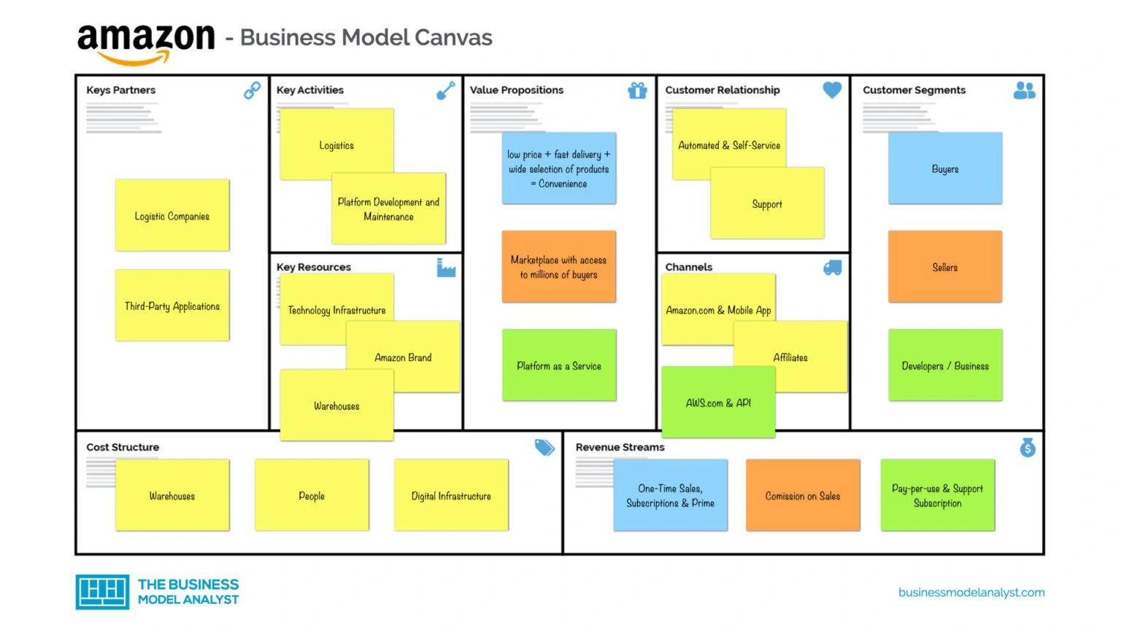
Amazon’s business model

Slide 9
Amazon’s corporate social responsibility
Amazon has been criticized for its lack of commitment to CSR within the company, in 2014 they employed their first sustainability executive, Kara Hartel this proves criticism was justified and how long they had neglected the companies CSR, they have since redeemed themselves and have gone above and beyond by starting up the relief fund in 2020 gifting electronic devices and gift cards to schools on the fulfillment areas in the us.
Amazon continues to offer employees the chance of returning to college and paying 95% of the fees, these employees can access courses such as nursing and aeroplane mechanics regardless of weather it it is relevant to their career within amazon or not.
In a bid to reduce their carbon emissions amazon have ordered 1000,000 fully electric cars in hope this will aid with meeting their 2040 goal of becoming a carbon free organisation, they have also reduced their packaging by becoming package free in some cities and reducing packaging material by 36% since 2015.

Slide 10
Adcock,P. (January,01,2023).Amazon operations. Businessinsider.com
Alshmrani,H,M. (June,18,2020).An analytical view of amazon’s success in the world.scolor.google
Amazon2022.(2022). Leadership principles.aboutamazon.com
Amazon business modelcanvas 2022. (2022) Amazon business model camvas2022.innovationtactics.com
An inside look at Jeff Bezos’ Billion dollar leadership.(october,4,2021). An inside look into Jeff bezos billion dollar leadership.topicinsights.com
Baelde,A. (March,12,2022). Hierarchical organisational structure, business organisational structure. Nibusinessinfo.co.uk
Casey,R.(2023). How many countries does Amazon operate in. ncesc.com

Slide 11
References
8. Casey,A,R.(March,27,2022).Amazon SWOT 2022.BStrategyhub.com
9. Curtis,A.(2022). Invesigation of amazons structures, aims and objectives.prezi.com(amazonCSR) a brief history.researchmethology.net
10. David,J(2022). Pestel analysis of Amazon.Howandwhat.net
11. Dudovskiy,J. (March,27,2022) .Amazons corporate social responsibility
12. Mcfadden,c.(february, 17,2022) A very brief history of Amazon, the everything store. Interestingengineering.com
13. Miller,k.(May,30,2022).An insightful exposition of contingency theory of leadership. Crowjack.com
14. Pereira,D.Amazon business model.businessmodelanalysis.com
15. uofano,G (september,4,2022).Amazons organisational structure in a nutshell. 4weekMBA

